Slide 1

Dictionary
Muhammad Abubakar Saddique

Slide 2

Dictionary
A book or electronic resource that lists the words of a language (typically in alphabetical order) and gives their meaning.

Slide 3

Binary Search Tree
Binary Search Tree is a node-based binary tree data structure which has the following properties:
The left subtree of a node contains only nodes with keys lesser than the node’s key.
The right subtree of a node contains only nodes with keys greater than the node’s key.
The left and right subtree each must also be a binary search tree.

Slide 4
Basic Operations on BST
Create: creates an empty tree.
Insert: insert a node in the tree.
Search: Searches for a node in the tree.
Delete: deletes a node from the tree.
Inorder: in-order traversal of the tree.
Preorder: pre-order traversal of the tree.
Postorder: post-order traversal of the tree.

Slide 5
Applications
BSTs are used for indexing in databases.
It is used to implement searching algorithms.
BSTs are used to implement Huffman coding algorithm.
It is also used to implement dictionaries.
Used for data caching.
Used in Priority queues.
Used in spell checkers.

Slide 6
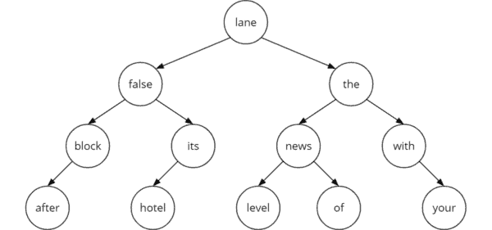
Implement Dictionary Using Binary Search Tree
A binary search tree is a binary tree such that each node stores a key of a dictionary.
Key 'k' of a node is always greater than the keys present in its left sub tree.
Similarly, key 'k' of a node is always lesser than the keys present in its right sub tree.

Slide 7
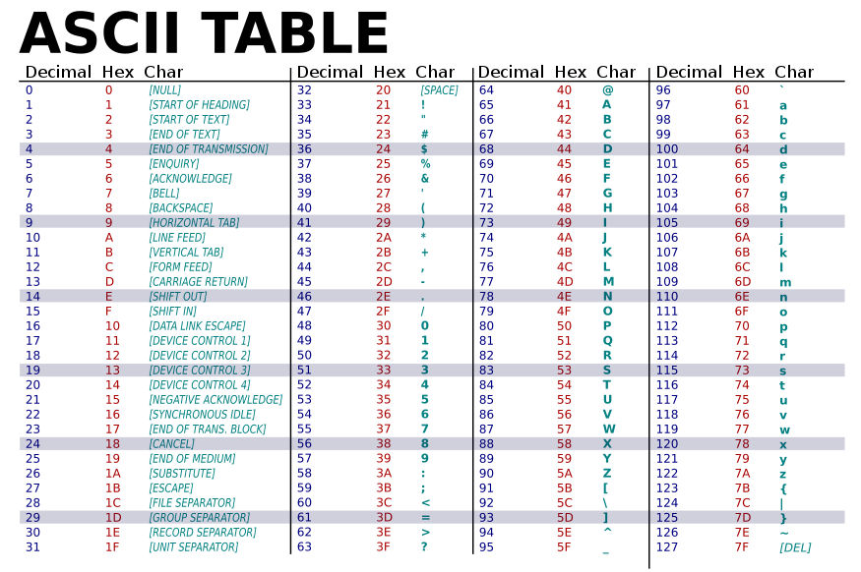

Slide 8
Conclusion
BST will only work when storing a sortable data type
BST can search, access, insert, and delete data elements in logarithmic time O(log n)
BST is much faster than an array at search, insert, and delete (O(log n) vs O(n))
BST is slightly slower than an array at access (O(log n) vs O(1))
BST’s main weakness is its tendency to become imbalanced if left unregulated by some self-balancing mechanism

Slide 9

Code Demo

Slide 10
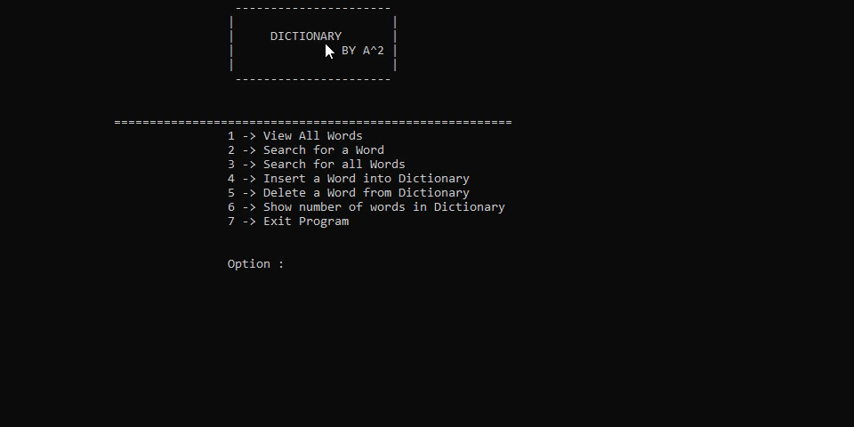

Slide 11

Thanks

