Slide 1
Notes:
Purpose:
The purpose of this chapter is to describe the operation of a layer 2 switch and to cover the basic configurations on the Cat 1900 switch.
Timing:
This module should take about two hours to present.
Contents:
Basic layer 2 switch operations.
Spanning Tree operations.
Cat1900 configurations.
Lab

Slide 2
Objectives
Upon completion of this chapter, you will be able to perform the following tasks:
  Describe Layer 2 switching (bridging) operations
  Describe the Catalyst 1900 switch operations
  Describe the Catalyst 1900 switch default configuration
  Configure Catalyst 1900 switch
  Use show commands to verify Catalyst 1900 switch configuration and operations
Notes:
Slide 1 of 1
Purpose:
Emphasize:

Slide 3



Three Switch Functions
  Address learning
  Forward/filter decision
  Loop avoidance
Notes:
Slide 1 of 1
Purpose:
Emphasize: The next few slides discuss the basic function of a bridge/switch.
1. How it learns the location of the hosts by reading the source mac address of incoming frames.
2. How it makes forwarding/filtering decisions.
Three conditions when a switch will flood a frame out on all ports except to the port where the frame came in on:
Unknown unicast address
Broadcast frame
Multicast frame
3. How STP is used to avoid loops in a switched/bridged network.

Slide 4

How Switches Learn Host Locations
MAC address table
A
B
0260.8c01.1111
E0
E1
0260.8c01.3333
C
E2
E3
D
0260.8c01.2222
0260.8c01.4444
Initial MAC address table is empty
Notes:
Slide 1 of 1
Purpose:
Emphasize: The 1900en max mac address table size is 1024. Once the table is full, it will flood all new addresses until existing entries age out.
The command to change the mac address table aging time is:
wg_sw_a(config)#mac-address-table aging-time ?
<10-1000000> Aging time value
The default is 300sec.
The MAC address table is also referred to as the CAM table (Content Address Memory) on some switches.

Slide 5
How Switches Learn Hosts Locations
MAC address table
E0: 0260.8c01.1111
A
B
0260.8c01.1111
E0
E1
0260.8c01.3333
C
E2
E3
D
0260.8c01.2222
0260.8c01.4444
Station A sends a frame to Station C
Switch caches station A MAC address to port E0 by learning the source address of data frames
The frame from station A to station C is flooded out to all ports except port E0 (unknown unicasts are flooded)
Notes:
Slide 1 of 1
Purpose:
Emphasize:

Slide 6
How Switches Learn Host Locations
MAC address table
E0: 0260.8c01.1111
E3: 0260.8c01.4444
A
B
0260.8c01.1111
E0
E1
0260.8c01.3333
C
E2
E3
D
0260.8c01.2222
0260.8c01.4444
Station D sends a frame to station C
Switch caches station D MAC address to port E3 by learning the source Address of data frames
The frame from station D to station C is flooded out to all ports except port E3 (unknown unicasts are flooded)
Notes:
Slide 1 of 1
Purpose:
Emphasize: Once C replies, the switch will also cache station C’s MAC address to port E2 as shown in the next slide.

Slide 7
How Switches Filter Frames
MAC address table
E0: 0260.8c01.1111
E2: 0260.8c01.2222
A
E1: 0260.8c01.3333
B
E3: 0260.8c01.4444
0260.8c01.1111
0260.8c01.3333
E0
X
E1
X
C
D
E2
E3
0260.8c01.2222
0260.8c01.4444
Station A sends a frame to station C
Destination is known, frame is not flooded
Notes:
Slide 1 of 1
Purpose:
Emphasize:

Slide 8
Broadcast and Multicast Frames
MAC address table
E0: 0260.8c01.1111
A
E2: 0260.8c01.2222
B
E1: 0260.8c01.3333
0260.8c01.1111
E3: 0260.8c01.4444
0260.8c01.3333
E0
E1
C
E2
E3
D
0260.8c01.2222
0260.8c01.4444
Station D sends a broadcast or multicast frame
Broadcast and multicast frames are flooded to all ports other than the originating port
Notes:
Slide 1 of 1
Purpose:
Emphasize:

Slide 9


Redundant Topology
Server/host X
Router Y
Segment 1
Segment 2
  Redundant topology eliminates single points of failure
  Redundant topology causes broadcast storms, multiple frame copies, and MAC address table instability problems
Notes:
Slide 1 of 1
Purpose:
Emphasize: Layer 2 has no mechanism (like a TTL) to stop loops.

Slide 10
Broadcast Storms
Server/host X
Router Y
Segment 1
Broadcast
Switch A
Switch B
Segment 2
Host X sends a Broadcast
Notes:
Slide 1 of 3
Purpose:
Emphasize: Broadcast frames are flooded.

Slide 11
Broadcast Storms
Server/host X
Router Y
Segment 1
Broadcast
Switch A
Switch B
Segment 2
Host X sends a Broadcast
Notes:
Slide 2 of 3
Purpose:
Emphasize:

Slide 12
Broadcast Storms
Server/host X
Router Y
Segment 1
Switch A
Broadcast
Switch B
Segment 2
  Switches continue to propagate broadcast traffic over and over
Notes:
Slide 3 of 3
Purpose:
Emphasize: Layer 2 has no TTL mechanism to stop looping frames.

Slide 13
Multiple Frame Copies
Server/host X
Unicast
Router Y
Segment 1
Switch A
Switch B
Segment 2
Host X sends an unicast frame to router Y
Router Y MAC address has not been learned by either switch yet
Notes:
Slide 1 of 2
Purpose:
Emphasize: This slide assumes Router Y Mac address has not been learned by Switch A and Switch B yet so the unknown unicast frame to Router Y will be flooded.

Slide 14
Multiple Frame Copies
Server/host X
Unicast
Router Y
Segment 1
Unicast
Unicast
Switch A
Switch B
Segment 2
Host X sends an unicast frame to Router Y
Router Y MAC Address has not been learned by either Switch yet
Router Y will receive two copies of the same frame
Notes:
Slide 2 of 2
Purpose:
Emphasize:

Slide 15
MAC Database Instability
Server/host X
Router Y
Segment 1
Unicast
Unicast
Port 0
Port 0
Switch A
Switch B
Port 1
Port 1
Segment 2
Host X sends an unicast frame to Router Y
Router Y MAC Address has not been learned by either Switch yet
Switch A and B learn Host X MAC address on port 0
Notes:
Slide 1 of 2
Purpose:
Emphasize: This slide assumes Router Y Mac address has not been learned by Switch A and Switch B yet so the unknown unicast frame to Router Y will be flooded.

Slide 16
MAC Database Instability
Server/host X
Router Y
Segment 1
Unicast
Unicast
Port 0
Port 0
Switch A
Switch B
Port 1
Port 1
Segment 2
Host X sends an unicast frame to Router Y
Router Y MAC Address has not been learned by either Switch yet
Switch A and B learn Host X MAC address on port 0
Frame to Router Y is flooded
Switch A and B incorrectly learn Host X MAC address on port 1
Notes:
Slide 2 of 2
Purpose:
Emphasize:

Slide 17


Multiple Loop Problems
Broadcast
Server/host
Loop
Loop
Loop
Workstations
  Complex topology can cause multiple loops to occur
  Layer 2 has no mechanism to stop the loop
Notes:
Slide 1 of 1
Purpose:
Emphasize:

Slide 18
Solution: Spanning-Tree Protocol
x
Block
  Provides a loop free redundant network topology by
  placing certain ports in the blocking state
Notes:
Slide 1 of 1
Purpose:
Emphasize: A looped topology is often desired to provide redundancy, but looped traffic is undesirable. The Spanning Tree protocol was originally designed for bridges. Today, it is also applied to LAN switches and routers operating as a bridge. STP ensures all bridged segments are reachable but any points where loops occur will be blocked.

Slide 19
Spanning-Tree Operations
One root bridge per network
One root port per nonroot bridge
One designated port per segment
100baseT
Designated port (F)
Root port (F)
Root bridge
Nonroot bridge
SW X
SW Y
x
Designated port (F)
Nondesignated port (B)
10baseT
Notes:
Slide 1 of 1
Purpose:
Emphasize: The three general rules when dealing with STP:
1. One root bridge per network. The root is the bridge with the lowest Bridge ID. All the ports on the root bridge are designated ports (forwarding).
2. For every non root bridge, there is a root port (forwarding). The root port is the port with the lowest accumulated path cost to the root bridge.
3. For every segment, there is only one designated port. The designated port forwards traffic for the segment. The designated port has the lowest accumulated path cost to the root bridge.

Slide 20
Spanning-Tree Protocol
Root Bridge Selection
Switch X
Default priority 32768
(8000 hex)
MAC 0c0011111111
Switch Y
Default priority 32768
(8000 hex)
MAC 0c0022222222
BPDU
BPDU = Bridge protocol data unit
(default = sent every 2 seconds)
Root bridge = Bridge with the lowest bridge ID
Bridge ID = Bridge priority + bridge MAC address
In the example, which switch has the lowest bridge ID?
Notes:
Slide 1 of 1
Purpose:
Emphasize: By default, the switch with the lowest MAC address will be the Root bridge.
Note: The Catalyst switches support an instance of Spanning tree per vlan. Each vlan will use an unique mac address for Spanning tree purpose. On the Cat 1900, the address it uses for Spanning tree are the Mac address on the various ports. VLAN is discussed in the next chapter.
The IEEE 802.1d spec specify for a 16 bit priority field. The Cat 1900 switch only supports the 802.1d stp. The default priority on the Cat 1900 is 32,768 in decimal or 8000 in hex, the midrange value.
BPDU contain the following fields:
Protocol ID version
Message type
Flags
Root ID
Cost of path
Bridge ID
Port ID
Message age
Max age
Hello time
Forward delay

Slide 21
Spanning-Tree Protocol Port States
100baseT
Designated port (F)
Root port (F)
Port 0
Port 0
Switch X
Default priority 32768
MAC 0c0011111111
Switch Y
Default priority 32768
MAC 0c0022222222
Root bridge
Port 1
Port 1
x
Designated port (F)
Nondesignated port (B)
10baseT
Notes:
Slide 1 of 1
Purpose:
Emphasize:
RPs and DPs are normally in the forwarding state.
There is only one DP per segment.

Slide 22
Spanning-Tree Protocol Path Cost
Link Speed Cost (reratify IEEE spec) Cost (previous IEEE spec)
----------------------------------------------------------------------------------------------------
10 Gbps 2 1
1 Gbps 4 1
100 Mbps 19 10
10 Mbps 100 100
Notes:
Slide 1 of 1
Purpose:
Emphasize: There are two cost calculation method. The Cat1900 uses the older method. The new method is designed to accommodate the higher gigabits ethernet speed.
Note:
Port Priority is used to determine which path has preference when path costs are equal. (Example, when you have two parallel links connecting two switches together). The default port priority is 128.
Port aggregation protocol and EtherChannels are not taught in this class.
Fast EtherChannel is supported by the Cat 1900 switch.

Slide 23
Spanning-Tree:
Switch Z
Mac 0c0011110000
Default priority 32768
Port 0
100baseT
Switch X
MAC 0c0011111111
Default priority 32768
Port 0
Port 0
Switch Y
MAC 0c0022222222
Default priority 32768
Port 1
Port 1
100baseT
Can you figure out:
  What is the root bridge?
  What are the designated, nondesignated, and root ports?
  Which are the forwarding and blocking ports?
Notes:
Slide 1 of 1
Purpose:
Emphasize:
Have the students try to work this out.
The next slide shows the answers.

Slide 24
Spanning-Tree:
Switch Z
Mac 0c0011110000
Default priority 32768
Port 0
Designated port (F)
100baseT
Port 0
Root port (F)
Port 0
Root port (F)
Switch X
MAC 0c0011111111
Default priority 32768
Switch Y
MAC 0c0022222222
Default priority 32768
Port 1
Designated port (F)
Port 1
Nondesignated port (BLK)
100baseT
Can you figure out:
  What is the root bridge?
  What are the designated, nondesignated, and root parts?
  Which are the forwarding and blocking ports?
Notes:
Slide 1 of 1
Purpose:
Emphasize: Switch X and Y has the same path cost to the root bridge. The DP for the bottom segment is on Switch X because Switch X has a lower bridge ID than Switch Y.

Slide 25
Spanning-Tree Port States
  Spanning-tree transitions each port through several different state:
Blocking
(20 sec)
Listening
(15 sec)
Learning
(15 sec)
Forwarding
Notes:
Slide 1 of 1
Purpose:
Emphasize: Using the default STP timers setting, the times it takes to go from the blocking state to the forwarding state is 50 sec (20 + 15 + 15).

Slide 26
Spanning-Tree Recalculation
100baseT
Designated port
Root port (F)
Switch X
MAC 0c0011111111
Default priority 32768
Port 0
Port 0
Switch Y
MAC 0c0022222222
Default priority 32768
Root Bridge
Port 1
Designated port
Port 1
x
Nondesignated port (BLK)
10baseT
Notes:
Slide 1 of 2
Purpose:
Emphasize: What will happen if Switch X fails?

Slide 27
Spanning-Tree Recalculation
100baseT
Designated port
Root port (F)
Port 0
Port 0
x
MAXAGE
Switch X
MAC 0c0011111111
Default priority 32768
x
Switch Y
MAC 0c0022222222
Default priority 32768
Root Bridge
BPDU
Port 1
Designated port
Port 1
x
Nondesignated port (BLK)
10baseT
Notes:
Slide 2 of 2
Purpose:
Emphasize: What will happen if Switch X fails?
Switch Y will detect the missing BPDU from Switch X in 20 seconds (max age timer) then recalculate STP.
After the network converged, Switch Y will be the root bridge, and all its port will transit to the forwarding states (DP) 30 seconds after the max age timer expires.

Slide 28
Key Issue: Time to Convergence
Convergence occurs when all the switch and bridge ports have transitioned to either the forwarding or blocking state
When network topology changes, switches and bridges must recompute the Spanning-Tree Protocol, which disrupts user traffic
Notes:
Slide 1 of 1
Purpose:
Emphasize:
Note: In large networks the effect of re-convergence may cause long periods of instability. During the election of a new root, all ports are blocked, all learned MAC addresses are aged out so that when forwarding again starts, there is a lot of flooding of unicast traffic until the MAC address tables are re-populated. Also if a preferred root and a backup root is not configured by lowering their default priority, then the final topology of the spanning tree may be very inefficient.

Slide 29

Bridging Compared to LAN Switching
Bridging
Primarily software based
One spanning-tree instance per bridge
Usually up to 16 ports per bridge
LAN Switching
Primarily hardware based (ASIC)
Many spanning-tree instances per switch
More ports on a switch
Notes:
Slide 1 of 1
Purpose:
Emphasize:
A layer 2 switch operates just like a bridge by default.
Switches use VLANs to solve many of the issues of a large layer 2 environment.

Slide 30
Transmitting Frames Through a Switch
Cut-through
  Switch checks destination address and immediately begins forwarding frame
Frame
Notes:
Slide 1 of 3
Purpose:
Emphasize:

Slide 31
Transmitting Frames through a Switch
Cut-through
  Switch checks destination address and immediately begins forwarding frame
Store and forward
  Complete frame is received and checked before forwarding
Frame
Frame
Frame
Frame
Notes:
Slide 2 of 3
Purpose:
Emphasize: In the cut-through mode, the switch checks the destination address (DA) as soon as the header is received and immediately begins forwarding the frame. There is a significant decrease in latency from input port to output port. The delay in cut-through switching remains constant regardless of frame size, because this switching mode starts to forward the frame as soon as the switch reads the destination addresses. In some switches just the destination addresses are read. Some other switches continue to read the CRC and keep a count of errors. If the error rate is too high, the switch can be set to use store-and-forward, either manually or automatically. Other Catalyst switches support combined cut-through and store-and-forward modes.

Slide 32
Transmitting Frames through a Switch
Cut-through
  Switch checks destination address and immediately begins forwarding frame
Store and forward
  Complete frame is received and checked before forwarding
Frame
Frame
Frame
Fragment free
(modified cut-through)—Cat1900 Default
  Switch checks the first 64 bytes then immediately
  begins forwarding frame
Frame
Frame
Notes:
Slide 3 of 3
Purpose:
Emphasize:
Note:
64 bytes is the minimum ethernet frame size.
The command to switch the mode on the 1900 is:
wg_sw_a(config)#switching-mode ?
fragment-free Fragment Free mode
store-and-forward Store-and-Forward mode

Slide 33

Duplex Overview
Switch
Half duplex (CSMA/CD)
Unidirectional data flow
Higher potential for collison
Hubs connectivity
Hub
Notes:
Slide 1 of 2
Purpose:
Emphasize: Hub connectivity are always Half duplex.
Note:

Slide 34
Duplex Overview
Switch
Half duplex (CSMA/CD)
Unidirectional data flow
Higher potential for collison
Hubs connectivity
Hub
Full duplex
Point-to-point only
Attached to dedicated switched port
Requires full-duplex support on both ends
Collision free
Collision detect circuit disabled
Notes:
Slide 2 of 2
Purpose:
Emphasize: Full Duplex is for point to point connection only. A Fastethernet full duplex connection provide a through put of 200Mbps (100Mbps per direction).
Note:

Slide 35

Configuring the Switch
  Catalyst 1900
    Menu driven interface
    Web-based VSM
    (Visual Switch Manager)
    IOS CLI
    (command-line interface)
Notes:
Slide 1 of 1
Purpose:
Emphasize: In this class, we will only cover the IOS CLI configuration method.
Note: Two versions of software exist for the 1900 switch, the Standard version and the Enterprise version. The difference between the Enterprise Edition Software and standard edition software is the supported feature set.

Slide 36
Catalyst 1900 Default Configurations
  IP address: 0.0.0.0
  CDP: Enabled
  Switching mode: fragment free
  100baseT port: Auto-negotiate duplex mode
  10baseT port: Half duplex
  Spanning Tree: Enabled
  Console password: none
Notes:
Slide 1 of 1
Purpose:
Emphasize: The Cat 1900 comes with a factory default setting. Listed in the slide are just some of the default settings on the switch. A switch is plug and play to use it for basic bridging functions.

Slide 37
Ports on the Catalyst 1900
Cat1912
Cat1924
10baseT ports
AUI port
100baseT uplink ports
e0/1 to e0/12
e0/1 to e0/24
e0/25
e0/25
fa0/26 (port A)
fa0/27 (port B)
fa0/26 (port A)
fa0/27 (port B)
Notes:
Slide 1 of 1
Purpose:
Emphasize:
On the 1912 and 1924,
The AUI port is e0/25.
The fastethernet ports are fast0/26 and fast0/27.

Slide 38
Ports on the Catalyst 1900
    wg_sw_d#sh run
    Building configuration...
    Current configuration:
    !
    !
    interface Ethernet 0/1
    !
    interface Ethernet 0/2
wg_sw_d#sh span
Port Ethernet 0/1 of VLAN1 is Forwarding
Port path cost 100, Port priority 128
Designated root has priority 32768, address 0090.8673.3340
Designated bridge has priority 32768, address 0090.8673.3340
Designated port is Ethernet 0/1, path cost 0
Timers: message age 20, forward delay 15, hold 1
wg_sw_a#show vlan-membership
Port VLAN Membership Type Port VLAN Membership Type
------------------------------------------------------------------
1 5 Static 13 1 Static
2 1 Static 14 1 Static
3 1 Static 15 1 Static
Notes:
Slide 1 of 1
Purpose: Use this slide to explain that the ports on the 1900 switch are refer to as port as well as interface.
Emphasize:

Slide 39
Configuring the Switch
  Configuration Modes
    Global configuration mode
      wg_sw_a# conf term
      wg_sw_a(config)#
    Interface configuration mode
      wg_sw_a(config)# interface e0/1
      wg_sw_a(config-if)#
Notes:
Slide 1 of 1
Purpose:
Emphasize:
Configuration of the 1900 switch using the IOS CLI is similar to that of the router.
The 1900 automatically saves any configuration changes to NVRAM (like the Cat 5000).

Slide 40
Configuring the Switch IP Address
wg_sw_a(config)#
ip address {ip address} {mask}
Notes:
Slide 1 of 2
Purpose:
Emphasize: The 1900 and the 2900xl IP address is always in vlan1.
You can’t move it to a different vlan like the sc0 port on the cat5000.

Slide 41
Configuring the Switch IP Address
wg_sw_a(config)#
ip address {ip address} {mask}
wg_sw_a(config)#ip address 10.5.5.11 255.255.255.0
Notes:
Slide 1 of 2
Purpose:
Emphasize: Explain to the students why a layer 2 switch requires an IP address?

Slide 42
Configuring the Switch Default Gateway
wg_sw_a(config)#
ip default-gateway {ip address}
Notes:
Slide 1 of 2
Purpose:
Emphasize:
Note:

Slide 43
Configuring the Switch Default Gateway
wg_sw_a(config)#
ip default-gateway {ip address}
wg_sw_a(config)#ip default-gateway 10.5.5.3
Notes:
Slide 2 of 2
Purpose:
Emphasize:
Note: By default, Rip is enabled on the Cat 1900 switch. This enable the switch to automatically learn the default gateway IP address by listening to the RIP updates.
To disable this feature, the command is:
wg_sw_a(config)#no rip
wg_sw_a(config)#end
wg_sw_a#sh ip
IP Address: 10.1.1.10
Subnet Mask: 255.255.255.0
Default Gateway: 0.0.0.0
Management VLAN: 1
Domain name:
Name server 1: 0.0.0.0
Name server 2: 0.0.0.0
HTTP server : Enabled
HTTP port : 80
RIP : Disabled

Slide 44
Showing the Switch IP Address
wg_sw_a#show ip
IP address: 10.5.5.11
Subnet mask: 255.255.255.0
Default gateway: 10.5.5.3
Management VLAN: 1
Domain name:
Name server 1: 0.0.0.0
Name server 2: 0.0.0.0
HTTP server: Enabled
HTTP port: 80
RIP: Enabled
wg_sw_a#
Notes:
Slide 1 of 1
Purpose:
Emphasize:
Note: The command to set the DNS server address is:
wg_sw_a(config)#ip name-server ?
A.B.C.D IP Address

Slide 45
Speed and Duplex Options
wg_sw_a(config)#interface e0/1
wg_sw_a(config-if)#
duplex {auto | full | full-flow-control | half}
Notes:
Slide 1 of 1
Purpose:
Emphasize:
The ethernet ports on the 1900 switch defaults to half duplex.
The fastEthernet ports on the 1900 switch defaults to auto.

Slide 46
Setting Duplex Options
wg_sw_a(config)#interface e0/1
wg_sw_a(config-if)#
duplex {auto | full | full-flow-control | half}
wg_sw_a(config-if)#duplex half
Notes:
Slide 1 of 1
Purpose:
Emphasize: “Half” is the default on the Ethernet ports.

Slide 47
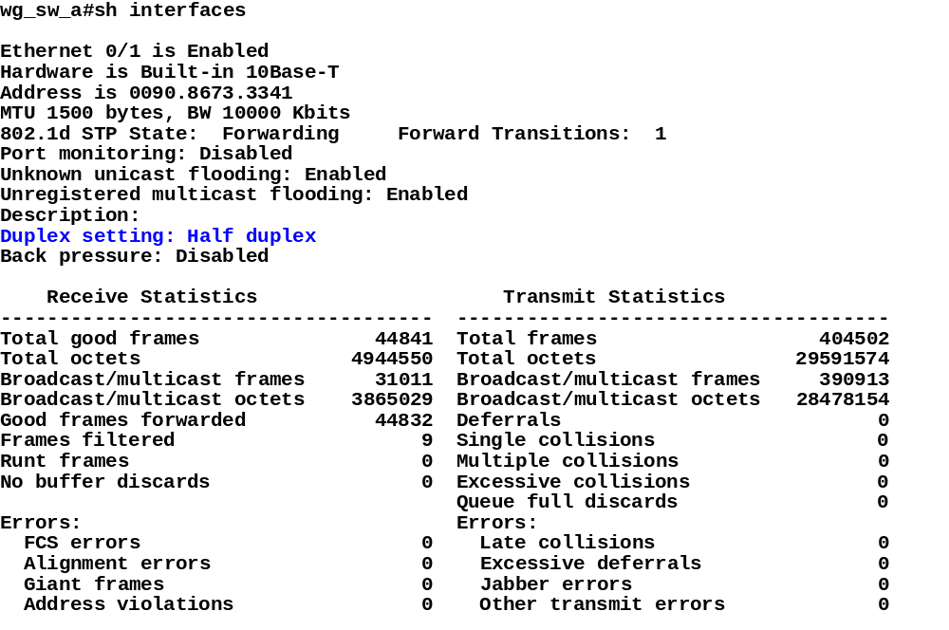
Showing Duplex Options
Notes:
Slide 1 of 1
Purpose:
Emphasize:
The show interfaces command will display the duplex status.
FCS errors and late collision errors are discussed in a later slide.

Slide 48
Duplex Mismatches
  The manually set duplex parameter differs between connected ports
  The switch port is in autonegotiate and the attached port is set to full duplex with no auto-negotiation capability causing the switch port to be in half-duplex mode
Notes:
Slide 1 of 1
Purpose:
Emphasize:

Slide 49
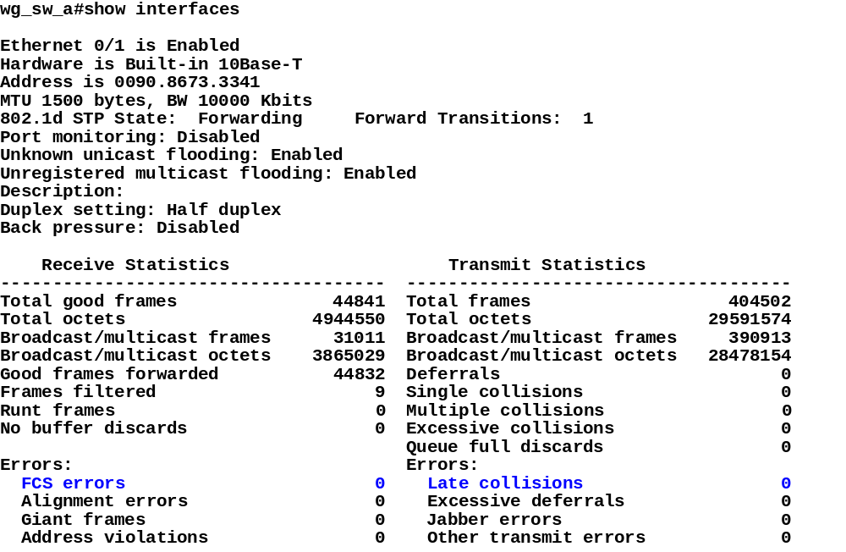
FCS and Late Collision Errors
Notes:
Slide 1 of 1
Purpose: Use this slide to discuss FCS and late collision errors.
Emphasize:

Slide 50
Managing Mac Address Table
wg_sw_a#show mac-address-table
Notes:
Slide 1 of 2
Purpose:
Emphasize: Displaying the mac address table provides reference information for managing the address table, it also provides a reference should you want or need to revert to previous table information.

Slide 51
Managing Mac Address Table
wg_sw_a#show mac-address-table
wg_sw_a#sh mac-address-table
Number of permanent addresses : 0
Number of restricted static addresses : 0
Number of dynamic addresses : 6
Address Dest Interface Type Source Interface List
-------------------------------------------------------------------------------------------------
00E0.1E5D.AE2F Ethernet 0/2 Dynamic All
00D0.588F.B604 FastEthernet 0/26 Dynamic All
00E0.1E5D.AE2B FastEthernet 0/26 Dynamic All
0090.273B.87A4 FastEthernet 0/26 Dynamic All
00D0.588F.B600 FastEthernet 0/26 Dynamic All
00D0.5892.38C4 FastEthernet 0/27 Dynamic All
Notes:
Slide 2 of 2
Purpose:
Emphasize:
Note:
The 1900en max mac address table size is 1024. Once the table is full, it will flood all new addresses until existing entries age out.
The command to change the mac address table aging time is:
wg_sw_a(config)#mac-address-table aging-time ?
<10-1000000> Aging time value
The default is 300sec.
The MAC address table is also referred to as the CAM table (Content Address Memory) on some switches.

Slide 52
Setting Permanent MAC Address
wg_sw_a(config)#
mac-address-table permanent {mac-address type module/port}
Notes:
Slide 1 of 3
Purpose:
Emphasize:

Slide 53
Setting Permanent MAC Address
wg_sw_a(config)#
mac-address-table permanent {mac-address type module/port}
wg_sw_a(config)#mac-address-table permanent 2222.2222.2222 ethernet 0/3
Notes:
Slide 2 of 3
Purpose:
Emphasize:

Slide 54
Setting Permanent MAC Address
wg_sw_a(config)#
mac-address-table permanent {mac-address type module/port}
wg_sw_a(config)#mac-address-table permanent 2222.2222.2222 ethernet 0/3
wg_sw_a#sh mac-address-table
Number of permanent addresses : 1
Number of restricted static addresses : 0
Number of dynamic addresses : 4
Address Dest Interface Type Source Interface List
--------------------------------------------------------------------------------------------------------------
00E0.1E5D.AE2F Ethernet 0/2 Dynamic All
2222.2222.2222 Ethernet 0/3 Permanent All
00D0.588F.B604 FastEthernet 0/26 Dynamic All
00E0.1E5D.AE2B FastEthernet 0/26 Dynamic All
00D0.5892.38C4 FastEthernet 0/27 Dynamic All
Notes:
Slide 3 of 3
Purpose:
Emphasize: Permanent addresses does not age out.

Slide 55
Setting Restricted Static MAC Address
wg_sw_a(config)#
mac-address-table restricted static {mac-address type module/port src-if-list}
Notes:
Slide 1 of 3
Purpose:
Emphasize:

Slide 56
Setting Restricted Static MAC Address
wg_sw_a(config)#
mac-address-table restricted static {mac-address type module/port src-if-list}
wg_sw_a(config)#mac-address-table restricted static 1111.1111.1111 e0/4 e0/1
Notes:
Slide 2 of 3
Purpose:
Emphasize:

Slide 57
Setting Restricted Static MAC Address
wg_sw_a(config)#
mac-address-table restricted static {mac-address type module/port src-if-list}
wg_sw_a(config)#mac-address-table restricted static 1111.1111.1111 e0/4 e0/1
wg_sw_a#sh mac-address-table
Number of permanent addresses : 1
Number of restricted static addresses : 1
Number of dynamic addresses : 4
Address Dest Interface Type Source Interface List
-----------------------------------------------------------------------------------------------
1111.1111.1111 Ethernet 0/4 Static Et0/1
00E0.1E5D.AE2F Ethernet 0/2 Dynamic All
2222.2222.2222 Ethernet 0/3 Permanent All
00D0.588F.B604 FastEthernet 0/26 Dynamic All
00E0.1E5D.AE2B FastEthernet 0/26 Dynamic All
00D0.5892.38C4 FastEthernet 0/27 Dynamic All
Notes:
Slide 3 of 3
Purpose:
Emphasize: Static address is a permanent address that does not age out. Static address allows you to restrict which ports can send traffic to it.

Slide 58
Configuring Port Security
wg_sw_a(config-if)#
port secure [max-mac-count count]
Configures an interface to be a secured port
Define a maximum number of mac addresses allowed in the address table for this port
Count can be from 1 to 132
Default is 132
Notes:
Slide 1 of 2
Purpose:
Emphasize:

Slide 59
Configuring Port Security
wg_sw_a(config-if)#
port secure [max-mac-count count]
Configures an interface to be a secured port
Define a maximum number of mac addresses allowed in the address table for this port
Count can be from 1 to 132
Default is 132
wg_sw_a(config)#interface e0/4
wg_sw_a(config-if)#port secure
wg_sw_a(config-if)#port secure max-mac-count 1
Notes:
Slide 2 of 2
Purpose:
Emphasize:
Note: When the switch sticky-learns a MAC address on a secured port, the switch will make that MAC address a permanent address.

Slide 60
Configuring Port Security
wg_sw_a#show mac-address-table security
wg_sw_a#show mac-address-table security
Action upon address violation : Suspend
Interface Addressing Security Address Table Size
------------------------------------------------------------------------------------
Ethernet 0/1 Disabled N/A
Ethernet 0/2 Disabled N/A
Ethernet 0/3 Disabled N/A
Ethernet 0/4 Enabled 1
Ethernet 0/5 Disabled N/A
Ethernet 0/6 Disabled N/A
Ethernet 0/7 Disabled N/A
Ethernet 0/8 Disabled N/A
Ethernet 0/9 Disabled N/A
Ethernet 0/10 Disabled N/A
Ethernet 0/11 Disabled N/A
Ethernet 0/12 Disabled N/A
Notes:
Slide 1 of 2
Purpose: Use the “show mac security” command to show if port security is enabled on a port.
Emphasize:

Slide 61
Configuring Port Security
wg_sw_a#show mac-address-table security
wg_sw_a#show mac-address-table security
Action upon address violation : Suspend
Interface Addressing Security Address Table Size
------------------------------------------------------------------------------------
Ethernet 0/1 Disabled N/A
Ethernet 0/2 Disabled N/A
Ethernet 0/3 Disabled N/A
Ethernet 0/4 Enabled 1
Ethernet 0/5 Disabled N/A
Ethernet 0/6 Disabled N/A
Ethernet 0/7 Disabled N/A
Ethernet 0/8 Disabled N/A
Ethernet 0/9 Disabled N/A
Ethernet 0/10 Disabled N/A
Ethernet 0/11 Disabled N/A
Ethernet 0/12 Disabled N/A
wg_sw_a(config)#address-violation {suspend | disable | ignore}
Notes:
Slide 2 of 2
Purpose:
Emphasize: The default action is “suspend”.

Slide 62
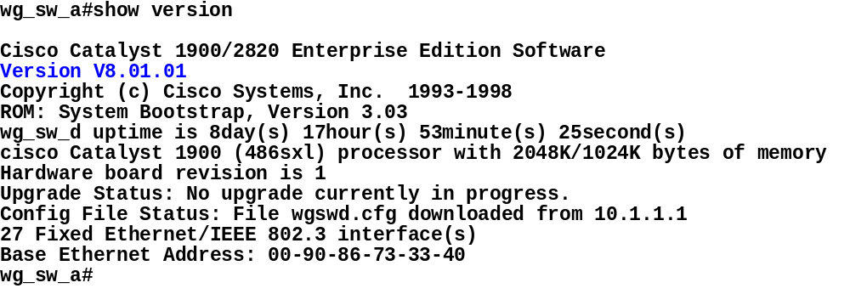
Show Version
Notes:
Slide 1 of 1
Purpose:
Emphasize:
Note: This is the output from a Cat 1924. It has 27 fixed Ethernet interfaces.

Slide 63
Managing Configuration File
To send the configuration to a TFTP server:
wg_sw_a#
copy nvram tftp://host/dst_file
Notes:
Slide 1 of 3
Purpose:
Emphasize:

Slide 64
Managing Configuration File
To send the configuration to a TFTP server:
wg_sw_a#
copy nvram tftp://host/dst_file
To download the configuration from a TFTP server:
wg_sw_a#
copy tftp://host/src_file nvram
Notes:
Slide 2 of 3
Purpose:
Emphasize:

Slide 65
Managing Configuration File
To send the configuration to a TFTP server:
wg_sw_a#
copy nvram tftp://host/dst_file
To download the configuration from a TFTP server:
wg_sw_a#
copy tftp://host/src_file nvram
    wg_sw_a#copy nvram tftp://10.1.1.1/wgswd.cfg
    Configuration upload is successfully completed
    wg_sw_a#copy tftp://10.1.1.1/wgswd.cfg nvram
    TFTP successfully downloaded configuration file
Notes:
Slide 3 of 3
Purpose:
Emphasize:

Slide 66
Clear NVRAM
    wg_sw_d#delete nvram
Resets the system configuration to factory defaults.
Notes:
Slide 1 of 1
Purpose:
Emphasize:
Note: This is equivalent to the router IOS CLI “erase start” command.

Slide 67


Visual Objective
pod sw ro’s e0
A 10.1.1.10 10.1.1.11
B 10.1.1.20 10.1.1.21
C 10.1.1.30 10.1.1.31
D 10.1.1.40 10.1.1.41
E 10.1.1.50 10.1.1.51
F 10.1.1.60 10.1.1.61
G 10.1.1.70 10.1.1.71
H 10.1.1.80 10.1.1.81
I 10.1.1.90 10.1.1.91
J 10.1.1.100 10.1.1.101
K 10.1.1.110 10.1.1.111
L 10.1.1.120 10.1.1.121
wg_pc_a
fa0/26
(port A)
e0/1
e0/2
e0
wg_sw_a
10.1.1.10
wg_ro_a
10.1.1.11
wg_pc_l
fa0/26
(port A)
e0/1
e0/2
e0
wg_sw_l
10.1.1.120
wg_ro_l
10.1.1.121
...
fa0/1
fa0/12
fa0/24
core_ server
(tftp server)
10.1.1.1
core_sw_a
10.1.1.2
Notes:
Slide 1 of 1
Purpose:
Emphasize: Refer to the lab setup guide for lab instructions.

Slide 68
Summary
After completing this chapter, you should be able to perform the following tasks:
  Describe Layer 2 switching (bridging) operations
  Describe the Catalyst 1900 switch operations
  Describe the Catalyst 1900 switch’s default configuration
  Configure Catalyst 1900 switch
  Use show commands to verify Catalyst 1900 switch configuration and operations
Notes:
Slide 1 of 1
Purpose:
Emphasize:

Slide 69
Review Questions
  1. What function does Spanning-Tree Protocol provide?
  2. What are the different spanning-tree port states?
  3. Describe the difference between full-duplex and half-duplex operations. What is the default duplex setting on the Catalyst 1900 10Mbps port and 100Mbps port?
  4. What is the default switching mode on the Catalyst 1900?
Notes:
Slide 1 of 1
Purpose:
Emphasize: Refer to the appendix for the answers to the review questions.

Slide 70
Review Questions
  5. What is the Catalyst 1900 CLI command to assign an IP address to the switch? Why does a Layer 2 switch require an IP address?
  6. Which type of MAC address does not age, permanent or dynamic?
  7. What is the Catalyst 1900 CLI command to display the contents of the MAC address table?
Notes:
Slide 1 of 1
Purpose:
Emphasize: Refer to the appendix for the answers to the review questions.

