Slide 1
Agenda
Introduction To NumPy
Creating NumPy Array
Basic Operation On Array
Indexing & Slicing
Reshaping, Stacking & Splitting
Iteration, Filtering & Boolean Indexing
NumPy Case Study
Data Structure In Pandas
Series & Dataframe
Creating Dataframe & Loading Files (Scv, Excel, Sql Etc)

Slide 2

NumPy (Numerical Python)
NumPy (Numerical Python) is a fundamental library in Python for numerical and scientific computing.
It provides support for arrays, matrices, and a wide range of mathematical functions to work efficiently with large datasets and perform various mathematical operations.
NumPy is suited for many applications:
  Image Processing
  Signal Processing
  Linear Algebra
  A Plethora of Others

Slide 3
Key Features - NumPy
Multidimensional Arrays: NumPy's numpy.ndarray supports n-dimensional arrays for scientific computing.
Element-Wise Operations: Perform efficient element-wise operations on arrays without explicit loops.
Broadcasting: Automatically aligns arrays of different shapes for operations.
Mathematical Functions: Offers a wide range of mathematical functions, including basic arithmetic, trigonometry, and statistics.
Random Number Generation: Provides tools for generating random data, crucial for simulations and stats.
File I/O: Supports reading/writing data from/to files, such as CSV and binary formats.
Integration: Often used with other libraries like Pandas, SciPy, and Matplotlib.

Slide 4
Creating NumPy Array
Creating NumPy Arrays:
1. From Lists or Tuples:
    import numpy as np
    arr = np.array([1, 2, 3, 4, 5])
2. Using Built-in Functions:
    zeros_arr = np.zeros((3, 3)) # Creates a 3x3 array filled with zeros
    ones_arr = np.ones((2, 2)) # Creates a 2x2 array filled with ones
3. Arange and Linspace:
    arr = np.arange(0, 10, 2) # Creates an array [0, 2, 4, 6, 8]
    lin_arr = np.linspace(0, 1, 5) # Creates an array [0. , 0.25, 0.5 , 0.75, 1. ]

Slide 5
Creating NumPy Array
Creating NumPy Arrays:
4. Random Arrays:
rand_arr = np.random.rand(3, 3)
# Creates a 3x3 array with random values between 0 and 1

Slide 6
Creating NumPy Array
Using dimesion to genertate N-dimensional arrays:
  arr = np.array([1,2,3,4], ndmin=2)
  print(arr)
  print(arr.reshape((2,2))) # to change the shape of the array | *NEED* to only provide the shape with matches the number of elements in the array
  print(type(arr)) # to check the type of the class for the given object
  print(arr.shape) # to check the shape of the arr | *shape* given info about rows and cols, helpful in matrix algebra
  print(arr.ndim) # to check the dimentions of the arr

Slide 7
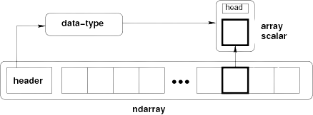
Array Memory Layout

Slide 8
NumPy
DataTypes in NumPy:
  Strings e.g. 'ABC'
  Integers e.g. 1
  float e.g. 5.98
  boolean e.g. True
  complex e.g. 1.0 + 2.0j
Data Type Codes:
i – integer, b – Boolean, u - unsigned integer, f – float, c - complex float, m – timedelta, M – datetime, O – object, S – string, U - unicode string, V - fixed chunk of memory for other type ( void )
  arr = np.array([1,2,3,4])
  print(arr.dtype) # int32
  arr = np.array(['dogs','cats','horses'], dtype='S') # to initalize with a specific datatype
  print(arr.dtype)
→ int32
→ |S6

Slide 9
Indexing and Slicing NumPy Arrays
Indexing and Slicing NumPy Arrays:
NumPy arrays can be accessed and sliced similar to Python lists, with the additional ability to index and slice in multiple dimensions for multi-dimensional arrays.
  import numpy as np
  arr = np.array([[1, 2, 3], [4, 5, 6], [7, 8, 9]])
  # Accessing elements
  element = arr[0, 1] # Accessing the element at the first row and second column
  slice_ro# Slicing
  w = arr[1, :] # Slicing the second row
  slice_column = arr[:, 2] # Slicing the third column
  # Advanced indexing
  mask = arr > 5 # Creating a boolean mask for values greater than 5
  filtered = arr[mask] # Getting values greater than 5

Slide 10
NumPy
      import numpy as np
      # Create the following rank 2 array with shape (3, 4)
          [[ 1 2 3 4]
          [ 5 6 7 8]
          [ 9 10 11 12]]
          a = np.array([[1,2,3,4], [5,6,7,8], [9,10,11,12]])
      # Use slicing to pull out the subarray consisting of the first 2 rows and columns 1 and 2; b is the following array of shape (2, 2):
          [[2 3]
          [6 7]]
          b = a[:2, 1:3]
      # A slice of an array is a view into the same data, so modifying it will modify the original array.
          print(a[0, 1]) # Prints "2"
          b[0, 0] = 77 # b[0, 0] is the same piece of data as a[0, 1]
          print(a[0, 1]) # Prints "77"

Slide 11
NumPy Operations
NumPy Operations:
NumPy arrays support a wide range of operations, including arithmetic, statistical, and more. These operations are performed element-wise.
    import numpy as np
    arr1 = np.array([1, 2, 3])
    arr2 = np.array([4, 5, 6])
    # Element-wise arithmetic operations
    addition = arr1 + arr2
    subtraction = arr1 - arr2
    multiplication = arr1 * arr2
    division = arr1 / arr2
    # Statistical operations
    mean = np.mean(arr1)
    std_dev = np.std(arr2)

Slide 12
NumPy Operations
    # Geometric operations
      exponentiation = np.exe(arr1)
      sq_root = np.sqrt(arr1)
      sin = np.sin(arr1)
      cos = np.cos(arr1)
      log = np.log(arr1)
    # Agregate Functions
      arr1.sum()
      arr1.min()
      arr1.max()

Slide 13
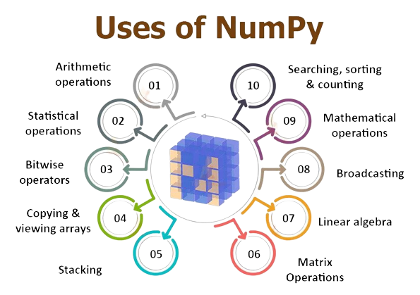
Application of NumPy
Application of NumPy
  Data Analysis and Manipulation
  Scientific and Engineering Computations
  Machine Learning and Deep Learning
  Image and Signal Processing
  Statistical Analysis
  Simulation and Modeling
  Financial and Economic Analysis
  Geospatial Data Analysis
  Bioinformatics
  Data Visualization
  Physics and Astronomy
  Materials Science
  Neuroscience
  Environmental Science
  Astronomy

Slide 14
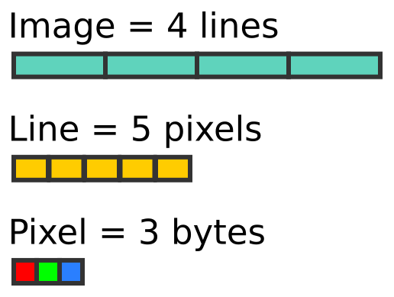
NumPy – Case Study
Image Processing using NumPy & Matplotlib
The fundamental idea is that we know images are made up of NumPy ndarrays. So we can manipulate these arrays and play with images.
Matplotlib: Matplotlib is a popular Python library for creating static, animated, and interactive visualizations in various formats, such as charts, plots, and graphs.
PIL (Python Imaging Library): PIL, also known as Pillow, is a library for working with images in Python, allowing you to open, manipulate, and save various image file formats.
  # importing all the required libraries for Image Processing
  import numpy as np
  import matplotlib.pyplot as plt
  from PIL import Image, ImageOps

Slide 15

Pandas Introduction
Pandas is a Python library designed for data manipulation and analysis.
It offers powerful DataFrame and Series data structures.
Pandas simplifies data tasks, from reading and cleaning data to analysis and visualization.
Throughout this presentation, we'll explore how Pandas revolutionizes data work

Slide 16
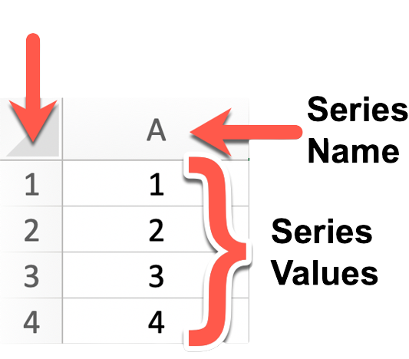
Data Structure in Pandas
Panda Series
A Pandas Series is a one-dimensional array-like data structure that can hold data of various types, including integers, floats, strings, and more.
It's essentially a labeled array where each element has an associated index or label. This label allows for easy data access and manipulation.

Slide 17
Pandas Series
Creating a Pandas Series:
import pandas as pd
# Creating a Series from a list
data = [10, 20, 30, 40, 50]
series_from_list = pd.Series(data)
# Creating a Series from a NumPy array
import numpy as np
numpy_array = np.array([1, 2, 3, 4, 5])
series_from_numpy = pd.Series(numpy_array)
# Creating a Series with custom index labels
custom_index = pd.Series(data, index=['A', 'B', 'C', 'D', 'E'])

Slide 18
Pandas Series
Indexing a Pandas Series:
# Accessing elements by position (zero-based index)
element_at_position_2 = series_from_list[2]
# Accessing elements by label
element_with_label_B = custom_index['B']
# Slicing a Series
slice_series = series_from_list[1:4] # Returns elements at positions 1, 2, and 3

Slide 19
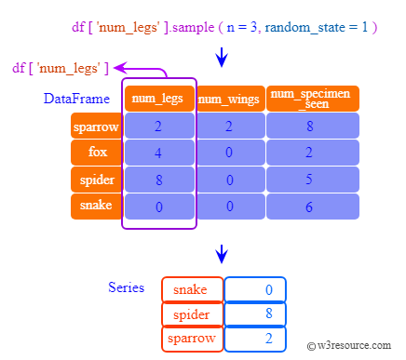
Pandas DataFrame
A Pandas DataFrame is a two-dimensional, tabular data structure that resembles a spreadsheet or SQL table. It consists of rows and columns, where each column can contain different data types.
DataFrames are especially well-suited for handling structured data, such as datasets with rows and columns of information.

Slide 20
Creating Pandas DataFrame
import pandas as pd
# Creating a DataFrame from a dictionary
data = {'Name': ['Alice', 'Bob', 'Charlie'],
'Age': [25, 30, 35]}
df_from_dict = pd.DataFrame(data)
# Creating a DataFrame from a list of lists with custom column names
data_list = [['Alice', 25], ['Bob', 30], ['Charlie', 35]]
df_from_list = pd.DataFrame(data_list, columns=['Name', 'Age'])
# Creating a DataFrame from a CSV file
df_from_csv = pd.read_csv('data.csv')
# Creating an empty DataFrame
empty_df = pd.DataFrame()

Slide 21
Indexing a Pandas DataFrame
DataFrames allow for various methods of indexing, including selecting columns, filtering rows, and more.
# Selecting a single column
name_column = df_from_dict['Name']
# Selecting multiple columns
subset = df_from_dict[['Name', 'Age']]
# Filtering rows based on a condition
young_people = df_from_dict[df_from_dict['Age'] < 30]
# Accessing a specific cell by row and column label
cell_value = df_from_dict.at[0, 'Name']

Slide 22
Loading Data from Files
CSV Files: CSV (Comma-Separated Values) files are one of the most frequently used formats for tabular data.
import pandas as pd
# Reading a CSV file
data = pd.read_csv('data.csv')
Excel Files: Pandas can read data from Excel files with multiple sheets and various formats.
# Reading an Excel file (first sheet by default)
data_from_excel = pd.read_excel('data.xlsx')
# Reading a specific sheet from an Excel file
data_from_sheet2 = pd.read_excel('data.xlsx', sheet_name='Sheet2')

Slide 23
Loading Data from Files
SQL Databases: You can connect to SQL databases and retrieve data using Pandas.
from sqlalchemy import create_engine
# Create a database connection
engine = create_engine('sqlite:///database.db')
# Read data from a SQL database
data_from_sql = pd.read_sql_query('SELECT * FROM table_name', engine)
JSON Files: JSON (JavaScript Object Notation) files are commonly used for semi-structured data.
# Reading data from a JSON file
data_from_json = pd.read_json('data.json')
HTML/Web Scraping: You can also scrape data from HTML tables on webpages.
# Reading tables from a webpage
data_from_html = pd.read_html('https://example.com')[0] # Adjust index as needed

Slide 24
Thank You!!!

