Slide 1
Work Study & Method Engineering
Lec-1

Slide 2


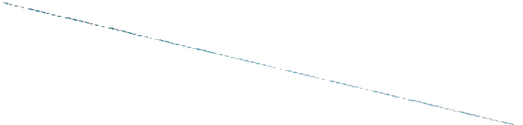

Branch of Industrial engineering
Combination of 2 Techniques
Method study, Work measurement

Slide 3
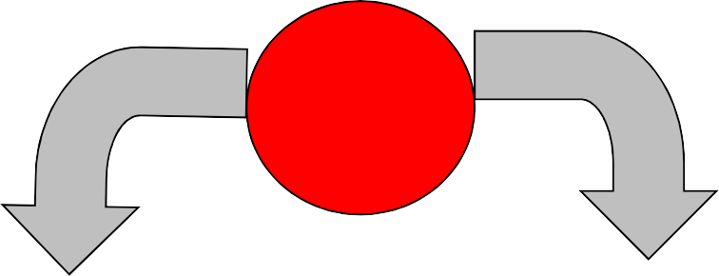




Work Study
Method Study
J O B
With Higher Productivity
J O B
Work Measurement
To simplify the job and develop more economical methods of doing it
To determine how long It should take to carry out

Slide 4
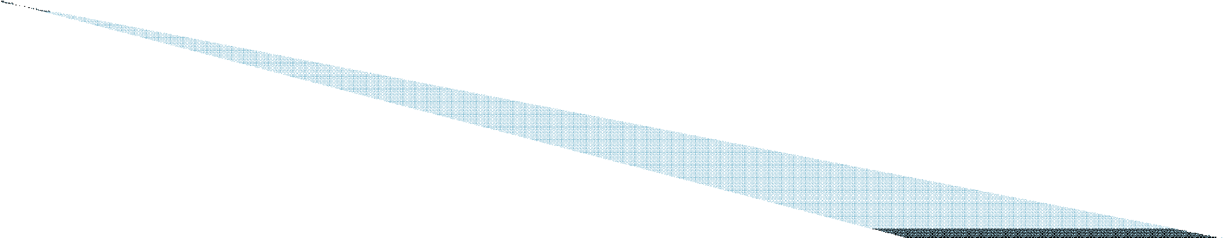
Generic term for
-Method Study
and work in the
measurement, examination of human
which are used
work in
all its to
contexts, and which the investigation of
leads
systematically
all the
factors which
affect the efficiency
and economy
of the
situation being reviewed,
in order to effect
improvement.

Slide 5

Uniform ,improved production flow
Higher productive efficiency
Reduced manufacturing costs
Fast , accurate delivery dates
Better employee-employer relations
Better service to customers
Job security and satisfaction
Better working conditions
Higher wagews

Slide 6

Systematic Recording and Critical Examination of Existing and Proposed ways of doing a work, as a means of developing and applying easier and more effective methods and reducing costs.

Slide 7

Improved working processes
Better work place layout
Less fatigue to workers
Better product quality
Effective utilization of resources
Efficient, fast material handling
Reduced health hazards
Efficient planning of section
Streamlined working proceedures.

Slide 8

Application of Techniques Designed to establish
the Time for a Qualified Worker
to carry out a specified job at a defined level of performance.

Slide 9

Determines time required, establishes fastest method;
Determines man power required for a job;
Decides equipments;
Provides information for effective production planning;
Aids in calculating exact delivery dates;
Decides realistic labour budgeting;
Provides a basis for sound incentive scheme;
Results in effective labour control.

Slide 10

The role of Work study: Work measurement: to investigate existing practice, locate ineffective time and set standards of performance as a basis for-
a) Planning and control
b) Utilisation of Plant
c) Labour cost control
d) Incentive Schemes

Slide 11

To evaluate Worker’s performance
To evaluate the existence of ineffective time
To determine available capacity
To determine price or cost of a product
To compare work methods
To facilitate operations scheduling
To establish wage incentive schemes

Slide 12


Time study technique.
Production study technique.
3 Analytical estimating techniques.
Activity/ work sampling.
Pre-determined time standard systems (PTS)

Slide 13
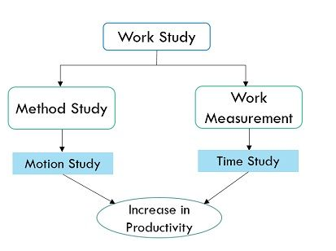
Work Study

Slide 14
Time and Motion Study
Time study is a method used to measure the time it takes to perform a specific task, while
Motion study is a method used to analyze and improve the efficiency of a worker's movements during a task.
Both are used in industrial engineering to improve productivity and reduce costs.
Time study focuses on the duration of a task, whereas;
Motion study focuses on the worker's movements and how they can be optimized.

Slide 15
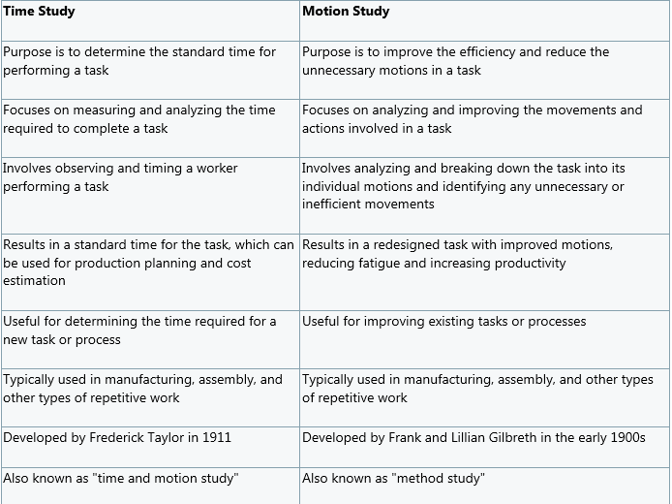
Difference between Time Study and Motion Study

Slide 16
Methods Engineering
After first introduction, time study developed in the direction of establishing standard times, while motion study evolved into a technique for improving work methods.
These two techniques became integrated and refined into a widely accepted method applicable to the improvement and upgrading of work systems.
This integrated approach to work system improvement is known as methods engineering and it is applied today to industrial as well as service organizations, including banks, schools and hospitals
A branch of industrial engineering specializing in the analysis of methods and the improvement and standardization of methods, equipment, and working conditions

Slide 17
Steps of Methods Engineering
Idea
Concept
Planning
Design
Development
Launch
The development step is often divided to include the iterative cycle of build, test, debug, and redesign.
Debug: to detect and remove defects or errors from

Slide 18
History
Frank Bunker Gilbreth (July 7, 1868 – June 14, 1924) was an American engineer, consultant, and author known as an early advocate of scientific management and a pioneer of time and motion study,
Both he and his wife Lillian Moller Gilbreth were industrial engineers and efficiency experts who contributed to the study of industrial engineering in fields such as motion study and human factors.
Frank and Lillian Gilbreth wrote some of the original work that laid the foundation for the field of motion and time study. They were the pioneers of motion study.

Slide 19
History
Frederick Taylor (July 7, 1868 – June 14, 1924) was an American inventor that established the Scientific Management Theory or Taylorism to influence how work was performed using scientific techniques.
Taylor was trained as an engineer by undertaking a master's degree in mechanical engineering.
To enhance his theory, Frederick Taylor wrote books like Shop Management and The Principles of Scientific Management.
Through those books, Taylor impacted management through quantitative concepts like cost accounting, ergonomics, and assembly line production to apply science to conduct quantitative analysis.

Slide 20
History
The Fredrick Taylor theory explained that the optimization of work translated to productivity and efficiency and not how the workers were made to work hard.
The Taylor scientific management theory assumed that productivity could increase by making jobs simpler and optimizing them.

Slide 21
History
The four principles of Scientific Management are as follows:
Splitting work between workers and managers where workers would create plans and workers would follow them.
The scientific training and hiring of workers.
The collecting of data and its analysis reduced to rules and laws.
Monitoring worker performance.

Slide 22
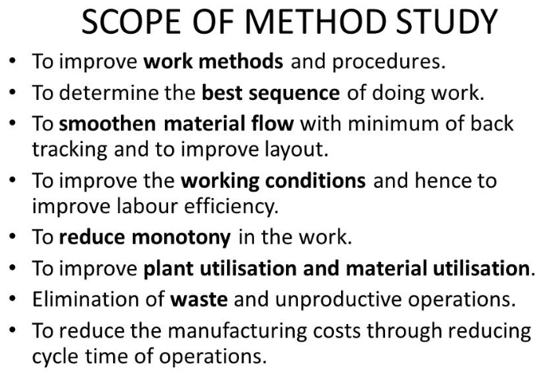
History
The four principles of Scientific Management are as follows:
Splitting work between workers and managers where workers would create plans and workers would follow them.
The scientific training and hiring of workers.
The collecting of data and its analysis reduced to rules and laws.
Monitoring worker performance.

Slide 23


Transformation of raw materials into finished goods
Can be increased by increased input.
Not a measure of performance
Not much effort required to achieve increased production

Slide 24


Ratio of output to input
Output=final goods
Input=resources
Measure of performance

Slide 25

Aggregate productivity
a) total productivity
b) total factor productivity
c) return on investment.
Partial productivity
a) Labor
b) Capital
c) material

Slide 26

PRODUCTION | PRODUCTIVITY
1. Means output of goods or services. | Means effective utilization of resources.
2. It can, be increased by increasing men, material, machines etc. | It can be achieved by reducing wastage of material, man power and machine hours.
3. By increasing production cost of the product will remain same. | By increase in productivity cost of the product will come down.
4. It does not have impact on standard of living. | It certainly improves the standard of living.
5. It changes the raw material into finished product. | It is the ratio between output to input.

Slide 27

To study performance of a system
To attain a relative comparison of different systems for a given level.
To compare actual to planned productivity

Slide 28
The Production System
Inputs
Processes
Outputs
Labor, capital, management
The U.S. economic system transforms inputs to outputs at about an annual 2.5% increase in productivity per year. The productivity increase is the result of a mix of capital (38% of 2.5%), labor (10% of 2.5%), and management (52% of 2.5%).
Goods and services
Feedback loop
Figure 1.7

Slide 29
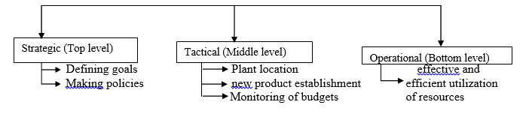
Production/Operation management
In the process of managing various subsystems of the organization, the executives at different levels of the organization need to track several management decisions.
The management decisions are Strategic, tactical and operational

Slide 30
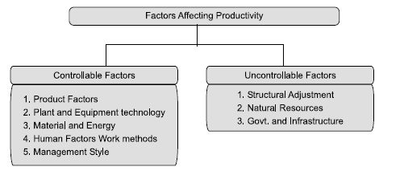
Factors Influencing Productivity
Factors influencing productivity can be classified broadly into two categories:
(A) controllable (or internal) factors and
(B) un-controllable (or external) factors.

Slide 31
Productivity
Units produced
Input used
Productivity =
Measure of process improvement
Represents output relative to input
Only through productivity increases can our standard of living improve

Slide 32
Productivity Calculations
Labor Productivity
Units produced
Labor-hours used
Productivity =
1,000
250
= = 4 units/labor-hour
One resource input ⇨ single-factor productivity

Slide 33
Multi-Factor Productivity
Output
Labor + Material + Energy + Capital + Miscellaneous
Productivity =
Also known as total factor productivity
Output and inputs are often expressed in dollars
Multiple resource inputs ⇨ multi-factor productivity

Slide 34
Collins Title Productivity
Old System:
Staff of 4 works 8 hrs/day 8 titles/day
Payroll cost = $640/day Overhead = $400/day
Old labor productivity
8 titles/day
32 labor-hrs
=

Slide 35
Collins Title Productivity
Old System:
Staff of 4 works 8 hrs/day 8 titles/day
Payroll cost = $640/day Overhead = $400/day
Old labor productivity
8 titles/day
32 labor-hrs
=
= .25 titles/labor-hr

Slide 36
Collins Title Productivity
Old System:
Staff of 4 works 8 hrs/day 8 titles/day
Payroll cost = $640/day Overhead = $400/day
New System:
14 titles/day Overhead = $800/day
Old labor productivity
8 titles/day
32 labor-hrs
=
= .25 titles/labor-hr
New labor productivity
14 titles/day
32 labor-hrs
=

Slide 37
Collins Title Productivity
Old System:
Staff of 4 works 8 hrs/day 8 titles/day
Payroll cost = $640/day Overhead = $400/day
New System:
14 titles/day Overhead = $800/day
Old labor productivity
8 titles/day
32 labor-hrs
=
= .25 titles/labor-hr
New labor productivity
14 titles/day
32 labor-hrs
=
= .4375 titles/labor-hr

Slide 38
Collins Title Productivity
Old System:
Staff of 4 works 8 hrs/day 8 titles/day
Payroll cost = $640/day Overhead = $400/day
New System:
14 titles/day Overhead = $800/day
Old multifactor productivity
8 titles/day
$640 + 400
=

Slide 39
Collins Title Productivity
Old System:
Staff of 4 works 8 hrs/day 8 titles/day
Payroll cost = $640/day Overhead = $400/day
New System:
14 titles/day Overhead = $800/day
Old multifactor productivity
8 titles/day
$640 + 400
=
= .0077 titles/dollar

Slide 40
Collins Title Productivity
Old System:
Staff of 4 works 8 hrs/day 8 titles/day
Payroll cost = $640/day Overhead = $400/day
New System:
14 titles/day Overhead = $800/day
Old multifactor productivity
8 titles/day
$640 + 400
=
= .0077 titles/dollar
New multifactor productivity
14 titles/day
$640 + 800
=

Slide 41
Collins Title Productivity
Old System:
Staff of 4 works 8 hrs/day 8 titles/day
Payroll cost = $640/day Overhead = $400/day
New System:
14 titles/day Overhead = $800/day
Old multifactor productivity
8 titles/day
$640 + 400
=
= .0077 titles/dollar
New multifactor productivity
14 titles/day
$640 + 800
=
= .0097 titles/dollar

Slide 42
Measurement Problems
Quality may change while the quantity of inputs and outputs remains constant
External elements may cause an increase or decrease in productivity
Precise units of measure may be lacking

Slide 43
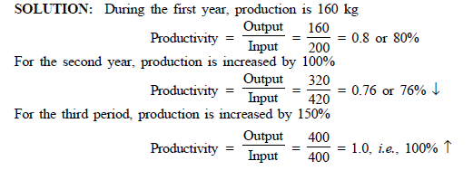
Examples
Example 1:
A company produces 160 kg of plastic molded parts of acceptable quality by consuming 200 kg of raw materials for a particular period. For the next period, the output is doubled (320 kg) by consuming 420 kg of raw material and for a third period, the output is increased to 400 kg by consuming 400 kg of raw material.
From the above illustration it is clear that, for second period, though production has doubled, productivity has decreased from 80% to 76% for period third, production is increased by 150% and correspondingly productivity increased from 80% to 100%.

Slide 44
Examples
Example 2:
The following information regarding the output produced and inputs consumed for a particular time period for a particular company is given below:
Output – Rs. 10,000
Human input – Rs. 3,000
Material input – Rs. 2,000
Capital input – Rs. 3,000
Energy input – Rs. 1,000
Other misc. input – Rs. 500
The values are in terms of base year rupee value. Compute various productivity indices.

Slide 45
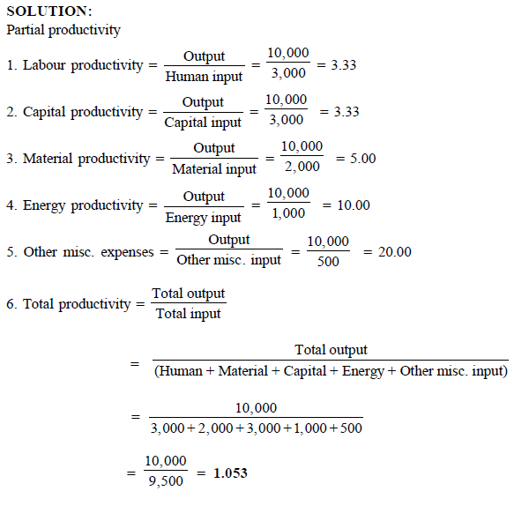
Examples

