Slide 1
Work Study & Method Engineering
Lec-4

Slide 2
What Is a Process?
A series of actions or steps taken in order to achieve a particular end
A process is a series of steps and decisions involved in the way work is completed
Based on complexity, processes can be viewed as both micro or sub-processes and constituents of more extensive macro processes.

Slide 3
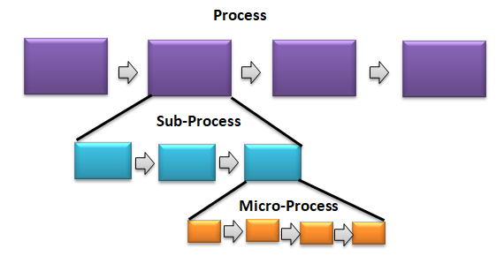
What Is a Process?

Slide 4
Why Does Understanding Processes Matter?.
They are important because they describe how things get done and then provide the focus for making them better and how they are done determines how successful the outcomes will be.
If you focus on the right processes, in the right way, you can design your way to success
The purpose of process is to ensure consistency.
A good process is like a checklist that ensures the right things get done by the right people at the right time.

Slide 5
What Is a Process Feedback Loop
A feedback loop is a process in which the outputs of a system are circled back and used as inputs.
In business, this refers to the process of using customer or employee feedback (the outputs of a service or product), to create a better product or workplace.

Slide 6
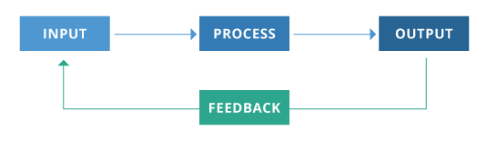
What Is a Process Feedback Loop
Feedback loops are checkpoints in the experience that allow you to ensure that all tasks assigned are being completed correctly and on time.
Feedback loops are essential to certain workflows because they ensure all standards are being met and that the workflow is successful from start to finish

Slide 7
The Process Improvement Cycle
Select a
process
Document
Study/document
Evaluate
Seek ways to
Improve it
Implement the
Improved process
Design an
Improved process

Slide 8
Process Analysis
A process analysis is a systematic review of all steps and procedures followed to perform a given activity.
It is a description of the way a particular task is done within an organization.
Process Analysis can be understood as the rational breakdown of the production process into different phases, that turns input into output
It refers to the full-fledged analysis of the business process, which incorporates a series of logically linked routine activities, that uses the resources of the organization, to transform an object, with the aim of achieving and maintaining the process excellence

Slide 9
What Does Process Analysis Mean?
Process analysis is an ongoing improvement process where organizations analyze the way they do things in order to find more efficient methods to perform a particular task.
This analysis is based on the three elements of any activity: input, process and output. Process analysis deals with the way the input is transformed into the desired output.
Process Analysis is nothing but a review of the entire process flow of an organization to arrive at a thorough understanding of the process.
One goal for this analysis is to reduce the amount of resources, including time, employed to get the output required.

Slide 10
Process Chart
The process chart is a chart that gives a detailed overview of the various operations, inspections and storage done in sequence for all the components that go into a particular product or assembly.
Any manufacturing process can be better visualized by representing the process in the form of a visual chart. These charts show how to manufacture the product in stages, the equipment and tools that are planned to be used, and other activities like movement, quality control checks, storages, etc.

Slide 11
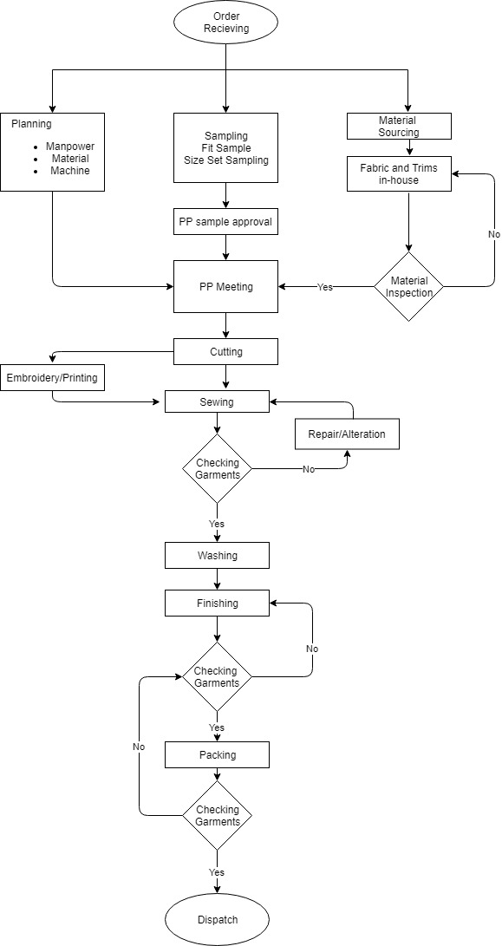
Process Chart

Slide 12
Symbols Used in Process Flow
The different kinds of process chart share a common core set of symbols, though some have additional symbols for specific and specialized process steps.
The common symbols (of which there are only five) were first INTRODUCED by the American Society of Mechanical Engineers and have become known as the ASME symbols.
In a Process flow chart symbols represent different items in a process or operation.

Slide 13
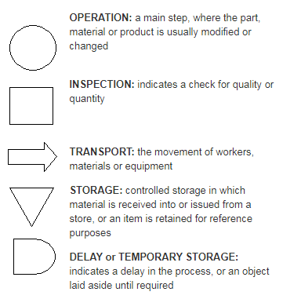
Symbols Used in Process Flow

Slide 14
Review of Process Flow
Process Analysis is nothing but a review of the entire process flow of an organization to arrive at a thorough understanding of the process.
Further, it is also helpful to set up targets for the purpose of process improvement, which is possible by eliminating unnecessary activities, reduce wastage and increasing efficiency.
Thus, it ultimately ends up improving the overall performance of the business activities.

Slide 15
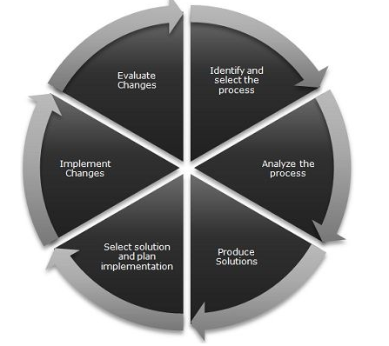
Review of Process Flow

Slide 16
Objectives of Process analysis
Identify the factors that make it difficult to understand the process.
Ascertain completeness of the process.
Remove bottlenecks
Find redundancies
Ascertain the PROPER allocation of resources
Check out process time

Slide 17
Steps Involved in Process Analysis
Process Analysis is a methodical approach to enhance the understanding and redesigning of the workflow of the organization.
It acts as a tool to maintain and improve the business processes and also help in attaining the incremental to transformational benefits, such as cost reduction, optimum utilization of resources, effective human resource allocation and process efficiency

Slide 18
Steps Involved in Process Analysis
Business process analysis consists of 6-steps:
Identify and define your goals
Identify the process to be analyzed
Collect information
Map out the process
Analyze the process
Identify the potential for business process improvement

Slide 19
i. Identify and define your goals
This first step involves identifying what you hope to achieve by conducting an analysis.
Perhaps you want to gain a better understanding of a specific business process within your organization.
Or your efforts may be part of a larger initiative like incorporating automation into all organizational processes.
Effective goals generally follow the SMART acronym, in that they are specific, measurable, attainable, relevant, and time-bound.

Slide 20
ii. Identify and define process
Knowing what your goals are help you to identify which processes you want to analyze.
A good place to start is with smaller business-critical processes, or aspects of your organization that are underperforming.
Identify your starting and end points to ensure that the scope of your analysis is not too broad.

Slide 21
iii. Collect information
At this stage you will want to assemble your team.
Include stakeholders that are involved with your business process design.
They will have the most information and be able to identify issues and bottlenecks.
Conduct interviews and brainstorming sessions with your team.
Review all available sources of information.
Gather as much information as you can, it will provide you with a better understanding of the process.

Slide 22
iv. Map it out
Business process mapping is a planning and management tool that visually depicts all aspects of a process.
Process mapping can be as simple as sketching out a flowchart on a piece of paper.
The important thing is that your map show the process in a clear and easy to follow manner.
You can also use workflow software to design detailed business process maps.
Using the software is as simple as dragging and dropping tasks on an easy to use dashboard

Slide 23
vi. Improvement
In this final step, return to the goals that you defined at the outset.
Any improvements to your processes should further those goals.
Discuss your findings and recommendations with stakeholders.
Get their feedback. Brainstorm and explore all possible solutions.
Consider how each solution will impact your organization in both the short and long-term.

