Slide 1
Process Charts Used In Method Study
Process chart:
A process chart records an overall picture of the process and records only the main events sequence-wise. It considers only the main operations and inspections.
Operation process chart:
The basic process chart, called an operation process chart, is understood as a graphic representation of the points at which the materials are introduced into the process and of the sequence of inspections and all operations except those involved in materials handling. It includes information considered desirable for analysis such as time required to carry out the operation and the location.

Slide 2
Flow process chart:
Flow process charts are graphic representations of the sequences of all operations, transportation, inspections, delays, delays and storages occurring during a process or a procedure and include information considered for analysis such as, time required and distance moved.
The flow process chart could be of two types namely,
Flow process chart material or product type.
Flow process chart machine type or equipment.
Two handed process chart:
In this chart, the activities of a workers’ or operators’ both
hands or limbs are recorded chronographically.

Slide 3
Multiple Activity Chart:
In this chart, the activities of more than one subject worker, machine or equipment are recorded on a common time scale to show their inter-relationship.
Flow diagram:
The flow diagram is a drawing or diagram drawn to a scale to show the relative position of a machine or equipment, jigs and fixtures and shows the path followed by materials or machines.
String diagram:
It is scale plan or model on which a string or a thread is used to trace and measure the path of workers, material or equipments during a specified sequence of events.

Slide 4
SIMO chart:
These indicate the basic motions consisting of three parts, viz.,
When the motion begins.
The nature of the motion.
When the motion ends.
The simultaneous motion cycle chart (SIMO) is a type of two handed process chart in which the micro motions of both hands are recorded.

Slide 5
1.Operation Process Chart
Also called Outline process chart
Bird’s eye view of whole process
Records only major activities and inspections
Uses only two symbols i.e. operations & inspection
Constructed by placing symbols one below another
An operation process chart is a graphic representation of the sequence of all operations and inspections taking place in a process.
Uses:-
Visualize sequence of operations & inspections in process
Know where operations selected fits into the entire process

Slide 6
Procedure Followed In Preparing The Chart
Write title at the top of the chart.
Begin the chart from the right hand side top corner.
Represent extreme.
Represent
the main component at the right
the sequence of operations and
by
inspections by their symbols. Connect them vertical flow lines.
5. Record the brief description of the activity to the right side of the symbols.

Slide 7
Note down the time for each activity to the left of the symbol.
Number all operations in one serial order. Start from the right hand top (from number 1).
Similarly number all inspections in another serial order (starting from 1).
Continue numbering, till the entry of the second component.
Show the entry of purchased parts by horizontal lines.

Slide 8
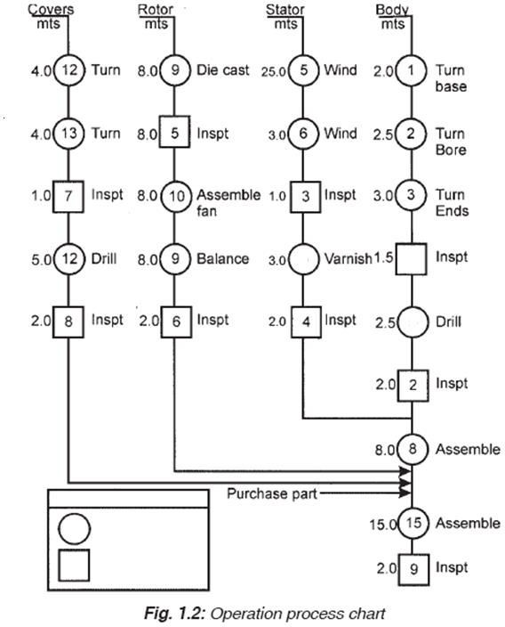
Operation Process / Outline Process Chart: example : manufacture of electric motor

Slide 9
Flow Process Chart
A flow process chart is a graphical representation of the sequence of all the activities (operation, inspection, transport, delay and storage) taking place in a process.
It is the detail version of outline process chart recording all the event.
Process chart symbols are used here to represent the activities.

Slide 10
Guidelines For Making A Flow Process Chart
The details must be obtained by direct observation—charts must not be based on memory.
All the facts must be correctly recorded.
No assumptions should be made.
Make it easy for future reference.
All charts must have the following details:
Name of the product, material or equipment that is observed.
Starting point and ending point.
The location where the activities take place.
The chart reference number, sheet number and number of total sheets.
Key to the symbols used must be stated.

Slide 11
Type of flow process charts
Man/ Worker type flow process chart
This flow process chart records what the worker does.
Material type flow process chart
This flow process chart records how the material is handled or treated.
Equipment type flow process chart
This flow process chart records how the equipment or machine is used.

Slide 12
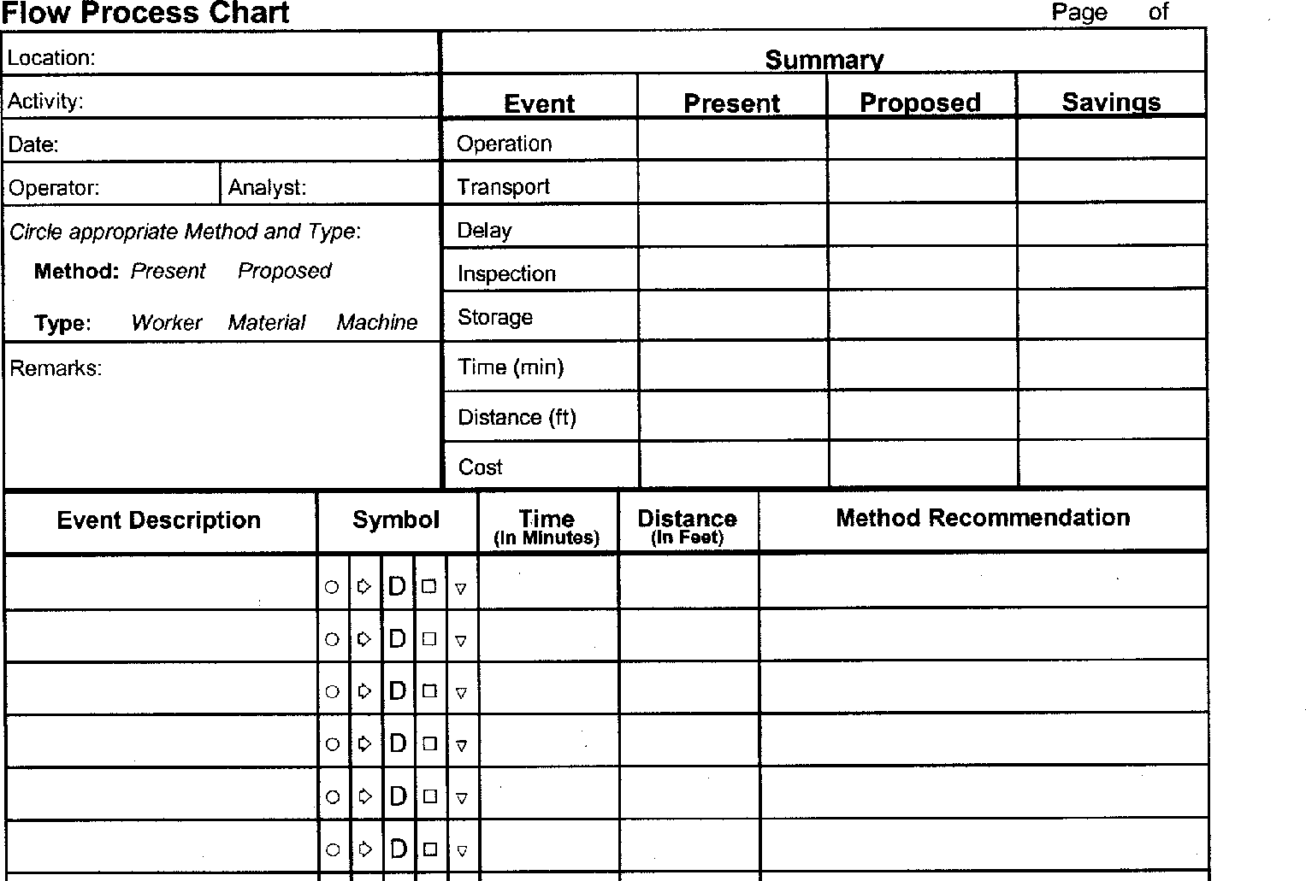
Standard formats used for flow process chart

Slide 13
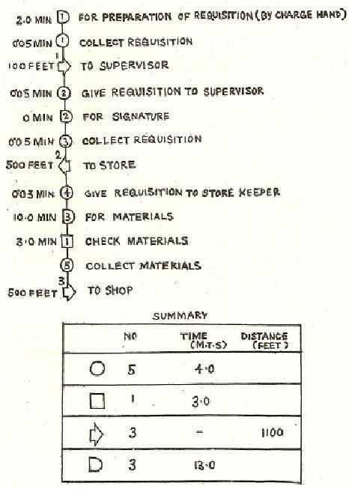
Example: Collection of materials from store (Man Type)

Slide 14
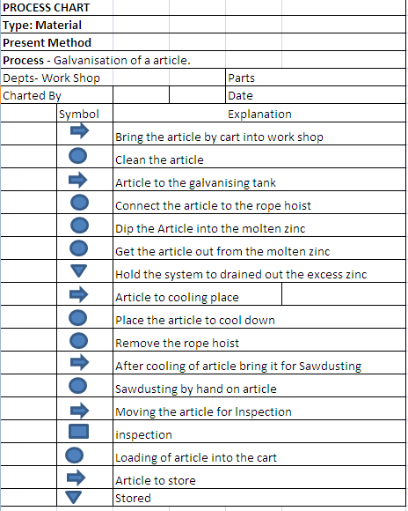

Slide 15
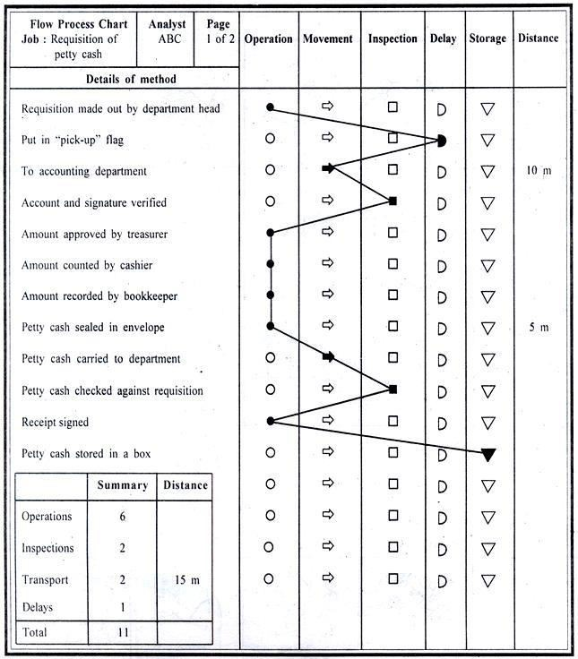
Machine/ Equipment Flow Process Chart:

Slide 16
Two-Handed Process Chart (or) Right Hand, Left Hand Chart
It is the process chart in which the activities of two hands of the operator are recorded.
Motions of both hands of worker are Right hand-Left hand chart recorded independently.
It shows whether the two hands of the operator are idle or moving in relation to one another, in a timescale.
It is generally used for repetitive operations.

Slide 17
Two-Handed Process Chart (or) Right Hand, Left Hand Chart
Operation: Represents the activities grasp, position, use, release etc. of a tool, component or material.
Transport: Represents the movement of the hand or limb to or from the work or a tool or material.
Delay: Refers to the time when the hand or limb is idle.
Storage (Hold): The term ‘hold’ is used here instead of storage. This refers to the time when the work is held by hand.
The activity ‘inspection’ by hand is considered as an operation. Hence, the symbol for inspection is not used in this chart.
Two-handed process chart can be used for assembly, machining and clerical jobs.

Slide 18
The objective of this investigation is to eliminate or reduce the unwanted motions and to arrange the remaining motions in a best sequence.
A two-handed process chart is made up of two columns in which the activities of the left hand and right hand and the appropriate symbols are respectively recorded in sequence.
The activities of the two hands are inter-related by aligning the symbols on the chart so that movements by both hands appear opposite to each other.
Additional columns can be designed to record the activities of the other parts of the body whenever necessary.

Slide 19
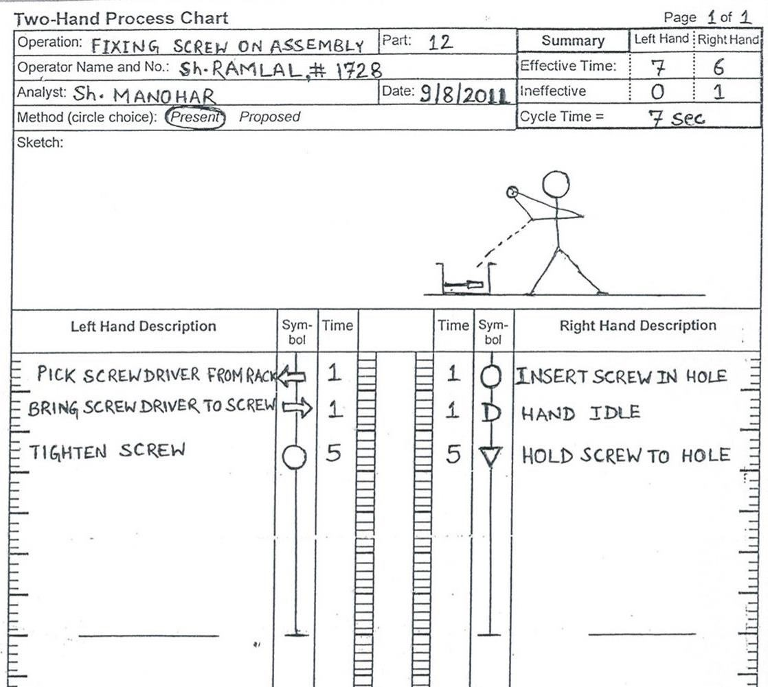

Slide 20
Multiple activity chart
A Chart in which the activities of more than one item are recorded on a common time scale to show their inter- relationship.
Man machine chart is the type of multiple activity charts.
TYPES:
Man - Machine chart: One man handling one job or one machine.
Man - Multi machine chart: One man handling a numbers of machines.
Machine Multi - man chart: A group or gang doing collectively one job as in riveting.
Multi – Man - Machine chart: A number of persons working on a computer system.

Slide 21
Multiple Activity Chart
In it, the activities of more than one item, worker, machine or equipment are recorded on a common time scale to show their inter relation ship.
It is used when a worker operates a number of machines at a time. It is also used when a number of workers jointly do a job.
Why:
Multiple Activity Charts are very useful tool for understanding the flow of work in a cyclic process and as a consequence understanding which resource is controlling the overall progress of the work.
The tool can be used to model different scenarios to determine the
optimum mix of resources for the work.

Slide 22
Purpose of Multiple Activity Chart
To detect the idle time on machine and workers
To optimize work distribution between workers and machines.
To decide no. of workers in a group.
To balance the work team
To examine the activities.
It is used for recording the complex movements of material or men.
Used to find out the most economical route.

Slide 23
Application Of Multiple Activity Chart
Plant repair & maintenance.
Job construction.
Planning team work.
It is used to check whether the work station is correctly located.

Slide 24
Multiple activity chart for doing three loads of laundry
Time | Operator | Machine 1 Washer | Machine 2 Dryer
# Sec | Load clothes & detergent in machine 1 | Being loaded | Idle
 | idle | Run | Idle
- | Remove clothes from machine 1 | Being unloaded | Idle
- | Load clothes into machine 2 | Idle | Being loaded
- | Load clothes & detergent into machine 1 | Being loaded | Run
- | Idle | Run | Run
- | Remove clothes from machine 2 | Idle | Being unloaded
- | Hang clothes | Idle | Idle

Slide 25
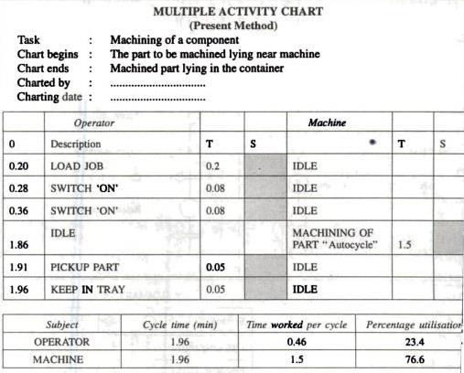
55

