Slide 1

PYTORCH WILDLIFE
GitHub repository offering state-of-the-art detection and classification models for animal detection using Megadetector and the AI4GAmazonRainforest classifier
Pipeline Components: It utilizes the Megadetector for detecting animals in images and the AI4GAmazonRainforest classifier for subsequent animal classification.
This library is particularly relevant because the project deployed in Margalla currently uses the Megadetector.
Training Data Limitation: The Megadetector has been trained on ideal images and may struggle when faced with images from Margalla that are hazed by snow, causing snow leopards to appear camouflaged.
Problem Area: Camouflaged images pose a classification challenge, though it is unclear whether the main issue lies in detection or classification.

Slide 2
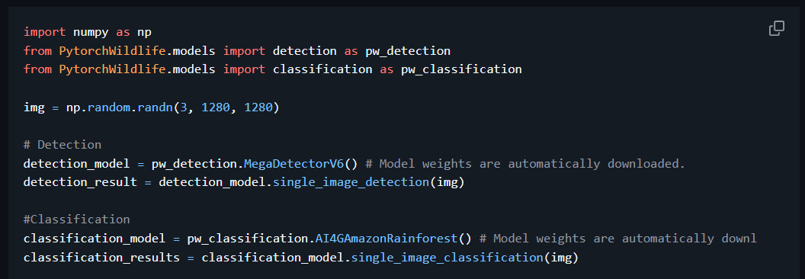
PYTORCH WILDLIFE
GitHub repository offering state-of-the-art detection and classification models for animal detection using Megadetector and the AI4GAmazonRainforest classifier
Code snippet showing the use of Pytorch Wildlife for detection and classification

Slide 3
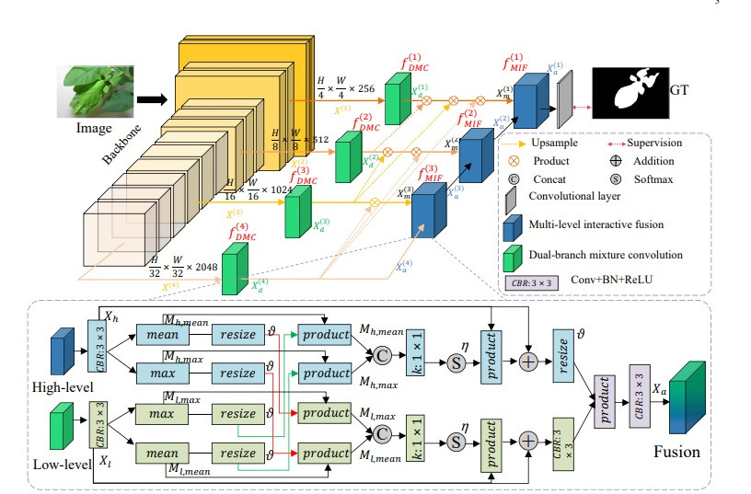
MIF-NET
STATE OF THE ART CAMOUFLAGE OBJECT DETECTION MODEL
Dual-branch mixture convolution(DMC) - increases the receptive field which helps in capturing the global context and not just the local context.
Multi-level interactive fusion(MIF) - effective attention bases feature fusion technique which is better than standard fusion techniques that simply concatenate or multiply the features.
Limitation:
This model can fail in certain scenarios where the background is too complex(contains complex patterns) or if there are multiple camouflaged objects, which could be a problem because this project's goal is to improve classification on not too ideal images.

Slide 4
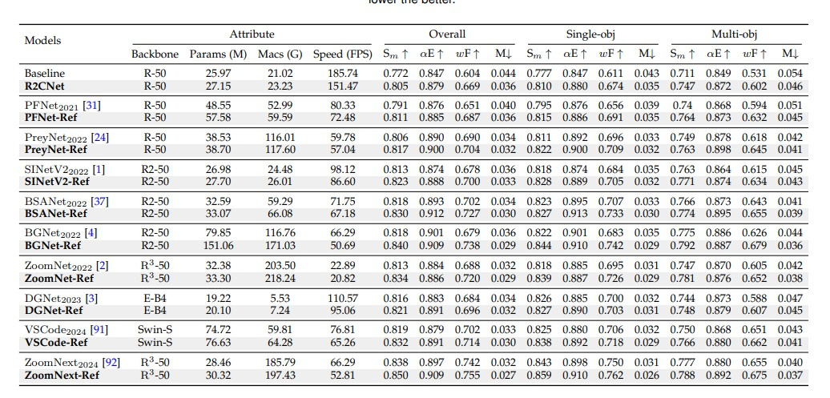
R2CNET
Another State of the Art COD Model
This model is an interesting prospect as it outputs the result in a highlighted image as a part of the original image, in contrast to most other COD models that just print a white shape of the detected object, which we are not sure if the pytorch classifier will give a good classification result from.
Dual source information fusion strategy
The main aspect of this model is the use of referring images and the referring branch, adding it to the standard COD models improves the performance significantly(as shown in the table)

Slide 5
AGLNET
Adaptive Guidance Learning for COD
Innovations:
Unified framework to integrate various auxiliary cues (boundary, texture, edge, frequency).
Additional Information Generation (AIG) module learns extra semantic features.
Hierarchical Feature Combination (HFC) module fuses multi-scale features effectively.
Recalibration Decoder (RD) refines predictions iteratively for enhanced segmentation.

Slide 6
OUR GOAL
Early Warning System for snow leopard conservation in challenging environments.
The plan is to integrate COD techniques to enhance the outputs of the Megadetector before passing them to the classifier.
Integration Strategy:
Use Microsoft CameraTraps as the baseline pipeline for data handling and initial detection.
Incorporate advanced COD techniques (MIF-NET, R2CNet, AGLNet) to refine detection and classification, especially for camouflaged animals.
Expected Benefits:
Improved accuracy in both day and night scenarios.
Enhanced capability to process complex backgrounds and low-contrast images.
A robust, scalable system for real-time monitoring and conservation efforts.

Slide 7
REFERENCES
Pytorch Wildlife and Microsoft CameraTraps Repository: https://github.com/microsoft/CameraTraps.git
MIF-NET: A Holistically Point-guided Text Framework for Weakly-Supervised Camouflaged Object Detection. Available at: https://arxiv.org/pdf/2501.06038
R2CNet: Towards Accurate Camouflaged Object Detection with Mixture Convolution and Interactive Fusion. Available at: https://arxiv.org/pdf/2101.05687
AGLNet: Adaptive Guidance Learning for Camouflaged Object Detection. https://arxiv.org/pdf/2405.02824

