Slide 1

Introduction to Shop Management System
Project By:
Ahmed Shah
Abubakar Khan
Eman Arshad

Slide 2
Objectives
Streamlined invoicing
Inventory management
Designed for small to medium-sized businesses
Centralized platform
Essential invoicing data handling
Customer data management
Efficient operations
Informed decision-making
Comprehensive solution
Business optimization

Slide 3
Key Features of the System
Invoicing
Inventory Tracking
Customer Management
Generate invoices with customizable templates, track payments, and manage outstanding balances.
Maintain real-time visibility into your stock levels and generate purchase orders with ease.
Store customer information, order history, and manage contact details to provide personalized service.

Slide 4
identifying essential features and functionalities
to streamline sales,
inventory, and customer management efficiently.
Requirements analysis
Design
Implementation
Testing
upgradation
Tables
ERD
relationships
Tables
ERD
relationships
Tables
ERD
relationships
Software MSAccess
Tables
Form
reports
Queries
Insertion data
Deletion data

Slide 5

Process
1
Create Invoice
2
Add and Remove Product
3
Shop location details
4
Shop keeper details
5
View all details
6
details

Slide 6
Inventory Management
Add Product
Add new product to the inventory .
Add the quantity of the product .

Slide 7
Shopkeeper
shopkeeper can add all customer detail.
shopkeeper can add new product in inventory.
All other required attributes can be filled by shopkeers.

Slide 8
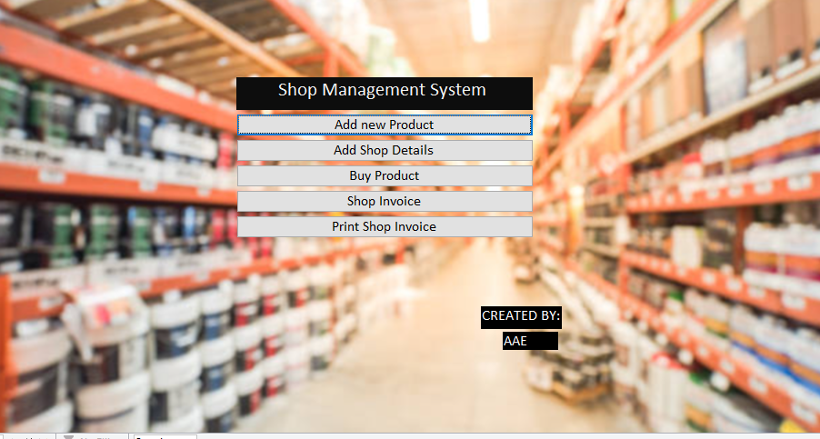
Shop Management System

Slide 9
Tables
product
ID | product name | quality | quantity | type | Size | Price
1 | pipe | Best | 5 | juliet | Large
2 | paint | Medium | 3 | diamond | Medium | $200.00
3 | paint | Best | 10 | master | Large | $4,000.00
4 | doorlock | Best | 20 | pak | Medium | $1,400.00
Main menu
ID | product | shopkeeper | Customer_Name | Buy_Date | Return_policy
1 | 2 | 1 | ali | 3/6/2024 | Yes
Shopkeeper
ID | s_Name | Shop_Name | Loc | Timing
1 | abubakkar | inventory store | kahuta
2 | ahmed | inventory store | kahuta

Slide 10
Queries Sample on Product Table
“Pipe” querie
product Query1
ID | product name | quality | quantity | type | Size | Price
1 | pipe | Best | 5 | juliet | Large

Slide 11
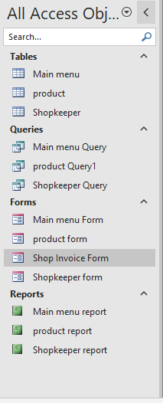
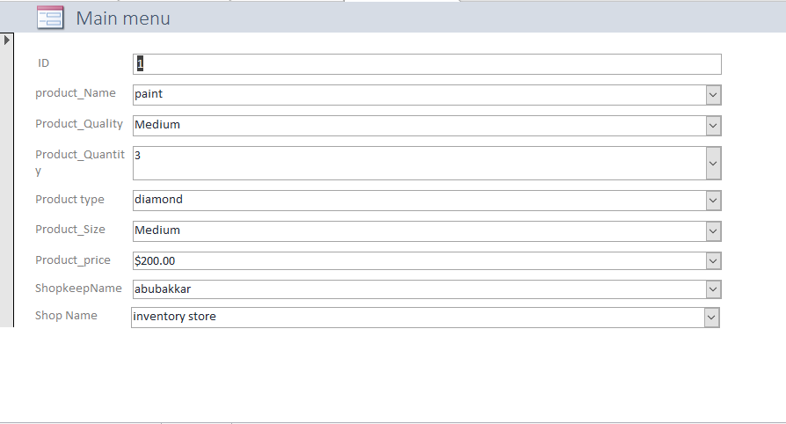
Dashboard View Main Menu View

Slide 12
Main Menu Report View
Main menu report
ID | product name | quality | quantity | type | Size | s_Name | Shop_Name | Loc | Timing | Customer_Name | Buy_Date | Return_policy | Text27 | Text28
1 | paint | Medium | 3 | diamond | Medium | abubakkar | inventory store | kahuta |  | ali | 3/6/2024 | -1 | Thursday, June 6, 2024 | Page 1 of 1

Slide 13
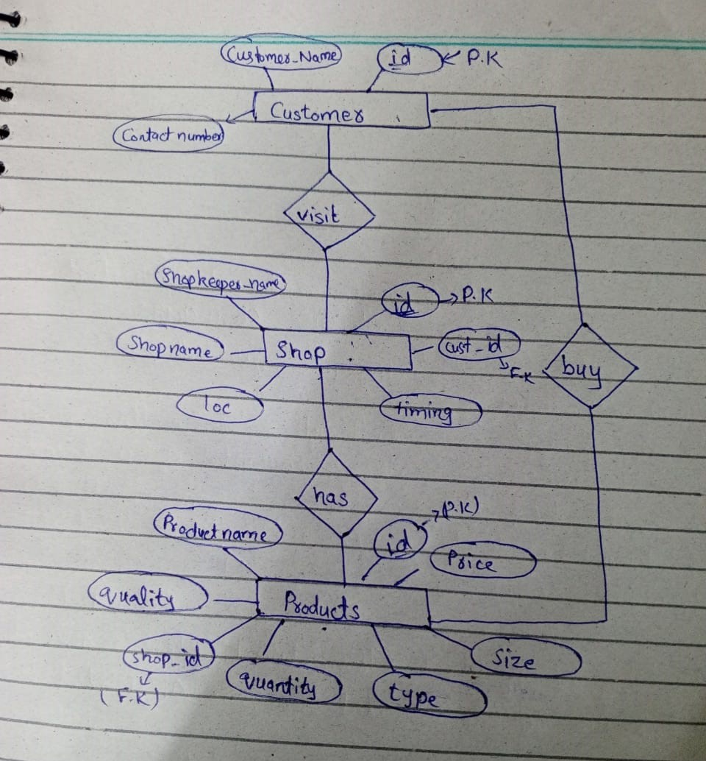
ERD

Slide 14



Conclusion and Next Steps
Streamline Operations
The Shop Invoice System simplifies invoicing, inventory management, and customer tracking, allowing you to focus on growing your business.
Gain Valuable Insights
Leverage the system's reporting and analytics to make data-driven decisions and identify new opportunities for growth.
Improve Customer Experience
Provide excellent customer service by maintaining a centralized customer database and personalizing your interactions.

Slide 15
identifying essential features and functionalities
to streamline sales,
inventory, and customer management efficiently.
Requirements
Testing
Development
upgradation
Design

Slide 16
Demonstration . . .
Questions

