Slide 1
IoT-Enabled Supply Chain Monitoring
Cold-chain risk detection · environmental visibility · supply-chain transparency
10+ analytical questions
Plotly-only notebook
Streamlit dashboard
Abubakar Umar Dangi
MSc Data Science
1

Slide 2
Project Overview
The prototype supports an analytical supply-chain story, but provenance must be transparent.
Brief requirements
Current asset
Integrity decision
Real-world, rich, varied dataset; 10+ analytical questions; Plotly-only explanatory visuals; curated interactive Streamlit dashboard; final presentation exported to PDF.
The existing dashboard is a strong Streamlit proof-of-concept: route map, threshold alerts, cumulative CO2, alert log, and detection-latency comparison.
The uploaded sensor records are labelled simulated_prototype. Final submission should add a verified real-world dataset and keep the prototype as a scenario layer.
580
4
3.86 h
100%
sensor readings
shipments
avg latency saved
runs with alerts
Final Individual Project · Data Visualization · Summer 2026
2

Slide 3
Data pipeline
A clean separation between raw prototype files, processed analysis tables, notebook, dashboard, and deck.
Raw uploads
Prepare data
Notebook
Dashboard
Presentation
shipment CSVs
batch_results.json
original dashboard
clean table
summary table
latency experiment
EDA
10 analytical questions
Plotly figures
curated tabs
filters
interactive visuals
insights
conclusions
dashboard screenshots
Processed tables created
clean_supply_chain_prototype.csv · shipment_summary_prototype.csv · batch_results.csv
Data Preparation
Add a real-world dataset such as UCI Daily Demand Forecasting Orders or a verified cold-chain sensor dataset, then connect it to the same dashboard architecture.
Final Individual Project · Data Visualization · Summer 2026
3

Slide 4
Sensor risk by shipment
Maximum temperature and unsafe exposure duration identify which shipments need attention.
Key Insight
Risk is not just whether an alert happens. The key is how intense the excursion becomes and how long the shipment stays outside its threshold.
Managerial use
Rank shipments for inspection and intervention using maximum temperature, alert duration, and emissions rather than a single alert flag.
Final Individual Project · Data Visualization · Summer 2026
4

Slide 5
Emissions visibility
The prototype links operational movement to environmental impact.
Two operational lenses belong together: climate impact and cold-chain safety. This makes the dashboard useful for both sustainability and quality control.
Final Individual Project · Data Visualization · Summer 2026
5

Slide 6
Real-time detection advantage
Across repeated runs, real-time monitoring detects threshold breaches around 3.86 hours before checkpoint inspection.
3.86 h
mean hours saved
100%
alert occurrence rate
Interpretation
Earlier visibility creates time for corrective action: rerouting, contacting the carrier, checking refrigeration equipment, or prioritizing receiving inspection.
Final Individual Project · Data Visualization · Summer 2026
6

Slide 7
Dashboard design
A curated Streamlit app, not a dump of every figure.
Executive Overview
KPIs, headline trends, summary table
Journey & Sensors
Route map, CO2 accumulation, interval emissions
Alerts & Risk
Threshold breaches by stage and shipment
Detection Speed
Real-time vs checkpoint comparison
Data Provenance
Clear disclosure and next dataset step
Primary filters: shipment ID · threshold · alert-only toggle
Final Individual Project · Data Visualization · Summer 2026
7

Slide 8
Final project package
Everything needed to continue the submission workflow has been assembled.
Ready now
Future Work
Cleaned prototype datasets, data-preparation script, executable analysis notebook, Streamlit dashboard, README, presentation deck, and zipped project package.
Add the real-world dataset, re-run the notebook, insert dashboard screenshots, deploy to Streamlit Community Cloud, then export the deck to PDF.
Notebook
Dashboard
Deck
GitHub
Streamlit
PDF submit
One dataset story · ten analytical questions · one interactive dashboard
Final Individual Project · Data Visualization · Summer 2026
8

Slide 9
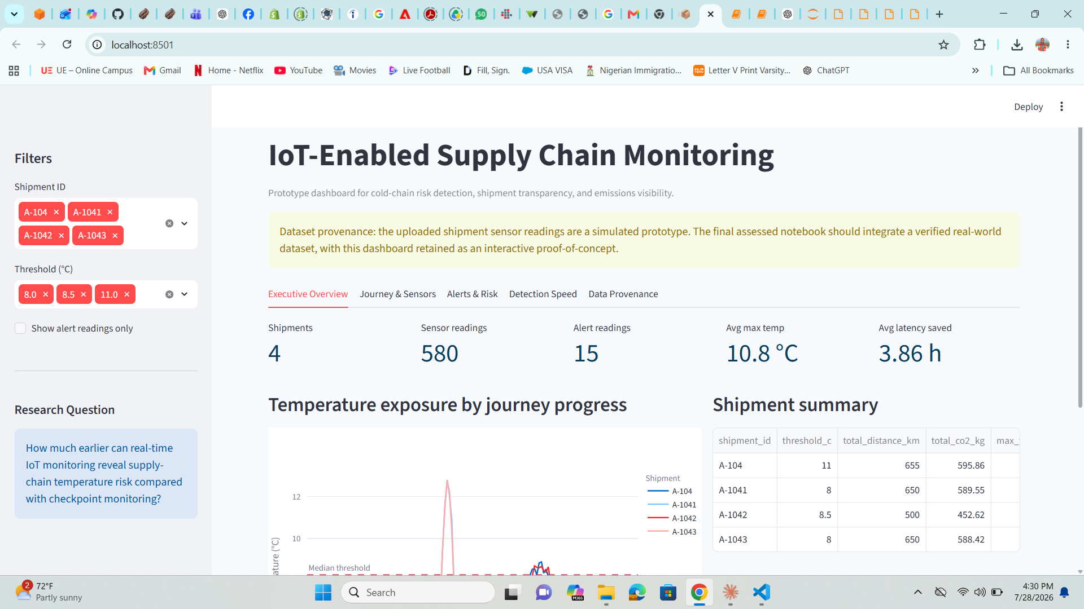
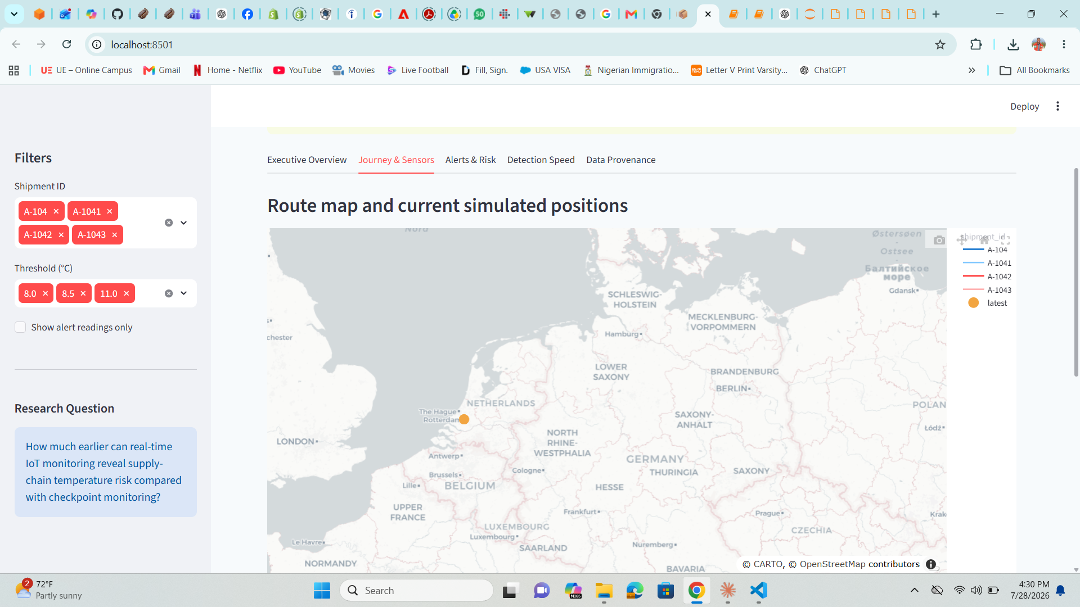
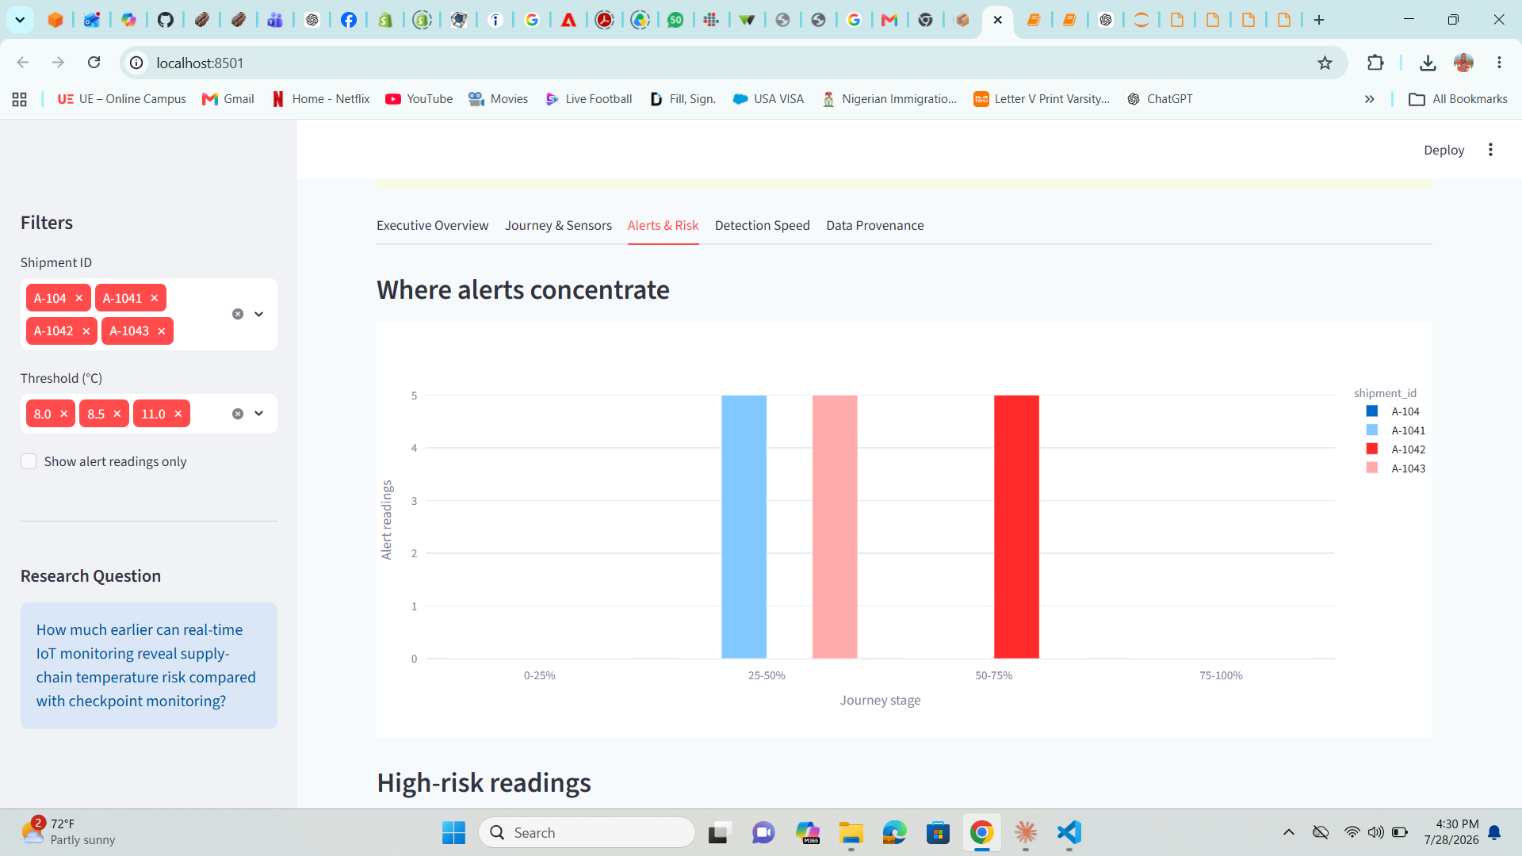
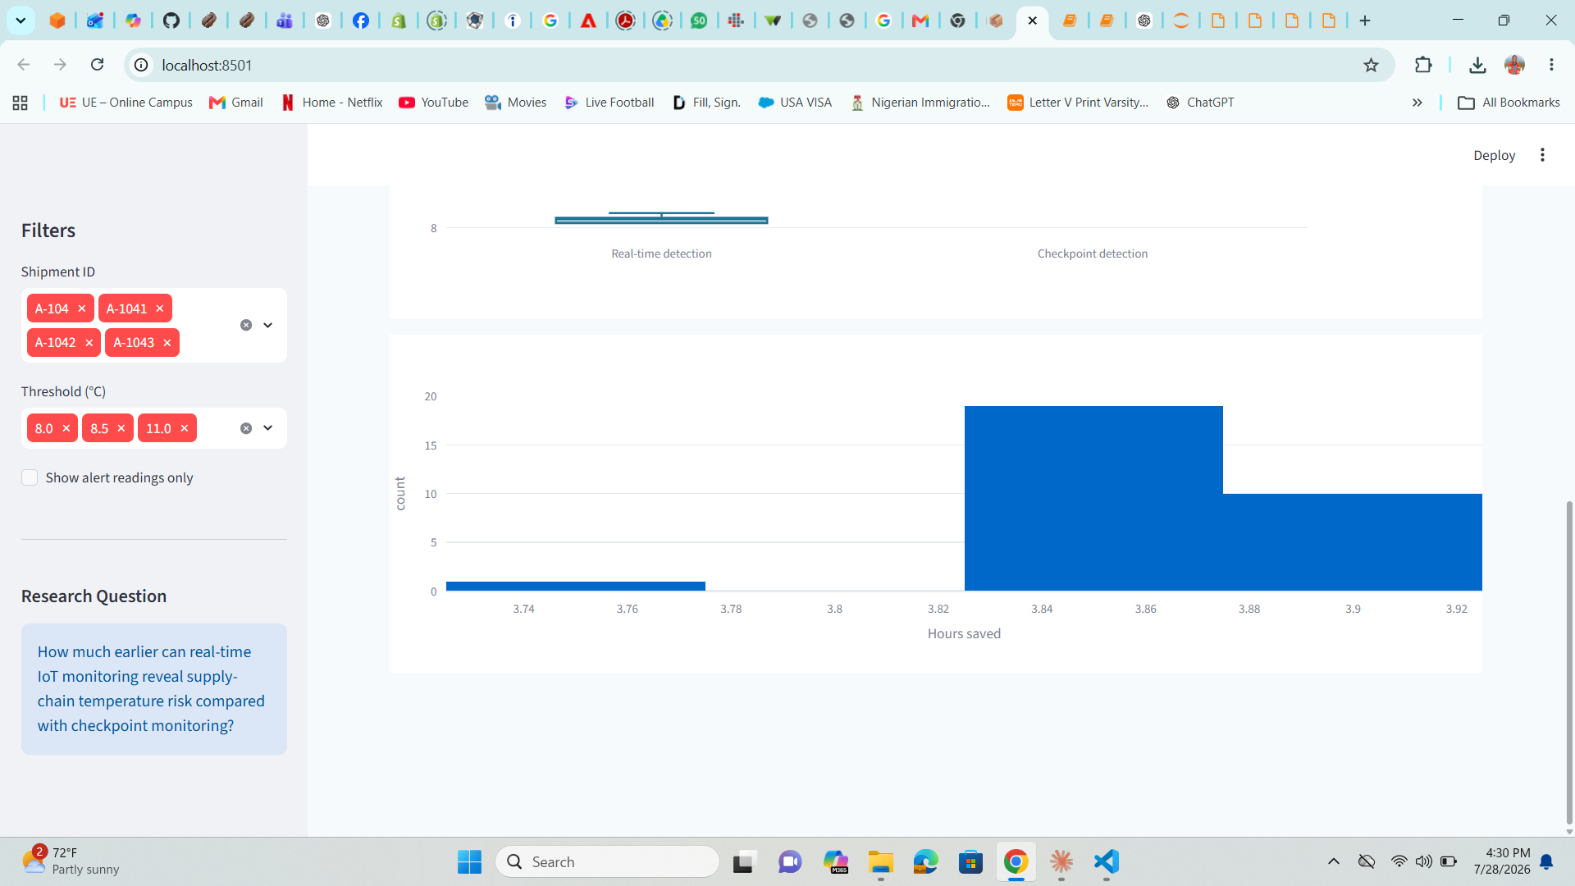
Interactive Streamlit Dashboard
Executive Overview
Journey & Sensors
Alerts & Risk
Detection Speed

