Slide 1

Amazon Fresh Analytics – SQL Project
By Abubakkar Siddiq A
Data Modeling, Queries, and Real-World Analysis
Design a relational database for Amazon Fresh to efficiently manage data, optimize operations, and enhance decision-making. The goal is to analyze customer trends, track top-performing products, and improve inventory management.

Slide 2
Entity-Relationship Diagram (ERD) Explanation
1
Customers
2
Orders
Stores customer details, linked to Orders and Reviews.
Captures purchase transactions, referencing Customers and linked to Order_Details.
3
Order_Details
4
Products
Connects Orders and Products, tracking quantities and discounts.
Contains product information, linked to Categories, Subcategories, and Suppliers.
5
Suppliers
6
Reviews
Stores supplier details, linked to Products.
Associates customer feedback with Products and Customers.

Slide 3





Primary & Foreign Keys with Relationships
customers (PK: customer_id)
Referenced in orders, reviews
orders (PK: order_id, FK: customer_id)
Referenced in order_details
order_details (PK: (order_id, product_id), FK: order_id, product_id)
products (PK: product_id, FK: sub_category, supplier_id)
Referenced in order_details, reviews
suppliers (PK: supplier_id)
Referenced in products

Slide 4
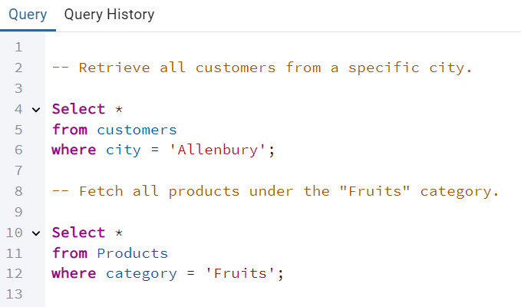
Basic Queries
Customer Query
Retrieve all customers from a specific city.
Product Query
Fetch all products under the "Fruits" category.

Slide 5




Data Definition Language (DDL)
and Constraints
Primary Key
1
NOT NULL
Ensures each row has a unique identifier
2
Requires a column to have a value
4
Unique
CHECK
3
Ensures all values in a column are different
Validates data before insertion

Slide 6




Data Manipulation Language (DML)
Insert Operations
Inserting new product rows.
Update Operations
Updating stock quantity.
Delete Operations
Deleting a supplier.

Slide 7
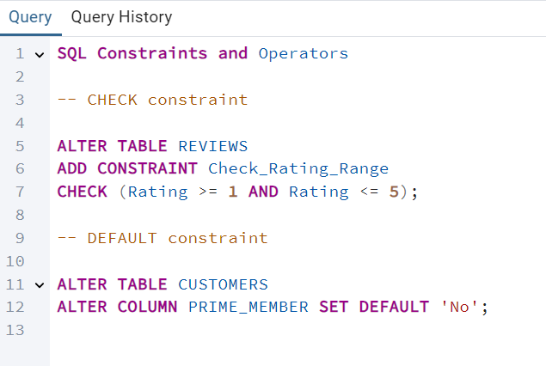
SQL Constraints and Operators
1
CHECK Constraint
2
DEFAULT Constraint
Examples: Queries ensuring ratings between 1-5 and default Prime Member status.
.

Slide 8

Clauses and Aggregations
1
WHERE Clause
Orders after 2024-01-01.
2
HAVING Clause
Products with avg rating > 4.
3
GROUP BY and ORDER BY
Ranking products by sales.

Slide 9
Identifying High-Value Customers
1
Calculation Methods
SQL queries for calculating total customer spending, ranking customers by spending, and identifying top spenders (> ₹65,000).
2
Ranking Criteria
Spending thresholds and categorization of high-value customers based on purchase history.
3
Business Applications
Using high-value customer data for targeted marketing and loyalty programs.
Rank
Customer ID
Name
Total Spending (₹)
1
82ea7efb-dd18-42cd-a4e3-9e2f4519beb5
Hannah Day
69,698
2
a3eb895d-40f9-423c-aabe-9b3826bdff3c
Ralph Evans
69,469
3
d736cf4e-bf76-4cc3-996c-8db1de150ed5
Yvette Murray
69,398
4
9a863734-e786-47b1-82c2-f976cbc54db3
Anthony Martinez
67,027
5
9dbf19e4-2148-4898-bef4-f59f65589a60
Joseph Thomas
66,310

Slide 10




Complex Joins and Aggregations
Calculate Revenue
Identify Top Customers
Analyze Suppliers
Use joins to calculate total revenue per order by combining data from multiple tables.
Join customer and order tables to identify customers with the most orders.
Use joins to find the supplier with the most stock by combining product and supplier data.

Slide 11

Normalization
1
Before Normalization (Unnormalized Table)
Contains redundant Category, Subcategory, and Supplier data.
2
Normalization Step 1
Separate Data into New Tables - Move Categories, Subcategories, and Suppliers to separate tables.
3
Normalization Step 2
Establish Relationships with Foreign Keys - Link tables via Category_ID, Subcategory_ID, and Supplier_ID.
4
After Normalization (3NF Schema)
Products: Product_ID, Product_Name, Category_ID, Subcategory_ID, Price_Per_Unit, Stock_Quantity, Supplier_ID
Categories: Category_ID, Category_Name
Subcategories: Subcategory_ID, Subcategory_Name, Category_ID
Suppliers: Supplier_ID, Supplier_Name, Contact_Info

Slide 12



Subqueries and Nested Queries
$58,823.76
$56,773.34
$54,804.91
Top Product 1
Top Product 2
Top Product 3
Product ID: bbb7b4eb-0e4b-42f6-b02e-ce03d3924454
Product ID: 8aba364b-ddfa-4752-9fb9-c4498728919a
Product ID: 1034fbb7-fdce-49e2-9230-98af72d7fa15
Customers Who Haven't Placed Any Orders Yet:
Inactive Group 2
2
Joel Shaffer, William Cummings, Jeremy Duran, Omar Taylor
Inactive Group 1
1
Melinda Mclaughlin, Hannah Meyer, Daniel Nguyen, Gloria Dominguez
Inactive Group 3
3
Sandra Martin, Erica Huber, Kimberly Mclean

Slide 13
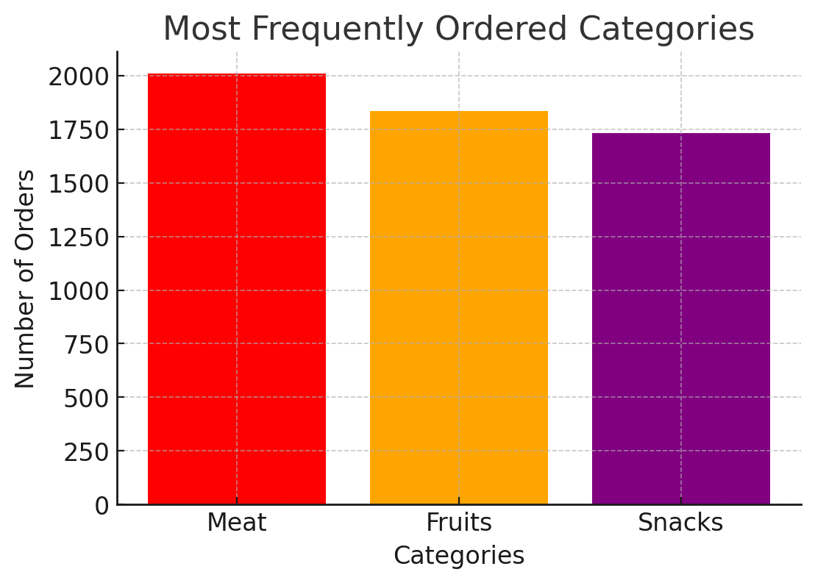
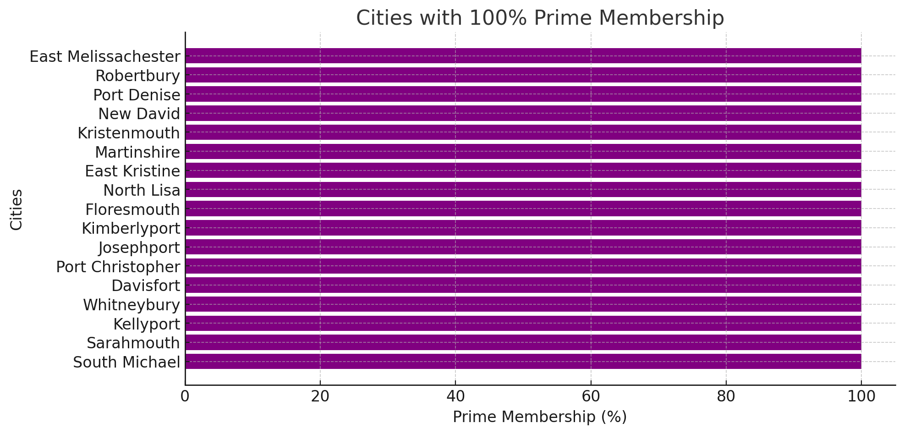
Real-World Analysis
1. Cities with the Most Prime Members (100% Prime Membership): East Melissachester, Robertbury, Port Denise, New David, Kristenmouth, Martinshire, East Kristine, North Lisa, Floresmouth, Kimberlyport, Josephport, Port Christopher, Davisfort, Whitneybury, Kellyport, Sarahmouth, South Michael
2. Most Frequently Ordered Categories: 1. Meat - 2,012 orders 2. Fruits - 1,837 orders 3. Snacks - 1,734 orders

