Slide 1
PROJECT NAME: SCHOOL ADMISSION PORTAL
Group Members:
Maaz hassan
Abdullah Akbar
Mujtaba Imtiaz
Mohammad Sarim
Ali
Course Instructor: Ms. Ramsha Khalid

Slide 2
BRIGHT FUTURE PUBLIC SCHOOL
Why Do We Need a Student Admission Portal
Streamlined Admissions
Simplify and centralize the entire admission process for both parents and administrative staff, making it more efficient and less time-consuming.
Reduced Errors & Paperwork
Minimize manual data entry, significantly reducing the chances of errors and decreasing the extensive paperwork traditionally associated with admissions.
24/7 Accessibility
Provide continuous access for families to apply, check application status, and obtain crucial information at their convenience, anytime, anywhere.

Slide 3

ABOUT BRIGHT FUTURE PUBLIC SCHOOL
At Bright Future Public School, we are deeply committed to nurturing young minds with a high standard of quality education. Our philosophy centers on creating an environment where every child can thrive.
We focus on fostering creativity, ensuring student safety, and promoting holistic development, preparing students not just academically, but as well-rounded individuals ready for the future.
Serving our community with unwavering transparency and embracing innovative approaches, we strive to make the admission process reflective of our core values.

Slide 4

Online Application
Parents complete a structured 5-step application form covering student information, academic history, and family background. Supports bulk document uploads (transcripts, birth certificates, immunization records) with real-time file validation and automatic organization.
Automated Eligibility
System instantly verifies age requirements, residency status, and document completeness against school criteria. Applicants receive SMS and email notifications at each stage: submission confirmation, eligibility verification, interview scheduling, and final decision.
DATA PROTECTION
All data encrypted with AES-256 encryption and stored on FERPA-compliant servers. Role-based access controls ensure only authorized staff view sensitive information. Automatic audit logs track all data access and modifications
Secure Data Management
All data encrypted with AES-256 encryption and stored on FERPA-compliant servers. Role-based access controls ensure only authorized staff view sensitive information. Automatic audit logs track all data access and modifications for compliance reporting.

Slide 5

USER EXPERIENCE:PARENTS & STAFF
For Parents
Our intuitive portal allows parents to :
Apply for admission at their convenience, 24/7.
Track the real-time progress of their child's application.
Receive automated updates and notifications regarding status change.
For Staff
The staff dashboard provides comprehensive tools for:
Efficient review and management of all applications.
Seamless communication with applicants and internal teams.
Informed decision-making with organized student profiles.

Slide 6

Technology Behind the Portal
User-Friendly Design
Developed with an intuitive interface for ease of use, ensuring seamless navigation on both desktop and mobile devices.
Robust & Secure Backend
Powered by a strong infrastructure that guarantees data security, privacy, and fast processing of all information.
Scalable Performance
Engineered to scale efficiently, the portal can handle high traffic volumes and peak admission periods without performance issues.

Slide 7



Benefits to Bright Future Public School
Faster Cycles
Significant reduction in admission processing time and administrative workload.
Improved Accuracy
Enhanced precision and transparency throughout the entire admissions process.
Enhanced Reputation
Boosted parent satisfaction and strengthened the school's reputation as a modern, efficient institution.

Slide 8
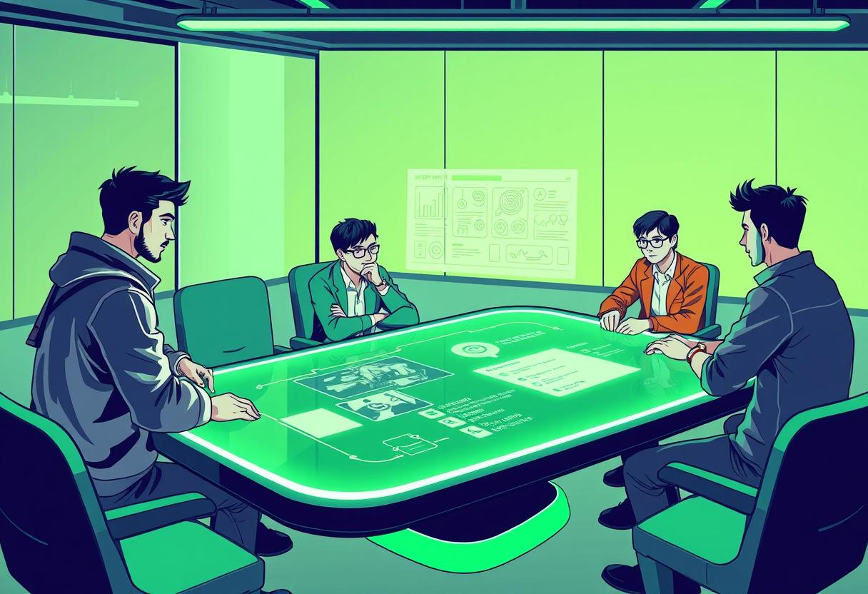

Implementation Plan & Timeline
Month 1: Requirement Gathering & Design
Defining features, user flows, and system architecture
Months 2-3: Development & Testing
Building the portal and conducting rigorous testing for functionality and security.
Month 4: Launch & Training
Official rollout of the portal and training for staff and parents.

Slide 9
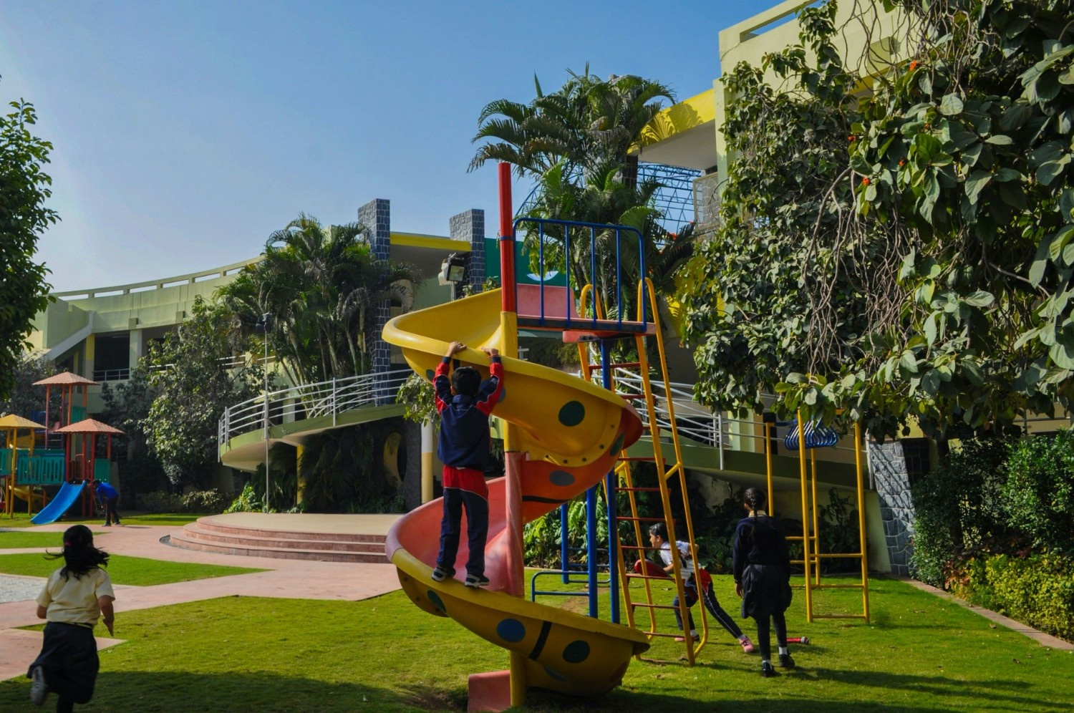

Cocurricular activities
Bright Future Public School provides playground facilities to encourage games, physical activity, and student motivation.
The library at Bright Future Public School promotes knowledge, curiosity, and independent learning through a wide range of books and study resources.

Slide 10

Success Metrics & Future Enhancements
Key Metrics
Our primary goal is to achieve significant adoption and efficiency:
Target: 90% of all admissions processed online within the first year of operation.
High user satisfaction ratings from both parents and staff.
Demonstrable reduction in administrative time spent on admissions.
Improved data accuracy and completeness, with fewer errors in student records due to standardized online forms and validation checks.
Future Growth
Continuous improvement and expansion are central to our vision:
Implement a feedback system for ongoing enhancements and user-driven improvements.
Integrate online fee payment modules for a fully seamless financial process.
Develop comprehensive student onboarding modules to welcome new students effectively.

