Slide 1
QuickSort
By Abdelrahman Ahmed Ibrahim
ID:222659

Slide 2
The Problem
The problem is having an unsorted array of elements that needs to be sorted

Slide 3
Strategy
The strategy used is Divide and Conquer which works by dividing the array into 2 sub arrays and then solving the problem

Slide 4
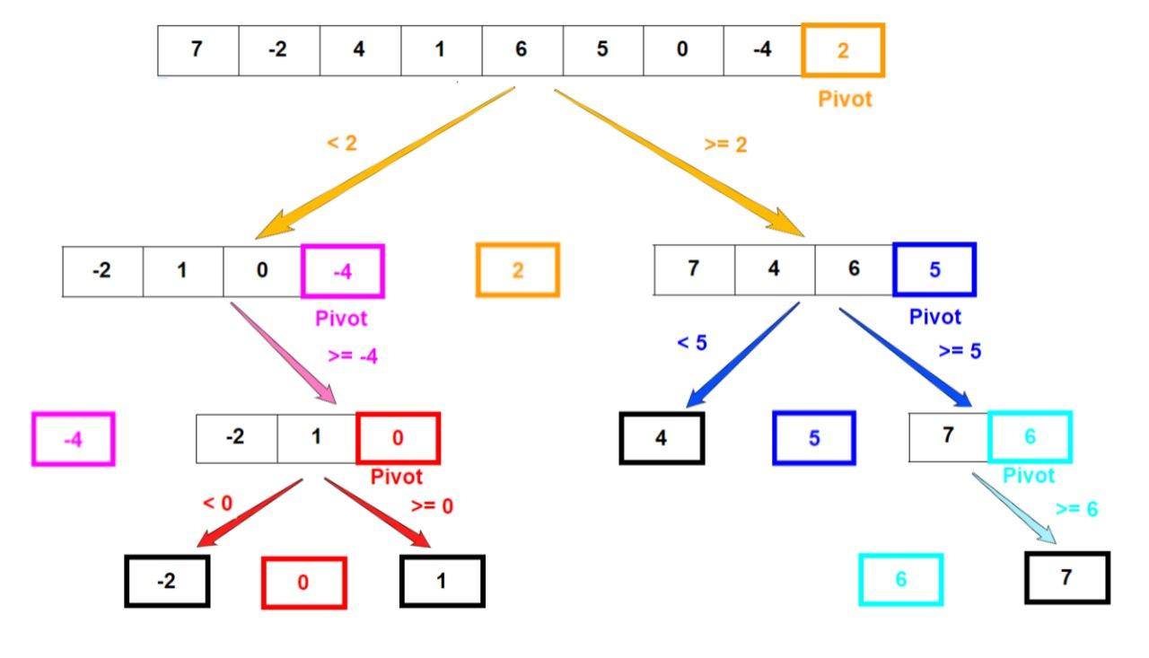
The Algorithm

Slide 5
The code
def partition(array, low, high):
pivot = array[high]
split_index = low
for i in range(low, high):
if array[i] <= pivot:
array[i], array[split_index] = array[split_index], array[i]
split_index += 1
array[split_index], array[high] = array[high], array[split_index]
return split_index
def quicksort(array, low, high):
if low < high:
split_position = partition(array, low, high)
quicksort(array, low, split_position - 1)
quicksort(array, split_position + 1, high)

Slide 6

Analysis-Best Case
t(n)=2t(n/2)+n a=2 ,b=2 ,f(n)=n
$n^{\log_{b}{a}}=n^{\log_{2}{2}}=n$
Since f(n)=g(n)
Then Ω€(nlogn)

Slide 7

Analysis-Worst Case
T(n)=t(n-1)+n
=t(n-2)+(n-1)+n
=t(n-3)+(n-2)+(n-1)+n
=t(n-k)+kn
After solving =(n(n+1))/2
Then O€${(n}^{2})$

