Slide 1


LAHORE · CAFÉ VERTICAL · AI SITE SELECTION
GeoSpatial Site Selection
for Cafés in Lahore
An AI-powered, explainable engine that ranks every neighborhood in Lahore for new café viability — fusing OpenStreetMap, population, and real-estate signals on a hexagonal spatial grid.
Prepared for: Project Presentation (ML)
Prepared by: Abuhurairah Faheem & Muhammad Ammar · ITU Lahore
· ML Spring 2026 (Semester Project)

Slide 2




THE PROBLEM
Picking a café location in Lahore is still a guess
Site selection today relies on gut feeling, word-of-mouth, and whichever commercial plot happens to be available — not on data.
Reframing the question
No negative examples exist
We only ever see where cafés succeeded. Failed locations are simply removed from the map — there is no labelled "bad site" dataset to learn from.
Not: “Is this hex a café or not?”
Instead: “Given only confirmed successes, how likely is every other hex in the city to support one — and is that land actually buildable?”
Success looks circular
Cafés cluster near other cafés. A naive model just learns "recommend where cafés already are," which finds nothing new.
This is a Positive-Unlabeled (PU) Learning problem, not standard binary classification.
Land is not always buildable
A statistically perfect hex may sit on a river bank, a graveyard, or restricted land — invisible to a model that only sees foot-traffic data.
...and the right answer must also respect physical and legal land constraints — not just statistics.
GeoSpatial Site Selection — Café Vertical, Lahore
2 / 10

Slide 3






THE IDEA
One pipeline: raw city data to an explainable shortlist
Five connected stages turn ten messy public datasets into a defensible, auditable recommendation — with every output traceable back to the data that produced it.
01
02
03
04
05
Collect
→
Grid + Features
→
Learn
→
Mask
→
Explain
OpenStreetMap, Kontur population, road network, real-estate rent
Hexagonal H3 spatial index, 8 engineered signals per hex
PU-learning XGBoost vs. logistic regression baseline
GIS veto of rivers, graveyards, restricted land
SHAP attributions + interactive map for stakeholders
Same pipeline generalizes beyond cafés and beyond Lahore — only the ground-truth POI layer and bounding box need to change.
GeoSpatial Site Selection — Café Vertical, Lahore
3 / 10

Slide 4









DATA CREATION — SOURCES
Ten datasets, one city: building ground truth from scratch
Cafés & Restaurants
Population
Commercial Zones
Road Network
Ground-truth positive class — confirmed venues
Kontur H3-gridded population, ~400m cells
OSM landuse=commercial nodes/ways/relations
Weighted by class: primary, secondary, residential…
275 venues
Kontur PK
OSM Overpass
Graph + nodes
Education
Parking
Luxury & Lifestyle
Rent / Real Estate
Universities & colleges — student foot-traffic proxy
Parking facility locations citywide
Malls, gyms, salons, cinemas — 22 weighted layers
Zameen & Graana listings — cost & wealth proxy
OSM
OSM
OSM, 2 passes
Cleaned listings
Resilient collection: multi-mirror Overpass fallback, JSON response caching, polite-geocoding with jittered delays and automatic HTTP-429 cooldown — every collector logs to a rotating audit trail.
GeoSpatial Site Selection — Café Vertical, Lahore
4 / 10

Slide 5
METHODOLOGY — SPATIAL INDEX
Why hexagons: a fair, uniform unit of analysis for the city
Lahore has no natural analytical grid — raw coordinates can't be compared, and administrative boundaries are too coarse and irregular for spatial ML.
8 Engineered Features per Hex
Equidistant neighbors — Every hex has 6 neighbors at equal distance — square grids have 4 near + 4 diagonal neighbors at different distances, biasing density math.
population_in_hex
Kontur population summed per hex
avg_rent_in_hex
Mean rent/sqft, KD-Tree NN imputed
dist_to_nearest_road
Haversine-correct distance (metres)
Global, reproducible index — Uber's H3 system gives every cell a fixed string ID (e.g. 89424d07207ffff) — stable across re-runs and resolutions.
commercial_density_1km
Commercial POIs within 1km
education_density_1km
Universities/colleges within 1km
Resolution 9 chosen — ~174m edge length, ~0.105 km² per hex — fine enough to separate “this side of the road,” coarse enough to keep ~3,700 hexes citywide.
parking_density_1km
Parking facilities within 1km
lifestyle_density_1km
Wellness/fitness/social POIs within 1km
luxury_density_1km
Malls, hotels, salons within 1km
Data-driven grid: only hexes containing real data points are kept — 3,691 active hexes, not an empty citywide tiling.
Target label: is_hotspot = 1 if a real café falls in that hex, else 0 (the “unlabelled” class)
GeoSpatial Site Selection — Café Vertical, Lahore
5 / 10

Slide 6
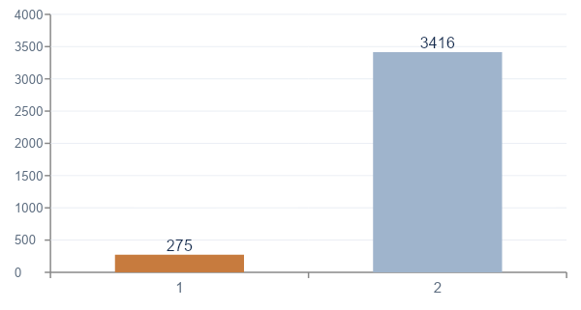
DATA STATISTICS
What the feature matrix actually looks like
3,691
275
3,416
12.4 : 1
Active H3 hexes
(resolution 9)
Confirmed café
locations (positives)
Unlabelled hexes
(not all are “bad”)
Unlabelled-to-positive
class ratio
Label Distribution (PU Framing)
Feature Ranges (citywide)
Feature | Mean | Max
Population / hex | 2,329 | 27,032
Avg rent (PKR/sqft) | 46,084 | 301,219
Dist. to road (m) | 367 | 4,436
Commercial density (1km) | 0.74 | 19
Education density (1km) | 0.86 | 16
Parking density (1km) | 1.20 | 21
Lifestyle density (1km) | 2.80 | 48
Luxury density (1km) | 7.41 | 106
GeoSpatial Site Selection — Café Vertical, Lahore
6 / 10

Slide 7

METHODOLOGY — MODELING
PU Learning: Spy + Weighted Bagging with XGBoost
Two models are trained side-by-side so every claim is benchmarked, never asserted on faith.
Baseline
Proposed: XGBoost — PU Spy + Weighted Bagging
Logistic Regression
STEP A — Spy Identification
STEP B — Weighted Bagging
Treats every unlabelled hex as a confirmed negative (the naive assumption). Uses class_weight=‘balanced’ as the only concession to the 12.4:1 imbalance — the “what if we ignored PU structure” control.
15% of confirmed positives are secretly relabelled as 0 (“spies”) and mixed into the unlabelled pool. A quick XGBoost pass finds the lowest score any spy receives — that becomes the confidence threshold.
Unlabelled hexes scoring below the threshold become Reliable Negatives. 100 balanced mini-models are trained (positives + sampled reliable negatives); final score = mean across all bags.
→
5-fold Stratified Cross-Validation
PR-AUC (Average Precision) as the headline metric
Core hyperparameters
n_estimators=200 · max_depth=5 · learning_rate=0.05
subsample=0.8 · colsample_bytree=0.8 · 100 bags · spy_ratio=0.15
Why PR-AUC, not ROC-AUC: with positives this rare, ROC-AUC is inflated by trivial true-negative recall.
Same evaluation discipline as the baseline: 5-fold Stratified CV — the full spy+bagging procedure re-runs inside every fold, so the reported score reflects real generalisation, not in-bag fit.
GeoSpatial Site Selection — Café Vertical, Lahore
7 / 10

Slide 8
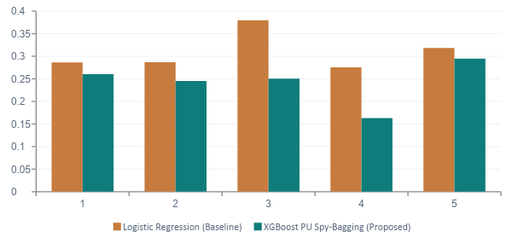
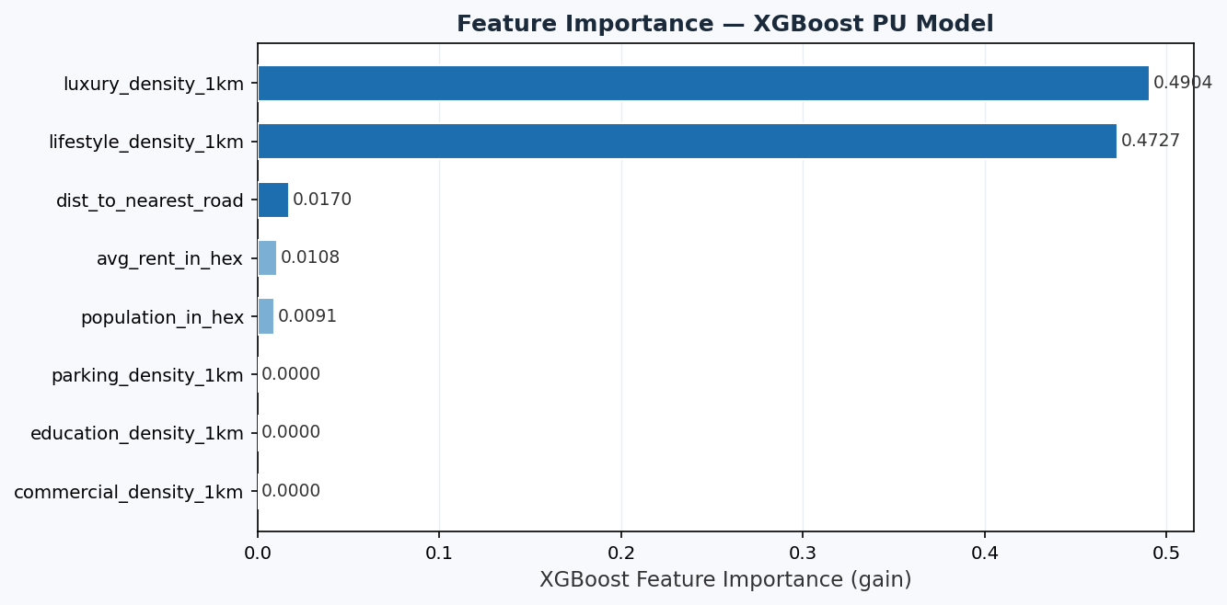
TRAINING RESULTS
Model comparison: an honest benchmark, not a foregone win
PR-AUC by Fold (5-fold CV, seed = 143)
Feature Importance — XGBoost PU Model (gain)
0.3093 ± 0.0380
0.2428 ± 0.0434
Logistic Regression — mean PR-AUC
XGBoost PU Spy-Bagging — mean PR-AUC
Key takeaway: luxury_density_1km and lifestyle_density_1km dominate (gain ≈0.49 / 0.47) — café success in Lahore tracks lifestyle/luxury commercial clustering far more than raw population or road proximity.
Honest finding: the simple baseline currently leads by 0.0665 PR-AUC (−21.5%) — with only 275 positives, the spy threshold is estimated from a small sample.
GeoSpatial Site Selection — Café Vertical, Lahore
8 / 10

Slide 9


OUTPUTS & DELIVERABLES
From model scores to a defensible, GIS-checked shortlist
predictions.csv
masked_predictions.csv
lahore_site_map.html
Every hex scored by both models, ranked by XGBoost probability
→
Top-200 hexes vetted against rivers, graveyards & restricted zones (UTM-accurate overlap, 10% veto threshold)
→
Self-contained interactive Folium map — ground truth, top-50 recommendations, SHAP popups, choropleth heatmap
Interactive Map — Three Toggleable Layers
Explainability, not a black box
Ground Truth Cafés 275 confirmed venues, for visual sanity-check
Every top-50 recommendation ships with a per-feature SHAP attribution — exactly which signals (and by how much) pushed that hex's score up or down. This is the difference between a ranked list and a decision a business owner can actually act on.
AI Recommendations (Top 50) Approved hexes, colour-ramped yellow→red by probability, click for SHAP breakdown
Choropleth Heatmap City-wide background context for every approved hex
Top-ranked approved hex: xgb_hotspot_probability ≈ 0.996, zero unbuildable-zone overlap.
GeoSpatial Site Selection — Café Vertical, Lahore
9 / 10

Slide 10







ROADMAP
From research pipeline to a real product
Harden the data foundation
Improve the PU model
Ship a scoring API
Pin dependencies, replace placeholder unbuildable-zones with verified zoning data, add CRS/projection unit tests.
Sweep spy-ratio & reliable-negative thresholds; explore label-volume growth before trusting bagging over the baseline.
Wrap the feature-matrix + model behind a lightweight “score this address” endpoint for on-demand queries.
Generalize the vertical
Expand beyond Lahore
Client-facing front end
Make the ground-truth POI layer configurable — gyms, pharmacies, salons — beyond cafés.
Parameterize the bounding box and amenity weights to onboard new cities with minimal rework.
Turn the static HTML map into a hosted dashboard: saved searches, comparisons, exportable site reports.
Thank you — questions and discussion welcome.
github.com/AbuhurairahFaheem/GeoSpatial-Site-Selection-for-Cafe-in-Lahore

