Slide 1
Placement of Relationship Attributes
The cardinality ratio of a relationship can affect the placement of relationship attributes.

Slide 2
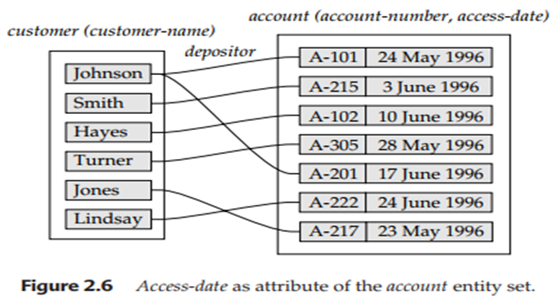
attributes of one-to-one or one-to-many relationship sets can be associated with one of the participating entity sets, rather than with the relationship set.
For instance, let us specify that depositor is a one-to-many relationship set such that one customer may have several accounts, but each account is held by only one customer.

Slide 3
In this case, the attribute access-date, which specifies when the customer last accessed that account, could be associated with the account entity set, as Figure 2.6 depicts; to keep the figure simple, only some of the attributes of the two entity sets are shown.

Slide 4
The design decision of where to place descriptive attributes in such cases—as a relationship or entity attribute—should reflect the characteristics of the enterprise being modeled.
The designer may choose to retain access-date as an attribute of depositor to express explicitly that an access occurs at the point of interaction between the customer and account entity sets.

Slide 5
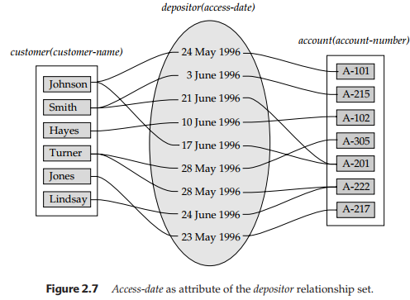
The choice of attribute placement is more clear-cut for many-to-many relationship sets.
Returning to our example, let us specify the perhaps more realistic case that depositor is a many-to-many relationship set expressing that a customer may have one or more accounts, and that an account can be held by one or more customers. If we are to express the date on which a specific customer last accessed a specific account, access-date must be an attribute of the depositor relationship set, rather than either one of the participating entities.

Slide 6
The choice of attribute placement is more clear-cut for many-to-many relationship sets. Returning to our example, let us specify the perhaps more realistic case that depositor is a many-to-many relationship set expressing that a customer may have one or more accounts, and that an account can be held by one or more customers. If we are to express the date on which a specific customer last accessed a specific account, access-date must be an attribute of the depositor relationship set, rather than either one of the participating entities. If access-date were an attribute of account, for instance, we could not determine which customer made the most recent access to a joint account. When an attribute is determined by the combination of participating entity sets, rather than by either entity separately, that attribute must be associated with the many-to-many relationship set. Figure 2.7 depicts the placement of accessdate as a relationship attribute; again, to keep the figure simple, only some of the attributes of the two entity sets are shown.

