Slide 1


Habifarm
Agricultural Equipment Sharing Platform

Slide 2




A groundbreaking solution designed to revolutionize the way modern farmers access and utilize agricultural equipment.
“ Solution to the Farmers struggle with the high capital costs of agricultural equipment that is often underutilized. ”

Slide 3

The Habifarm Top Features
Small farm owners will need our platform the most!
Equipment Listing and Renting
Rating and reviews
Search for type & availability
Insurance Coverage
“ The world’s smallholder farmers produce around a third of the world’s food ”
-UN
Booking, and scheduling
Digital Contract

Slide 4



Lists their equipment type and model on the app
Can look for the nearest equipment
I would like to Lend
VS
I would like to Rent
Chooses from 7 or more categories of equipment
Sets the costs per day
Sets the agreement
Renter is able to schedule a date

Slide 5

Equipment Categories:
Harvesting Equipment
Planting Equipment
Crop Protection Equipment
Tillage Equipment
Tractors

Slide 6
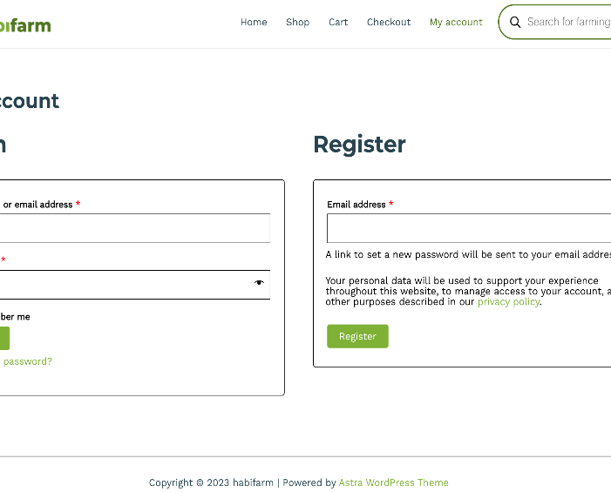
Check out our website:
acrobatic-peace.localsite.io
Step 1
Username: Habibi
Step 2
Password: ilovecorn
Step 3
Enjoy our website!

Slide 7


Team “Habibit “
1
John Akujobi – South Dakota State University Student
2
Patrick Kamba – South Dakota State University Student
3
Abul Hasan Shaik – South Dakota State University Student
4
Munkhjin Chuluunkhuu – South Dakota State University Student

