Slide 1
Well Come
To
The Party

Slide 2
5 Places where I visited
Karachi
Sialkot
Islamabad
Lahore
Narowal

Slide 3
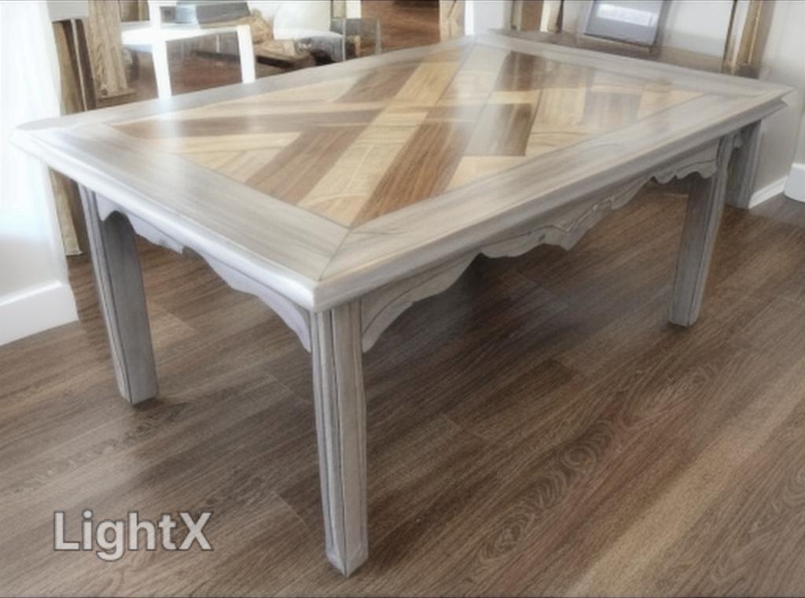
Karachi

Slide 4
Narowal

Slide 5
Sialkot

Slide 6
Islamabad

Slide 7
Lahore

Slide 8
Thanks You

