Slide 1
Memory Persistency
Steven Pelley, Peter M. Chen, Thomas F. Wenisch

Slide 2
Nonvolatile memory (NVRAM)
Low latency random access, durable
Storage technology | Random read latency | Durable?
Disk | 10ms | ✓
Flash | 90µs | ✓
DRAM | 100ns | ✗
NVRAM | 50-1000ns [IBM] | ✓
NVRAM enables persistent main memory

Slide 3
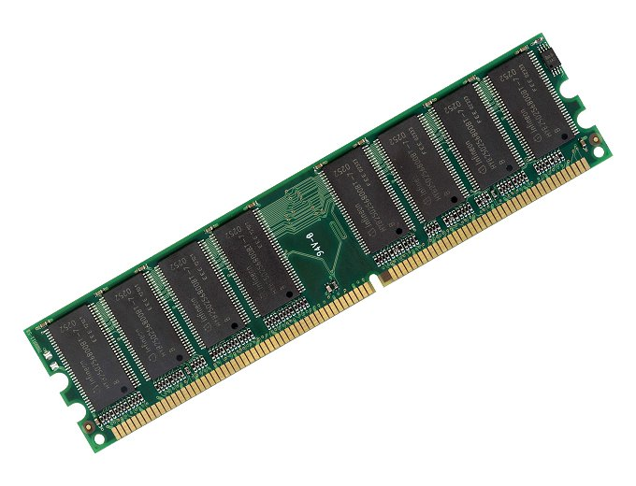
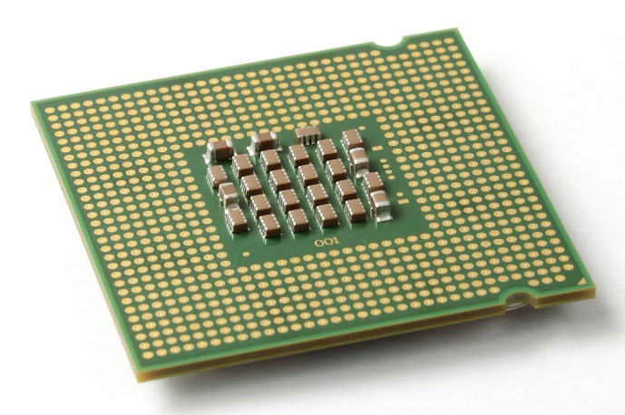
NVRAM recovery
Writes unordered!
writes
Must constrain write order for recovery
Cache eviction reorders writes to memory
Enforcing program order writes incurs 30x slowdown over instruction execution rate.
Must constrain writes for correctness, but reorder for performance

Slide 4
Memory order
Writes to memory reorder
?
✓
But loads/stores between processors and cores ordered: memory consistency
Use memory consistency to reason about NVRAM write order

Slide 5
Memory persistency
Build on memory consistency, providing models to constrain NVRAM write order
Relax persistency to improve write concurrency, increasing throughput
This project: focus on models (interface), rather than implementations

Slide 6
Outline
Define Memory Persistency
Memory persistency models
Evaluation

Slide 7
Define Memory Persistency
Memory consistency:
Constrain order of loads and Stores Between processors
Memory persistency:
Imagine failure as recovery observer
Atomically loads all of memory
If two stores are ordered, then the associated persists also ordered

Slide 8
Memory Persistency Design Space
Persistency
strict
relaxed
Sequential consistency (SC), persistent state must match volatile state
SC, but persistent state de-coupled from volatile states. Persists may reorder
Consistency
Relaxed consistency, persistent state still matches some volatile state
Loads, stores, and persists may all reorder. Complex, but minimizes delays for both persists and concurrency control
Persist order determined by consistency model
Persist order determined by new persist barriers

Slide 9
Outline
Define Memory Persistency
Persistency models
Evaluation

Slide 10
Persistent Queue
Useful as log/journal in file systems and db
Features:
Serialize inserts
Recovered queue disallows or detects holes
Goal: maximize volatile performance (instruction execution rate) and improve persist concurrency for inserts
Implementation: based on circular buffer
Data segment, head marks next location to insert

Slide 11
Queue Designs
Copy-while-locked (CWL)
Single lock protects insert operation
Two-Lock Concurrent
Different locks to reserve and update head
Lesson: thread concurrency creates persist concurrency even for strict persistency
Queue-holes [IBM]
Detect holes. Single lock but concurrent copies
Focus on CWL (see dissertation for others)

Slide 12
Copy-While-Locked Queue
Insert(entry, length):
lock(queue_lock)
data[head] = length
data[head+sizeof(length)] = entry
head += length + sizeof(length)
unlock(queue_lock)
Persist Ordering Constraints
Data
Head
Persistency model must enforce persist orderings

Slide 13
Persistency assumptions and goals
Assume all persists occur in-place (no logging)
Assume persist buffering
Thread state proceeds ahead of persists
But persists still occur in proper order
Persist order critical path limits performance
Assume persist coalescing
Persists to the same address may coalesce (persist only last value) if no ordering constraints violated
Goal: create models to minimize critical path

Slide 14
New persistency models
All models use SC as consistency model
Easier to reason about (removes relaxed consistency/relaxed persistency weirdness)
Easier to evaluate (memory tracing observes SC)
Successively relax persistency to improve persist concurrency/reduce critical path

Slide 15
Model 1: strict persistency
Any volatile memory state that might be observed by the recovery observer processor under SC is an allowable persistent state
Equivalent: two stores guaranteed to be ordered w.r.t. recovery observer implies ordered persists
Persist sync allows ordering persists with visible side effects (syscall)

Slide 16
Strict persistency queue
Persist order determined by program order
No code annotation necessary!
Insert(entry, length):
lock(queue_lock)
data[head] = length
data[head+sizeof(length)] = entry
head += length + sizeof(length)
unlock(queue_lock)
Large entries persist in program order
Lock serializes persists between threads

Slide 17
Strict persistency dependences
Data
Thread 1
Head
Data
Thread 2
Head
Minimal dependences shown. Persists to head likely to coalesce

Slide 18
Strict persistency dependences
Data
Thread 1
Head
Data
Thread 2
Head
Guarantees correct recovery, but over-constraints persists

Slide 19
Strict persistency implementations
Delay execution at each persist
Serialize persists when reserving memory bus
Queue persists from each thread, detecting access races (including synchronization races) that introduce order across threads
Combine HTM and hardware durable transactions
Persistent bulkSC?

Slide 20
Model 2: epoch persistency
Motivation: persisting large objects with SC introduces program-order constraints
Instead, use persist barrier to divide execution into persist epochs
Persists within each epoch are concurrent
Data sharing continues to observer SC
Determining persist order between threads can get tricky

Slide 21
Persist epoch races (PER)
Under what circumstances are persists between threads ordered?
Persist epoch race: 2+ threads contain epochs that race (including sync. races) and at least one epoch persists
Thread 1
Persist A
Persist B
Barrier
Thread 2
Read A
Persist B’
Barrier
Can B’ persist before A?
Can B’ persist before B?
Epochs aren’t serializable!

Slide 22
Epoch persistency queue, 1st attempt
Insert(entry, length):
barrier()
lock(queue_lock)
barrier()
data[head] = length
data[head+sizeof(length)] = entry
barrier()
head += length + sizeof(length)
barrier()
unlock(queue_lock)
barrier()
Surround lock/unlock with barriers to prevent persist epoch races. Serializes inserts
Barrier ensures head does
not persist before data, but data persists concurrently

Slide 23
Race-free epoch persistency dependences
Data
Thread 1
Head
Data
Thread 2
Head

Slide 24
Race-free epoch persistency dependences
Data
Thread 1
Head
Data
Thread 2
Head

Slide 25
Race-free epoch persistency dependences
Data
Thread 1
Head
Data
Thread 2
Head
Entries persist in parallel, but inserts still serialized

Slide 26
Epoch persistency ordering with PER
Persist A ordered before persist B if:
Race (sync or data) in epoch after A and in epoch prior to B (same rule as in absence of PER)
Or A and B are to the same address (even if epochs race)
Otherwise concurrent

Slide 27
PER persist ordering
Persist⇨Load
Load⇨Persist
Thread 1: A | B C
Thread 2: load C D | E
A before E (race and barriers)
Not C before E
Thread 1: A | B load C
Thread 2: C D | E
A before E (race and barriers)
Persist⇨Persist
C is volatile
Thread 1: A | B C
Thread 2: C’ D | E
A before E (race and barriers)
C before C’ (cache coherence)
A before C’ (transitivity)
C before E (transitivity)
Thread 1: A | B C
Thread 2: C D | E
A before E (race and barriers)
PER orders persists outside of racing epochs, except for cache coherence

Slide 28
Epoch persistency queue, 2nd attempt
Insert(entry, length):
barrier()
lock(queue_lock)
barrier()
data[head] = length
data[head+sizeof(length)] = entry
barrier()
head += length + sizeof(length)
barrier()
unlock(queue_lock)
barrier()
Allow persist epoch races
head persists ordered by cache coherence

Slide 29
Epoch persistency dependences
Data
Thread 1
Head
Data
Thread 2
Head

Slide 30
Epoch persistency dependences
Data
Thread 1
Head
Data
Thread 2
Head

Slide 31
Epoch persistency dependences
Data
Thread 1
Head
Data
Thread 2
Head
Entries on different threads persist in parallel

Slide 32
Epoch persistency implementation
Similar to BPFS (see paper/dissertation)
Queue persists from each thread, record persist barriers, only enforce order at barriers
Persistent BulkSC (transactions)
Use persist barrier knowledge to optimize persistent transactions and intelligently place transaction boundaries

Slide 33
Model 3: strand persistency
Motivation: epochs only allow adjacent persists on same thread or persists in racing epochs to be labeled concurrent
Divide execution into strands
NewStrand begins a strand
Strands execute in order on a thread, but from perspective of persistency are independent.
Equiv: a new strand clears persist dependences
Races/conflicts introduce order between strands
Epoch pers. orders persists within strands

Slide 34
Strand examples
...
Epoch
Strand
A
B
A
B
Barrier
C
NewStrand
A
Barrier
C
NewStrand
B
A
Barrier
B
C
or
C
B must be ordered with either A or C
...
Strands allow precise persist constraint labeling

Slide 35
Perfect constraint labeling
For each persist:
New strand
Read all addresses persist depends on
Barrier
Persist
Creates DAG of dependences. Edge from each read to persist
Minimal persist dependences (introduces additional instructions)

Slide 36
Strand persistency queue
Insert(entry, length):
lock(queue_lock)
new_strand()
data[head] = length
data[head+sizeof(length)] = entry
barrier()
head += length + sizeof(length)
unlock(queue_lock)
Removes unnecessary dependences between inserts

Slide 37
Strand persistency dependences
Data
Thread 1
Head
Data
Thread 2
Head

Slide 38
Strand persistency dependences
Data
Thread 1
Head
Data
Thread 2
Head

Slide 39
Strand persistency dependences
Data
Thread 1
Head
Data
Thread 2
Head
Back to minimal dependences

Slide 40
Outline
Define Memory Persistency
Persistency models
Evaluation

Slide 41
Methodology
Assume buffered NVRAM with infinite banks (no conflicts ever occur). All persists occur in place (no logging; persists may coalesce)
Either
Persists drain faster than instruction execution rate; instructions limit performance
Persists drain slower than instruction execution rate; persist rate limits performance
Determine slower of the two and resulting throughput

Slide 42
Methodology
Measure execution rate on real server
2.4 GHz Xeon E5645
Use 1 and 8 threads to test concurrency
Pad to 64 bytes to remove false sharing
Repeatedly insert 100-byte entries as quickly as possible, reporting insert rate

Slide 43
Methodology
Measure persist rate via memory traces
Produce SC memory trace from PIN
Annotate barriers, persistent malloc, etc.
Persist critical path from simulation
Track persist dependences at variable granularity
Persists coalesce assuming variable atomic persist
(both 8 bytes by default)
Observe persist timing and dependences from persistency model

Slide 44
Relaxed persistency
Line indicates instruction execution rate
Assumes 500ns persists
Relaxed persistency removes constraints and regains throughput

Slide 45
Persist latency
17ns
119ns
6.2µs
(1 Thread)
Relaxed persistency tolerates greater persist latency

Slide 46
Persist coalescing
Larger atomic persists improve concurrency for strict models

Slide 47
Persistent false sharing
Coarse dependence tracking reintroduces constraints

Slide 48
Conclusion
Must order persists, but over-constraining hurts performance (resembles consistency)
Memory persistency builds on consistency to enforce persist order
Persistency may be relaxed, de-coupling store and persist order constraints
Relaxed persistency enables instruction execution rate with recovery correctness

Slide 49
Thank You!
Thanks to my family, friends, Tom, committee, collaborators, and all of you

Slide 50
Backup Slides
Defining order of persists to same address
Relaxed persistency, all queues
Effect of latency on CWL, 8 threads

Slide 51
Persists to same address
Strict persistency relies on consistency model to define order or persists to same address
Often relies on cache coherence guarantees
Relaxed consistency/relaxed persistency allows:
Store visibility to reorder across persist barrier
Persists to reorder across store barrier
May violate cache coherence persist ordering

Slide 52
Persists to same address
Thread 1:
Persist A
Barrier
Persist B
Thread 2:
Persist B
Barrier
Persist A
Thread 1’s stores reorder around the barrier
Persist ordering dependences shown for barriers and cache coherence order
Dependence cycle cannot be enforced

Slide 53
Persists to same address
Resolve by:
Relying on strict persistency
Preventing stores from reordering around persist barriers
Defining additional synchronization to prevent such situations
Interaction between consistency barriers and persist barriers

Slide 54
All queues, 1 thread
Varied volatile performance. Require strand persistency

Slide 55
All queues, 8 threads
Multi-threading improves persist concurrency. Epochs sufficient

Slide 56
Latency, CWL 8 threads
PER-free: 202ns (not shown)
28ns
1.6µs
10.5µs
Epoch persistency likely sufficient

Slide 57
[dependence template]
Data
Thread 1
Head
Data
Thread 2
Head

