Slide 1
Database and System Design for Emerging Storage Technologies
Steven Pelley
Committee:
Thomas F. Wenisch (Chair)
Michael J. Caffarella
Peter M. Chen
Zhengya Zhang

Slide 2
Future storage technologies
Flash no longer scaling
Need high capacity, low energy persistent storage
DRAM no longer scaling
Need high performance volatile storage
New nonvolatile memories (NVRAM) might provide both!
Phase change (PCM)
Memristor (from HP)
Spin-transfer torque (STT RAM)

Slide 3
Nonvolatile memory (NVRAM)
Low latency random access, durable
Storage technology | Random read latency | Durable?
Disk | 10ms | ✓
Flash | 90µs | ✓
DRAM | 100ns | ✗
NVRAM | 50-1000ns [IBM] | ✓
NVRAM enables persistent main memory

Slide 4
Accelerating recoverable systems
NVRAM reduces storage access delays
Redesign software at a high level assuming low-cost accesses
Leverage native memory instruction interface to remove additional software overheads
Reduce memory copy operations
Improve concurrency/synchronization
NVRAM removes delays and stalls due to storage access

Slide 5
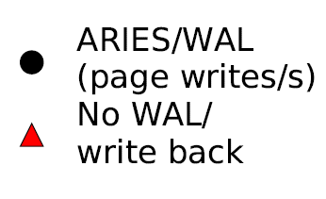
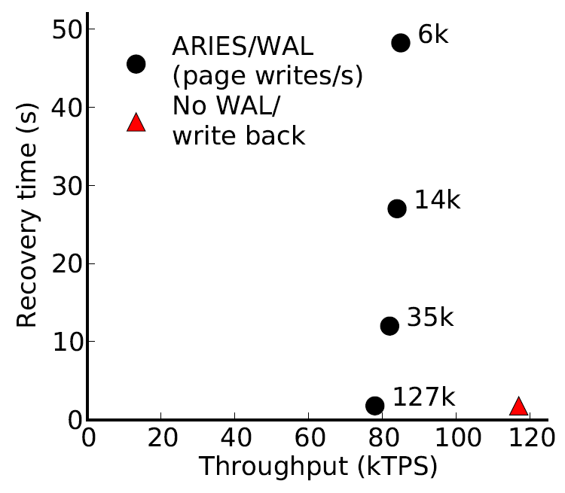
Example: transaction processing (VLDB)
~ 30 15krpm disks
or 3 Flash SSDs
[device IOPS rates: Symantec]
Disk-management overheads impose bottleneck
As disk replacement NVRAM enables near-instant recovery

Slide 6
Ensuring correct recovery
Constrain order of persistent writes
Current memory systems allow memory writes to reorder
Cache eviction order ≠ store order
Require persist barriers
File system/disk sync()
Many possible implementations
Despite fast NVRAM accesses, persist barriers limit performance

Slide 7
NVRAM group commit
Time
Undo log
Updates
Transactions quiesce at end of batch
Transaction updates write atomically using batch log
Couple transaction and durability management
Amortize persist barrier cost over many transactions
Minimal software overhead/complexity

Slide 8
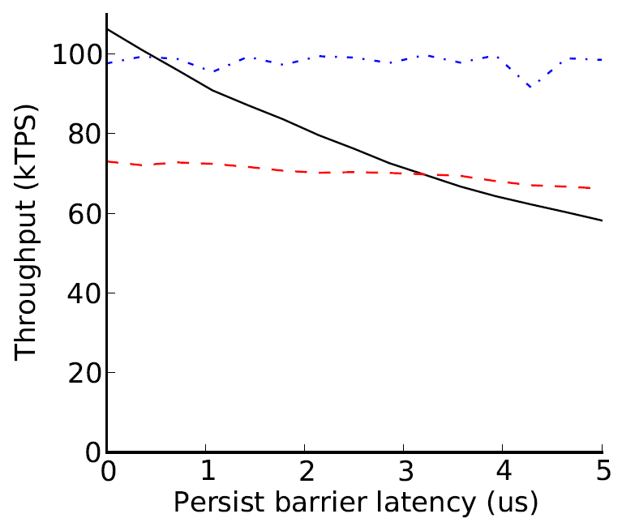
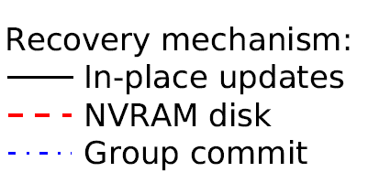
Recovery management performance
Group commit helps, but high performance barriers ideal

Slide 9
Practical persist barriers
How do we minimize barrier stalls?
How do barriers behave with shared memory?
How poor is performance if we simply enforce program order of NVRAM writes?
explore fundamental primitives for persist synchronization

Slide 10
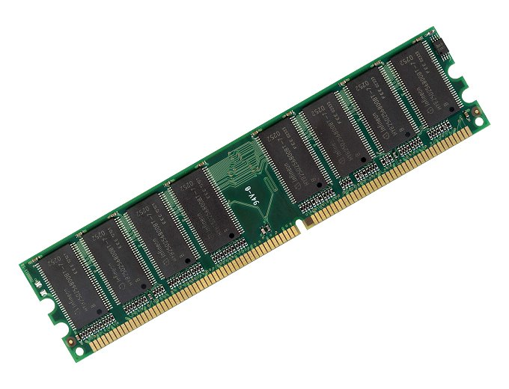
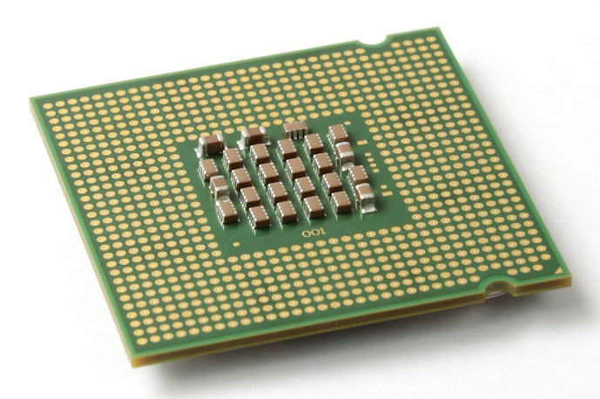
Memory ordering
Writes to memory reorder
?
✓
But loads/stores between processors and cores ordered: memory consistency
Extend memory consistency to reason about NVRAM write order: Memory Persistency

Slide 11
Thesis
Using Flash memory for analytics
ADMS 2011
Using NVRAM to accelerate transactions
Upcoming VLDB
Memory persistency (focus of this talk)
Extend memory consistency to reason about the order of NVRAM writes
Program order NVRAM writes limit throughput to 1/30th instruction execution rate
New persistency models regain performance

Slide 12
Outline
Motivate memory persistency
Memory consistency review
Define memory persistency
Persistent queue benchmark
Memory persistency models
Methodology
Evaluation

Slide 13
Memory consistency primer
Motivation: reorder instructions while providing intended shared memory behavior
Store barrier
Thread 1:
Buffer[0] ← 1
Buffer[8] ← 1
…
Flag ← 1
Thread 2:
If (Flag == 1) {
localBuffer[0] ← Buffer[0]
localBuffer[8] ← Buffer[8]
…
}
Load barrier
In isolation may reorder, but when sharing must constraint

Slide 14
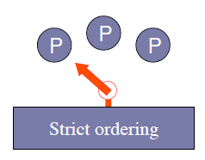
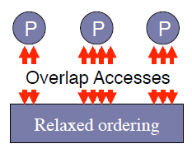
Memory consistency models
Guarantees for reasoning about reordering
Sequential Consistency (SC): no reordering, memory appears as a switch
Relaxed Memory Order (RMO): complete reordering, must use barriers
Model separate from implementation
Consistency spectrum

Slide 15
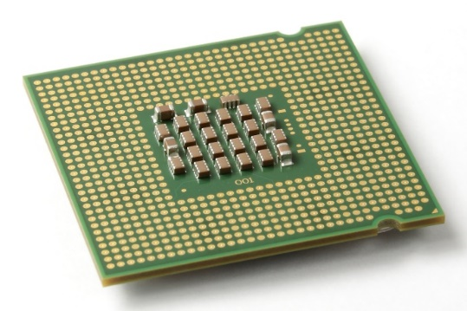
Recovery observer
Memory consistency:
Constrain order of loads and stores between processors
Memory persistency:
Imagine failure as recovery observer
Atomically copies to NVRAM at failure, adhering to consistency model
Treats failure as a processor
Enforcing NVRAM write order equivalent to enforcing store order

Slide 16
Strict persistency
Couples consistency and persistency
1:1 mapping between observable volatile and persistent states
Any two stores that may only be observed in some order implies ordered persists
The store and the persist are the same event
Consistency model and barriers constrain persist order and thread synchronization
Implementation free to optimize

Slide 17
Strict persistency/SC
SC, enforcing order for persists and stores
Persists from each thread must not be observed out of program order after failure
Persists from different threads must be observed as interleaving of program orders
Volatile accesses may order persists!

Slide 18
Buffered persistency
Thread execution (volatile state) proceeds ahead of persistent state
Recovery observer lags arbitrarily behind
Problem: side effects violate model
Persist sync forces durable state to “catch up”
…
Persist to object A
PersistSync
Syscall() // network
…
May observe syscall but after recovery fail to see persist to A
PersistSync constrains order

Slide 19
Strict persistency/RMO
Barriers constrain memory operation order
Barriers that order stores also order persists
Persists on single thread now concurrent
Barriers enforce both persist and store visibility order, even when only one required

Slide 20
Relaxed persistency
Decouple thread synchronization and persists
Store and persist are separate events
Persist order may deviate from store order
New persist barriers order persists
Allows thread to observe persist values without introducing order dependence
Later I’ll introduce relaxed persistency models assuming SC as underlying consistency model

Slide 21
Relaxed persistency example
Lock()
Persist 0x100
Persist 0x108
…
Persist flag=1
Unlock()
Memory barrier
Persist barrier
Memory barrier
Lock provides thread synchronization. No need to additionally enforce persist order at this point
flag must not persist before data, but as the lock protects against data races an additional memory barrier is unnecessary
Stores reorder around persist barriers, persists reorder around store barriers.
Simultaneously relaxed consistency and persistency gets complicated.
Precise, independent control over consistency and persistency

Slide 22
Memory Persistency Design Space
Persistency
strict
relaxed
Sequential consistency (SC), persistent state must match volatile state
SC, but persistent state de-coupled from volatile states. Persists may reorder
Consistency
Relaxed consistency, persistent state matches volatile state
Loads, stores, and persists may all reorder. Minimizes delays for persists and thread synchronization
Persist order determined by consistency model
Persist order determined by new persist barriers

Slide 23
Outline
Define Memory Persistency
Persistency models
Evaluation

Slide 24
Persistent Queue
Useful as log/journal in file systems and db
Features:
Serialize inserts
Recovered queue disallows or detects holes
Goal: maximize volatile performance (instruction execution rate) and improve persist concurrency for inserts
Implementation: based on circular buffer
head marks next location to insert

Slide 25
Queue Designs
Copy-while-locked (CWL)
Single lock protects insert operation
Two-Lock Concurrent
Different locks to reserve and update head
Lesson: thread concurrency creates persist concurrency even for strict persistency
Queue-holes [IBM]
Detect holes. Single lock but concurrent copies
Focus on CWL (see dissertation for others)

Slide 26
Copy-While-Locked Queue
Insert(entry, length):
lock(queue_lock)
data[head] = length
data[head+sizeof(length)] = entry
head += length + sizeof(length)
unlock(queue_lock)
Persist Ordering Constraints
Data
Head
Persistency model must enforce persist orderings

Slide 27
Persistency assumptions and goals
Assume all persists occur in-place (no logging)
Persist ordering constraint implies delay
Assume persist buffering
Persist critical path limits persist rate
Assume limited atomic persists and coalescing
E.g., 8-byte atomic persists
Persists to the same address may coalesce (persist only last value) if no ordering constraints violated
Goal: create models to minimize persist critical path

Slide 28
New persistency models
All models use SC as consistency model
Easier to reason about (removes relaxed consistency/relaxed persistency weirdness)
Easier to evaluate (memory tracing observes SC)
Successively relax persistency to improve persist concurrency/reduce critical path

Slide 29
Model 1: strict persistency
Any volatile memory state that might be observed by the recovery observer processor under SC is an allowable persistent state
Equivalent: two stores ordered w.r.t. recovery observer implies ordered persists
Same thread: program order
Different threads: synchronization
Persist sync allows ordering persists with visible side effects (syscall)

Slide 30
Strict persistency queue
Persist order determined by program order
No code annotation necessary!
Insert(entry, length):
lock(queue_lock)
data[head] = length
data[head+sizeof(length)] = entry
head += length + sizeof(length)
unlock(queue_lock)
Large entries persist in program order
Lock serializes persists between threads

Slide 31
Strict persistency dependences
Data
Thread 1
Head
Data
Thread 2
Head
Minimal dependences shown. Persists to head likely to coalesce

Slide 32
Strict persistency dependences
Data
Thread 1
Head
Data
Thread 2
Head
Guarantees correct recovery, but over-constrains persists

Slide 33
Strict persistency implementations
Delay execution at each persist
Serialize persists when reserving memory bus
Queue persists from each thread, detecting access races (including synchronization races) that introduce order across threads
Combine HTM and hardware durable transactions
Persistent bulkSC?

Slide 34
Model 2: epoch persistency
Motivation: persisting large objects with SC introduces program-order constraints.
Instead, use persist barrier to divide execution into persist epochs, ordering persists
Data sharing continues to observe SC
Persist order resembles RMO, persist barrier acts as a full memory barrier

Slide 35
Persist epoch races (PER)
Under what circumstances are persists between threads ordered?
Persist epoch race: 2+ threads contain epochs that race (including sync. races) and at least one epoch persists
Thread 1
Barrier
Persist A
Persist B
Barrier
Thread 2
Barrier
Read B
Persist A’
Barrier
Can A’ persist before A?
Can A’ persist before B?
Epochs aren’t serializable!

Slide 36
Epoch persistency queue, 1st attempt
Insert(entry, length):
barrier()
lock(queue_lock)
barrier()
data[head] = length
data[head+sizeof(length)] = entry
barrier()
head += length + sizeof(length)
barrier()
unlock(queue_lock)
barrier()
Surround lock/unlock with barriers to prevent PER. Serializes inserts
Barrier ensures head does
not persist before data, but data persists concurrently

Slide 37
Race-free epoch persistency dependences
Data
Thread 1
Head
Data
Thread 2
Head

Slide 38
Race-free epoch persistency dependences
Data
Thread 1
Head
Data
Thread 2
Head

Slide 39
Race-free epoch persistency dependences
Data
Thread 1
Head
Data
Thread 2
Head
Entries persist in parallel, but inserts still serialized

Slide 40
Relaxed persist ordering
Memory operations (including volatile) have a persistent memory order
This order contains fewer partial order constraints than SC execution
Rule 1: memory operations from same thread separated by persist barrier are ordered
Rule 2: operations that conflict (same address, at least 1 write) ordered by SC execution
What to call this? Not a race because they aren’t adjacent in any SC execution
Resembles RMO persist order (but SC synchronization and values)

Slide 41
Another way to say this
Assume only specific partial orders from SC
Rule 1: partial orders within each thread that cross a persist barrier
Rule 2: partial orders within and across threads due to accesses to the same address where at least one access is a store/persist
For strand persistency rule 1 becomes: partial orders within each strand that cross a persist barrier

Slide 42
Persist ordering example
Thread 1: A | B C
Thread 2: E | F
Thread 3: G | H
conflict
Rule 1: A before {B, C}; E before F; G before H
Rule 2: C before E; F before G
Trans.: A before {E ,F, G, H}; E before {G, H}
B concurrent with {C, E, F, G, H} (even though value of operations may depend on B)
Dependences propagate regardless of operation type (load, store, persist) including volatile operations

Slide 43
Epoch persistency queue, 2nd attempt
Insert(entry, length):
barrier()
lock(queue_lock)
barrier()
data[head] = length
data[head+sizeof(length)] = entry
barrier()
head += length + sizeof(length)
barrier()
unlock(queue_lock)
barrier()
Allow persist epoch races
head persists from different inserts ordered due to conflicts

Slide 44
Epoch persistency dependences
Data
Thread 1
Head
Data
Thread 2
Head

Slide 45
Epoch persistency dependences
Data
Thread 1
Head
Data
Thread 2
Head

Slide 46
Epoch persistency dependences
Data
Thread 1
Head
Data
Thread 2
Head
Entries on different threads persist in parallel

Slide 47
Epoch persistency implementation
Similar to BPFS (see paper/dissertation)
Queue persists from each thread, record persist barriers, only enforce order at barriers
Persistent BulkSC (transactions)
Use persist barrier knowledge to optimize persistent transactions and intelligently place transaction boundaries

Slide 48
Model 3: strand persistency
Motivation: epochs allow limited concurrency
Divide execution into strands
NewStrand begins a strand
Strands execute in order on threads, but from persistency standpoint are independent threads
Equiv: a new strand clears persist dependences
Races/conflicts introduce order between strands
Epoch pers. orders persists within strands

Slide 49
Strand persistency ordering
Rule 1: memory operations from same strand separated by persist barrier are ordered
Rule 2: operations that conflict (same address, at least 1 write) ordered by SC execution
Such conflicts consider each strand as a separate thread (operations on same thread may conflict)
Strand order within a thread determines order of conflicts

Slide 50
Strand examples
...
Epoch
Strand
A
B
A
B
Barrier
C
NewStrand
A
Barrier
C
NewStrand
B
A
Barrier
B
C
or
C
B must be ordered with either A or C
...
Strands allow precise persist constraint labeling

Slide 51
Perfect constraint labeling
For each persist:
New strand
Read all addresses persist depends on
Barrier
Persist
Creates DAG of dependences. Edge from each read to persist
Minimal persist dependences (introduces additional instructions)

Slide 52
Strand persistency queue
Insert(entry, length):
lock(queue_lock)
new_strand()
data[head] = length
data[head+sizeof(length)] = entry
barrier()
head += length + sizeof(length)
unlock(queue_lock)
Removes unnecessary dependences between inserts

Slide 53
Strand persistency dependences
Data
Thread 1
Head
Data
Thread 2
Head

Slide 54
Strand persistency dependences
Data
Thread 1
Head
Data
Thread 2
Head

Slide 55
Strand persistency dependences
Data
Thread 1
Head
Data
Thread 2
Head
Back to minimal dependences

Slide 56
Outline
Define Memory Persistency
Persistency models
Evaluation

Slide 57
Methodology
Assume buffered NVRAM with infinite banks (no conflicts ever occur). All persists occur in place (no logging but persists may coalesce)
Either
Persists drain faster than instruction execution rate; instructions limit performance
Persists drain slower than instruction execution rate; persist rate limits performance
Determine slower of the two and resulting throughput

Slide 58
Methodology
Measure execution rate on real server
2.4 GHz Xeon E5645
Use 1 and 8 threads to test concurrency
Pad to 64 bytes to remove false sharing
Repeatedly insert 100-byte entries as quickly as possible, reporting insert rate

Slide 59
Methodology
Measure persist rate via memory traces
Produce SC memory trace from PIN
Annotate barriers, persistent malloc, etc.
Persist critical path from simulation
Track persist dependences at variable granularity
Persists coalesce assuming variable atomic persist
(both 8 bytes by default)
Observe persist timing and dependences from persistency model

Slide 60
Relaxed persistency
Line indicates instruction execution rate
Assumes 500ns persists
30x
Other queues
Relaxed persistency removes constraints and regains throughput

Slide 61
Persist latency
17ns
119ns
6.2µs
1 Thread
(8 Threads)
Relaxed persistency tolerates greater persist latency

Slide 62
Persist coalescing
Larger atomic persists improve concurrency for strict models

Slide 63
Persistent false sharing
Coarse dependence tracking reintroduces constraints

Slide 64
Conclusion
Must order persists, but over-constraining hurts performance (resembles consistency)
Memory persistency builds on consistency to enforce persist order
Persistency may be relaxed, de-coupling store and persist order constraints
Relaxed persistency enables instruction execution rate with recovery correctness

Slide 65
Thank You!
Thanks to my family, friends, Tom, committee, collaborators, and all of you

Slide 66
Backup Slides
Persistency definition
Defining order of persists to same address
Queue
Circular buffer
Other queue designs
Results
Coalescing
Relaxed persistency, all queues
Effect of latency on CWL, 8 threads
Alternative interfaces
Disk/block
Moneta
Transactions
Various [Mnemosyne, RIO Vista, STM]
Kiln-decouple thread synchronization from persistency control
Barriers
BPFS

Slide 67
Persists to same address
Strict persistency relies on consistency model to define order or persists to same address
Often relies on cache coherence guarantees
Relaxed consistency/relaxed persistency allows:
Store visibility to reorder across persist barrier
Persists to reorder across store barrier
May violate cache coherence persist ordering

Slide 68
Persists to same address
Thread 1:
Persist A
Barrier
Persist B
Thread 2:
Persist B
Barrier
Persist A
Thread 1’s stores reorder around the barrier
Persist ordering dependences shown for barriers and cache coherence order
Dependence cycle cannot be enforced

Slide 69
Persists to same address
Resolve by:
Relying on strict persistency
Preventing stores from reordering around persist barriers
Defining additional synchronization to prevent such situations
Interaction between consistency barriers and persist barriers
Back
Backup slides

Slide 70
Coalescing
Any two persists may coalesce if:
Hardware allows them to persist atomically
No happens-before constraints are violated
Given a DAG of persist constraints, coalescing:
Combines the two persists into a single node
Node takes union of edges into and out of node
Edges entirely inside the node go away
Coalescing legal if no cycles introduced

Slide 71
Coalescing example
A
B
B
A’
A/A’
Cycle!
A
C
D
A
D
C/C’
✓
B
C’
E
B
E
Back -- Backup slides

Slide 72
All queues, 1 thread
Varied volatile performance. Require strand persistency

Slide 73
All queues, 8 threads
Back -- Backup slides
Multi-threading improves persist concurrency. Epochs sufficient

Slide 74
Latency, CWL 8 threads
PER-free: 202ns (not shown)
28ns
1.6µs
10.5µs
Back -- Backup slides
Epoch persistency likely sufficient

Slide 75
BPFS
“Better IO Through Byte-Addressable, Persistent Memory”
Cache implementation of barriers and epochs
Stalls to persist at thread conflicts
Flush cache for persist sync
Differences
Programmer must provide isolated epochs (including false sharing, otherwise deadlock)
No dependences through volatile memory
Loads may bypass store in persist order (persist barrier is 3/4 RMO barrier)
Back Backup slides

Slide 76
[dependence template]
Data
Thread 1
Head
Data
Thread 2
Head

Slide 77
PER persist ordering
Persist⇨Load
Load⇨Persist
Thread 1: A | B C
Thread 2: load C’ D | E
C before E
A before E (transitivity; A before C)
Thread 1: A | B load C
Thread 2: C’ D | E
load C before E
A before E (transitivity)
A before C’
Persist⇨Persist
B, C volatile
Thread 1: A | B C
Thread 2: C’ D | E
A before E (race and barriers)
C before C’ (cache coherence)
A before C’ (transitivity)
C before E (transitivity)
Persist⇨Persist race good candidate for coalescing
Thread 1: A | B
Thread 2: B’ | C
Thread 3: C’ | D
A before D (race and barriers)
Red barrier required
PER orders persists outside of racing epochs, except for cache coherence

Slide 78
Memory Persistency
Steven Pelley, Peter M. Chen, Thomas F. Wenisch

Slide 79
Nonvolatile memory (NVRAM)
Low latency random access, durable
Storage technology | Random read latency | Durable?
Disk | 10ms | ✓
Flash | 90µs | ✓
DRAM | 100ns | ✗
NVRAM | 50-1000ns [IBM] | ✓
NVRAM enables persistent main memory

Slide 80
NVRAM recovery
Writes unordered!
writes
Must constrain write order for recovery
Cache eviction reorders writes to memory
Enforcing program order writes incurs 30x slowdown over instruction execution rate.
Must constrain writes for correctness, but reorder for performance

