Slide 1
Memory Persistency
Steven Pelley, Peter M. Chen, Thomas F. Wenisch

Slide 2
Nonvolatile memory (NVRAM)
Low latency random access, durable
Storage technology | Random read latency | Durable?
Disk | 10ms | ✓
Flash | 90µs | ✓
DRAM | 100ns | ✗
NVRAM | 50-1000ns [IBM] | ✓
NVRAM enables persistent main memory

Slide 3
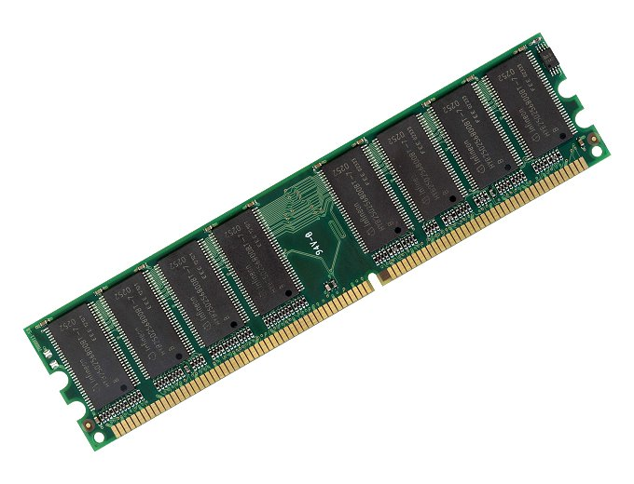
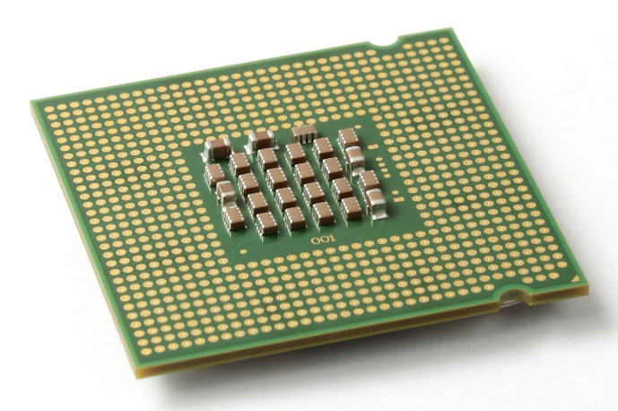
NVRAM recovery
Writes unordered!
writes
Must constrain write order for recovery
Cache eviction reorders writes to memory
Enforcing program order writes incurs 30x slowdown over instruction execution rate.
Must constrain writes for correctness, but reorder for performance

Slide 4
Memory order
Writes to memory reorder
?
✓
But loads/stores between processors and cores ordered: memory consistency
Use memory consistency to reason about NVRAM write order

Slide 5
Memory persistency
Build on memory consistency, providing models to constrain NVRAM write order
Relax persistency to improve write concurrency, increasing throughput
This project: focus on models (interface), rather than implementations

Slide 6
Outline
Define memory persistency
Persistent queue benchmark
Memory persistency models
Methodology
Evaluation

Slide 7
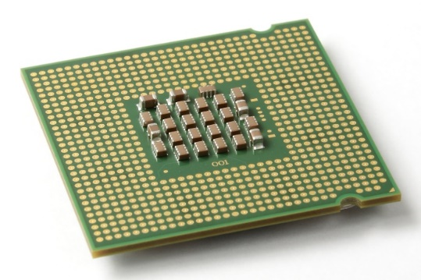
Recovery observer
Memory consistency:
Constrain order of loads and Stores Between processors
Memory persistency:
Imagine failure as recovery observer
Atomically copies to NVRAM at failure, adhering to consistency model
Treats failure as a processor
Enforcing persist order equivalent to enforcing store order

Slide 8
Strict persistency
Couples consistency and persistency
1:1 mapping between observable volatile and persistent states
Any two stores that may only be observed in some order implies ordered persists
The store and the persist are the same event
Consistency model and barriers constrain persist order and thread synchronization
Implementation free to optimize

Slide 9
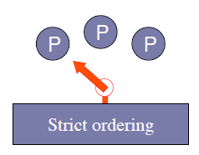
Strict persistency/SC
SC, enforcing order for persists and stores
Persists from each thread must not be observed out of program order after failure
Persists from different threads must be observed as interleaving of program orders
Volatile accesses may order persists!

Slide 10
Buffered persistency
Thread execution (volatile state) proceeds ahead of persistent state
Recovery observer lags arbitrarily behind
Problem: side effects violate model
Persist sync forces durable state to “catch up”
…
Persist to object A
PersistSync
Syscall() // network
…
May observe syscall but after recovery fail to see persist to A
PersistSync constrains order

Slide 11
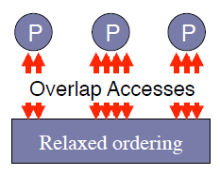
Strict persistency/RMO
Barriers constrain memory operation order
Barriers that order stores also order persists
Persists on single thread now concurrent
Barriers enforce both persist and store visibility order, even when only one required

Slide 12
Relaxed persistency
Decouple thread synchronization and persists
Persist order may deviate from store order
Store and persist are separate events
Additional persist barriers order persists
Allows thread to observe persist values without introducing order dependence
Later I’ll introduce relaxed persistency models assuming SC as underlying consistency model

Slide 13
Relaxed persistency example
Lock()
Persist 0x100
Persist 0x108
…
Persist flag=1
Unlock()
Memory barrier
Persist barrier
Memory barrier
Lock provides thread synchronization. No need to additionally enforce persist order at this point
flag must not persist before data, but as the lock protects against data races an additional memory barrier is unnecessary
Stores reorder around persist barriers, persists reorder around store barriers.
Simultaneously relaxed consistency and persistency gets complicated.
Precise, independent control over consistency and persistency

Slide 14
Memory Persistency Design Space
Persistency
strict
relaxed
Sequential consistency (SC), persistent state must match volatile state
SC, but persistent state de-coupled from volatile states. Persists may reorder
Consistency
Relaxed consistency, persistent state matches volatile state
Loads, stores, and persists may all reorder. Minimizes delays for persists and thread synchronization
Persist order determined by consistency model
Persist order determined by new persist barriers

Slide 15
Outline
Define Memory Persistency
Persistency models
Evaluation

Slide 16
Persistent Queue
Useful as log/journal in file systems and db
Features:
Serialize inserts
Recovered queue disallows or detects holes
Goal: maximize volatile performance (instruction execution rate) and improve persist concurrency for inserts
Implementation: based on circular buffer
head marks next location to insert

Slide 17
Queue Designs
Copy-while-locked (CWL)
Single lock protects insert operation
Two-Lock Concurrent
Different locks to reserve and update head
Lesson: thread concurrency creates persist concurrency even for strict persistency
Queue-holes [IBM]
Detect holes. Single lock but concurrent copies
Focus on CWL (see dissertation for others)

Slide 18
Copy-While-Locked Queue
Insert(entry, length):
lock(queue_lock)
data[head] = length
data[head+sizeof(length)] = entry
head += length + sizeof(length)
unlock(queue_lock)
Persist Ordering Constraints
Data
Head
Persistency model must enforce persist orderings

Slide 19
Persistency assumptions and goals
Assume all persists occur in-place (no logging)
Persist ordering constraint implies delay
Assume persist buffering
Persist critical path limits persist rate
Assume limited atomic persists and coalescing
E.g., 8-byte atomic persists
Persists to the same address may coalesce (persist only last value) if no ordering constraints violated
Goal: create models to minimize persist critical path

Slide 20
New persistency models
All models use SC as consistency model
Easier to reason about (removes relaxed consistency/relaxed persistency weirdness)
Easier to evaluate (memory tracing observes SC)
Successively relax persistency to improve persist concurrency/reduce critical path

Slide 21
Model 1: strict persistency
Any volatile memory state that might be observed by the recovery observer processor under SC is an allowable persistent state
Equivalent: two stores ordered w.r.t. recovery observer implies ordered persists
Same thread: program order
Different threads: synchronization
Persist sync allows ordering persists with visible side effects (syscall)

Slide 22
Strict persistency queue
Persist order determined by program order
No code annotation necessary!
Insert(entry, length):
lock(queue_lock)
data[head] = length
data[head+sizeof(length)] = entry
head += length + sizeof(length)
unlock(queue_lock)
Large entries persist in program order
Lock serializes persists between threads

Slide 23
Strict persistency dependences
Data
Thread 1
Head
Data
Thread 2
Head
Minimal dependences shown. Persists to head likely to coalesce

Slide 24
Strict persistency dependences
Data
Thread 1
Head
Data
Thread 2
Head
Guarantees correct recovery, but over-constraints persists

Slide 25
Strict persistency implementations
Delay execution at each persist
Serialize persists when reserving memory bus
Queue persists from each thread, detecting access races (including synchronization races) that introduce order across threads
Combine HTM and hardware durable transactions
Persistent bulkSC?

Slide 26
Model 2: epoch persistency
Motivation: persisting large objects with SC introduces program-order constraints.
Instead, use persist barrier to divide execution into persist epochs.
Persists within each epoch are concurrent
Data sharing continues to observer SC
Determining persist order between threads can get tricky

Slide 27
Persist epoch races (PER)
Under what circumstances are persists between threads ordered?
Persist epoch race: 2+ threads contain epochs that race (including sync. races) and at least one epoch persists
Thread 1
Barrier
Persist A
Persist B
Barrier
Thread 2
Barrier
Read B
Persist A’
Barrier
Can A’ persist before A?
Can A’ persist before B?
Epochs aren’t serializable!

Slide 28
Epoch persistency queue, 1st attempt
Insert(entry, length):
barrier()
lock(queue_lock)
barrier()
data[head] = length
data[head+sizeof(length)] = entry
barrier()
head += length + sizeof(length)
barrier()
unlock(queue_lock)
barrier()
Surround lock/unlock with barriers to prevent PER. Serializes inserts
Barrier ensures head does
not persist before data, but data persists concurrently

Slide 29
Race-free epoch persistency dependences
Data
Thread 1
Head
Data
Thread 2
Head

Slide 30
Race-free epoch persistency dependences
Data
Thread 1
Head
Data
Thread 2
Head

Slide 31
Race-free epoch persistency dependences
Data
Thread 1
Head
Data
Thread 2
Head
Entries persist in parallel, but inserts still serialized

Slide 32
Persist ordering
Even volatile events contain persist ordering constraints
This is the “persistent memory stream” of execution, differs from volatile stream
Persists assume their order from this stream (order of volatile accesses in persist order not directly visible)
Event considers loads, stores, persists

Slide 33
Persist ordering rules
All memory events from same thread separated by barrier
Consider race (x, y) – x and y are memory events to same address, at least one a store/persist, and they are adjacent under some serialized order (SC). Event E is after x if y is on E’s thread and in an epoch prior to E’s
All persists to same address ordered by CC
Transitivity applies
Concurrent if not ordered

Slide 34
Race ordering
Thread 1: A | B C
Thread 2: D E | F
C and D represent a race (same address, at least one writes, adjacent)
Orders
A before B/C; D/E before F (rule 1)
C before F (rule 2)
Transitivity: A before F
C before D if both C, D persists (rule 3)
Transitivity: A before D, C before F

Slide 35
Epoch persistency ordering with PER
Persist A ordered before persist B if:
Same thread, A in earlier epoch than B
Or A is implied by cache coherence event on B’s thread in epoch prior to B’s
Or A and B persist to the same address and B’s store is observed after A’s by cache coherence
Transitivity using any previous rules
Otherwise concurrent

Slide 36
PER persist ordering
Persist⇨Load
Load⇨Persist
Thread 1: A | B C
Thread 2: load C’ D | E
C before E
A before E (transitivity; A before C)
Thread 1: A | B load C
Thread 2: C’ D | E
load C before E
A before E (transitivity)
Not A before C’
Persist⇨Persist
B, C volatile
Thread 1: A | B C
Thread 2: C’ D | E
A before E (race and barriers)
C before C’ (cache coherence)
A before C’ (transitivity)
C before E (transitivity)
Persist⇨Persist race good candidate for coalescing
Thread 1: A | B
Thread 2: B’ | C
Thread 3: C’ | D
A before D (race and barriers)
Red barrier required
PER orders persists outside of racing epochs, except for cache coherence

Slide 37
Epoch persistency queue, 2nd attempt
Insert(entry, length):
barrier()
lock(queue_lock)
barrier()
data[head] = length
data[head+sizeof(length)] = entry
barrier()
head += length + sizeof(length)
barrier()
unlock(queue_lock)
barrier()
Allow persist epoch races
head persists ordered by cache coherence

Slide 38
Epoch persistency dependences
Data
Thread 1
Head
Data
Thread 2
Head

Slide 39
Epoch persistency dependences
Data
Thread 1
Head
Data
Thread 2
Head

Slide 40
Epoch persistency dependences
Data
Thread 1
Head
Data
Thread 2
Head
Entries on different threads persist in parallel

Slide 41
Epoch persistency implementation
Similar to BPFS (see paper/dissertation)
Queue persists from each thread, record persist barriers, only enforce order at barriers
Persistent BulkSC (transactions)
Use persist barrier knowledge to optimize persistent transactions and intelligently place transaction boundaries

Slide 42
Model 3: strand persistency
Motivation: epochs only allow adjacent persists on same thread or persists in racing epochs to be labeled concurrent
Divide execution into strands
NewStrand begins a strand
Strands execute in order on a thread, but from perspective of persistency are independent.
Equiv: a new strand clears persist dependences
Races/conflicts introduce order between strands
Epoch pers. orders persists within strands

Slide 43
Ordering under strand persistency
Persist A ordered before persist B if:
Race (sync or data) in epoch after A and in epoch prior to B. Race must occur within same strands as A and B
Or A and B are to the same address
???
Profit?

Slide 44
Strand examples
...
Epoch
Strand
A
B
A
B
Barrier
C
NewStrand
A
Barrier
C
NewStrand
B
A
Barrier
B
C
or
C
B must be ordered with either A or C
...
Strands allow precise persist constraint labeling

Slide 45
Perfect constraint labeling
For each persist:
New strand
Read all addresses persist depends on
Barrier
Persist
Creates DAG of dependences. Edge from each read to persist
Minimal persist dependences (introduces additional instructions)

Slide 46
Strand persistency queue
Insert(entry, length):
lock(queue_lock)
new_strand()
data[head] = length
data[head+sizeof(length)] = entry
barrier()
head += length + sizeof(length)
unlock(queue_lock)
Removes unnecessary dependences between inserts

Slide 47
Strand persistency dependences
Data
Thread 1
Head
Data
Thread 2
Head

Slide 48
Strand persistency dependences
Data
Thread 1
Head
Data
Thread 2
Head

Slide 49
Strand persistency dependences
Data
Thread 1
Head
Data
Thread 2
Head
Back to minimal dependences

Slide 50
Outline
Define Memory Persistency
Persistency models
Evaluation

Slide 51
Methodology
Assume buffered NVRAM with infinite banks (no conflicts ever occur). All persists occur in place (no logging but persists may coalesce)
Either
Persists drain faster than instruction execution rate; instructions limit performance
Persists drain slower than instruction execution rate; persist rate limits performance
Determine slower of the two and resulting throughput

Slide 52
Methodology
Measure execution rate on real server
2.4 GHz Xeon E5645
Use 1 and 8 threads to test concurrency
Pad to 64 bytes to remove false sharing
Repeatedly insert 100-byte entries as quickly as possible, reporting insert rate

Slide 53
Methodology
Measure persist rate via memory traces
Produce SC memory trace from PIN
Annotate barriers, persistent malloc, etc.
Persist critical path from simulation
Track persist dependences at variable granularity
Persists coalesce assuming variable atomic persist
(both 8 bytes by default)
Observe persist timing and dependences from persistency model

Slide 54
Relaxed persistency
Line indicates instruction execution rate
Assumes 500ns persists
30x
Other queues
Relaxed persistency removes constraints and regains throughput

Slide 55
Persist latency
17ns
119ns
6.2µs
1 Thread
(8 Threads)
Relaxed persistency tolerates greater persist latency

Slide 56
Persist coalescing
Larger atomic persists improve concurrency for strict models

Slide 57
Persistent false sharing
Coarse dependence tracking reintroduces constraints

Slide 58
Conclusion
Must order persists, but over-constraining hurts performance (resembles consistency)
Memory persistency builds on consistency to enforce persist order
Persistency may be relaxed, de-coupling store and persist order constraints
Relaxed persistency enables instruction execution rate with recovery correctness

Slide 59
Thank You!
Thanks to my family, friends, Tom, committee, collaborators, and all of you

Slide 60
Backup Slides
Persistency definition
Defining order of persists to same address
Queue
Circular buffer
Other queue designs
Results
Coalescing
Relaxed persistency, all queues
Effect of latency on CWL, 8 threads
Alternative interfaces
Disk/block
Moneta
Transactions
Various [Mnemosyne, RIO Vista, STM]
Kiln-decouple thread synchronization from persistency control
Barriers
BPFS

Slide 61
Persists to same address
Strict persistency relies on consistency model to define order or persists to same address
Often relies on cache coherence guarantees
Relaxed consistency/relaxed persistency allows:
Store visibility to reorder across persist barrier
Persists to reorder across store barrier
May violate cache coherence persist ordering

Slide 62
Persists to same address
Thread 1:
Persist A
Barrier
Persist B
Thread 2:
Persist B
Barrier
Persist A
Thread 1’s stores reorder around the barrier
Persist ordering dependences shown for barriers and cache coherence order
Dependence cycle cannot be enforced

Slide 63
Persists to same address
Resolve by:
Relying on strict persistency
Preventing stores from reordering around persist barriers
Defining additional synchronization to prevent such situations
Interaction between consistency barriers and persist barriers
Back
Backup slides

Slide 64
Coalescing
Any two persists may coalesce if:
Hardware allows them to persist atomically
No happens-before constraints are violated
Given a DAG of persist constraints, coalescing:
Combines the two persists into a single node
Node takes union of edges into and out of node
Edges entirely inside the node go away
Coalescing legal if no cycles introduced

Slide 65
Coalescing example
A
B
B
A’
A/A’
Cycle!
A
C
D
A
D
C/C’
✓
B
C’
E
B
E
Back -- Backup slides

Slide 66
All queues, 1 thread
Varied volatile performance. Require strand persistency

Slide 67
All queues, 8 threads
Back -- Backup slides
Multi-threading improves persist concurrency. Epochs sufficient

Slide 68
Latency, CWL 8 threads
PER-free: 202ns (not shown)
28ns
1.6µs
10.5µs
Back -- Backup slides
Epoch persistency likely sufficient

Slide 69
BPFS
“Better IO Through Byte-Addressable, Persistent Memory”
Cache implementation of barriers and epochs
Stalls to persist at thread conflicts
Flush cache for persist sync
Differences
Programmer must provide isolated epochs (including false sharing, otherwise deadlock)
No dependences through volatile memory
Introduces dependences according to TSO
Back Backup slides

Slide 70
[dependence template]
Data
Thread 1
Head
Data
Thread 2
Head

