Slide 1
Database and System Design for Emerging Storage Technologies
Steven Pelley
Thesis Proposal

Slide 2
Emerging storage technologies
Flash memory
Nonvolatile Memory (NVRAM)
Phase Change (PCRAM)
Memristor (HP)
Spin-Torque Transfer (STT-RAM)
Storage technology | Random read latency
Disk | 10ms
Flash | 90µs
NVRAM | 50-1000ns [IBM]
Devices offer immediate performance increase over disk

Slide 3
Optimizing systems for Flash/NVRAM
Decades of research/engineering to avoid random access on disk
Redesign/optimize database applications for most relevant storage technology
Analytics (DSS) on Flash
Transaction Processing (OLTP) on NVRAM
Ongoing: Persistent Memory Consistency
Intuitive mechanisms to enable high persist throughput and enforce proper recovery

Slide 4
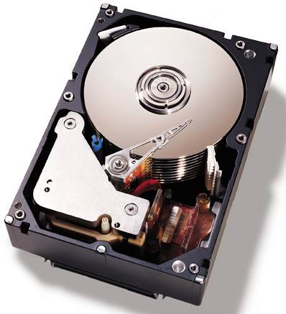
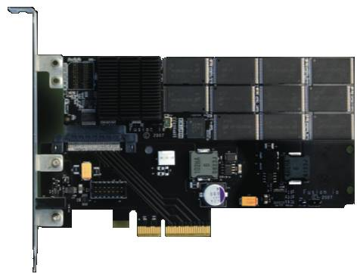
Taking advantage of SSDs
Data should “prefer” disk or Flash
Flash accelerates random access to tables
Measure disk/Flash performance to determine
When optimal query plan shifts [ADMS ’11]
Table 1: Accessed Sequentially
Table 2: Accessed Randomly
Coarse-grain access limits ability to leverage fast random reads
Notes:
Keeping this performance difference in mind, I came up with an idea.
Data may prefer either disk or flash
For example… scans
But the real contribution is that the optimal query plan, and thus performance, will depend on where the data resides.
So I needed to figure out exactly how query optimizers dealt with flash SSDs
Fix the colors in the table boxes

Slide 5
NVRAM OLTP optimization
Hypothesis: NVRAM should accelerate transaction processing and recovery
True, but existing systems not optimized for NVRAM
Disk optimizations impose unnecessary overheads
Persist barriers to ensure proper recovery introduce delays
Greater-than-DRAM read latency lengthens read stalls
Provide NVRAM performance methodology, new NVRAM recovery mechanisms, and read performance analysis [submitted to VLDB]
NVRAM enables high throughput and instant recovery

Slide 6
Ongoing: NVRAM programming models
Hypothesis: Recovery/durability changes instruction ordering requirements
Persisting in program order yields poor performance
Annotating persist order difficult
Similar to memory consistency models
Define order that writes observed
Persistence defines order that persists observed
Persistent Memory Consistency (PMC)
Provide high performance, intuitive persistence model

Slide 7

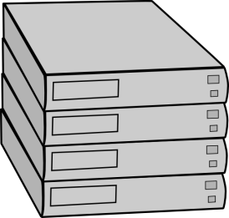
Additional publications
Understanding and Abstracting Total Data Center Power [WEED ‘09]
Data center power model encompassing all components
PowerRouting: Dynamic Power Provisioning in the DataCenter [ASPLOS ‘10]
Better utilize installed power infrastructure by introducing power feed switching mechanisms and smart control
?

Slide 8
Outline
Flash analytics – leveraging fast random reads
NVRAM OLTP recovery management
Persistent Memory Consistency (PMC)
Ex: data structure and consistency models

Slide 9
Outline
Flash analytics – leveraging fast random reads
NVRAM OLTP recovery management
Persistent Memory Consistency (PMC)
Ex: data structure and consistency models

Slide 10
Flash analytics optimization
Flash favors random data access
relative to disk.
Ex: Scans that return < 10% of
table should use index, > 10%
scan entire table.
[Ramakrishnan and Gehrke]
Expect to shift right with Flash
Measure performance of scans and joins on disk/Flash
Determine when query plans change between devices
Relation scan
Runtime (time)
Index scan
Selectivity (%)

Slide 11
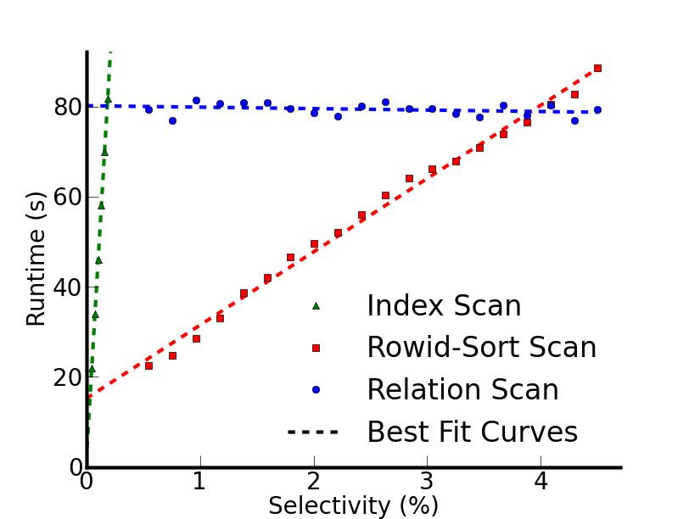
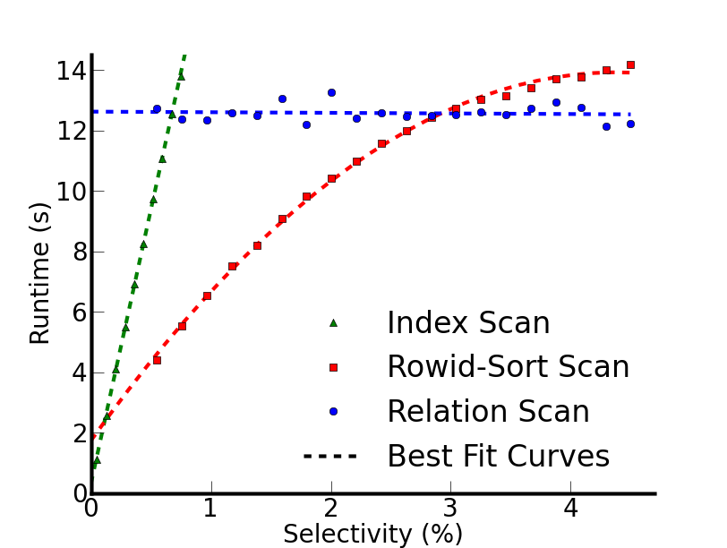
Actual performance
Disk
Flash
Break-even points at lower selectivity than expected
Break-even points shift for only 0.9% selectivities
10% rule appropriate for pages
Notes:
Distinguish between previous index line and the rowid-sort scan
Scans start with cold data

Slide 12
Flash Implications
See proposal for join analysis and details
Little opportunity to advantage of device-dependent query optimization
Large access granularity interferes with Flash’s low random read latency
Future NVRAMs provide fine-grained access
NVRAM holds promise for recovery management

Slide 13
Outline
Flash analytics – leveraging fast random reads
NVRAM OLTP recovery management
Persistent Memory Consistency (PMC)
Ex: data structure and consistency models

Slide 14
Outline
Flash analytics – leveraging fast random reads
NVRAM OLTP recovery management
Persistent Memory Consistency (PMC)
Ex: data structure and consistency models

Slide 15
NVRAM characteristics
Byte addressable reads and persistent writes
Greater-than-DRAM read latency
Asymmetric writes/reads (slower writes)
MLC slows both reads and writes further
Possible interfaces – implies varied latency
Disk replacement
PCIe attached
Main memory bus
Slower than DRAM, but much faster than disk/Flash

Slide 16
NVRAM Transaction Processing
Online Transaction Processing (OLTP) relies on durability for recovery management
Recovery management optimized for disk [ARIES]
Faster storage provides low latency recovery and greater transaction throughput
Define persist: write to NVRAM durably
Main-memory DB performance, disk DB recovery

Slide 17
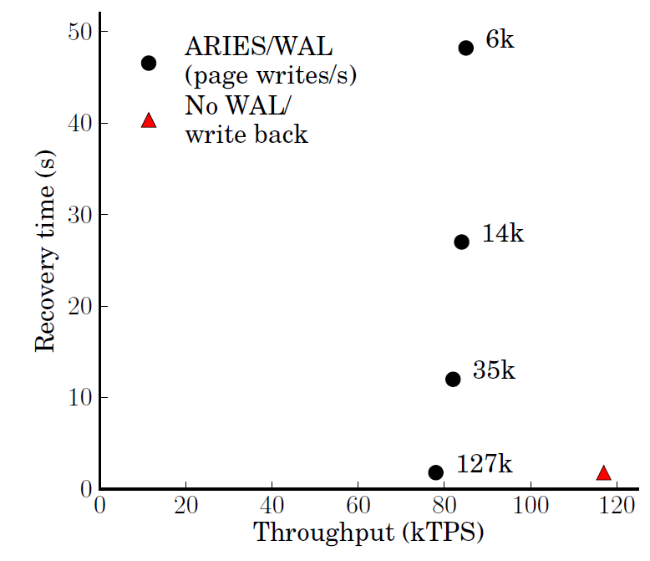
NVRAM OLTP opportunity
~ 30 15krpm disks
or 3 Flash SSDs
[device IOPS rates: Symantec]
Disk-management overheads impose bottleneck
As disk replacement NVRAM enables near-instant recovery

Slide 18
Storage Management for the NVRAM Era
Methodology to evaluate NVRAM on real hardware
Implement and compare recovery management
NVRAM Disk-Replacement has software overhead
Persisting to NVRAM immediately as In-Place Updates, enforcing persist order with persist barriers incurs frequent synchronization delays
Introduce new NVRAM Group Commit to minimize persist barrier frequency while trading off transaction latency
Read performance analysis (see proposal)

Slide 19
ARIES Recovery Management
Store
xct 1
xct 2
xct 1
Log
redo
undo
redo
undo
redo
undo
Log orders actions from concurrent transactions Redo entries record how to repeat action
Undo entries record how to remove action
Log transforms random writes into sequential writes

Slide 20
ARIES Recovery Management
Defer page write back – may only write back after log persists
Store
Transactions commit/abort must persist before responding to client
xct 1
xct 2
xct 1
xct 2
Log
redo
undo
redo
undo
redo
undo
commit
Transactions only stall on disk write at commit

Slide 21
ARIES Recovery Management
On failure:
Replay log to reproduce state at the time of failure. Fetch necessary store pages
Apply undo to remove any in-flight transactions
Store
xct 1
xct 2
xct 1
xct 2
Log
redo
undo
redo
undo
redo
undo
commit
Log is sufficient to maintain durable consistent state

Slide 22
ARIES Recovery Management
Overheads:
Serialized log introduces large code paths and high contention
Frequent page flushing creates contention on hot page latches
Page and log flusher threads use CPU time
Store
xct 1
xct 2
xct 1
xct 2
Log
redo
undo
redo
undo
redo
undo
commit
Optimizations necessary for disk now get in the way

Slide 23
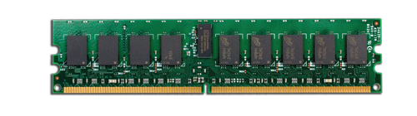
In-Place Updates
Persist updates in place immediately
Requires persist barriers, causing transaction to stall
Requires per-update log to make page updates atomic
Always at “replayed” state
No undo, no replay
Store
xct 1
xct 2
xct 1
xct 2
Remove centralized log Undo now transaction-local
Log
redo
undo
redo
undo
redo
undo
commit
Remove centralized log, but transactions incur persist delays

Slide 24
Choosing recovery mechanism
NVRAM Disk-Replacement incurs persist delays on page and flusher threads
Transaction threads delay only at commit
In-Place Updates delays at each update
As persist barrier delay increases NVRAM Disk-Replacement eventually wins
Want to remove logging and synchronous persist overheads
NVRAM Group Commit

Slide 25
NVRAM Group Commit
Time
Transactions operate on copy of data in volatile buffer
NVRAM
store
volatile
buffer
NVRAM
log

Slide 26
NVRAM Group Commit
Time
Transactions quiesce at end of batch
NVRAM
store
volatile
buffer
NVRAM
log

Slide 27
NVRAM Group Commit
Time
Undo log
Overwritten data copied to NVRAM log
NVRAM
store
volatile
buffer
NVRAM
log

Slide 28
NVRAM Group Commit
Time
Undo log
Persist store
Persist batch updates in-place
NVRAM
store
volatile
buffer
NVRAM
log

Slide 29
NVRAM Group Commit
Time
Undo log
Persist store
Remove log
Commit transactions
Begin new batch
NVRAM
store
volatile
buffer
NVRAM
log

Slide 30
NVRAM Group Commit
Time
Undo log
Persist store
Recovery copies valid log back to store
NVRAM
store
volatile
buffer
NVRAM
log

Slide 31
NVRAM Group Commit
Time
Undo log
Persist store
Constant number of persist barriers per batch
No centralized logging
Throughput high so long as batch quiesce/persist short

Slide 32
Modeling unavailable devices
Run database on real hardware
Log and Stores on RAMDisk
Introduce precise delays (20ns precision using x86 RDTSCP) to model persist barrier latency
Model persist bandwidth constraints with shared variable reservation
Build recovery mechanisms in Shore
Rely on dirty bit fields to track how much of buffer pool is written during transaction/page latch

Slide 33
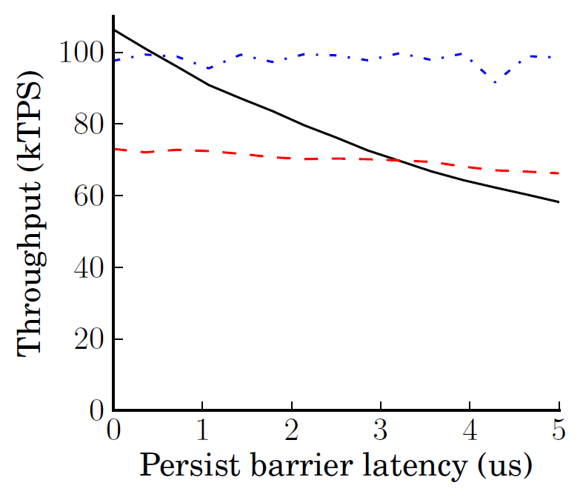
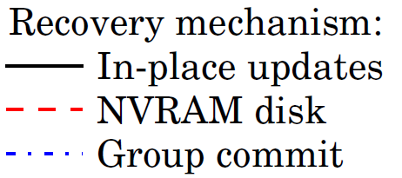
Recovery management performance
Group commit necessary above 2µs but increases xct latency

Slide 34
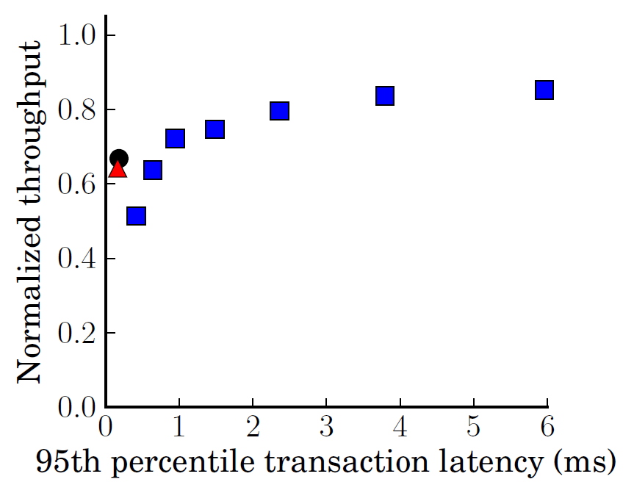
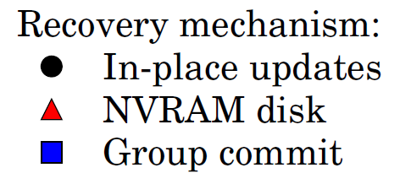
Transaction latency
Shown for 3µs persist barrier latency
Normalized to 0µs In-place updates
Batching increases throughput with less-than-disk latencies

Slide 35
Future work
Detailed description of Group Commit and quantitative demonstration of performance
Data structures and concurrency management
Methodology
Quantitative validation of timing model
Evaluation
Device lifetime and persist bandwidth constraints

Slide 36
Summary
OLTP not yet optimized for NVRAM
Methodology to evaluate unavailable devices
Recovery mechanisms to avoid software overheads and persist synchronization delays
Consider implications of increased read latency and caching solutions (in proposal)
Efficient barriers enable simple high performance recovery management

Slide 37
Outline
Flash analytics – leveraging fast random reads
NVRAM OLTP recovery management
Persistent Memory Consistency (PMC)
Ex: data structure and consistency models

Slide 38
Outline
Flash analytics – leveraging fast random reads
NVRAM OLTP recovery management
Persistent Memory Consistency (PMC)
Ex: data structure and consistency models

Slide 39
Persistent Programming
More than databases: recoverable data structures in NVRAM
Need intuitive mechanisms to establish NVRAM persist order
DRAM – cannot control write order
Disk – flush cache lines and sync. Unintuitive
Perform persists in program order – terrible performance! Must persist out of order
Persist ordering resembles memory consistency
Notes:
On one extreme we might assume that things persist in program order – no additional annotation required. On the other extreme we borrow the disk interface and flush individual cache lines (much harder to program for and unintuitive).

Slide 40
Memory consistency
Prefer to reorder instruction execution
Complicates multi-threaded applications
flag1, flag2 initialized to 0
(Dekker’s mutex without atomic RMW)
Thread 1:
flag1 = 1
if flag2 == 0:
# critical sec.
Thread 2:
flag2 = 1
if flag1 == 0:
# critical sec.

Slide 41
Memory consistency
Prefer to reorder instruction execution
Complicates multi-threaded applications
flag1, flag2 initialized to 0
(Dekker’s mutex without atomic RMW)
CPU might reorder
Thread 1:
flag1 = 1
barrier
if flag2 == 0:
# critical sec.
Thread 2:
flag2 = 1
barrier
if flag1 == 0:
# critical sec.
Improving performance requires user intervention

Slide 42
Persistent consistency
Concurrency control similar to persistence
Consistency: order in which stores are visible
Persistence: order in which persists are visible
Persist order must be enforced across threads
Leverage consistency to determine persist order
Persistent Memory Consistency (PMC)
Goal: motivate PMC as necessary, don’t consider precise implementations

Slide 43
Outline
Flash analytics – leveraging fast random reads
NVRAM OLTP recovery management
Persistent Memory Consistency (PMC)
Ex: data structure and consistency models

Slide 44
Outline
Flash analytics – leveraging fast random reads
NVRAM OLTP recovery management
Persistent Memory Consistency (PMC)
Ex: data structure and consistency models

Slide 45
Persistent log/buffer
Persistent array
Persistent counter marks valid end of array
On recovery: base through counter considered valid
0
1
2
3
Insert(obj, size):
lock()
start = &array[counter]
memcpy(start,obj,size)
counter += size
unlock()
Buffer
array
Counter = 1
Buffer data must persist before counter for correct recovery

Slide 46
Implications of persist order
Important optimization: execution runs ahead of persistent state via buffering
Persists still occur in consistent order
If average persist throughput less than average execution rate, buffers fill
Persist order constraints limit persist parallelism and throughput
Maximize performance by minimizing persist-order critical path

Slide 47
Persistent Sequential Consistency (PSC)
Strict
Persists occur strictly in program order, as valid interleaving of persists between threads
Persistent state tied to execution state
Running instruction implies previous persists complete
No barriers (ordering or sync) necessary
Buffered
Persistent state lags execution state
Requires sync barrier for external communication

Slide 48
PSC persist constraints
Buffer atomic segment
Persists before
Counter
Insert(obj, size):
lock()
start = &array[counter]
memcpy(start,obj,size)
counter += size
unlock()
100 byte entries
8 byte atomic persist
100ns persist
Can insert every 1.4 µs (slow)
Strict consistency requires no barriers but limits performance

Slide 49
Local Persist Order (LPO)
Remove unnecessary cross-thread ordering
Single threaded operation resembles PSC
Enforcing order across threads: 1st thread inserts persist-before, 2nd thread persist-after
Data sharing implies persist order
Similar to release-acquire consistency model

Slide 50
LPO persist constraints
Insert(obj, size):
lock()
start = &array[counter]
memcpy(start,obj,size)
persist_after # counter persists after last
counter += size
persist_before # counter persists before next
unlock()
Single-thread constraint
Allows buffer data from multiple threads to persist concurrently

Slide 51
Ideal Dependencies
Only enforce counter persist order, both within and across threads
Critical path: one barrier per insert

Slide 52
Example optimization
Skip persists to counter values
Requires all counter dependencies satisfied
Critical path: bounded constant

Slide 53
Possible directions
Evaluation
Assume naïve implementation, measure persist critical path of simple data structures
Is persist the bottleneck for each model?
Data structures
Buffer
OLTP/Shore-MT
Batching (from OLTP design)
Possible new consistency models

Slide 54
Backup slides

Slide 55
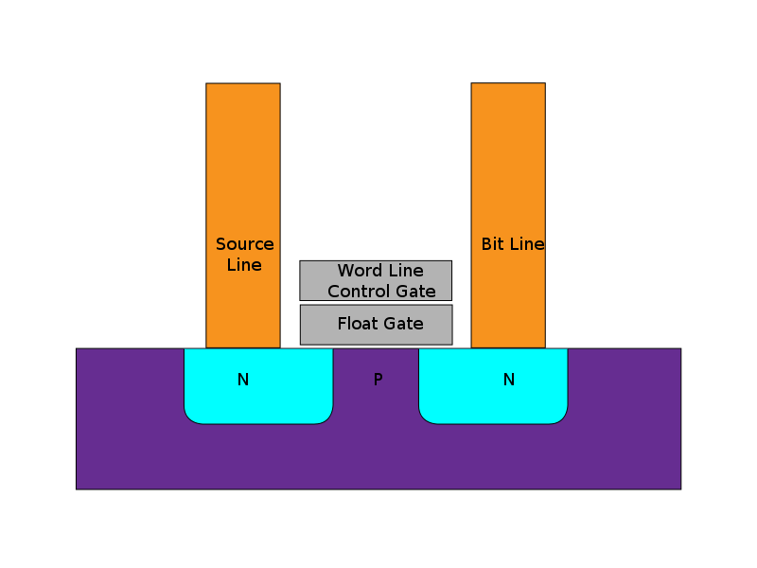
Flash memory
New durable storage popularized
by mobile devices
State stored in floating gate
Variable charge stored in
gate allows Multi-Level
Cells (MLC)
Limited write endurance
Image: Wikipedia
Flash now popular for high performance enterprise storage

Slide 56
Flash memory performance
 | Disk | Flash
Model | WD 10Krpm | OCZ RevoDrive
Seq. Read | 120MB/s | 190MB/s
Random Read | 10ms | 90µs
$/GB | .55 | 2.5
2011 devices
Flash much lower read latency than disk
Flash eliminates performance difference between random and sequential accesses
Current DBMS optimized for disk
Notes:
The sequential bandwidth is similar across devices, but random read is much faster on flash SSDs. Could possibly simplify DBMSs, which have long been optimized for high latency disks.
Say a bit more on this slide

Slide 57
SSD query plans unchanged
Flash gives better performance, but…
Query plans do not need to be changed on Flash
Using commercial DBMS – IBM DB2
0.9% of scan selectivities change access path
Join choice matters on disk, but not on Flash
Intelligent layout does not depend on query opt.
Notes:
Flash is best, but found that it wasn’t better for a set of queries
Performance difference that appears on disk disappears on flash
Mention commercial systems. Not sure where
Spend more time here.

Slide 58
Experimental structure
Focus on two key aspects of query plans
Access paths (scan type)
Join type
Force specific query plans and measure actual performance
Determine performance difference between devices

Slide 59
Methodology
IBM DB2 v9.7
Intel core 2 (dual core)
2GB memory
Disk: WD VelociRaptor 10Krpm drive
Flash: OCZ RevoDrive PCIe
Wisconsin Benchmark schema and data
Notes:
Limited Scope, but the simplicity of these experiments yields tremendous insight

Slide 60
Background: DB2 access paths
Table

Slide 61
Background: DB2 access paths
Table
Relation scan: high selectivity

Slide 62
Background: DB2 access paths
B-Tree index
Table
…

Slide 63
Background: DB2 access paths
B-Tree index
Table
…
Index scan: low selectivity

Slide 64
Background: DB2 access paths
B-Tree index
Table
…

Slide 65
Background: DB2 access paths
B-Tree index
Rowids
Table
{5;10}
{17;7}
{10;1}
{17;5}
…
Notes:
Add some addresses/numbers to the rowids (2 parts, page and tuple)

Slide 66
Background: DB2 access paths
B-Tree index
Rowids
Table
…
Rowid-sort scan: mid selectivities

Slide 67
Background: Selecting access path
Below 10% selectivity use index scan
Above 10% selectivity use relation scan
Relation scan
Runtime (time)
Index scan
Selectivity (%)
Flash’s low latency should shift break-even point to right

Slide 68
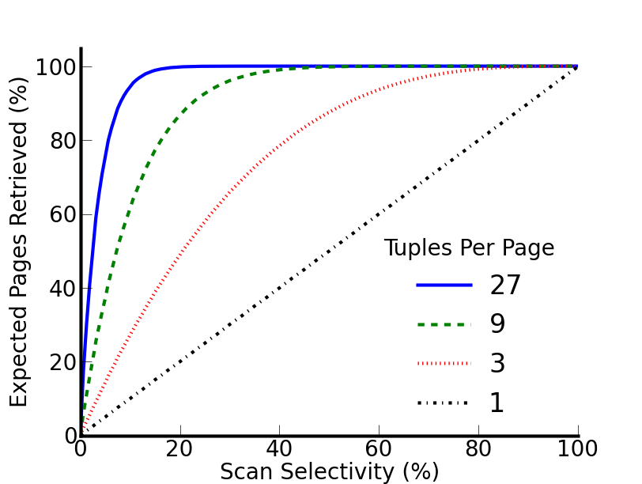
Why is the 10% rule wrong?
10% rule really applies to page selectivity
Index scan, uniform random layout:
[Yue et al.]
Notes:
Clean up this slide
If there were exactly 1 tuple per page we would see … but for a realistic 27 tuples per page…
Focus on tuple selectivity vs page selectivity
What follows from this is that the range where index scan works
Zoom in on a point? 3% on blue?

Slide 69
Why is the 10% rule wrong?
10% rule really applies to page selectivity
Index scan, uniform random layout:
27 tuples/page
at 4% row sel.
expect 67% pages
[Yue et al.]
Implication: relation scan preferred even on flash
Notes:
If there were exactly 1 tuple per page we would see … but for a realistic 27 tuples per page…
Focus on tuple selectivity vs page selectivity
What follows from this is that the range where index scan works
Zoom in on a point? 3% on blue?

Slide 70
Join
Join performance on disk depends on:
Algorithm
Relation sizes
Projectivity
These determine
Device access patterns
Data read and written to device

Slide 71
Join performance
Notes:
Explain database size relative to database size
Before I hit the button talk about these results more-
With one outlier, the best join type changes with projectivity

Slide 72
Join performance
Notes:
Focus on performance different between algorithms on flash

Slide 73
Join performance
CPU bound outlier
Flash insensitive to join type – 5.4% avg. difference w/o outlier

Slide 74
NVRAM
Both Flash and DRAM expected to stop scaling in the next few years
Need scalable dense replacements for both
Numerous technologies for “Storage Class Memory” or “Universal Memory”
Resistive RAM
Phase Change
Memristor
Magnetic RAM
STT RAM
FerroElectric RAM

Slide 75
NVRAM read performance
NVRAM read latency may be up to 5x DRAM read latency [IBM]
Greater if not connected via main memory bus
Require DRAM/on-chip cache to accelerate reads
Traditional software-managed DRAM buffer pool or hardware-managed DRAM cache?
Depends on capacity necessary to improve performance

Slide 76
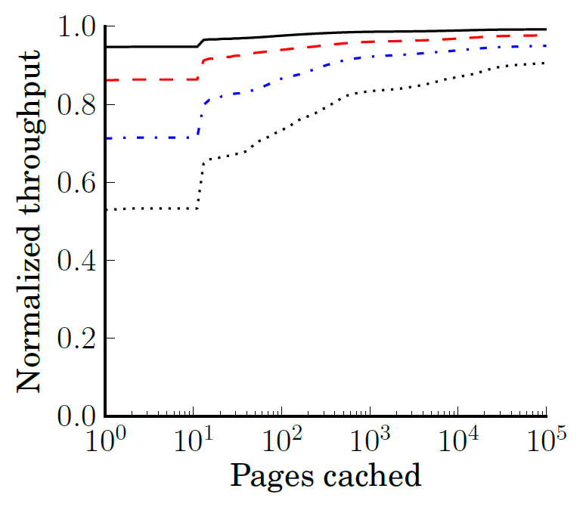
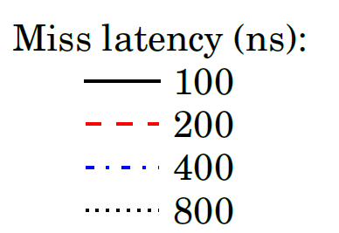
Read throughput
Caches likely required but even small capacity largely effective

Slide 77
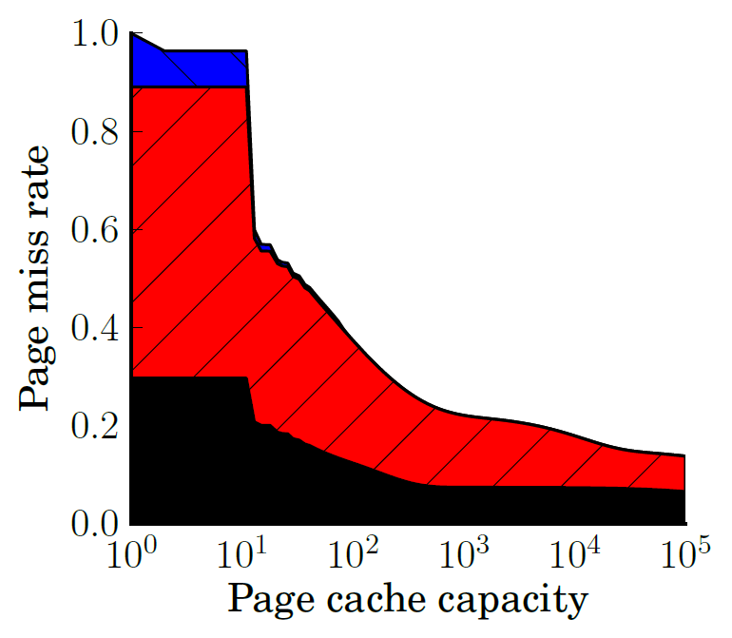

Caching
B-Trees, append-heavy, and small tables cache effectively

Slide 78
Group Commit future work
Journal only allows so much room
Group Commit large software effort
Useful mechanism for NVRAM persistence (not just OLTP)
Intend to include:
Description of new data structures to efficiently track and log dirty regions
Batch management to quickly persist batch

Slide 79
Methodology future work
Intend to include detailed study of timing model and bandwidth reservation
More detail
Quantify accuracy and limitations

Slide 80
Results future work
Intend to include quantitative study of:
Persist bandwidth required for each mechanism
Group commit is bursty, required more bandwidth
Device lifetime due to write endurance
Each recovery mechanism produces varying quantity of persists and distributes persists across addresses/cells differently
Prior work imagines hardware to distribute writes to the same address across numerous cells. Consider device lifetime with hardware ware-leveling

Slide 81
BPFS (Total Epoch Order)
Better I/O through byte-addressable, persistent memory – Condit et al.
Divide code into epochs with epoch barriers
Persists within same epoch occur in parallel
Persists may not reorder across barriers
Shared memory accesses w/ at least one write imply epoch order between threads
Propose hardware (cache extensions)
No races in persist epochs (even volatile synchronization)

Slide 82
BPFS (Total Epoch Order)
Insert(obj, size):
lock()
barrier
start = &array[counter]
memcpy(start,obj,size)
barrier
counter += size
barrier
unlock()
Buffer should persist in parallel with prev. counter
Restricts important programming patterns (batching)

Slide 83
Partial Epoch Order (PEO)
Consider epochs from separate threads concurrent if they contain a race
Subsequent epochs inherit order constraint
Insert(obj, size):
barrier
lock()
start = &array[counter]
memcpy(start,obj,size)
barrier
counter += size
unlock()
barrier
Similar to BPFS code
(barriers outside locks)
Buffer persists in parallel
with previous counter

Slide 84
Partial Epoch Order (PEO)
Race with counter orders with counter’s dependencies
Adjacent insert from same thread enforces ordering
Prevents deadlock. Removes most unnecessary constraints
Too complicated to be useful?

