Slide 1
Database and System Design for Emerging Storage Technologies
Steven Pelley
Thesis Proposal

Slide 2
Emerging storage technologies
Flash – driven by mobile
NVRAM – not readily available yet
Punchline – Device-specific optimizations enable additional performance increases

Slide 3
Storage characteristics
Flash – fast random reads
Writes still prefer sequential
Sequential reads on par with disk (per cost)
NVRAM – low latency byte addressability
Punchline: accelerate database applications, optimizing for these new storage technologies

Slide 4
Flash analytics optimization
Flash accelerates random reads

Slide 5
NVRAM OLTP optimization
Recovery mechanisms require high software overheads
Thread contention
Long code paths
Straightforward recovery by immediately enforcing persists incurs frequent persist barriers resulting in transaction delays
Introduce NVRAM Group Commit
Also look at reads

Slide 6
NVRAM programming models
Programming (at the assembly level) cannot order persists
Currently use consistency models to control the order that threads observe reads and writes
Can use similar models to control the order in which data persists (control within thread and between threads)
Want to provide best performance with easiest programming model

Slide 7
Outline
Flash Memory
Analytics
NVRAM technologies
NVRAM OLTP
NVRAM programming

Slide 8
Flash memory
 | Disk | Flash
Model | WD 10Krpm | OCZ RevoDrive
Seq. Read | 120MB/s | 190MB/s
Random Read | 10ms | 90µs
$/GB | .55 | 2.5
2011 devices
Flash much lower read latency than disk
Flash eliminates performance difference between random and sequential accesses
Current DBMS optimized for disk
Notes:
The sequential bandwidth is similar across devices, but random read is much faster on flash SSDs. Could possibly simplify DBMSs, which have long been optimized for high latency disks.
Say a bit more on this slide

Slide 9
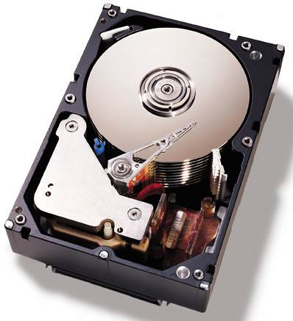
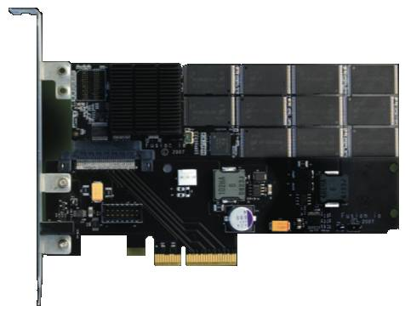
Taking advantage of SSDs
Data may “prefer” disk or flash
Intelligent layout:
Improve performance
Maintain low cost
Automated Layout
[Agrawal et al., Ozmen et al.]
Table 1: Accessed Sequentially
Table 2: Accessed Randomly
Optimal query plan should depend on where data resides
Notes:
Keeping this performance difference in mind, I came up with an idea.
Data may prefer either disk or flash
For example… scans
But the real contribution is that the optimal query plan, and thus performance, will depend on where the data resides.
So I needed to figure out exactly how query optimizers dealt with flash SSDs
Fix the colors in the table boxes

Slide 10
SSD query plans unchanged
Flash gives better performance, but…
Query plans do not need to be changed on flash
Using commercial DBMS – IBM DB2
0.9% of scan selectivities change access path
Join choice matters on disk, but not on flash
Intelligent layout does not depend on query opt.
Notes:
Flash is best, but found that it wasn’t better for a set of queries
Performance difference that appears on disk disappears on flash
Mention commercial systems. Not sure where
Spend more time here.

Slide 11
Experimental structure
Focus on two key aspects of query plans
Access paths (scan type)
Join type
Force specific query plans and measure actual performance
Determine performance difference between devices

Slide 12
Methodology
IBM DB2 v9.7
Intel core 2 (dual core)
2GB memory
Disk: WD VelociRaptor 10Krpm drive
Flash: OCZ RevoDrive PCIe
Wisconsin Benchmark schema and data
Notes:
Limited Scope, but the simplicity of these experiments yields tremendous insight

Slide 13
Background: DB2 access paths
Table

Slide 14
Background: DB2 access paths
Table
Relation scan: high selectivity

Slide 15
Background: DB2 access paths
B-Tree index
Table
…

Slide 16
Background: DB2 access paths
B-Tree index
Table
…
Index scan: low selectivity

Slide 17
Background: DB2 access paths
B-Tree index
Table
…

Slide 18
Background: DB2 access paths
B-Tree index
Rowids
Table
{5;10}
{17;7}
{10;1}
{17;5}
…
Notes:
Add some addresses/numbers to the rowids (2 parts, page and tuple)

Slide 19
Background: DB2 access paths
B-Tree index
Rowids
Table
…
Rowid-sort scan: mid selectivities

Slide 20
Background: Selecting access path
Below 10% selectivity use index scan
Above 10% selectivity use relation scan
Relation scan
Runtime (time)
Index scan
Selectivity (%)
Flash’s low latency should shift break-even point to right

Slide 21
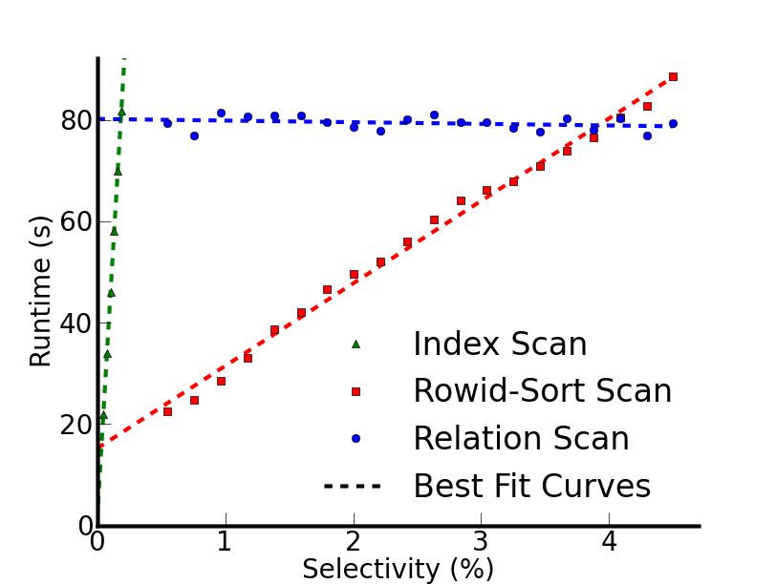
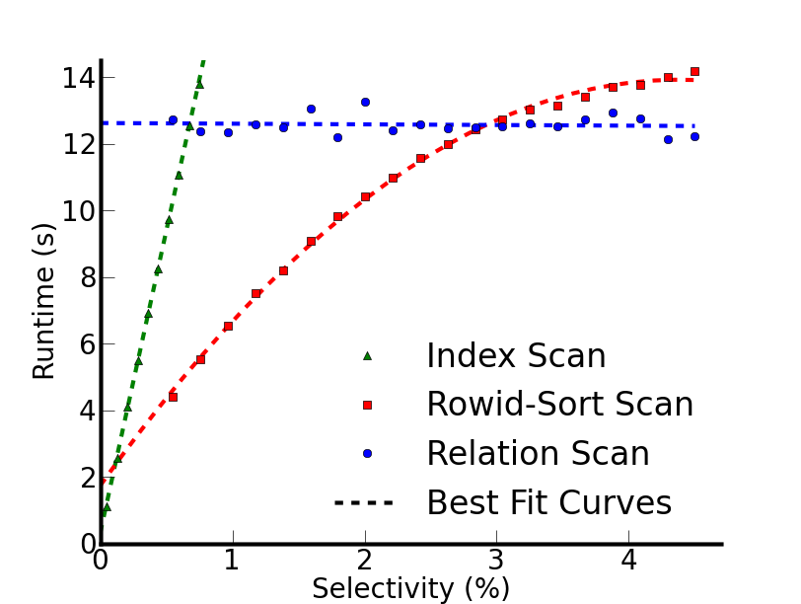
Actual performance
Disk
Flash
Break-even points at lower selectivity than expected
Break-even points shift for only 0.9% selectivities
Notes:
Distinguish between previous index line and the rowid-sort scan
Scans start with cold data

Slide 22
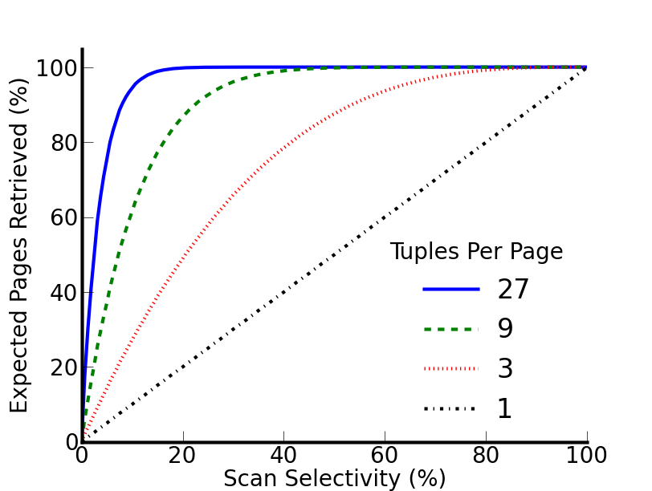
Why is the 10% rule wrong?
10% rule really applies to page selectivity
Index scan, uniform random layout:
[Yue et al.]
Notes:
Clean up this slide
If there were exactly 1 tuple per page we would see … but for a realistic 27 tuples per page…
Focus on tuple selectivity vs page selectivity
What follows from this is that the range where index scan works
Zoom in on a point? 3% on blue?

Slide 23
Why is the 10% rule wrong?
10% rule really applies to page selectivity
Index scan, uniform random layout:
27 tuples/page
at 4% row sel.
expect 67% pages
[Yue et al.]
Implication: relation scan preferred even on flash
Notes:
If there were exactly 1 tuple per page we would see … but for a realistic 27 tuples per page…
Focus on tuple selectivity vs page selectivity
What follows from this is that the range where index scan works
Zoom in on a point? 3% on blue?

Slide 24
Join
Join performance on disk depends on:
Algorithm
Relation sizes
Projectivity
These determine
Device access patterns
Data read and written to device

Slide 25
Join performance
Notes:
Explain database size relative to database size
Before I hit the button talk about these results more-
With one outlier, the best join type changes with projectivity

Slide 26
Join performance
Notes:
Focus on performance different between algorithms on flash

Slide 27
Join performance
CPU bound outlier
Flash insensitive to join type – 5.4% avg. difference w/o outlier

Slide 28
What does this really say
Little opportunity for taking advantage of device-dependent query optimization
Large access granularity interferes with flash’s low random read latency
Rather disk-optimizations that provide locality within page (use entire page on access) are already optimized for Flash
Need Flash-specific operations before reconsidering query planning

Slide 29
VLDB

Slide 30
NVRAM programming models
Programming models/hardware systems cannot enforce persist order
Modern systems need to reorder instructions to improve performance
NVRAM’s high latency makes this more important
How is persist order determined/enforced within thread? Across threads?
Punchline: Tradeoff between performance and ease of programming
Notes:
On one extreme we might assume that things persist in program order – no additional annotation required. On the other extreme we borrow the disk interface and flush individual cache lines (much harder to program for and unintuitive).

Slide 31
Leverage memory consistency
Persistence similar to memory consistency
Defines the order of loads and stores to memory between threads
Models may be relaxed to improve performance while still easily programming common patterns
Instead of order and values of loads and stores, now care about persist order
Persistent Memory Consistency

Slide 32
Persistent Memory Consistency
High performance recoverable data structures with minimal software modifications
Demonstrate new consistency models and reason about their performance
Future: evaluate models and data structures
Point of this project is to motivate that PMC is necessary and effective, not to consider exact implementations

Slide 33
Implications of persist order
Persist barriers order and sync
Volatile execution may run ahead of persistent state via buffering
Persist throughput determines when persists slow execution (buffers might fill)
Persist order constraints limit persist throughput/parallelism

Slide 34
Consistency models
Allow memory operations to reorder for performance
Foundation for persistent consistency
Mechanism to order actions
PMC relies on underlying consistency model to establish persist order between threads
Sequential Consistency (SC)
Total Store Order (TSO)
Release Consistency (RC)

Slide 35
Sequential Consistency

Slide 36
Total Store Order

Slide 37
Release Consistency

Slide 38
Persistent Log/Buffer
For each model provide the code snippet and highlight the dependences for single thread and multithreaded separately (animate in and out).

Slide 39
Persistent Sequential Consistency (PSC)

Slide 40
Local Persist Order (LPO)

Slide 41
BPFS (TEO)

Slide 42
Partial Epoch Order (PEO)

