Slide 1
Database and System Design for Emerging Storage Technologies
Steven Pelley
Thesis Proposal

Slide 2
Emerging storage technologies
Flash memory
Nonvolatile Memory (NVRAM)
Phase Change (PCRAM)
Memristor (HP)
Spin-Torque Transfer (STT-RAM)
Storage technology | Random read latency
Disk | 10ms
Flash | 90µs
NVRAM | 50-1000ns [IBM]
Devices offer immediate performance increase over disk

Slide 3
Optimizing systems for Flash/NVRAM
Decades of research/engineering to avoid random access on disk
Redesign/optimize database applications for most relevant storage technology
Analytics (DSS) on Flash
Transaction Processing (OLTP) on NVRAM
Ongoing: Persistent Memory Consistency
Intuitive mechanisms to enable high persist throughput and enforce proper recovery

Slide 4
Flash analytics optimization
Flash favors random data access
relative to disk.
Ex: Scans that return < 10% of
table should use index, > 10%
scan entire table.
Expect to shift right with Flash
Relation scan
Runtime (time)
Index scan
Selectivity (%)
ADMS 2011 – Flash-specific query planning for scans/joins
Negative result. Queries rarely affected.

Slide 5
NVRAM OLTP optimization
Recovery management benefits from NVRAM’s low-latency persistent writes
Existing systems not optimized for NVRAM
Disk optimizations impose unnecessary overheads
Greater-than-DRAM read latency
Persist barriers introduce delays to enforce persist order necessary for recovery
Under review at VLDB

Slide 6
NVRAM programming models
Existing main memory systems not equipped for durability
Cannot order writes to the device (persist barrier)
Programming interfaces do not imply persist order
Similar to memory consistency models
Define order that writes observed
Persistence defines order that persists observed
Ongoing: Persistent Memory Consistency

Slide 7

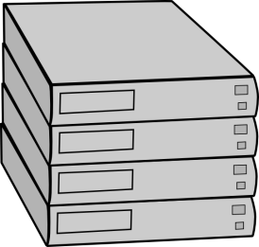
Additional work (not included)
Understanding and Abstracting Total Data Center Power
WEED 2009
PowerRouting: Dynamic Power Provisioning in the DataCenter
?

Slide 8
Outline
Flash Memory
Analytics
NVRAM technologies
NVRAM OLTP
NVRAM programming

Slide 9
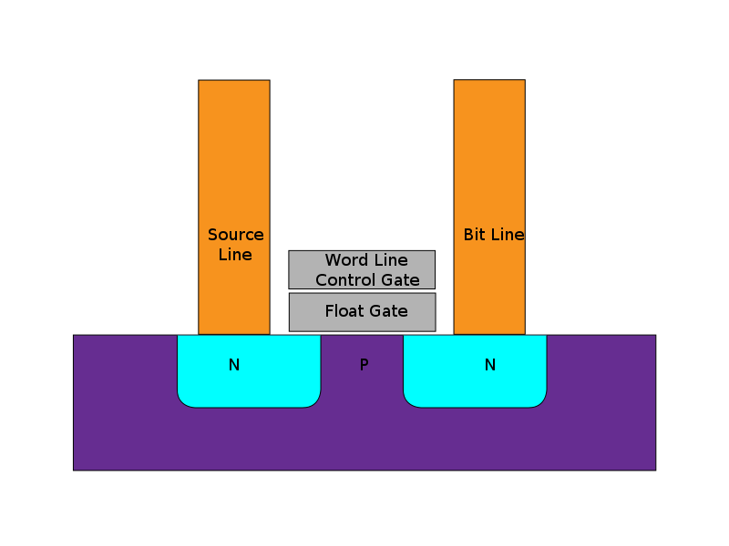
Flash memory
New durable storage popularized
by mobile devices
State stored in floating gate
Variable charge stored in
gate allows Multi-Level
Cells (MLC)
Limited write endurance
Image: Wikipedia
Flash now popular for high performance enterprise storage

Slide 10
Flash memory performance
 | Disk | Flash
Model | WD 10Krpm | OCZ RevoDrive
Seq. Read | 120MB/s | 190MB/s
Random Read | 10ms | 90µs
$/GB | .55 | 2.5
2011 devices
Flash much lower read latency than disk
Flash eliminates performance difference between random and sequential accesses
Current DBMS optimized for disk
Notes:
The sequential bandwidth is similar across devices, but random read is much faster on flash SSDs. Could possibly simplify DBMSs, which have long been optimized for high latency disks.
Say a bit more on this slide

Slide 11
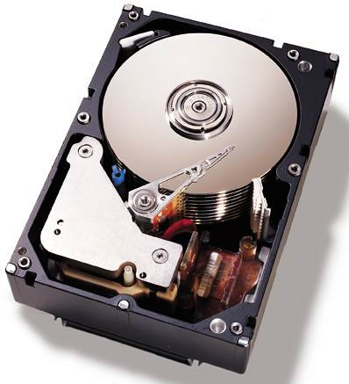
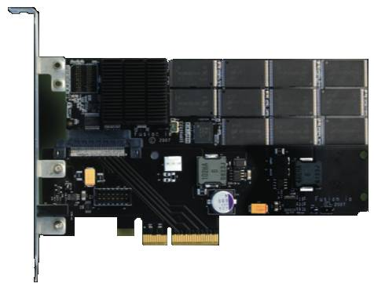
Taking advantage of SSDs
Data may “prefer” disk or Flash
Intelligent layout:
Improve performance
Maintain low cost
Automated Layout
[Agrawal et al., Ozmen et al.]
Table 1: Accessed Sequentially
Table 2: Accessed Randomly
Optimal query plan should depend on where data resides
Notes:
Keeping this performance difference in mind, I came up with an idea.
Data may prefer either disk or flash
For example… scans
But the real contribution is that the optimal query plan, and thus performance, will depend on where the data resides.
So I needed to figure out exactly how query optimizers dealt with flash SSDs
Fix the colors in the table boxes

Slide 12
SSD query plans unchanged
Flash gives better performance, but…
Query plans do not need to be changed on Flash
Using commercial DBMS – IBM DB2
0.9% of scan selectivities change access path
Join choice matters on disk, but not on Flash
Intelligent layout does not depend on query opt.
Notes:
Flash is best, but found that it wasn’t better for a set of queries
Performance difference that appears on disk disappears on flash
Mention commercial systems. Not sure where
Spend more time here.

Slide 13
Experimental structure
Focus on two key aspects of query plans
Access paths (scan type)
Join type
Force specific query plans and measure actual performance
Determine performance difference between devices

Slide 14
Methodology
IBM DB2 v9.7
Intel core 2 (dual core)
2GB memory
Disk: WD VelociRaptor 10Krpm drive
Flash: OCZ RevoDrive PCIe
Wisconsin Benchmark schema and data
Notes:
Limited Scope, but the simplicity of these experiments yields tremendous insight

Slide 15
Background: DB2 access paths
Table

Slide 16
Background: DB2 access paths
Table
Relation scan: high selectivity

Slide 17
Background: DB2 access paths
B-Tree index
Table
…

Slide 18
Background: DB2 access paths
B-Tree index
Table
…
Index scan: low selectivity

Slide 19
Background: DB2 access paths
B-Tree index
Table
…

Slide 20
Background: DB2 access paths
B-Tree index
Rowids
Table
{5;10}
{17;7}
{10;1}
{17;5}
…
Notes:
Add some addresses/numbers to the rowids (2 parts, page and tuple)

Slide 21
Background: DB2 access paths
B-Tree index
Rowids
Table
…
Rowid-sort scan: mid selectivities

Slide 22
Background: Selecting access path
Below 10% selectivity use index scan
Above 10% selectivity use relation scan
Relation scan
Runtime (time)
Index scan
Selectivity (%)
Flash’s low latency should shift break-even point to right

Slide 23
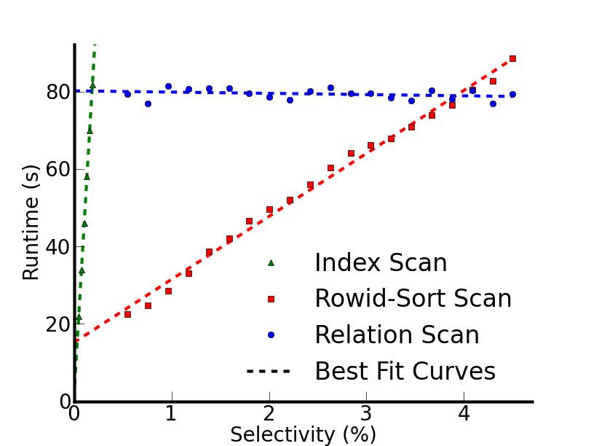
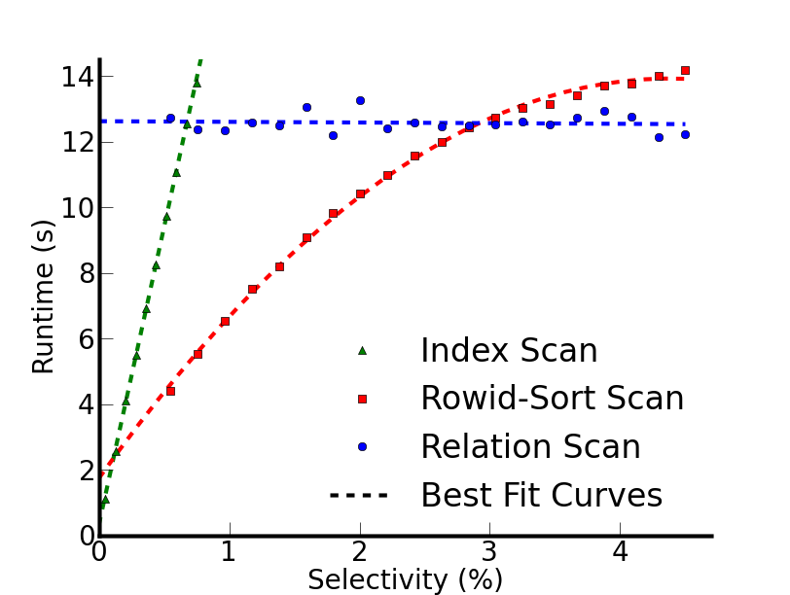
Actual performance
Disk
Flash
Break-even points at lower selectivity than expected
Break-even points shift for only 0.9% selectivities
Notes:
Distinguish between previous index line and the rowid-sort scan
Scans start with cold data

Slide 24
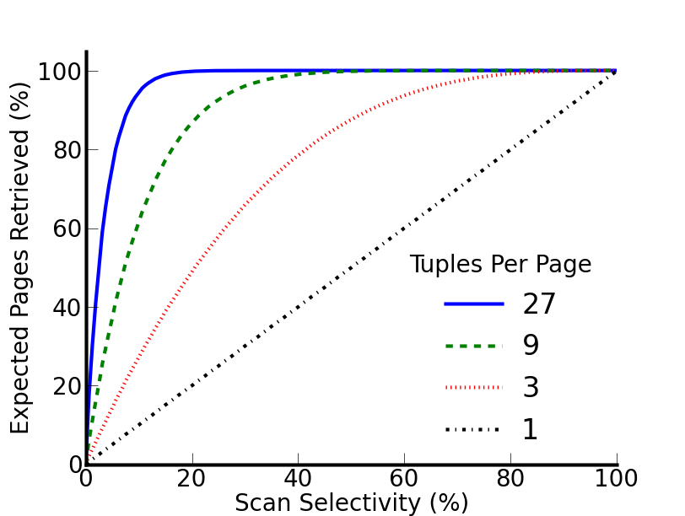
Why is the 10% rule wrong?
10% rule really applies to page selectivity
Index scan, uniform random layout:
[Yue et al.]
Notes:
Clean up this slide
If there were exactly 1 tuple per page we would see … but for a realistic 27 tuples per page…
Focus on tuple selectivity vs page selectivity
What follows from this is that the range where index scan works
Zoom in on a point? 3% on blue?

Slide 25
Why is the 10% rule wrong?
10% rule really applies to page selectivity
Index scan, uniform random layout:
27 tuples/page
at 4% row sel.
expect 67% pages
[Yue et al.]
Implication: relation scan preferred even on flash
Notes:
If there were exactly 1 tuple per page we would see … but for a realistic 27 tuples per page…
Focus on tuple selectivity vs page selectivity
What follows from this is that the range where index scan works
Zoom in on a point? 3% on blue?

Slide 26
Join
Join performance on disk depends on:
Algorithm
Relation sizes
Projectivity
These determine
Device access patterns
Data read and written to device

Slide 27
Join performance
Notes:
Explain database size relative to database size
Before I hit the button talk about these results more-
With one outlier, the best join type changes with projectivity

Slide 28
Join performance
Notes:
Focus on performance different between algorithms on flash

Slide 29
Join performance
CPU bound outlier
Flash insensitive to join type – 5.4% avg. difference w/o outlier

Slide 30
What does this really say
Little opportunity for taking advantage of device-dependent query optimization
Large access granularity interferes with flash’s low random read latency
Disk-optimizations that provide page locality (use entire page on access) already optimized for Flash
Future NVRAMs provide fine-grained access
NVRAM analytics strongly resembles DRAM
NVRAM holds promise for recovery management

Slide 31
NVRAM
Both Flash and DRAM expected to stop scaling in the next few years
Need scalable dense replacements for both
Numerous technologies for “Storage Class Memory” or “Universal Memory”
Resistive RAM
Phase Change
Memristor
Magnetic RAM
STT RAM
FerroElectric RAM

Slide 32
NVRAM characteristics
Low latency, byte addressable reads and writes
Often asymmetric (write lat. ~5x read lat.)
Unlike DRAM, writes do not benefit from caching
MLC slows both reads and writes
Write endurance concerns
Possible interfaces – implies varied latency
Disk replacement
PCIe attached
Main memory bus

Slide 33
NVRAM Transaction Processing
Online Transaction Processing (OLTP) relies on durability for recovery management
Modern recovery management optimized for disk [ARIES]
Faster storage provides low latency recovery and greater transaction throughput
Define persist: write to NVRAM durably

Slide 34
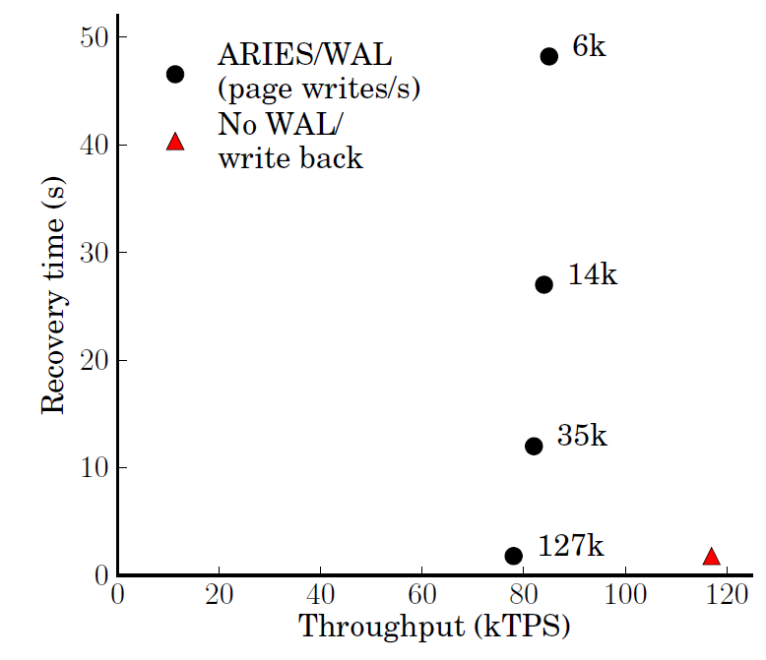
NVRAM OLTP opportunity
~ 30 15krpm disks
or 3 Flash SSDs
[device IOPS rates: Symantec]
Disk-management overheads impose bottleneck
As disk replacement NVRAM enables near-instant recovery

Slide 35
NVRAM OLTP study
Recovery management
NVRAM Disk-Replacement has software overhead
Persist to NVRAM immediately as In-Place Updates, enforcing persist order with persist barriers incurs frequent synchronization delays
Introduce NVRAM Group Commit to minimize barrier frequency
Read performance
NVRAM read latency greater than DRAM
Is DRAM caching necessary? Hardware/Software?

Slide 36
ARIES Recovery Management
Store
xct 1
xct 2
xct 1
Log
redo
undo
redo
undo
redo
undo
Redo entries record how to repeat action
Undo entries record how to remove action
Log transforms random writes into sequential writes

Slide 37
ARIES Recovery Management
Page may only write back after corresponding log entry persists
Store
Transactions mark commit/abort
In the log. Must persist before responding to client
xct 1
xct 2
xct 1
xct 2
Log
redo
undo
redo
undo
redo
undo
commit
Transactions only stall on disk write at commit

Slide 38
ARIES Recovery Management
On failure:
Replay log to reproduce state at the time of failure. Fetch necessary store pages
Apply undo to remove any in-flight transactions
Store
xct 1
xct 2
xct 1
xct 2
Log
redo
undo
redo
undo
redo
undo
commit
Log is sufficient to maintain durable consistent state

Slide 39
ARIES Recovery Management
Overheads:
Serialized log introduces large code paths and high contention
Frequent page flushing creates contention on hot page latches
Page and log flusher threads use CPU time
Store
xct 1
xct 2
xct 1
xct 2
Log
redo
undo
redo
undo
redo
undo
commit
Optimizations necessary for disk now only get in the way

Slide 40
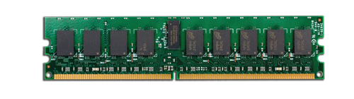
In-Place Updates
Persist updates in place
No more redo log No replay at recovery
Requires per-action log to make page updates atomic
Requires persist barriers, causing transaction to stall
Store
xct 1
xct 2
xct 1
xct 2
Undo logs now transaction local. Transactions commit by persistently invalidating undo logs
Log
redo
undo
redo
undo
redo
undo
commit
Remove centralized log, but transactions incur persist delays

Slide 41
Choosing recovery mechanism
With low persist barrier latency In-Place Updates will outperform NVRAM Disk-Replacement
As persist barrier delay increases NVRAM Disk-Replacement eventually wins
Where is this break even point?
Can we provide a design to simultaneously minimize software overhead and barriers?
NVRAM Group Commit

Slide 42
NVRAM Group Commit
Similar to Disk Group Commit
Defer transaction commit to commit transactions in batches.
Transactions write to volatile staging buffer
Transactions quiesce between batches
Quiesced time must be small relative to batch
When batch completes first persist log (copy) of all batch updates, then all updates in place
No centralized logging, minimal barriers, but increases xct latency
Notes:
Mention support for filling buffer and long transactions

Slide 43
Group Commit future work
Journal only allows so much room
Group Commit large software effort
Useful mechanism for NVRAM persistence (not just OLTP)
Intend to include:
Description of new data structures to efficiently track and log dirty regions
Batch management to quickly persist batch

Slide 44
NVRAM read performance
NVRAM read latency may be up to 5x DRAM read latency [IBM]
Greater if not connected via main memory bus
Require DRAM/on-chip cache to accelerate reads
Traditional software-managed DRAM buffer pool or hardware-managed DRAM cache?
Depends on capacity necessary to improve performance

Slide 45
Methodology
Shore-MT with Aether logging
Run Shore on real hardware
Log and Stores on RAMDisk
Introduce precise delays (20ns precision using x86 RDTSCP) to model persist barrier latency
Model persist bandwidth constraints with shared variable reservation
Build recovery mechanisms in Shore
Rely on dirty bit fields to track how much of buffer pool is written during transaction/page latch

Slide 46
Methodology Cont.
Read performance analysis
Use PIN [Intel] to create NVRAM memory trace
Simulate page cache
Calculate average stall per page latch. Insert in timing model
three workloads
TPCB
TPCC
TATP

Slide 47
Methodology future work
Intend to include detailed study of timing model and bandwidth reservation
More detail
Quantify accuracy and limitations

Slide 48
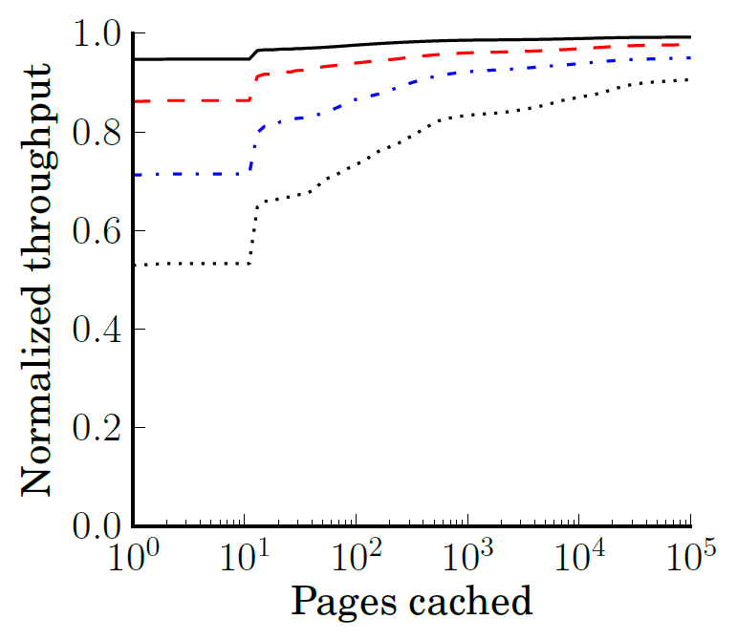
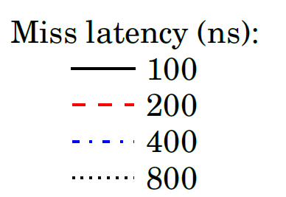
Read throughput
Caches likely required but even small capacity largely effective

Slide 49
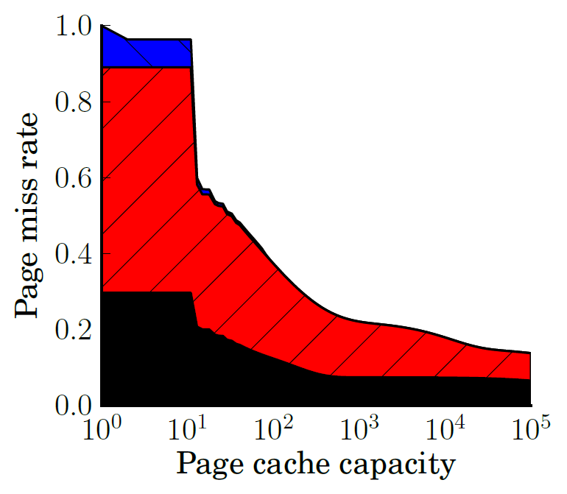

Caching
B-Trees, append-heavy, and small tables cache effectively

Slide 50
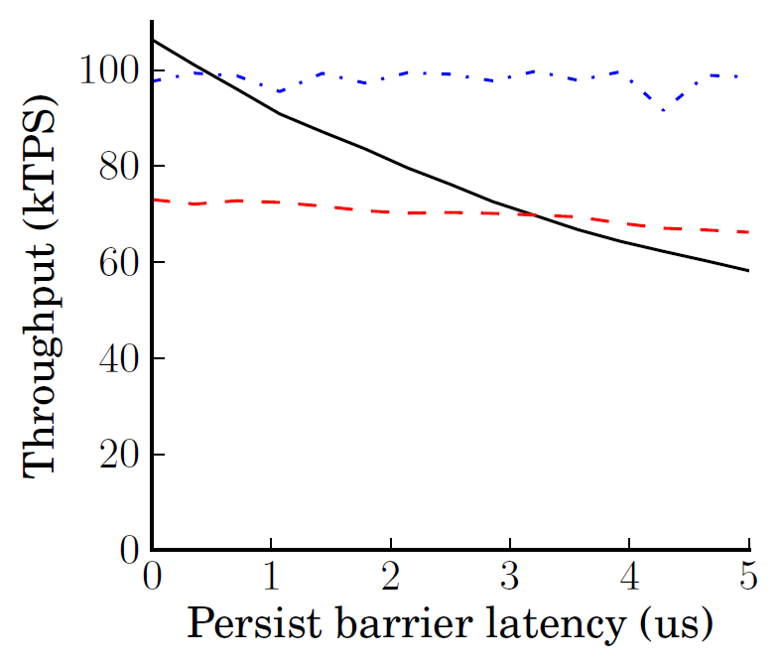
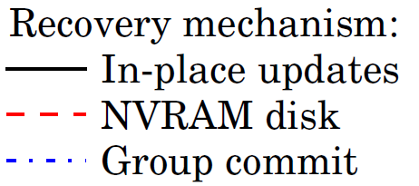
Recovery management performance
Group commit useful above 2µs but increases xct latency

Slide 51
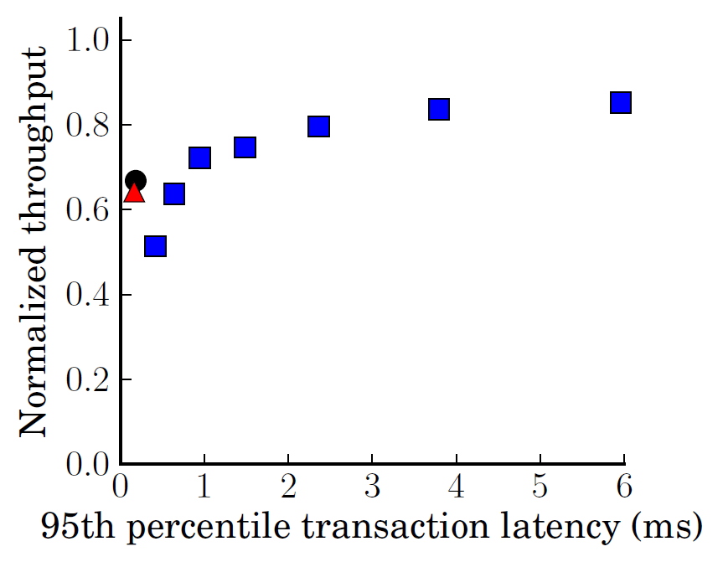
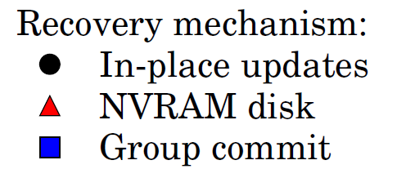
Transaction latency
Shown for 3µs persist barrier latency
Normalized to 0µs In-place updates
Batching increases throughput with less-than-disk latencies

Slide 52
Results future work
Intend to include quantitative study of:
Persist bandwidth required for each mechanism
Group commit is bursty, required more bandwidth
Device lifetime due to write endurance
Each recovery mechanism produces varying quantity of persists and distributes persists across addresses/cells differently
Prior work imagines hardware to distribute writes to the same address across numerous cells. Consider device lifetime with hardware ware-leveling

Slide 53
Summary
OLTP not yet optimized for NVRAM
I outline an interesting methodology to evaluate devices that aren’t readily available
I consider the effect of increased read latency on caching architectures for NVRAM
I observe that disk optimizations introduce substantial software overheads and propose new designs to avoid these overheads and persist barriers

Slide 54
Persistent Programming
How are persist barriers implemented?
Need intuitive programming models to reason about NVRAM persistence
Disk interface – flush cache lines and sync. Must know data cache lines and produces delays
DRAM interface – cannot control write order
Perform all persists in program order – terrible performance! Must persist out of order
Performance/programmability tradeoff like memory consistency
Notes:
On one extreme we might assume that things persist in program order – no additional annotation required. On the other extreme we borrow the disk interface and flush individual cache lines (much harder to program for and unintuitive).

Slide 55
Memory consistency
Prefer to reorder instruction execution
Complicates multi-threaded applications
flag1, flag2 initialized to 0
(Dekker’s mutex without atomic RMW)
Thread 1:
flag1 = 1
if flag2 == 0:
# critical sec.
Thread 2:
flag2 = 1
if flag1 == 0:
# critical sec.

Slide 56
Memory consistency
Prefer to reorder instruction execution
Complicates multi-threaded applications
flag1, flag2 initialized to 0
(Dekker’s mutex without atomic RMW)
Might reorder
Thread 1:
flag1 = 1
barrier
if flag2 == 0:
# critical sec.
Thread 2:
flag2 = 1
barrier
if flag1 == 0:
# critical sec.
Improved performance requires user intervention

Slide 57
Why memory consistency?
Concurrency control similar to persistence
Consistency: order in which stores are visible
Persistence: order in which persists are visible
Persist order must be enforced across threads
Leverage consistency to determine persist order
Extend memory consistency with persistence
Persistent Memory Consistency (PMC)

Slide 58
Persistent Memory Consistency goals
High performance recoverable data structures with minimal software modifications
Demonstrate new consistency models and reason about their performance
Future: evaluate models and data structures
motivate PMC as necessary and effective, don’t consider precise implementations

Slide 59
Progress
Reason about persist performance
What makes a high-performance consistency model?
Demonstrate a simple data structure
Introduce new consistency models

Slide 60
Implications of persist order
Important optimization: execution runs ahead of persistent state via buffering
Persists still occur in consistent order
If average persist throughput less than average execution rate, buffers fill
Persist order constraints limit persist throughput/parallelism
Maximize performance by minimizing persist order critical path

Slide 61
Persistent consistency models
Define/Constrain the order of persists
Parallel persists in single-threaded code
Consistency and persistence -- does thread reading persistent value from 2nd thread imply order?
Sync – how to enforce that execution state equals persistent state
Implementation is separate!
Implementations allow any optimization so long as appearance of model is maintained

Slide 62
Example – persistent log/buffer
Persistent array
Persistent counter marks valid end of array
On recovery: base to counter considered valid
0
1
2
3
Insert(obj, size):
lock()
start = &array[counter]
memcpy(start,obj,size)
counter += size
unlock()
Buffer
array
Counter = 1
Buffer data must persist before counter

Slide 63
Persistent Sequential Consistency (PSC)
Buffer atomic segment
Persists before
Tail LSN
Insert(obj, size):
lock()
start = &array[counter]
memcpy(start,obj,size)
counter += size
unlock()
Assume:
100 byte entries
8 byte atomic persist
100ns persist
Can insert every 1.4 µs
Strict consistency limits performance

Slide 64
Local Persist Order (LPO)
Remove unnecessary cross-thread ordering
Within thread all persists in program order
Enforcing order across threads: 1st thread inserts persist-before, 2nd thread persist-after
Any data sharing between threads implies order
Similar to release-acquire semantics

Slide 65
Local Persist Order (LPO)
Insert(obj, size):
lock()
start = &array[counter]
memcpy(start,obj,size)
persist_after # counter persists after last
counter += size
persist_before # counter persists before next
unlock()
Single-thread constraint
Allows buffer data from multiple threads to persist concurrently

Slide 66
BPFS (Total Epoch Order)
Better I/O through byte-addressable, persistent memory – Condit et al.
Divide code into epochs with epoch barriers
Persists within same epoch occur in parallel
Persists may not reorder across barriers
Shared memory accesses w/ at least one write imply epoch order between threads
Propose hardware (cache extensions)
No races in persist epochs (even volatile synchronization)

Slide 67
BPFS (Total Epoch Order)
Insert(obj, size):
lock()
barrier
start = &array[counter]
memcpy(start,obj,size)
barrier
counter += size
barrier
unlock()
Buffer should persist in parallel with prev. counter
Restricts important programming patterns (batching)

Slide 68
Partial Epoch Order (PEO)
Consider epochs from separate threads concurrent if they contain a race
Subsequent epochs inherit order constraint
Insert(obj, size):
barrier
lock()
start = &array[counter]
memcpy(start,obj,size)
barrier
counter += size
unlock()
barrier
Similar to BPFS code
(barriers outside locks)
Buffer persists in parallel
with previous counter

Slide 69
Partial Epoch Order (PEO)
Race with counter orders with counter’s dependencies
Adjacent insert from same thread enforces ordering
Prevents deadlock. Removes most unnecessary constraints
Too complicated to be useful?

Slide 70
Ideal Dependencies
Only enforce counter persist order, both within and across threads

Slide 71
Future optimizations
Implementation in hardware allows opt.
E.g., skip persists to counter

Slide 72
Future work
Evaluation
Assume naïve implementation, measure persist critical path of simple data structures
Is persist the bottleneck for each model?
Data structures
Buffer
OLTP/Shore-MT
Batching (from OLTP design)
Possible new consistency models

