Slide 1
High Performance Transaction Processing for NVRAM
Steven Pelley, Thomas F. Wenisch
University of Michigan

Slide 2
Nonvolatile memory (NVRAM)
New NVRAMs provide fast, scalable storage (phase change, memristor, STT-RAM)
Storage technology | Random read latency | Durable?
Disk | 10ms | ✓
Flash | 90µs | ✓
DRAM | 100ns | ✗
NVRAM | 50-1000ns [IBM] | ✓
NVRAM enables persistent main memory

Slide 3
Recoverable systems
Must protect data through failure
E.g., file systems and databases
Typically rely on disk, flash for persistent storage
NVRAM provides faster persistent storage
Byte-addressable (native memory instructions) further decrease execution overheads
High performance data structures (main-memory/DRAM speed) that recover instantly
NVRAM requires new recovery mechanisms

Slide 4
Optimizing NVRAM services
Case study of transaction processing [VLDB]
NVRAM as a disk replacement (ARIES)
Fast NVRAM imposes frequent persist ordering
New software design to avoid ordering delays
Explore desirable optimizations and semantics for NVRAM memory systems

Slide 5
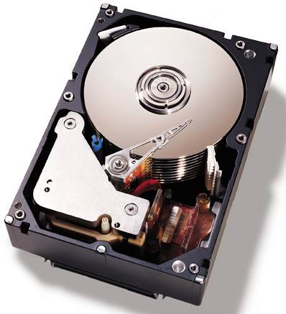
NVRAM as a disk replacement
Write Ahead Logging (WAL) via ARIES
Defer persists
Persist from specialized threads
Serialize log records
Transaction thread
Update
Log flusher
Log buffer
Page flusher
Buffer cache
Complexity necessary for slow disk now excessive overhead

Slide 6
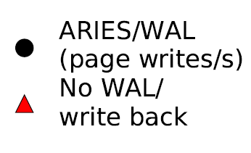
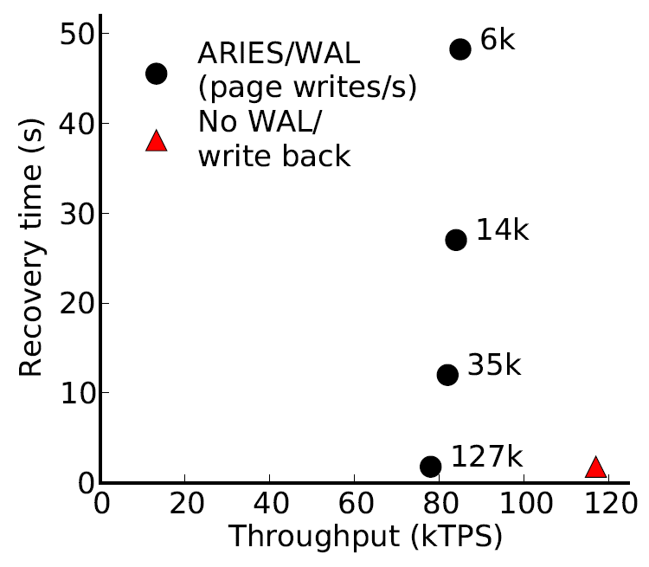
Disk replacement performance
~ 30 15krpm disks
or 3 Flash SSDs
[device IOPS rates: Symantec]
TPCB benchmark
Disk-management overheads impose bottleneck
As disk replacement NVRAM enables near-instant recovery

Slide 7
Ordering persists directly: persist barriers
Barriers proposed in Better I/O Through Byte-Addressable Persistent Memory [SOSP ‘09]
Persists following barrier instruction may not complete before persists prior to barrier
Persists that are not separated by barrier instruction are concurrent
Barriers delay execution
Frequency of barriers and exposed barrier latency determines resulting performance

Slide 8
NVRAM in-place updatess
Persist immediately
Remove centralized log
Barriers necessary at each update
Transaction thread
Update
Transaction log
Heap
Simple, removes software overhead, but frequent persist ordering

Slide 9
NVRAM Group Commit
Time
Persist barriers
Undo log
Persist store
Transactions quiesce at end of batch
Overwritten data persists as log and updates persist in place
NVRAM
log
Volatile update
buffer
NVRAM
store

Slide 10
NVRAM Group Commit
Time
Persist barriers
Undo log
Persist store
Constant number of persist barriers per batch
No centralized logging
Throughput high so long as batch quiesce/persist short
Several other tradeoffs (e.g., increased transaction latency)

Slide 11
Modeling unavailable devices
Run database on real hardware
Log and Stores on RAMDisk
Introduce precise delays (20ns precision using x86 RDTSCP) to model persist barrier latency
Build recovery mechanisms in software
Shore-MT: research platform for high performance transaction processing
Rely on dirty bit fields to track buffer pool writes during transaction, page latch, or batch

Slide 12
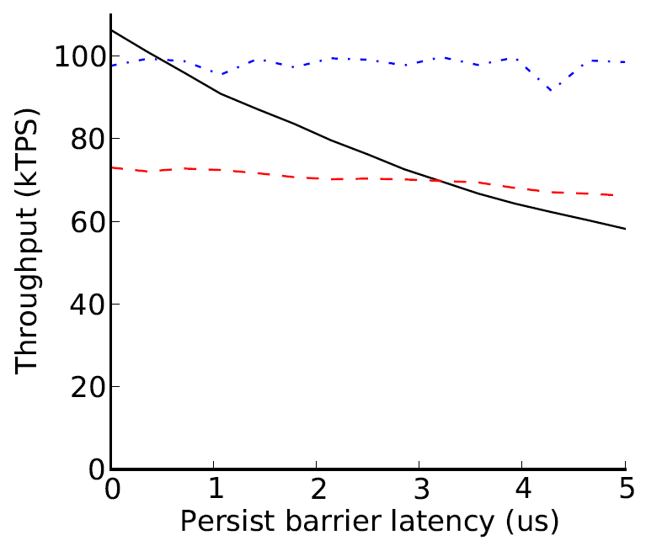
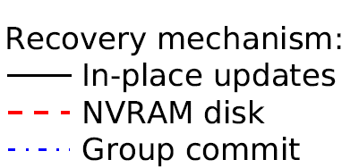
Recovery management performance
TPCB benchmark
Group commit helps, but high performance barriers ideal

Slide 13
Practical persist barriers
Asynchronous persists
Allow execution to proceed ahead of persists
Investigated by prior work (e.g., [BPFS])
Persist ordering critical path limits persist rate
Persist coalescing
Omit persists when no ordering violated
Acts as bandwidth filter (like write-back cache)
Reduces persists to hot data (aiding wear leveling)
Reduces persist ordering critical path
Need new semantics to precisely label persist ordering constraints

Slide 14
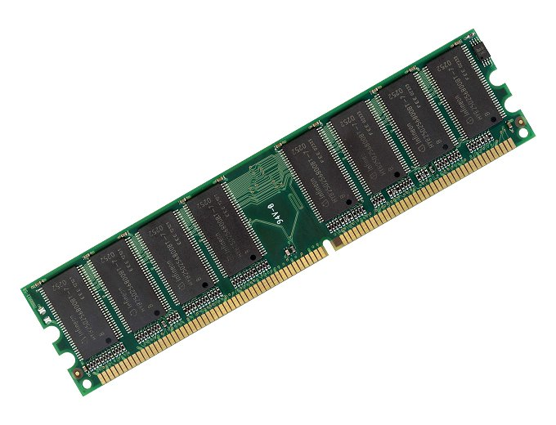
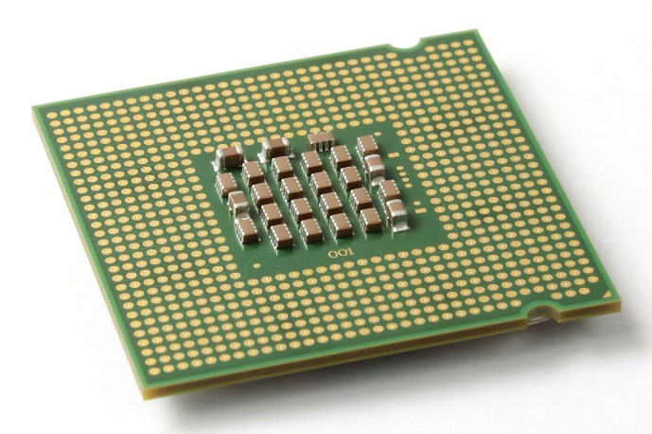
Memory persistency [upcoming ISCA]
Writes to memory reorder due to write-back caches
?
✓
But loads/stores between processors and cores ordered: memory consistency
Extend memory consistency to reason about NVRAM write order: Memory Persistency

Slide 15
Thank you
Questions?
References
Website: http://web.eecs.umich.edu/~spelley
Steven Pelley, Thomas F. Wenisch, Brian T. Gold, Bill Bridge: Storage Management in the NVRAM Era. PVLDB 7(2): 121-132 (2013)
[BPFS] Jeremy Condit, Edmund B. Nightingale, Christopher Frost, Engin Ipek, Benjamin Lee, Doug Burger, and Derrick Coetzee. 2009. Better I/O through byte-addressable, persistent memory. In Proceedings of the ACM SIGOPS 22nd symposium on Operating systems principles (SOSP '09). ACM, New York, NY, USA, 133-146.

