Slide 1
High Performance Transaction Processing for NVRAM
Steven Pelley, Thomas F. Wenisch
University of Michigan

Slide 2
Nonvolatile memory (NVRAM)
New NVRAMs provide fast, scalable storage (phase change, memristor, STT-RAM)
Storage technology | Random read latency | Durable?
Disk | 10ms | ✓
Flash | 90µs | ✓
DRAM | 100ns | ✗
NVRAM | 50-1000ns [IBM] | ✓
NVRAM enables persistent main memory

Slide 3
Recoverable systems
Must protect data against failure
E.g., file systems and databases
Typically rely on disk, flash for persistent storage
NVRAM accelerates persistent storage access
Byte-addressable (native memory instructions) further decrease execution overheads
Create recoverable, high performance data structures (main-memory/DRAM speed)
NVRAM requires new recovery mechanisms

Slide 4
Optimizing NVRAM
Case study of transaction processing [VLDB]
NVRAM as a disk replacement (ARIES/WAL)
Fast NVRAM imposes frequent persist ordering
New software design to avoid ordering delays
Future work: explore desirable optimizations and semantics for NVRAM memory systems

Slide 5
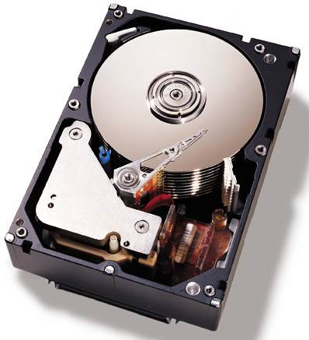
NVRAM as a disk replacement
Write Ahead Logging (WAL) via ARIES
Defer persists
Persist from specialized threads
Serialize log records
Transaction thread
Update
Log flusher
Log buffer
Page flusher
Buffer cache
Complexity necessary for slow disk now excessive overhead

Slide 6
Alternative: order persists immediately
Persist barriers [BPFS: SOSP ‘09]
Persists following barrier instruction may not complete before persists prior to barrier
Persists that are not separated by barrier instruction are concurrent
Barriers delay execution
Frequency of barriers and exposed barrier latency determine resulting performance

Slide 7
NVRAM in-place updates
Persist immediately
Remove centralized log
Barriers necessary at each update
Transaction thread
Update
Transaction/update logs
Heap
Simple, removes software overhead, but frequent persist ordering

Slide 8
NVRAM Group Commit
Time
Persist barriers
Persist log
Persist heap
Transactions quiesce at end of batch
Batch’s updates persist to batch log, then in place
NVRAM
log
Volatile update
buffer
NVRAM
store

Slide 9
NVRAM Group Commit
Time
Persist barriers
Undo log
Persist store
Constant number of persist barriers per batch
No centralized logging
Throughput high so long as batch quiesce/persist short
Several other tradeoffs (e.g., increased transaction latency)

Slide 10
Modeling unavailable devices
Run database on real hardware
Log and db heap on RAMDisk (or just in DRAM)
Introduce precise delays (20ns precision using x86 RDTSCP) to model persist barrier latency
Build recovery mechanisms in software
Shore-MT: research platform for high performance transaction processing
Rely on dirty bit fields to track buffer pool writes during transaction, page latch, or batch

Slide 11
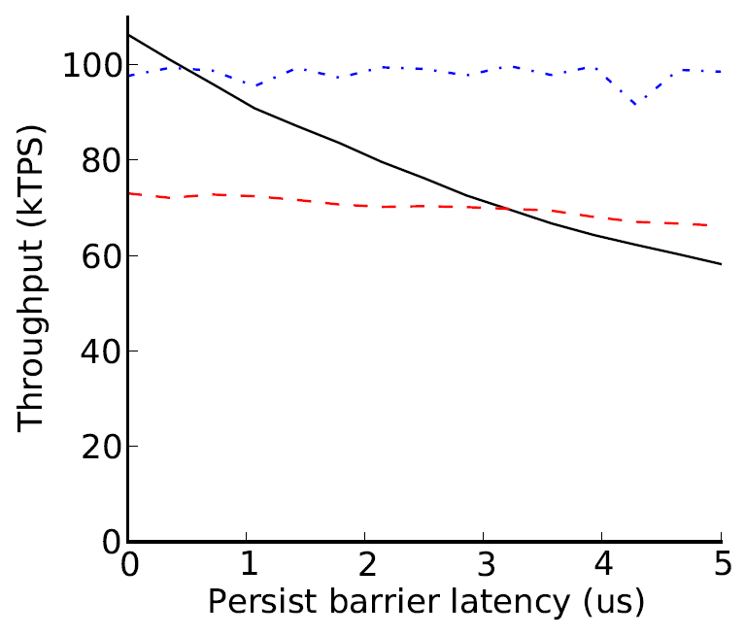
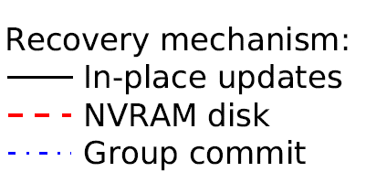
Recovery management performance
TPCB benchmark
Group commit recovers throughput when barrier latency exposed
High performance barriers and memory system ideal
Disk replacement insensitive to latency, but slow

Slide 12
In the VLDB paper…
Implementation and methodology details
Persist bandwidth modeling
Group commit trade-offs and transaction latency analysis
Read-cache performance based on memory trace analysis

Slide 13
Future work: NVRAM optimizations
Asynchronous persists
Allow execution to proceed ahead of persists
Hides persist and persist barrier latency
Persist ordering critical path limits persist rate
Persist coalescing
Omit persists if ordering constraints not violated
Acts as bandwidth filter (like write-back cache)
Reduces persist ordering critical path
Need mechanisms to precisely label persist ordering constraints
[upcoming ISCA: Memory Persistency]

Slide 14
Conclusions
Disk-based software carries baggage
Frequent persist synchronization also slow
New software and memory systems improve performance and simplify software design
References
Website: http://web.eecs.umich.edu/~spelley
Steven Pelley, Thomas F. Wenisch, Brian T. Gold, Bill Bridge: Storage Management in the NVRAM Era. PVLDB 7(2): 121-132 (2013)
[BPFS] Jeremy Condit, Edmund B. Nightingale, Christopher Frost, Engin Ipek, Benjamin Lee, Doug Burger, and Derrick Coetzee. 2009. Better I/O through byte-addressable, persistent memory. In Proceedings of the ACM SIGOPS 22nd symposium on Operating systems principles (SOSP '09)

Slide 15
Backup slides

Slide 16
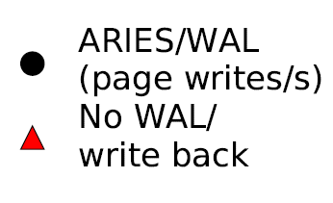
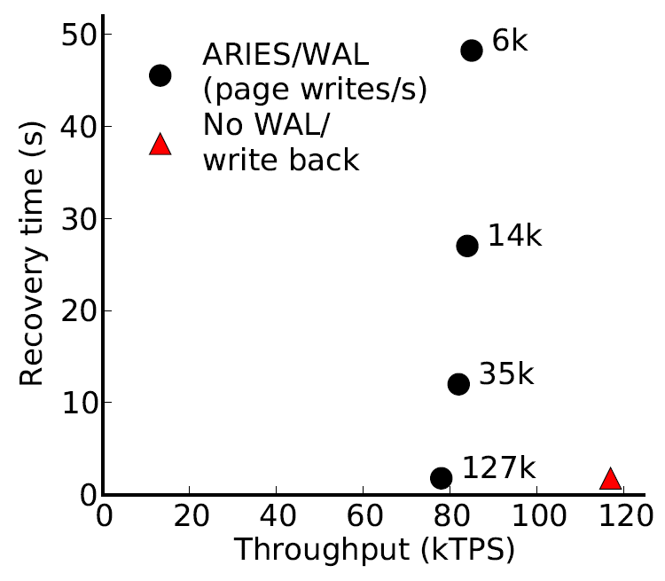
Disk replacement performance
~ 30 15krpm disks
or 3 Flash SSDs
[device IOPS rates: Symantec]
TPCB benchmark
Place log and store on RAMDisk
Artificially limit write IOPS
+50%
Disk-management overheads impose bottleneck
As disk replacement NVRAM enables near-instant recovery

Slide 17
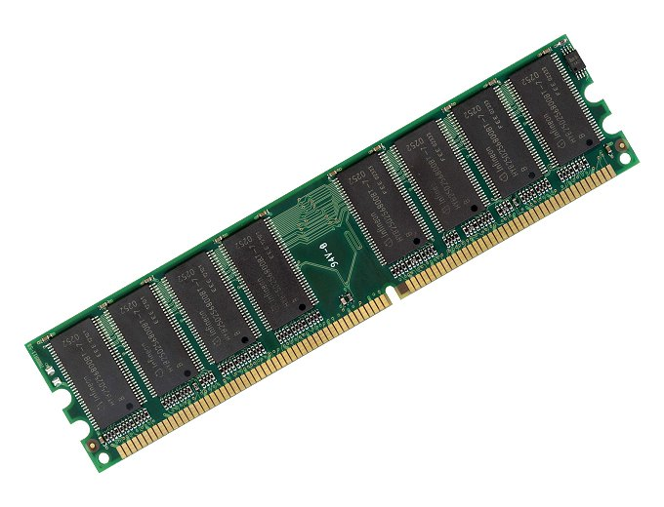
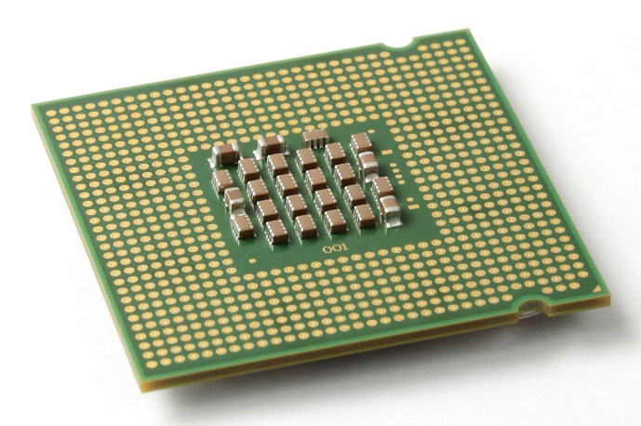
Memory persistency [upcoming ISCA]
Writes to memory reorder due to write-back caches
?
✓
But loads/stores between processors and cores ordered: memory consistency
Extend memory consistency to reason about NVRAM write order: Memory Persistency

