Slide 1
Database and System Design for Emerging Storage Technologies
Steven Pelley
Thesis Proposal

Slide 2
Emerging storage technologies
Flash memory
Nonvolatile Memory (NVRAM)
Phase Change (PCRAM)
Memristor (HP)
Spin-Torque Transfer (STT-RAM)
Storage technology | Random read latency
Disk | 10ms
Flash | 90µs
NVRAM | 50-1000ns [IBM]
Devices offer immediate performance increase over disk

Slide 3
Optimizing systems for Flash/NVRAM
Decades of research/engineering to avoid random access on disk
Specifically want to leverage fast random accesses on Flash and NVRAM
Analytics (DSS) on Flash
Transaction Processing (OLTP) on NVRAM
Ongoing: Persistent Memory Consistency
Intuitive mechanisms to enable high persist throughput and enforce proper recovery

Slide 4
Flash analytics optimization
Flash accelerates random reads
Foreshadow negative result

Slide 5
NVRAM OLTP optimization
Recovery mechanisms require high software overheads
Thread contention
Long code paths
Straightforward recovery by immediately enforcing persists incurs frequent persist barriers resulting in transaction delays
Introduce NVRAM Group Commit
Also look at reads

Slide 6
NVRAM programming models
Programming (at the assembly level) cannot order persists
Currently use consistency models to control the order that threads observe reads and writes
Can use similar models to control the order in which data persists (control within thread and between threads)
Want to provide best performance with easiest programming model

Slide 7
Outline
Flash Memory
Analytics
NVRAM technologies
NVRAM OLTP
NVRAM programming

Slide 8
Flash memory
 | Disk | Flash
Model | WD 10Krpm | OCZ RevoDrive
Seq. Read | 120MB/s | 190MB/s
Random Read | 10ms | 90µs
$/GB | .55 | 2.5
2011 devices
Flash much lower read latency than disk
Flash eliminates performance difference between random and sequential accesses
Current DBMS optimized for disk
Notes:
The sequential bandwidth is similar across devices, but random read is much faster on flash SSDs. Could possibly simplify DBMSs, which have long been optimized for high latency disks.
Say a bit more on this slide

Slide 9
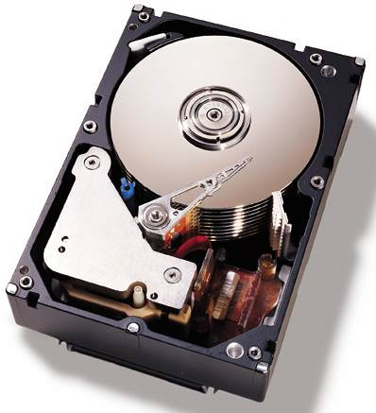
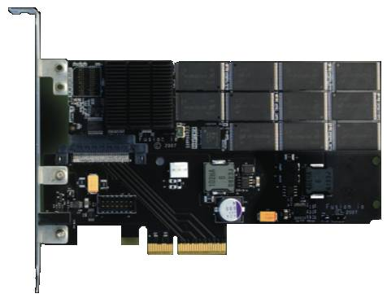
Taking advantage of SSDs
Data may “prefer” disk or flash
Intelligent layout:
Improve performance
Maintain low cost
Automated Layout
[Agrawal et al., Ozmen et al.]
Table 1: Accessed Sequentially
Table 2: Accessed Randomly
Optimal query plan should depend on where data resides
Notes:
Keeping this performance difference in mind, I came up with an idea.
Data may prefer either disk or flash
For example… scans
But the real contribution is that the optimal query plan, and thus performance, will depend on where the data resides.
So I needed to figure out exactly how query optimizers dealt with flash SSDs
Fix the colors in the table boxes

Slide 10
SSD query plans unchanged
Flash gives better performance, but…
Query plans do not need to be changed on flash
Using commercial DBMS – IBM DB2
0.9% of scan selectivities change access path
Join choice matters on disk, but not on flash
Intelligent layout does not depend on query opt.
Notes:
Flash is best, but found that it wasn’t better for a set of queries
Performance difference that appears on disk disappears on flash
Mention commercial systems. Not sure where
Spend more time here.

Slide 11
Experimental structure
Focus on two key aspects of query plans
Access paths (scan type)
Join type
Force specific query plans and measure actual performance
Determine performance difference between devices

Slide 12
Methodology
IBM DB2 v9.7
Intel core 2 (dual core)
2GB memory
Disk: WD VelociRaptor 10Krpm drive
Flash: OCZ RevoDrive PCIe
Wisconsin Benchmark schema and data
Notes:
Limited Scope, but the simplicity of these experiments yields tremendous insight

Slide 13
Background: DB2 access paths
Table

Slide 14
Background: DB2 access paths
Table
Relation scan: high selectivity

Slide 15
Background: DB2 access paths
B-Tree index
Table
…

Slide 16
Background: DB2 access paths
B-Tree index
Table
…
Index scan: low selectivity

Slide 17
Background: DB2 access paths
B-Tree index
Table
…

Slide 18
Background: DB2 access paths
B-Tree index
Rowids
Table
{5;10}
{17;7}
{10;1}
{17;5}
…
Notes:
Add some addresses/numbers to the rowids (2 parts, page and tuple)

Slide 19
Background: DB2 access paths
B-Tree index
Rowids
Table
…
Rowid-sort scan: mid selectivities

Slide 20
Background: Selecting access path
Below 10% selectivity use index scan
Above 10% selectivity use relation scan
Relation scan
Runtime (time)
Index scan
Selectivity (%)
Flash’s low latency should shift break-even point to right

Slide 21
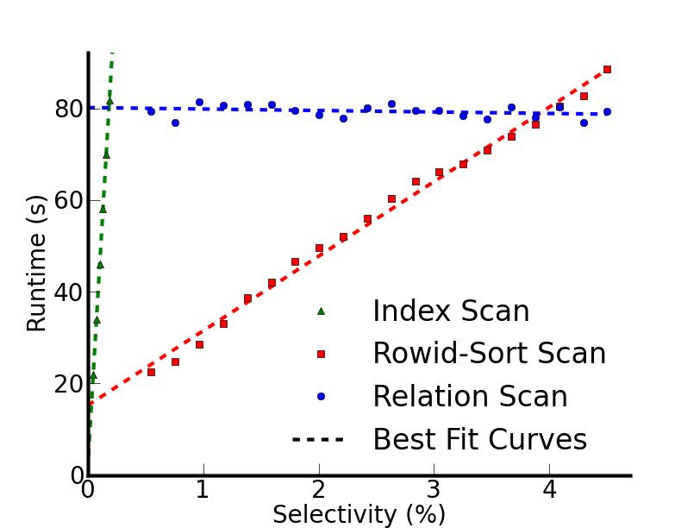
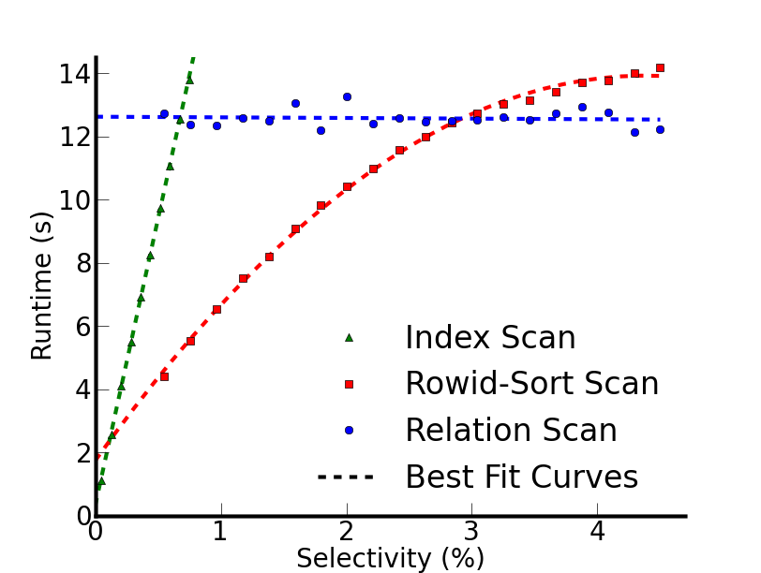
Actual performance
Disk
Flash
Break-even points at lower selectivity than expected
Break-even points shift for only 0.9% selectivities
Notes:
Distinguish between previous index line and the rowid-sort scan
Scans start with cold data

Slide 22
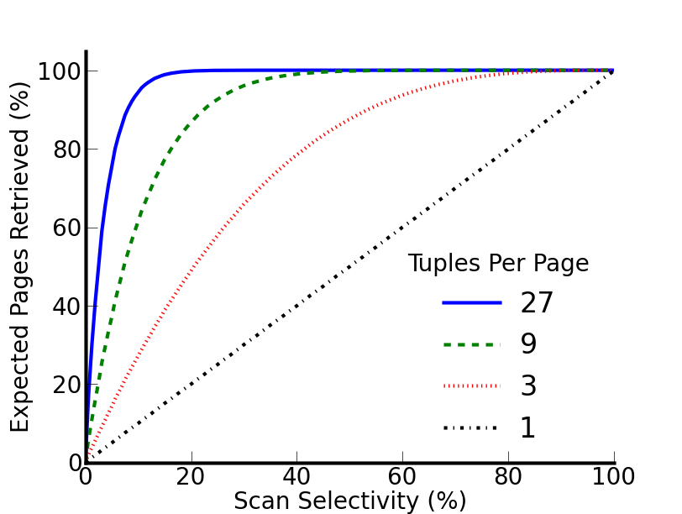
Why is the 10% rule wrong?
10% rule really applies to page selectivity
Index scan, uniform random layout:
[Yue et al.]
Notes:
Clean up this slide
If there were exactly 1 tuple per page we would see … but for a realistic 27 tuples per page…
Focus on tuple selectivity vs page selectivity
What follows from this is that the range where index scan works
Zoom in on a point? 3% on blue?

Slide 23
Why is the 10% rule wrong?
10% rule really applies to page selectivity
Index scan, uniform random layout:
27 tuples/page
at 4% row sel.
expect 67% pages
[Yue et al.]
Implication: relation scan preferred even on flash
Notes:
If there were exactly 1 tuple per page we would see … but for a realistic 27 tuples per page…
Focus on tuple selectivity vs page selectivity
What follows from this is that the range where index scan works
Zoom in on a point? 3% on blue?

Slide 24
Join
Join performance on disk depends on:
Algorithm
Relation sizes
Projectivity
These determine
Device access patterns
Data read and written to device

Slide 25
Join performance
Notes:
Explain database size relative to database size
Before I hit the button talk about these results more-
With one outlier, the best join type changes with projectivity

Slide 26
Join performance
Notes:
Focus on performance different between algorithms on flash

Slide 27
Join performance
CPU bound outlier
Flash insensitive to join type – 5.4% avg. difference w/o outlier

Slide 28
What does this really say
Little opportunity for taking advantage of device-dependent query optimization
Large access granularity interferes with flash’s low random read latency
Rather disk-optimizations that provide locality within page (use entire page on access) are already optimized for Flash
Need Flash-specific operations before reconsidering query planning

Slide 29
VLDB

Slide 30
Persistent Programming
How are persist barriers implemented?
Need intuitive programming models to reason about NVRAM persistence
Disk interface – flush cache lines and sync. Must know data cache lines and produces delays
DRAM interface – cannot control write order
Perform all persists in program order – terrible performance! Must persist out of order
Performance/programmability tradeoff like memory consistency
Notes:
On one extreme we might assume that things persist in program order – no additional annotation required. On the other extreme we borrow the disk interface and flush individual cache lines (much harder to program for and unintuitive).

Slide 31
Memory consistency
Prefer to reorder instruction execution
Complicates multi-threaded applications
flag1, flag2 initialized to 0
(Dekker’s mutex without atomic RMW)
Thread 1:
flag1 = 1
if flag2 == 0:
# critical sec.
Thread 2:
flag2 = 1
if flag1 == 0:
# critical sec.

Slide 32
Memory consistency
Prefer to reorder instruction execution
Complicates multi-threaded applications
flag1, flag2 initialized to 0
(Dekker’s mutex without atomic RMW)
Might reorder
Thread 1:
flag1 = 1
barrier
if flag2 == 0:
# critical sec.
Thread 2:
flag2 = 1
barrier
if flag1 == 0:
# critical sec.
Improved performance requires user intervention

Slide 33
Why memory consistency?
Concurrency control similar to persistence
Consistency: order in which stores are visible
Persistence: order in which persists are visible
Persist order must be enforced across threads
Leverage consistency to determine persist order
Extend memory consistency with persistence
Persistent Memory Consistency (PMC)

Slide 34
Persistent Memory Consistency goals
High performance recoverable data structures with minimal software modifications
Demonstrate new consistency models and reason about their performance
Future: evaluate models and data structures
motivate PMC as necessary and effective, don’t consider precise implementations

Slide 35
Progress
Reason about persist performance
What makes a high-performance consistency model?
Demonstrate a simple data structure
Introduce new consistency models

Slide 36
Implications of persist order
Important optimization: execution runs ahead of persistent state via buffering
Persists still occur in consistent order
If average persist throughput less than average execution rate, buffers fill
Persist order constraints limit persist throughput/parallelism
Maximize performance by minimizing persist order critical path

Slide 37
Persistent consistency models
Define/Constrain the order of persists
Parallel persists in single-threaded code
Consistency and persistence -- does thread reading persistent value from 2nd thread imply order?
Sync – how to enforce that execution state equals persistent state
Implementation is separate!
Implementations allow any optimization so long as appearance of model is maintained

Slide 38
Example – persistent log/buffer
Persistent array
Persistent counter marks valid end of array
On recovery: base to counter considered valid
0
1
2
3
Insert(obj, size):
lock()
start = &array[counter]
memcpy(start,obj,size)
counter += size
unlock()
Buffer
array
Counter = 1
Buffer data must persist before counter

Slide 39
Persistent Sequential Consistency (PSC)
Buffer atomic segment
Persists before
Tail LSN
Insert(obj, size):
lock()
start = &array[counter]
memcpy(start,obj,size)
counter += size
unlock()
Assume:
100 byte entries
8 byte atomic persist
100ns persist
Can insert every 1.4 µs
Strict consistency limits performance

Slide 40
Local Persist Order (LPO)
Remove unnecessary cross-thread ordering
Within thread all persists in program order
Enforcing order across threads: 1st thread inserts persist-before, 2nd thread persist-after
Any data sharing between threads implies order
Similar to release-acquire semantics

Slide 41
Local Persist Order (LPO)
Insert(obj, size):
lock()
start = &array[counter]
memcpy(start,obj,size)
persist_after # counter persists after last
counter += size
persist_before # counter persists before next
unlock()
Single-thread constraint
Allows buffer data from multiple threads to persist concurrently

Slide 42
BPFS (Total Epoch Order)
Better I/O through byte-addressable, persistent memory – Condit et al.
Divide code into epochs with epoch barriers
Persists within same epoch occur in parallel
Persists may not reorder across barriers
Shared memory accesses w/ at least one write imply epoch order between threads
Propose hardware (cache extensions)
No races in persist epochs (even volatile synchronization)

Slide 43
BPFS (Total Epoch Order)
Insert(obj, size):
lock()
barrier
start = &array[counter]
memcpy(start,obj,size)
barrier
counter += size
barrier
unlock()
Buffer should persist in parallel with prev. counter
Restricts important programming patterns (batching)

Slide 44
Partial Epoch Order (PEO)
Consider epochs from separate threads concurrent if they contain a race
Subsequent epochs inherit order constraint
Insert(obj, size):
barrier
lock()
start = &array[counter]
memcpy(start,obj,size)
barrier
counter += size
unlock()
barrier
Similar to BPFS code
(barriers outside locks)
Buffer persists in parallel
with previous counter

Slide 45
Partial Epoch Order (PEO)
Race with counter orders with counter’s dependencies
Adjacent insert from same thread enforces ordering
Prevents deadlock. Removes most unnecessary constraints
Too complicated to be useful?

Slide 46
Ideal Dependencies
Only enforce counter persist order, both within and across threads

Slide 47
Future optimizations
Implementation in hardware allows opt.
E.g., skip persists to counter

Slide 48
Future work
Evaluation
Assume naïve implementation, measure persist critical path of simple data structures
Is persist the bottleneck for each model?
Data structures
Buffer
OLTP/Shore-MT
Batching (from OLTP design)
Possible new consistency models

