Slide 1
Database and System Design for Emerging Storage Technologies
Steven Pelley
Committee:
Thomas F. Wenisch (Chair)
Michael J. Caffarella
Peter M. Chen
Zhengya Zhang

Slide 2
Nonvolatile memory (NVRAM)
DRAM and flash will stop scaling
New NVRAMs provide fast persistent storage (phase change, memristor, STT-RAM)
Storage technology | Random read latency | Durable?
Disk | 10ms | ✓
Flash | 90µs | ✓
DRAM | 100ns | ✗
NVRAM | 50-1000ns [IBM] | ✓
NVRAM enables persistent main memory

Slide 3
Recoverable systems
Must protect data through failure
E.g., file systems and databases
Typically rely on disk, flash for persistent storage
NVRAM provides faster persistent storage
Redesign software assuming fast access
Byte-addressable (native memory instructions) further decrease execution overheads
NVRAM will require new recovery mechanisms

Slide 4
Protecting data through failure
Must constrain order of writes (persists)
Disk: stall next request until previous completes
However, memory allows writes to reorder
Cache eviction order ≠ store order
NVRAM requires persist barriers
Semantics, implementation, and performance implications uncertain
Despite fast NVRAM accesses, persist barriers limit performance

Slide 5
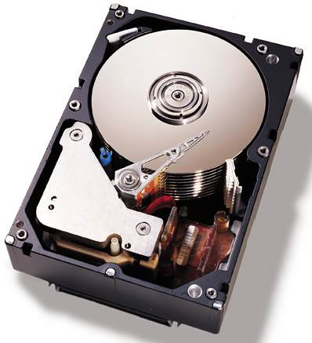
Example: transaction processing (VLDB)
NVRAM as disk replacement (Write Ahead Logging)
Defer persists
Persist from specialized threads
Serialize log records
Transaction thread
Update
Log flusher
Log buffer
Page flusher
Buffer cache
Complexity necessary for slow disk now excessive overhead

Slide 6
Example: transaction processing (VLDB)
NVRAM In-place updates
Persist immediately
Barriers order persists to log and heap
Transaction thread
Update
Transaction log
Heap
Simple but frequent persist barriers

Slide 7
Example: transaction processing (VLDB)
?
NVRAM Disk
In-place Updates
Transaction throughput
≤ 100ns
~1-10µs
≥100µs
Average exposed persist barrier latency
In-place updates provides max throughput only at low latency

Slide 8
Example: transaction processing (VLDB)
NVRAM group commit
persist barrier
Undo log
Updates
Transactions quiesce at end of batch
Transaction updates write atomically using batch log
Constant number of persist barriers per batch
Amortize persist barrier cost over many transactions
But several limitations (transaction latency, long transactions)

Slide 9
Example: transaction processing (VLDB)
NVRAM disk
In-place updates
Group commit
Transaction throughput
≤ 100ns
~1-10µs
≥100µs
Average exposed persist barrier latency
Ideally hide persist latency entirely

Slide 10
Practical persist barriers
How do we minimize barrier stalls?
When are persists ordered across threads?
How do we minimally label persist ordering constraints?
What performance results if we simply enforce program order of NVRAM writes?
Explore fundamental primitives for persist synchronization

Slide 11
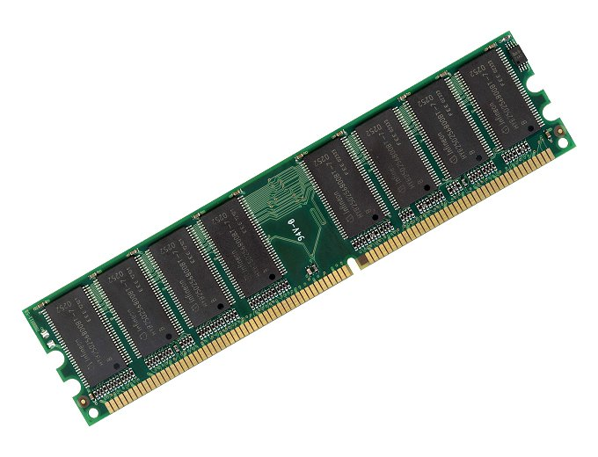
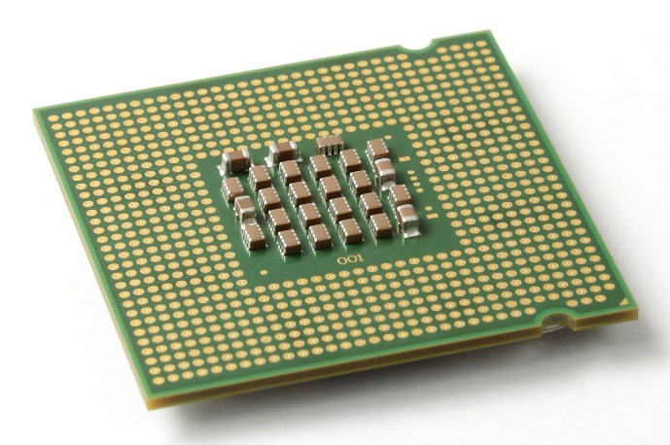
Memory ordering
Writes to memory reorder
?
✓
But loads/stores between processors and cores ordered: memory consistency
Extend memory consistency to reason about NVRAM write order: Memory Persistency

Slide 12
Thesis
Using Flash memory for database analytics
ADMS 2011
Using NVRAM to accelerate transactions
Upcoming VLDB
Memory persistency
Extend consistency to reason about persist order
Enforcing program-order persists limits throughput to 1/30th instruction execution rate
Relaxed persistency models regain performance

Slide 13
Outline
Motivate memory persistency
Memory consistency review
Define memory persistency
Persistent queue benchmark
Memory persistency models
Methodology
Evaluation

Slide 14
Outline
Motivate memory persistency
Memory consistency review
Define memory persistency
Persistent queue benchmark
Memory persistency models
Methodology
Evaluation

Slide 15
Outline
Motivate memory persistency
Memory consistency review
Define memory persistency
Persistent queue benchmark
Memory persistency models
Methodology
Evaluation

Slide 16
Memory consistency primer
Motivation: reorder instructions while providing intended shared memory behavior
Barrier
Thread 1:
Buffer[0] ← 1
Buffer[8] ← 1
…
Flag ← 1
Thread 2:
If (Flag == 1) {
localBuffer[0] ← Buffer[0]
localBuffer[8] ← Buffer[8]
…
}
Barrier
In isolation may reorder, but when sharing must constrain

Slide 17
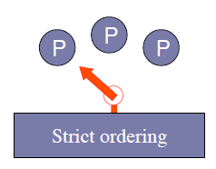
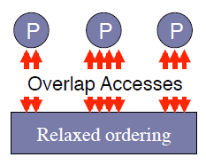
Memory consistency models
Guarantees for reasoning about reordering
Sequential Consistency (SC): no reordering, memory appears as a switch to processors
Relaxed Memory Order (RMO): any reordering possible, must use barriers
Model separate from implementation
Consistency spectrum

Slide 18
Outline
Motivate memory persistency
Memory consistency review
Define memory persistency
Persistent queue benchmark
Memory persistency models
Methodology
Evaluation

Slide 19
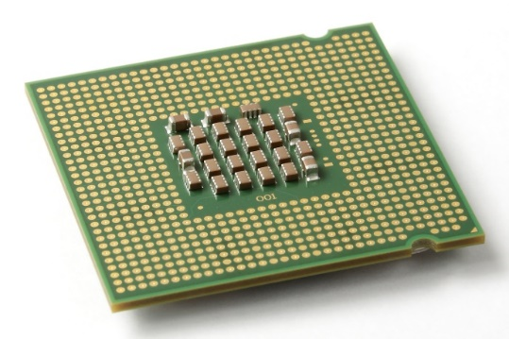
Recovery observer
Memory consistency:
Constrain order of loads and stores between processors
Memory persistency:
Imagine failure as recovery observer
Atomically copies to NVRAM at failure, adhering to consistency model
Treats failure as a processor
Enforcing NVRAM write order equivalent to enforcing store order

Slide 20
Strict persistency
Couples consistency and persistency
1:1 mapping between observable volatile and persistent states
Two stores that may only be observed in some order implies ordered persists
The store and the persist are the same event
Consistency model and barriers constrain persist order and thread synchronization
Implementation free to optimize

Slide 21
Buffered persistency
Thread execution (volatile state) proceeds ahead of persistent state
Recovery observer lags arbitrarily behind
Problem: side effects violate model
Persist sync forces durable state to “catch up”
…
Persist to object A
PersistSync
Syscall() // network
…
May observe syscall but after recovery fail to see persist to A
PersistSync constrains order

Slide 22
Relaxed persistency
Decouple thread synchronization and persists
Store and persist are separate events
Persist order may deviate from store order
New persist barriers order persists
Allows thread to observe persist values without introducing order dependence
Later I’ll introduce relaxed persistency models assuming SC as underlying consistency model

Slide 23
Relaxed persistency example
Lock()
Persist 0x100
Persist 0x108
…
Persist Flag=1
Unlock()
Memory barrier
Persist barrier
Memory barrier
Lock provides thread synchronization, but no need to additionally enforce persist order at this point
Flag must not persist before data, but as the lock protects against races an additional memory barrier is unnecessary
Stores reorder around persist barriers, persists reorder around store barriers.
Simultaneously relaxed consistency and persistency gets complicated.
Precise, independent control over consistency and persistency

Slide 24
Outline
Motivate memory persistency
Memory consistency review
Define memory persistency
Persistent queue benchmark
Memory persistency models
Methodology
Evaluation

Slide 25
Persistent queue
Useful as log/journal in file systems and db
Goal: maximize volatile performance (instruction execution rate) and improve persist concurrency for inserts
Implementation: based on circular buffer
head marks next location to insert

Slide 26
Queue operation
Insert(entry, length):
lock(queue_lock)
data[head] = length
data[head+sizeof(length)] = entry
head += length + sizeof(length)
unlock(queue_lock)
Persist Ordering Constraints
Data
Head
Persistency model must enforce persist orderings

Slide 27
Outline
Motivate memory persistency
Memory consistency review
Define memory persistency
Persistent queue benchmark
Memory persistency models
Methodology
Evaluation

Slide 28
Persistency assumptions and goals
Assume all persists occur in-place (no logging)
Assume persist buffering
Persist critical path limits persist rate
Assume limited atomic persists and coalescing
E.g., 8-byte atomic persists
Persists to the same address may coalesce (persist only last value) if no ordering constraints violated
Goal: create models to minimize persist critical path

Slide 29
New persistency models
All models use SC as consistency model
Easier to reason about (removes relaxed consistency/relaxed persistency weirdness)
Successively relax persistency to improve persist concurrency/reduce critical path

Slide 30
Model 1: strict persistency
Any volatile memory state that might be observed by the recovery observer processor under SC is an allowable persistent state
Equivalent: if two stores ordered w.r.t. recovery observer, persists also ordered
Same thread: program order
Different threads: synchronization and conflicts
If not ordered: concurrent!

Slide 31
Strict persistency queue
Persist order determined by program order
No code annotation necessary!
Insert(entry, length):
lock(queue_lock)
data[head] = length
data[head+sizeof(length)] = entry
head += length + sizeof(length)
unlock(queue_lock)
Large queue entries persist in program order
Lock serializes persists between threads

Slide 32
Queue required dependences
Data
Thread 1
Head
Data
Thread 2
Head

Slide 33
Strict persistency dependences
Data
Thread 1
Head
Data
Thread 2
Head
Guarantees correct recovery, but over-constrains persists

Slide 34
Model 2: epoch persistency
Motivation: strict persistency introduces program-order constraints.
Instead, use persist barrier to enforce an ordering constraint between persists
Execution divided into persist epochs
Data sharing continues to observe SC
Persist order resembles RMO, persist barrier acts as a full memory barrier

Slide 35
Persist epoch races (PER)
Under what circumstances are persists between threads ordered?
Persist epoch race: 2+ threads contain epochs that race (including sync. races) and at least one epoch persists
Thread 1
Barrier
Persist A
Persist B
Barrier
Thread 2
Barrier
Read B
Persist A’
Barrier
Can A’ persist before A?
Can A’ persist before B?
Epochs aren’t serializable!

Slide 36
Epoch persistency queue, 1st attempt
Insert(entry, length):
barrier()
lock(queue_lock)
barrier()
data[head] = length
data[head+sizeof(length)] = entry
barrier()
head += length + sizeof(length)
barrier()
unlock(queue_lock)
barrier()
Surround lock/unlock with barriers to prevent PER. Serializes inserts
Barrier ensures head does
not persist before data, but data persists concurrently

Slide 37
Race-free epoch persistency dependences
Data
Thread 1
Head
Data
Thread 2
Head

Slide 38
Race-free epoch persistency dependences
Data
Thread 1
Head
Data
Thread 2
Head

Slide 39
Race-free epoch persistency dependences
Data
Thread 1
Head
Data
Thread 2
Head
Entries persist in parallel, but inserts still serialized

Slide 40
Epoch persistency ordering
Separate volatile memory order and persistent memory order
Volatile order fulfills SC
Persistent order contains subset of constraints
Rule 1: memory operations from same thread separated by persist barrier are ordered
Rule 2: conflicting operations (same address, at least 1 store/persist) ordered
Rule 3: 8-byte persists atomic with respect to recovery observer

Slide 41
Persist ordering example
Thread 1: A | B C
Thread 2: C’ D | E
Thread 3: E’ | F
conflict
Rule 1: A before {B, C}; {C’, D} before E; E’ before F
Rule 2: C before C’; E before E’
Trans: A before {C’, E, E’, F}; C before {E, E’, F}…
B concurrent with shown accesses on T2, T3
Even if value of C depends on B
D concurrent with shown accesses on T1
Dependences propagate through volatile address space

Slide 42
Load-store conflicts
Thread 1: A | B C
Thread 2: C’ D | E
Thread 3: E’ | F
conflict
Imagine:
C is a load
C’ is a store/persist
Still a conflict!
Difficult to implement, typically load-store conflict does not imply order with previous stores/persists (e.g., TSO)

Slide 43
Epoch persistency queue, 2nd attempt
Insert(entry, length):
barrier()
lock(queue_lock)
barrier()
data[head] = length
data[head+sizeof(length)] = entry
barrier()
head += length + sizeof(length)
barrier()
unlock(queue_lock)
barrier()
Allow persist epoch races
head persists from different inserts ordered due to conflicts

Slide 44
Epoch persistency dependences
Data
Thread 1
Head
Data
Thread 2
Head

Slide 45
Epoch persistency dependences
Data
Thread 1
Head
Data
Thread 2
Head

Slide 46
Epoch persistency dependences
Data
Thread 1
Head
Data
Thread 2
Head
Entries on different threads persist in parallel

Slide 47
Model 3: strand persistency
Motivation: epochs allow limited concurrency
Divide execution into strands
NewStrand begins a strand
Strands execute in order on threads, but NewStrand clears persist dependences
Epoch pers. orders persists within strands
Change Epoch persistency rule 1:
Memory operations from same strand separated by persist barrier are ordered
New accesses accumulate dependences

Slide 48
Strand example
...
Epoch
Strand
A
B
A
B
Barrier
C
NewStrand
A
Barrier
C
NewStrand
B
A
Barrier
B
C
or
C
B must be ordered with A and/or C
...
Strands allow precise persist constraint labeling

Slide 49
Perfect constraint labeling
For each persist:
New strand
Read all addresses persist depends on
Barrier
Persist
Creates DAG of dependences. Edge from each read to persist
Minimal persist dependences (introduces additional instructions)

Slide 50
Strand persistency queue
Insert(entry, length):
lock(queue_lock)
new_strand()
data[head] = length
data[head+sizeof(length)] = entry
barrier()
head += length + sizeof(length)
unlock(queue_lock)
Removes unnecessary dependences between inserts

Slide 51
Strand persistency dependences
Data
Thread 1
Head
Data
Thread 2
Head

Slide 52
Strand persistency dependences
Data
Thread 1
Head
Data
Thread 2
Head

Slide 53
Strand persistency dependences
Data
Thread 1
Head
Data
Thread 2
Head
Back to minimal dependences

Slide 54
Outline
Motivate memory persistency
Memory consistency review
Define memory persistency
Persistent queue benchmark
Memory persistency models
Methodology
Evaluation

Slide 55
Methodology
Assume buffered NVRAM with infinite banks (no conflicts ever occur). All persists occur in place (no logging but persists may coalesce)
Persists drain faster than instruction execution rate; instructions limit performance
Persists drain slower than instruction execution rate; persist rate limits performance
Determine throughput from slower of two
Real systems likely delay elsewhere to persist

Slide 56
Methodology
Measure execution rate on real server
2.4 GHz Xeon E5645
Use 1 and 8 threads to test concurrency
Pad to 64 bytes to remove false sharing
Repeatedly insert 100-byte entries as quickly as possible, reporting insert rate

Slide 57
Methodology
Measure persist rate via memory traces
Produce SC memory trace from PIN
Annotate barriers, persistent malloc, etc.
Persist critical path from simulation
Track persist dependences at variable granularity
Persists coalesce assuming variable atomic persist
(both 8 bytes by default)
Observe persist timing and dependences from persistency model

Slide 58
Outline
Motivate memory persistency
Memory consistency review
Define memory persistency
Persistent queue benchmark
Memory persistency models
Methodology
Evaluation

Slide 59
Relaxed persistency
Line indicates instruction execution rate
Assumes 500ns persists
30x
Other queues
Relaxed persistency removes constraints and regains throughput

Slide 60
Persist latency
17ns
119ns
6.2µs
1 Thread
(8 Threads)
Relaxed persistency tolerates greater persist latency

Slide 61
Persist coalescing
Larger atomic persists improve concurrency for strict models

Slide 62
Persistent false sharing
Coarse dependence tracking reintroduces constraints

Slide 63
What’s next?
Design hardware
What relaxations give best performance?
How do we track dependences and persist values (in cache, in queues?)
How do we correctly coalesce?
New workloads, data structures, services

Slide 64
Conclusion
Must order persists, but over-constraining hurts performance (resembles consistency)
Memory persistency builds on consistency to enforce persist order
Persistency may be relaxed, de-coupling store and persist order constraints
Relaxed persistency enables instruction execution rate with recovery correctness

Slide 65
Thank You!
Thanks to my family, friends, Tom, committee, collaborators, and all of you

Slide 66
Backup Slides
Persistency definition
Defining order of persists to same address
Queue
Circular buffer
Other queue designs
Results
Coalescing
Relaxed persistency, all queues
Effect of latency on CWL, 8 threads
Alternative interfaces
Disk/block
Moneta
Transactions
Various [Mnemosyne, RIO Vista, STM]
Kiln-decouple thread synchronization from persistency control
Barriers
BPFS

Slide 67
Persists to same address
Strict persistency relies on consistency model to define order or persists to same address
Often relies on cache coherence guarantees
Relaxed consistency/relaxed persistency allows:
Store visibility to reorder across persist barrier
Persists to reorder across store barrier
May violate cache coherence persist ordering

Slide 68
Persists to same address
Thread 1:
Persist A
Barrier
Persist B
Thread 2:
Persist B
Barrier
Persist A
Thread 1’s stores reorder around the barrier
Persist ordering dependences shown for barriers and cache coherence order
Dependence cycle cannot be enforced

Slide 69
Persists to same address
Resolve by:
Relying on strict persistency
Preventing stores from reordering around persist barriers
Defining additional synchronization to prevent such situations
Interaction between consistency barriers and persist barriers
Back
Backup slides

Slide 70
Coalescing
Any two persists may coalesce if:
Hardware allows them to persist atomically
No happens-before constraints are violated
Given a DAG of persist constraints, coalescing:
Combines the two persists into a single node
Persist value taken from last persist
Node takes union of edges into and out of node
Edges entirely inside the node go away
Coalescing legal if no cycles introduced

Slide 71
Coalescing example
A
B
B
A’
A’
Cycle!
A
C
D
A
D
C’
✓
B
C’
E
B
E
Back -- Backup slides

Slide 72
All queues, 1 thread
Varied volatile performance. Require strand persistency

Slide 73
All queues, 8 threads
Back -- Backup slides
Multi-threading improves persist concurrency. Epoch sufficient

Slide 74
Latency, CWL 8 threads
PER-free: 202ns (not shown)
28ns
1.6µs
10.5µs
Back -- Backup slides
Epoch persistency likely sufficient

Slide 75
BPFS
“Better IO Through Byte-Addressable, Persistent Memory”
Cache implementation of barriers and epochs
Stalls to persist at thread conflicts
Flush cache for persist sync
Different from epoch persistency
Programmer must provide isolated epochs (including false sharing, otherwise deadlock)
No dependences through volatile memory
Loads may bypass store in persist order (persist barrier is 3/4 RMO barrier; similar to TSO)
Back Backup slides

Slide 76
[dependence template]
Data
Thread 1
Head
Data
Thread 2
Head

Slide 77
PER persist ordering
Persist⇨Load
Load⇨Persist
Thread 1: A | B C
Thread 2: load C’ D | E
C before E
A before E (transitivity; A before C)
Thread 1: A | B load C
Thread 2: C’ D | E
load C before E
A before E (transitivity)
A before C’
Persist⇨Persist
B, C volatile
Thread 1: A | B C
Thread 2: C’ D | E
A before E (race and barriers)
C before C’ (cache coherence)
A before C’ (transitivity)
C before E (transitivity)
Persist⇨Persist race good candidate for coalescing
Thread 1: A | B
Thread 2: B’ | C
Thread 3: C’ | D
A before D (race and barriers)
Red barrier required
Resembles RMO with full barriers

Slide 78
Memory Persistency
Steven Pelley, Peter M. Chen, Thomas F. Wenisch

Slide 79
NVRAM recovery
Writes unordered!
writes
Must constrain write order for recovery
Cache eviction reorders writes to memory
Enforcing program order writes incurs 30x slowdown over instruction execution rate.
Must constrain writes for correctness, but reorder for performance

Slide 80
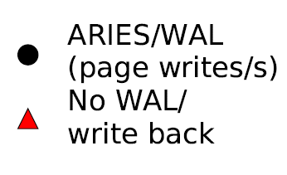
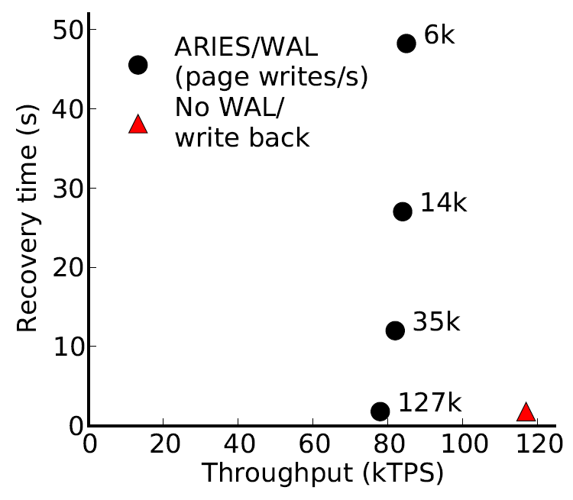
Example: transaction processing (VLDB)
~ 30 15krpm disks
or 3 Flash SSDs
[device IOPS rates: Symantec]
TPCB benchmark
Disk-management overheads impose bottleneck
As disk replacement NVRAM enables near-instant recovery

Slide 81
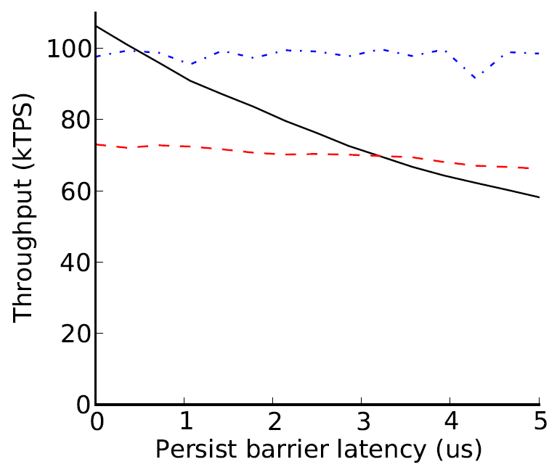
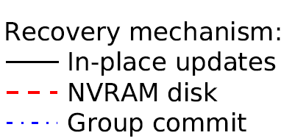
Recovery management performance
Group commit helps, but high performance barriers ideal

Slide 82
Memory Persistency Design Space
Persistency
strict
relaxed
Sequential consistency (SC), persistent state must match volatile state
SC, but persistent state de-coupled from volatile states. Persists may reorder
Consistency
Relaxed consistency, persistent state matches volatile state
Loads, stores, and persists may all reorder. Minimizes delays for persists and thread synchronization
Persist order determined by consistency model
Persist order determined by new persist barriers

Slide 83
Strict persistency implementations
Delay execution at each persist
Serialize persists when reserving memory bus
Queue persists from each thread, detecting access races (including synchronization races) that introduce order across threads
Combine HTM and hardware durable transactions
Persistent bulkSC?

Slide 84
Epoch persistency implementation
Similar to BPFS (see paper/dissertation)
Queue persists from each thread, record persist barriers, only enforce order at barriers
Persistent BulkSC (transactions)
Use persist barrier knowledge to optimize persistent transactions and intelligently place transaction boundaries

