Slide 1
Database and System Design for Emerging Storage Technologies
Steven Pelley
Thesis Proposal

Slide 2
Emerging storage technologies
Flash memory
Nonvolatile Memory (NVRAM)
Phase Change (PCRAM)
Memristor (HP)
Spin-Torque Transfer (STT-RAM)
Storage technology | Random read latency
Disk | 10ms
Flash | 90µs
NVRAM | 50-1000ns [IBM]
Devices offer immediate performance increase over disk

Slide 3
Optimizing systems for Flash/NVRAM
Decades of research/engineering to avoid random access on disk
Redesign/optimize database applications for most relevant storage technology
Analytics (DSS) on Flash
Transaction Processing (OLTP) on NVRAM
Ongoing: Persistent Memory Consistency
Intuitive mechanisms to enable high persist throughput and enforce proper recovery

Slide 4
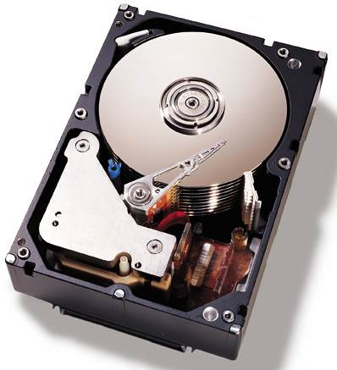
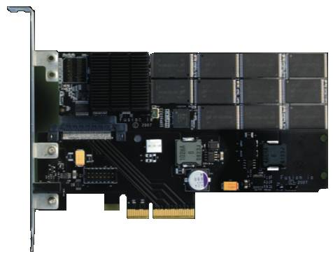
Taking advantage of SSDs
Data should “prefer” disk or Flash
Flash accelerates random access to tables
Measure disk/Flash performance to determine
When optimal query plan shifts [ADMS ’11]
Table 1: Accessed Sequentially
Table 2: Accessed Randomly
Coarse-grain access limits ability to leverage fast random reads
Notes:
Keeping this performance difference in mind, I came up with an idea.
Data may prefer either disk or flash
For example… scans
But the real contribution is that the optimal query plan, and thus performance, will depend on where the data resides.
So I needed to figure out exactly how query optimizers dealt with flash SSDs
Fix the colors in the table boxes

Slide 5
Leveraging NVRAM for recovery
Hypothesis: Databases designed for disk limit performance with NVRAM
Disk optimizations impose unnecessary overheads
NVRAM presents own set of obstacles
Persist barriers to ensure proper recovery introduce delays
Greater-than-DRAM read latency lengthens read stalls
I provide NVRAM evaluation methodology and new recovery mechanisms [VLDB submission]
New designs improve throughput and recovery

Slide 6
Ongoing: persistent programming
Hypothesis: Recovery/durability changes memory access ordering requirements
Writing NVRAM in program order yields poor performance
Annotating persist order difficult and error prone
Similar to memory consistency models
Define order that writes observed
Persistence defines order that persists observed
Persistent Memory Consistency (PMC)
Provide high performance, intuitive persistence model

Slide 7

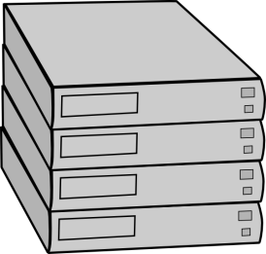
Data center infrastructure (appendix)
Understanding and Abstracting Total Data Center Power [WEED ‘09]
Data center power model encompassing all components
PowerRouting: Dynamic Power Provisioning in the DataCenter [ASPLOS ‘10]
Better utilize installed power infrastructure by introducing power feed switching mechanisms and intelligent control
?

Slide 8
Outline
Briefly: Flash analytics – leveraging fast reads
NVRAM OLTP recovery management
New: Persistent Memory Consistency (PMC)
Ex: data structure and consistency models

Slide 9
Flash: more than just a fast disk?
Flash favors random data access
relative to disk.
Ex: Scans that return < 10% of
table should use index, > 10%
scan entire table.
[Ramakrishnan and Gehrke]
Expect to shift right with Flash
Measure performance of scans and joins on disk/Flash
Determine when query plans change between devices
Relation scan
Runtime (time)
Index scan
Selectivity (%)

Slide 10
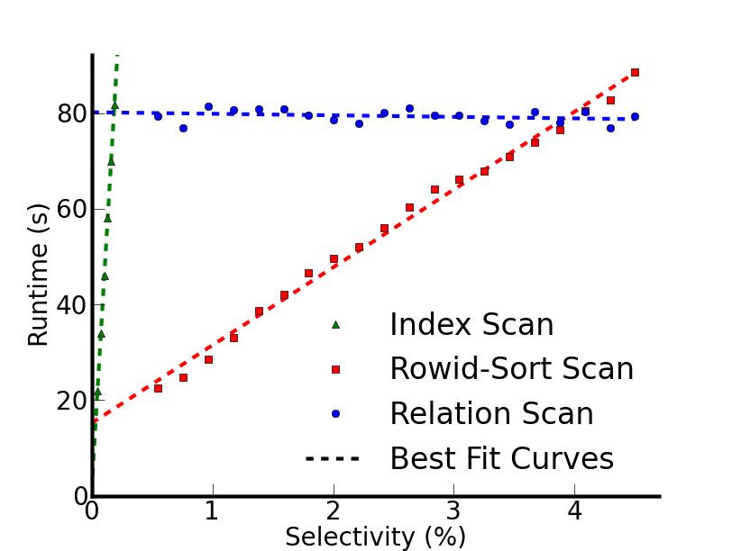
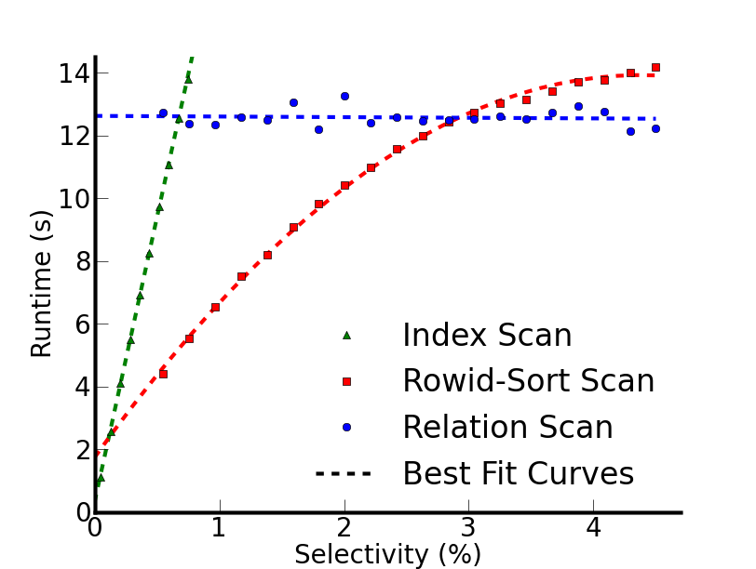
Negligible shift
Disk
Flash
Break-even points at lower selectivity than expected
Break-even points shift for only 0.9% selectivities
10% rule appropriate for pages
Notes:
Distinguish between previous index line and the rowid-sort scan
Scans start with cold data

Slide 11
Flash Implications
See proposal for join analysis and details
Little opportunity to take advantage of device-dependent query optimization
Large access granularity interferes with Flash’s low random read latency
Future NVRAMs provide fine-grained access
NVRAM holds promise for recovery management

Slide 12
Outline
Briefly: Flash analytics – leveraging fast reads
NVRAM OLTP recovery management
New: Persistent Memory Consistency (PMC)
Ex: data structure and consistency models

Slide 13
NVRAM characteristics
Byte addressable reads and persistent writes
Greater-than-DRAM read latency
Asymmetric writes/reads (slower writes)
MLC slows both reads and writes further
Possible interfaces – implies varied latency
Disk replacement
PCIe attached
Main memory bus
Slower than DRAM, but much faster than disk/Flash

Slide 14
Accelerating transaction processing
Online Transaction Processing (OLTP) relies on durability for recovery management
Recovery management optimized for disk [ARIES]
Faster storage provides low latency recovery and greater transaction throughput
Define persist: write to NVRAM durably
Main-memory DB performance, disk DB recovery

Slide 15
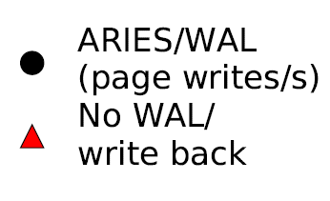
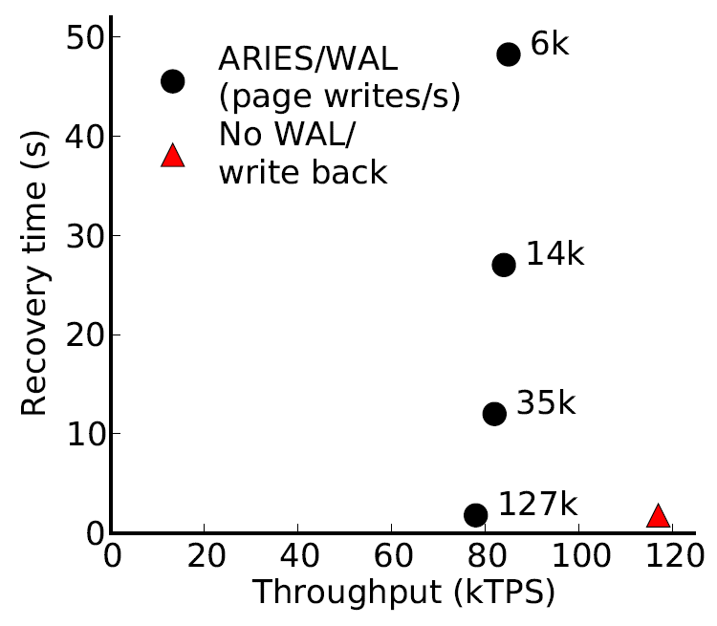
NVRAM OLTP opportunity
~ 30 15krpm disks
or 3 Flash SSDs
[device IOPS rates: Symantec]
Disk-management overheads impose bottleneck
As disk replacement NVRAM enables near-instant recovery

Slide 16
Storage Management for the NVRAM Era
Methodology to evaluate NVRAM on real hardware
Implement and compare recovery management
NVRAM Disk-Replacement has software overhead
Persisting to NVRAM immediately as In-Place Updates, enforcing persist order with persist barriers incurs frequent synchronization delays
Introduce new NVRAM Group Commit to minimize persist barrier frequency while trading off transaction latency
NVRAM Read performance analysis (see proposal)

Slide 17
Background: ARIES recovery
Defer page write back – may only write back after log persists
Transactions stall on persist only at commit
Replay log to recreate database on failure. Abort xcts with undo
Store
xct 1
xct 2
xct 1
Log
redo
undo
redo
undo
redo
undo
Log orders actions from concurrent transactions Redo entries record how to repeat action
Undo entries record how to remove action
Log transforms random writes into sequential writes

Slide 18
ARIES performance overheads
Serialized log introduces large code paths and high contention
Frequent page flushing creates contention on hot page latches
Page and log flusher threads use CPU time
Store
xct 1
xct 2
xct 1
Log
redo
undo
redo
undo
redo
undo
Optimizations necessary for disk now get in the way

Slide 19
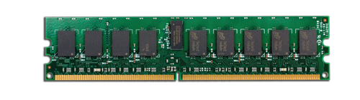
In-Place Updates
Persist updates in place immediately
Requires persist barriers, causing transaction to stall
Requires per-update log to make page updates atomic
Always at “replayed” state
No redo, no replay
Store
xct 1
xct 2
xct 1
Remove centralized log Undo now transaction-local
Log
redo
undo
redo
undo
redo
undo
Remove centralized log, but transactions incur persist delays

Slide 20
Choosing recovery mechanism
NVRAM Disk-Replacement incurs persist delays on page and flusher threads
Transaction threads delay only at commit
In-Place Updates delays at each update
As persist barrier delay increases NVRAM Disk-Replacement eventually wins
Want to remove logging and synchronous persist overheads
NVRAM Group Commit – Entire batch commits or aborts

Slide 21
NVRAM Group Commit
Time
Undo log
Persist store
Transactions quiesce at end of batch
Overwritten data persists as log, updates persist in place
NVRAM
store
Remove log
Commit transactions
Begin new batch
volatile
buffer
NVRAM
log

Slide 22
NVRAM Group Commit
Time
Additional details in proposal
Undo log
Persist store
Constant number of persist barriers per batch
No centralized logging
Throughput high so long as batch quiesce/persist short

Slide 23
Modeling unavailable devices
Run database on real hardware
Log and Stores on RAMDisk
Introduce precise delays (20ns precision using x86 RDTSCP) to model persist barrier latency
Build recovery mechanisms in Shore
Rely on dirty bit fields to track buffer pool writes during transaction, page latch, or batch

Slide 24
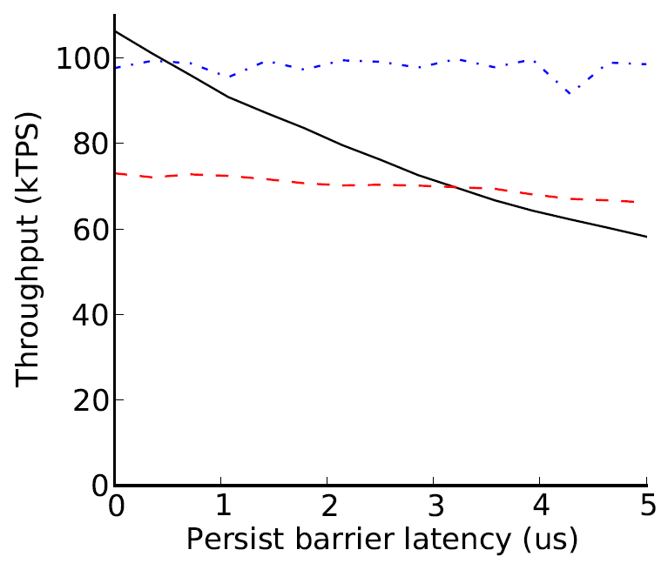
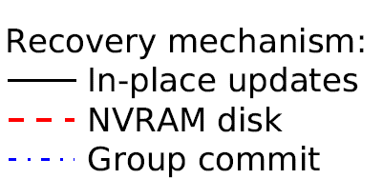
Recovery management performance
Group commit necessary above 2µs but increases xct latency

Slide 25
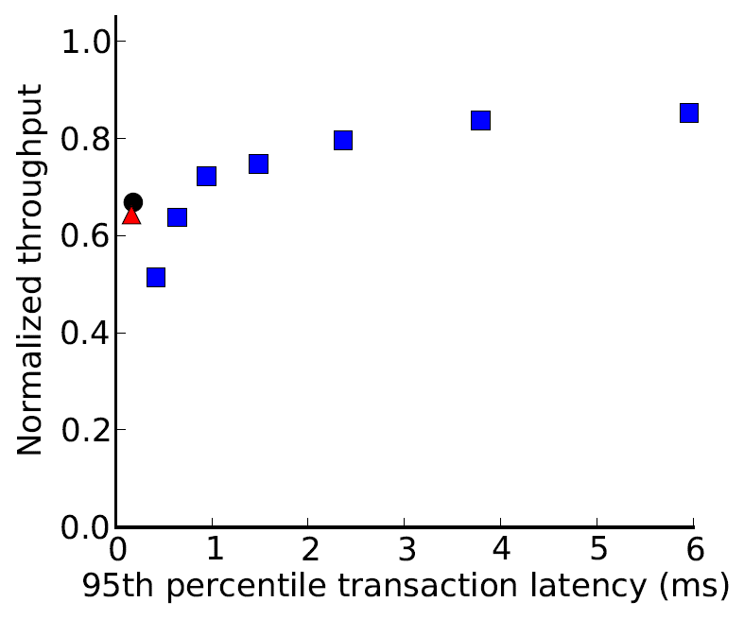
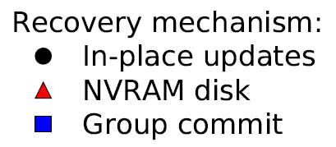
Transaction latency
3µs persist barrier latency
Normalized to 0µs in-place updates
Batching increases throughput with less-than-disk latencies

Slide 26
OLTP Future work
Detailed description of Group Commit and quantitative demonstration of performance
Data structures and concurrency management
Methodology
Quantitative validation of timing model
Evaluation
Device lifetime and persist bandwidth constraints

Slide 27
OLTP Summary
OLTP not yet optimized for NVRAM
Methodology to evaluate unavailable devices
Recovery mechanisms to avoid software overheads and persist synchronization delays
Consider implications of increased read latency and caching solutions (in proposal)
Efficient barriers enable simple, high performance recovery management

Slide 28
Outline
Briefly: Flash analytics – leveraging fast reads
NVRAM OLTP recovery management
New: Persistent Memory Consistency (PMC)
Ex: data structure and consistency models

Slide 29
Persistent Programming
More than databases: recoverable data structures in NVRAM
Various prior works [BPFS, CDDS, IBM NVRAM log, NVHeaps, Nmemosyne]
Must constrain NVRAM persist order
DRAM – cannot control write order
Disk – flush cache lines and sync. Unintuitive
Perform persists in program order – terrible performance! Must persist out of order
Persist ordering resembles memory consistency
Notes:
On one extreme we might assume that things persist in program order – no additional annotation required. On the other extreme we borrow the disk interface and flush individual cache lines (much harder to program for and unintuitive).

Slide 30
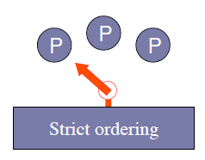
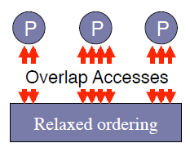
Memory consistency
CPUs/compilers like to reorder instructions
Defines allowable memory access orders between threads
Strict ordering (SC) intuitive, lower poerformance
Relaxed models difficult to reason about/program
Consistency spectrum
Persists require similar ordering constraints

Slide 31
Memory consistency
Prefer to reorder instruction execution
Complicates multi-threaded applications
flag1, flag2 initialized to 0
(Dekker’s mutex without atomic RMW)
Thread 1:
flag1 = 1
if flag2 == 0:
# critical sec.
Thread 2:
flag2 = 1
if flag1 == 0:
# critical sec.

Slide 32
Memory consistency
Prefer to reorder instruction execution
Complicates multi-threaded applications
flag1, flag2 initialized to 0
(Dekker’s mutex without atomic RMW)
CPU might reorder
Thread 1:
flag1 = 1
barrier
if flag2 == 0:
# critical sec.
Thread 2:
flag2 = 1
barrier
if flag1 == 0:
# critical sec.
Improving performance requires user intervention

Slide 33
Persistent consistency
Concurrency control similar to persistence
Consistency: order in which stores are visible
Persistence: order in which persists are visible
Persist order often enforced across threads
Leverage consistency to determine persist order
Persistent Memory Consistency (PMC)
Investigate PMC semantics, don’t fully explore implementations

Slide 34
Outline
Briefly: Flash analytics – leveraging fast reads
NVRAM OLTP recovery management
New: Persistent Memory Consistency (PMC)
Ex: data structure and consistency models

Slide 35
Persistent log/buffer
Persistent array
Persistent counter marks valid end of array
On recovery: base through counter considered valid
0
1
2
3
Insert(obj, size):
lock()
start = &array[counter]
memcpy(start,obj,size)
counter += size
unlock()
Buffer
array
Counter = 1
Buffer data must persist before counter for correct recovery

Slide 36
Implications of persist order
Important optimization: execution runs ahead of persistent state via buffering
Persists still occur in consistent order
If average persist throughput less than average execution rate, buffers fill
Persist order constraints limit persist parallelism and throughput
Maximize performance by minimizing persist-order critical path

Slide 37
Persistent Sequential Consistency (PSC)
Persists occur strictly in program order, as valid interleaving of persists between threads
Visibility of store and persist are atomic
Reaching instruction implies previous persists complete
No barriers (ordering or sync) necessary
P1 before P2
P4 before P1, P2
P4 before sys_call()
T1: P1 P2 W3 …
T2: … R3 P4 sync() sys_call()

Slide 38
Buffered PSC
Persistent state lags execution state
But persistent state always a previous interleaving
Sync barrier for external communication
At sys_call, persisted through P1
sys_call occurs before P2 persists
T1: P1 P2 W3
Require sync before sys call
T2: … R3 P4 sync() sys_call()

Slide 39
PSC persist constraints
Buffer atomic segment
Persists before
Counter
100 byte entries
8 byte atomic persist
100ns persist
Can insert every 1.4 µs (slow)
Strict consistency requires no barriers but limits performance

Slide 40
Local Persist Order (LPO)
Remove unnecessary cross-thread ordering
Single threaded operation resembles buffered PSC
Requires sync to delay until all persists complete
persists to single address ordered (without barriers)
Enforcing order across threads requires barrier
Data sharing implies persist order
Inserted barrier: all persists after the barrier must occur after any previous persists the thread observed according to the consistency model (simpler than in proposal)
Simplest implementation: thread delays until outstanding persists complete

Slide 41
LPO example
T1: P1 P2 W3
T2: R3 barrier P4
P4 not ordered after P1, P2
Violates SC
Persistent state may not match any memory order produced by the consistency model

Slide 42
LPO example
T1: P1 P2 W3
T2: R3 barrier P4
P4 must occur after any dependences through R3
P4 now necessarily after P1, P2

Slide 43
LPO persist constraints
Single-thread constraint
Allows buffer data from multiple threads to persist concurrently

Slide 44
Ideal persist constraints
Buffer persists before associated counter
Counters persist in-order
Critical path: one barrier per insert

Slide 45
Example implementation optimization
Skip persists to counter values
Requires all counter dependencies satisfied
Critical path: bounded constant

Slide 46
Possible directions
Evaluation
Assume naïve implementation, measure persist critical path of simple data structures
Is persist the bottleneck for each model?
Data structures
Buffer
OLTP/Shore-MT
Batching (from OLTP design)
New consistency models when necessary

Slide 47
Backup slides

Slide 48
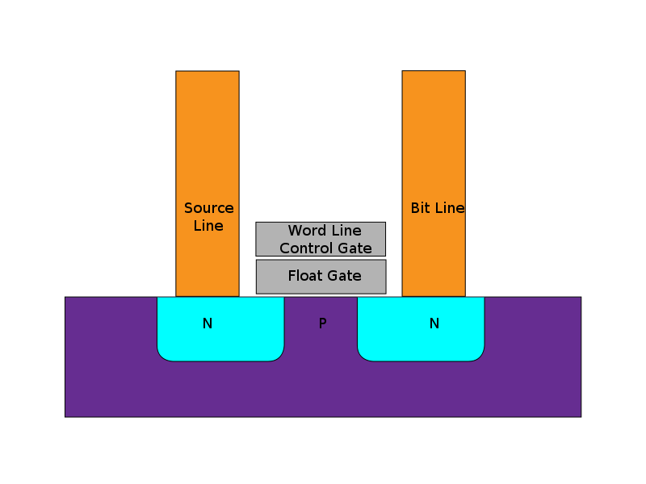
Flash memory
New durable storage popularized
by mobile devices
State stored in floating gate
Variable charge stored in
gate allows Multi-Level
Cells (MLC)
Limited write endurance
Image: Wikipedia
Flash now popular for high performance enterprise storage

Slide 49
Flash memory performance
 | Disk | Flash
Model | WD 10Krpm | OCZ RevoDrive
Seq. Read | 120MB/s | 190MB/s
Random Read | 10ms | 90µs
$/GB | .55 | 2.5
2011 devices
Flash much lower read latency than disk
Flash eliminates performance difference between random and sequential accesses
Current DBMS optimized for disk
Notes:
The sequential bandwidth is similar across devices, but random read is much faster on flash SSDs. Could possibly simplify DBMSs, which have long been optimized for high latency disks.
Say a bit more on this slide

Slide 50
SSD query plans unchanged
Flash gives better performance, but…
Query plans do not need to be changed on Flash
Using commercial DBMS – IBM DB2
0.9% of scan selectivities change access path
Join choice matters on disk, but not on Flash
Intelligent layout does not depend on query opt.
Notes:
Flash is best, but found that it wasn’t better for a set of queries
Performance difference that appears on disk disappears on flash
Mention commercial systems. Not sure where
Spend more time here.

Slide 51
Experimental structure
Focus on two key aspects of query plans
Access paths (scan type)
Join type
Force specific query plans and measure actual performance
Determine performance difference between devices

Slide 52
Methodology
IBM DB2 v9.7
Intel core 2 (dual core)
2GB memory
Disk: WD VelociRaptor 10Krpm drive
Flash: OCZ RevoDrive PCIe
Wisconsin Benchmark schema and data
Notes:
Limited Scope, but the simplicity of these experiments yields tremendous insight

Slide 53
Background: DB2 access paths
Table

Slide 54
Background: DB2 access paths
Table
Relation scan: high selectivity

Slide 55
Background: DB2 access paths
B-Tree index
Table
…

Slide 56
Background: DB2 access paths
B-Tree index
Table
…
Index scan: low selectivity

Slide 57
Background: DB2 access paths
B-Tree index
Table
…

Slide 58
Background: DB2 access paths
B-Tree index
Rowids
Table
{5;10}
{17;7}
{10;1}
{17;5}
…
Notes:
Add some addresses/numbers to the rowids (2 parts, page and tuple)

Slide 59
Background: DB2 access paths
B-Tree index
Rowids
Table
…
Rowid-sort scan: mid selectivities

Slide 60
Background: Selecting access path
Below 10% selectivity use index scan
Above 10% selectivity use relation scan
Relation scan
Runtime (time)
Index scan
Selectivity (%)
Flash’s low latency should shift break-even point to right

Slide 61
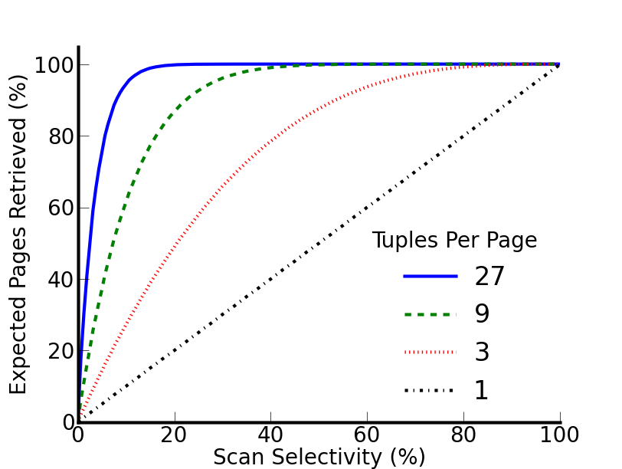
Why is the 10% rule wrong?
10% rule really applies to page selectivity
Index scan, uniform random layout:
[Yue et al.]
Notes:
Clean up this slide
If there were exactly 1 tuple per page we would see … but for a realistic 27 tuples per page…
Focus on tuple selectivity vs page selectivity
What follows from this is that the range where index scan works
Zoom in on a point? 3% on blue?

Slide 62
Why is the 10% rule wrong?
10% rule really applies to page selectivity
Index scan, uniform random layout:
27 tuples/page
at 4% row sel.
expect 67% pages
[Yue et al.]
Implication: relation scan preferred even on flash
Notes:
If there were exactly 1 tuple per page we would see … but for a realistic 27 tuples per page…
Focus on tuple selectivity vs page selectivity
What follows from this is that the range where index scan works
Zoom in on a point? 3% on blue?

Slide 63
Join
Join performance on disk depends on:
Algorithm
Relation sizes
Projectivity
These determine
Device access patterns
Data read and written to device

Slide 64
Join performance
Notes:
Explain database size relative to database size
Before I hit the button talk about these results more-
With one outlier, the best join type changes with projectivity

Slide 65
Join performance
Notes:
Focus on performance different between algorithms on flash

Slide 66
Join performance
CPU bound outlier
Flash insensitive to join type – 5.4% avg. difference w/o outlier

Slide 67
NVRAM
Both Flash and DRAM expected to stop scaling in the next few years
Need scalable dense replacements for both
Numerous technologies for “Storage Class Memory” or “Universal Memory”
Resistive RAM
Phase Change
Memristor
Magnetic RAM
STT RAM
FerroElectric RAM

Slide 68
NVRAM read performance
NVRAM read latency may be up to 5x DRAM read latency [IBM]
Greater if not connected via main memory bus
Require DRAM/on-chip cache to accelerate reads
Traditional software-managed DRAM buffer pool or hardware-managed DRAM cache?
Depends on capacity necessary to improve performance

Slide 69
NVRAM Group Commit
Time
Transactions operate on copy of data in volatile buffer
NVRAM
store
volatile
buffer
NVRAM
log

Slide 70
NVRAM Group Commit
Time
Transactions quiesce at end of batch
NVRAM
store
volatile
buffer
NVRAM
log

Slide 71
NVRAM Group Commit
Time
Undo log
Overwritten data copied to NVRAM log
NVRAM
store
volatile
buffer
NVRAM
log

Slide 72
NVRAM Group Commit
Time
Undo log
Persist store
Barriers ensure store persists after log
Persist batch updates in-place
NVRAM
store
volatile
buffer
NVRAM
log

Slide 73
NVRAM Group Commit
Time
Undo log
Persist store
Remove log
Commit transactions
Begin new batch
NVRAM
store
volatile
buffer
NVRAM
log

Slide 74
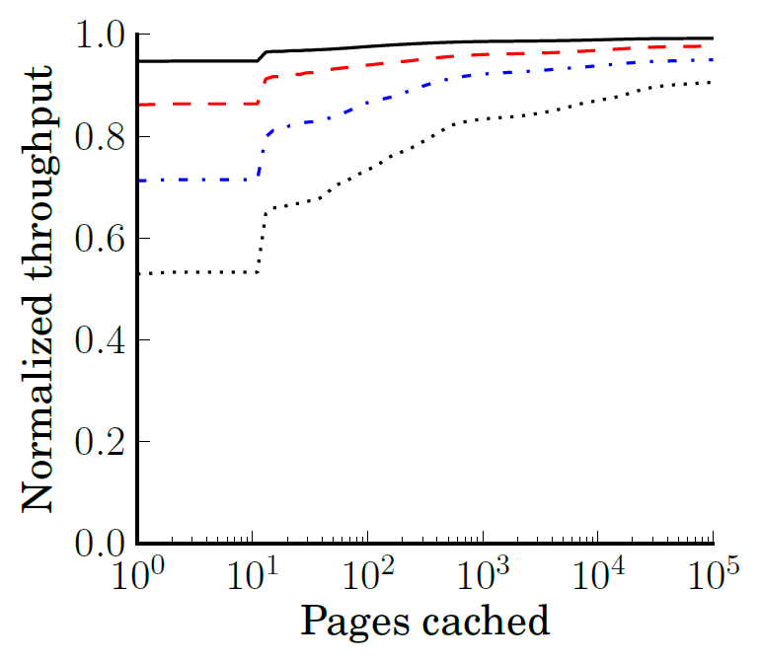
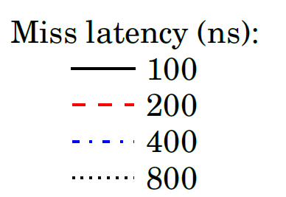
Read throughput
Caches likely required but even small capacity largely effective

Slide 75
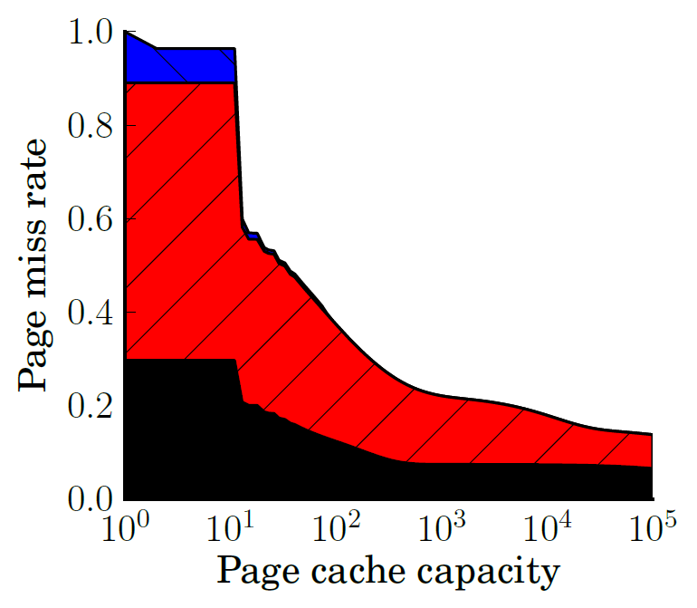

Caching
B-Trees, append-heavy, and small tables cache effectively

Slide 76
Group Commit future work
Journal only allows so much room
Group Commit large software effort
Useful mechanism for NVRAM persistence (not just OLTP)
Intend to include:
Description of new data structures to efficiently track and log dirty regions
Batch management to quickly persist batch

Slide 77
Methodology future work
Intend to include detailed study of timing model and bandwidth reservation
More detail
Quantify accuracy and limitations

Slide 78
Results future work
Intend to include quantitative study of:
Persist bandwidth required for each mechanism
Group commit is bursty, required more bandwidth
Device lifetime due to write endurance
Each recovery mechanism produces varying quantity of persists and distributes persists across addresses/cells differently
Prior work imagines hardware to distribute writes to the same address across numerous cells. Consider device lifetime with hardware ware-leveling

Slide 79
BPFS (Total Epoch Order)
Better I/O through byte-addressable, persistent memory – Condit et al.
Divide code into epochs with epoch barriers
Persists within same epoch occur in parallel
Persists may not reorder across barriers
Shared memory accesses w/ at least one write imply epoch order between threads
Propose hardware (cache extensions)
No races in persist epochs (even volatile synchronization)

Slide 80
BPFS (Total Epoch Order)
Insert(obj, size):
lock()
barrier
start = &array[counter]
memcpy(start,obj,size)
barrier
counter += size
barrier
unlock()
Buffer should persist in parallel with prev. counter
Restricts important programming patterns (batching)

Slide 81
Partial Epoch Order (PEO)
Consider epochs from separate threads concurrent if they contain a race
Subsequent epochs inherit order constraint
Insert(obj, size):
barrier
lock()
start = &array[counter]
memcpy(start,obj,size)
barrier
counter += size
unlock()
barrier
Similar to BPFS code
(barriers outside locks)
Buffer persists in parallel
with previous counter

Slide 82
Partial Epoch Order (PEO)
Race with counter orders with counter’s dependencies
(constraint between all buffer segments not shown)
Adjacent insert from same thread enforces ordering
Prevents deadlock. Removes most unnecessary constraints
Too complicated to be useful?

