Slide 1

Predicting Asthma Severity Using Machine Learning: Symptoms and Demographic Factors
Project Presentation
M.Sc. Department of Statistics
Presented By
Name : Abu Saeed
Roll No : 212205
Reg. No : 1578
Session :2021-22
May 20, 2025

Slide 2
OUTLINE
Introduction
Literature Review
Objectives of the study
Methodology
Analysis of data
Recommendation
Conclusion

Slide 3
Introduction
Asthma is a chronic respiratory disease affecting millions globally, with varying severity levels.
Severity is influenced by multiple factors including symptoms, age, gender, and environmental conditions.
Accurate classification of asthma severity is critical for early diagnosis and effective treatment.
Traditional statistical methods help identify significant symptom-demographic relationships.
Machine learning models offer advanced capabilities to predict severity and discover hidden patterns in data.
This project combines both approaches to improve the understanding and prediction of asthma severity.

Slide 4
Literature Review
Asthma symptoms and severity are influenced by age, gender, and environment.
PCA helps reduce data complexity and highlight critical factors (Zhang et al., 2020).
Clustering (e.g., K-means) reveals hidden patient groups (Liu et al., 2019).
Neural networks and ROC analysis are effective for prediction and
performance evaluation (Al-Garadi et al., 2021).

Slide 5
Objectives of the study
To analyze and visualize asthma severity data using graphs and frequency tables.
To identify significant differences in symptoms and severity across demographic groups.
To test hypotheses and find key factors influencing asthma severity.
To apply PCA for factor reduction and K-means clustering for patient segmentation.
To assess model performance with ROC analysis and build a neural network for prediction.

Slide 6
Methodology
Exploratory Data Analysis: Graphs, frequency tables.
Statistical Tests: Hypothesis testing.
PCA: Dimensionality reduction.
ROC Analysis: Model performance evaluation.
K-means Clustering: Patient segmentation.
Neural Network: Severity prediction model.

Slide 7
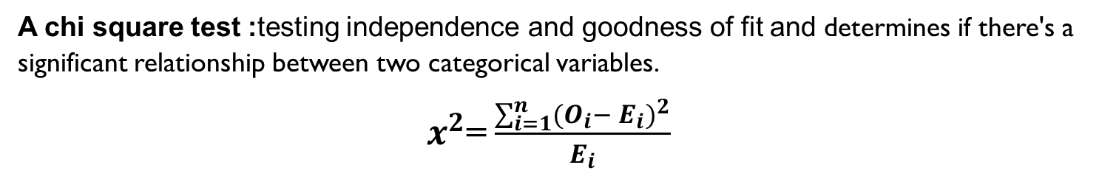
Hypothesis testing
A chi square test :testing independence and goodness of fit and determines if there's a significant relationship between two categorical variables.
$x^{2}$=$\frac{\sum_{i=1}^{n}{(O_{i}}{− E_{i})}^{2}}{E_{i}}$
Association between | Pearson Chi-Square (Value) | DF | P-Value | Decision
Association between tiredness and dry cough | 45257.143 | 1 | 0.001 | Reject
Association between dry cough and sore throat | 822.857 | 1 | 0.001 | Reject
Association between difficulty in breathing and sore throat | 51840 | 1 | 0.001 | Reject
Association between nasal congestion and runny nose | 22528 | 1 | 0.001 | Reject
Association between difficulty in breathing and dry cough | 45257.143 | 1 | 0.023 | Reject
Association between sore throat and pains. | 0 | 1 | 1 | Accept

Slide 8
Factor Analysis Using PCA
Statistical technique that reduces a set of variables by extracting all their commonalities into a smaller number of factors.
The table shows how much of the variance in the variables has been accounted for by the extracted factors.
Such As 64.7% of the variance in “Runny Nose” is accounted for.
Communalities
 | Initial | Extraction
Tiredness | 1.000 | 0.719
Dry Cough | 1.000 | 0.642
Difficulty in Breathing | 1.000 | 0.696
Sore Throat | 1.000 | 0.702
None Symptoms | 1.000 | 0.459
Pains | 1.000 | 0.828
Nasal Congestion | 1.000 | 0.599
Runny Nose | 1.000 | 0.805
None Experiencing | 1.000 | 0.607
Age_09 | 1.000 | 1.000
Age_10-19 | 1.000 | 1.000
Age_20-24 | 1.000 | 1.000
Age_25-59 | 1.000 | 1.000
Age_60 | 1.000 | 1.000
Gender Female | 1.000 | 0.750
Gender Male | 1.000 | 0.750
Severity None | 1.00 | .000

Slide 9
Total variance Explained
For analysis and interpretation purposes we are concerned only with Initial Eigenvalues and Extracted Sums of Squared Loadings
Total Variance Explained
Component | Initial Eigenvalues |  |  | Extraction Sums of Squared Loadings |  |  | Rotation Sums of Squared Loadings
 | Total | % of Variance | Cumulative % | Total | % of Variance | Cumulative % | Total | % of Variance | Cumulative %
1 | 1.884 | 11.080 | 11.080 | 1.884 | 11.080 | 11.080 | 1.699 | 9.994 | 9.994
2 | 1.757 | 10.335 | 21.415 | 1.757 | 10.335 | 21.415 | 1.589 | 9.345 | 19.339
3 | 1.500 | 8.824 | 30.239 | 1.500 | 8.824 | 30.239 | 1.519 | 8.934 | 28.273
4 | 1.334 | 7.848 | 38.086 | 1.334 | 7.848 | 38.086 | 1.500 | 8.824 | 37.096
5 | 1.250 | 7.353 | 45.439 | 1.250 | 7.353 | 45.439 | 1.250 | 7.354 | 44.450
6 | 1.250 | 7.353 | 52.792 | 1.250 | 7.353 | 52.792 | 1.250 | 7.353 | 51.803
7 | 1.250 | 7.353 | 60.145 | 1.250 | 7.353 | 60.145 | 1.250 | 7.353 | 59.156
8 | 1.250 | 7.353 | 67.498 | 1.250 | 7.353 | 67.498 | 1.250 | 7.353 | 66.509
9 | 1.082 | 6.364 | 73.862 | 1.082 | 6.364 | 73.862 | 1.250 | 7.353 | 73.862
10 | 1.000 | 5.882 | 79.745
11 | 0.755 | 4.438 | 84.183
12 | 0.641 | 3.768 | 87.951
13 | 0.597 | 3.512 | 91.463
14 | 0.520 | 3.062 | 94.525
15 | 0.500 | 2.941 | 97.466
16 | 0.431 | 2.534 | 100.000
17 | -1.155E-13 | -6.794E-13 | 100.000

Slide 10
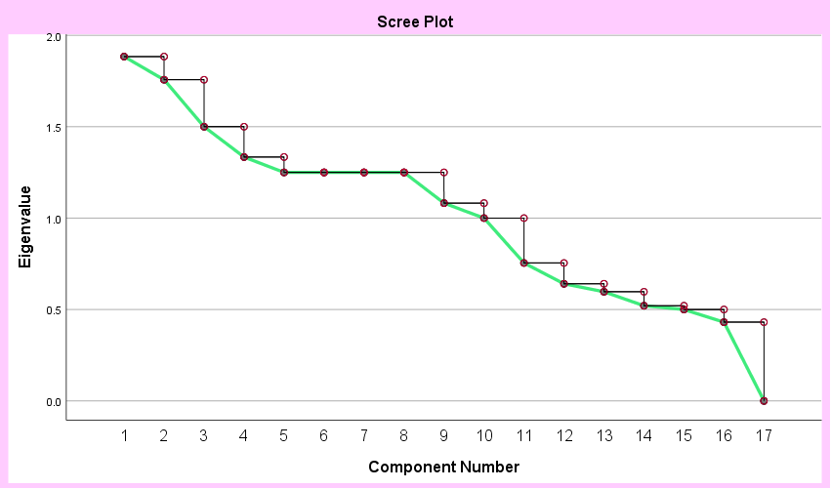
Scree plot
To find the elbow point, the point at which the slope of the graph levels off. This indicates the optimal number of components/factors to keep

Slide 11
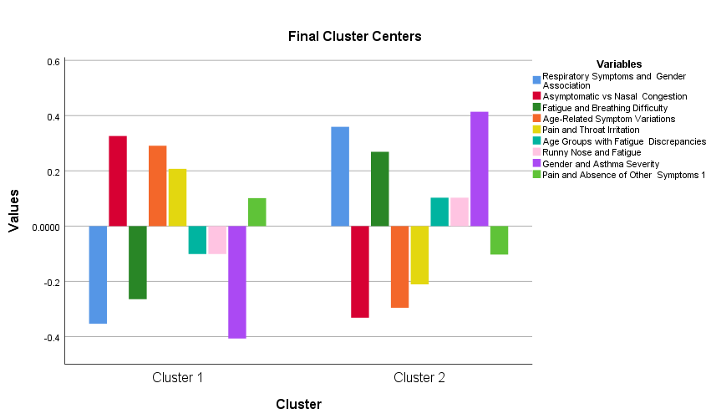
K-means clustering
Unsupervised machine learning algorithm used to group similar data points into clusters.
Cluster 1 shows milder symptoms with nasal congestion and fatigue, while Cluster 2 reflects more severe, pain-related symptoms influenced by age and asthma severity.
Final Cluster Centers
 | Cluster
 | 1 | 2
Respiratory Symptoms and Gender Association | -0.35342 | 0.35936
Asymptomatic vs Nasal Congestion | 0.32626 | -0.33174
Fatigue and Breathing Difficulty | -0.26456 | 0.26900
Age-Related Symptom Variations | 0.29077 | -0.29566
Pain and Throat Irritation | 0.20722 | -0.21071
Age Groups with Fatigue Discrepancies | -0.10108 | 0.10278
Runny Nose and Fatigue | -0.10123 | 0.10293
Gender and Asthma Severity | -0.40705 | 0.41389
Pain and Absence of Other Symptoms 1 | 0.10123 | -0.10294

Slide 12
K-means clustering
The key variables driving cluster separation are respiratory symptoms, gender-linked nasal congestion, fatigue, and asthma severity, while age-related fatigue and isolated pain have minimal impact.
ANOVA
 | Cluster |  | Error |  | F | Sig.
 | Mean Square | df | Mean Square | df
Respiratory Symptoms and Gender Association | 40235.253 | 1 | 0.873 | 316798 | 46088.643 | 0.001
Asymptomatic vs Nasal Congestion | 34288.324 | 1 | 0.892 | 316798 | 38449.777 | 0.001
Fatigue and Breathing Difficulty | 22545.657 | 1 | 0.929 | 316798 | 24273.026 | 0.000
Age-Related Symptom Variations | 27235.260 | 1 | 0.914 | 316798 | 29796.810 | 0.000
Pain and Throat Irritation | 13832.416 | 1 | 0.956 | 316798 | 14463.911 | 0.000
Age Groups with Fatigue Discrepancies | 3291.449 | 1 | 0.990 | 316798 | 3325.994 | 0.000
Runny Nose and Fatigue | 3300.769 | 1 | 0.990 | 316798 | 3335.512 | 0.000
Gender and Asthma Severity | 53373.287 | 1 | 0.832 | 316798 | 64187.168 | 0.000
Pain and Absence of Other Symptoms 1 | 3301.235 | 1 | 0.990 | 316798 | 3335.987 | 0.000

Slide 13
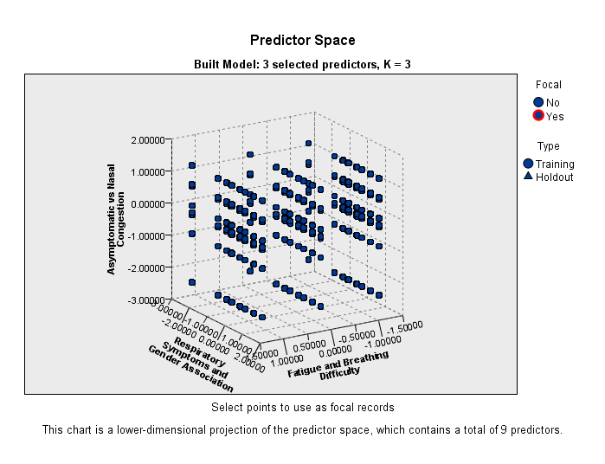
K-Nearest Neighbors (KNN) Model
simple supervised machine learning algorithm used for classification.
Predictor Space built with 3 selected predictors out of a total of 9. The axes represent Fatigue and Breathing Difficulty, Respiratory Symptoms and Gender Association and Asymptomatic vs. Nasal Congestion.
Case Processing Summary
 |  | N | Percent
Sample | Training | 221490 | 69.9%
 | Holdout | 95310 | 30.1%
Valid |  | 316800 | 100.0%
Excluded |  | 0
Total |  | 316800

Slide 14
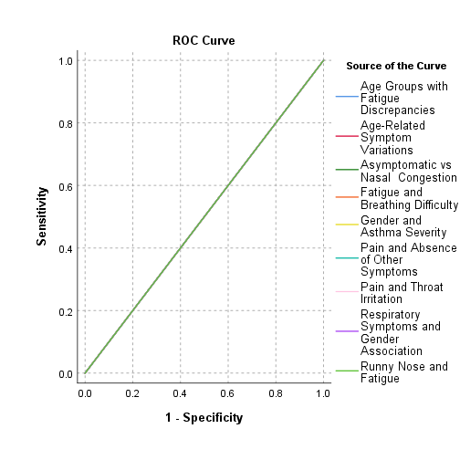
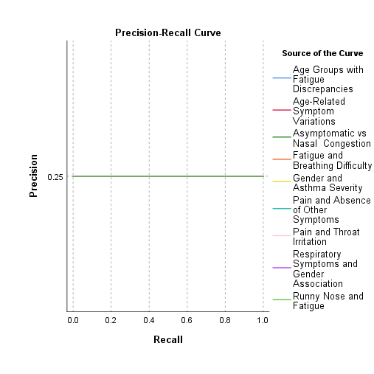
ROC (Receiver Operating Characteristic)
evaluate the performance of various predictive models related to asthma severity

Slide 15
Neural Network
Artificial neural networks, usually simply called neural networks or neural nets. Pattern recognition and classification, Predictive modeling, Dimensionality reduction, Feature extraction are the key feature of NN.
Network Information
Input Layer | Covariates | 1 | Respiratory Symptoms and Gender Association
 |  | 2 | Asymptomatic vs Nasal Congestion
 |  | 3 | Fatigue and Breathing Difficulty
 |  | 4 | Age-Related Symptom Variations
 |  | 5 | Pain and Throat Irritation
 |  | 6 | Age Groups with Fatigue Discrepancies
 |  | 7 | Runny Nose and Fatigue
 |  | 8 | Gender and Asthma Severity
 |  | 9 | Pain and Absence of Other Symptoms
 | Number of Units |  | 9
 | Rescaling Method for Covariates |  | Standardized
Hidden Layer(s) | Number of Hidden Layers |  | 1
 | Number of Units in Hidden Layer 1ª |  | 7
 | Activation Function |  | Hyperbolic tangent
Output Layer | Dependent Variables | 1 | Severity_None
 | Number of Units |  | 2
 | Activation Function |  | Identity
 | Error Function |  | Sum of Squares
Case Processing Summary
 |  | N | Percent
Sample | Training | 222003 | 70.1%
 | Testing | 94797 | 29.9%
Valid |  | 316800 | 100.0%
Excluded |  | 0
Total |  | 316800

Slide 16
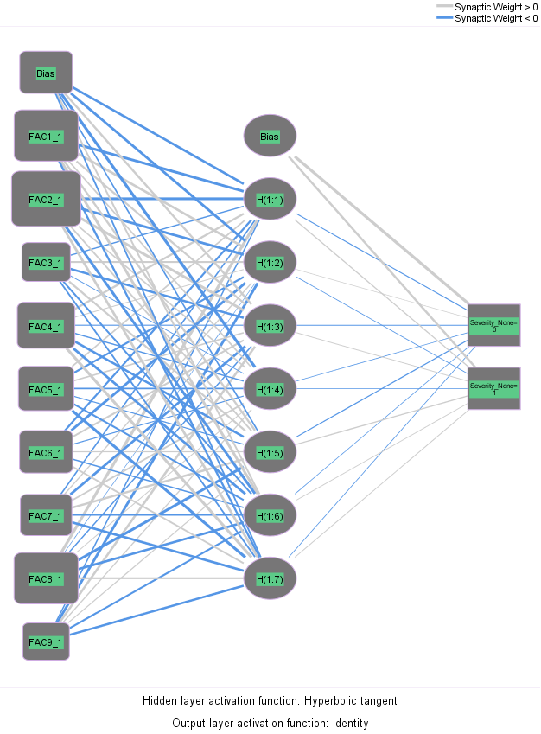
Neural network model (Multiple perceptions)

Slide 17
Classification
Classification
Sample | Observed | Predicted
 |  | No | Yes | Percent Correct
Training | No | 166629 | 0 | 100.00%
 | Yes | 55374 | 0 | 0.00%
 | Overall Percent | 100.00% | 0.00% | 75.10%
Testing | No | 70971 | 0 | 100.00%
 | Yes | 23826 | 0 | 0.00%
 | Overall Percent | 100.00% | 0.00% | 74.90%
Accuracy: Accuracy is the probability that the model prediction is correct. Here accuracy 74.90% that means the model prediction is 75% correct.

Slide 18
Conclusion
Demographic and symptom data can effectively predict asthma severity.
Combining PCA, clustering, and neural networks improves classification.
Results can support early detection and personalized treatment.

Slide 19
Thank You

