Slide 1
Toxic Comment Classification Using Deep Learning
AI-Powered Moderation for Safer Online Communities
Presented by: Abu Sufian Emon

Slide 2
Introduction
Online platforms face challenges with toxic and harmful user content
Manual moderation is slow and limited in scale
Toxic_Comment_Detection uses deep learning to automate toxic comment detection

Slide 3
Objective
Build a multi-label classification model
Detect various toxicity types (toxic, obscene, threat, etc.)
Provide a simple, interactive interface using Gradio

Slide 4
Tools & Technologies
Programming: Python
Libraries: TensorFlow, Pandas, NumPy, Matplotlib
Interface: Gradio
Platform: Google Colab

Slide 5
Dataset
Source: Kaggle
Features: Raw text comments
Labels: Toxic, Severe Toxic, Obscene, Threat, Insult, Identity Hate
Preprocessing: Text vectorization and batching using TensorFlow

Slide 6
Model Architecture
Embedding Layer: Converts words to vectors
Bidirectional LSTM: Captures context from both directions
Dense Layers: Extract meaningful patterns
Output Layer: 6 sigmoid units for multi-label classification

Slide 7
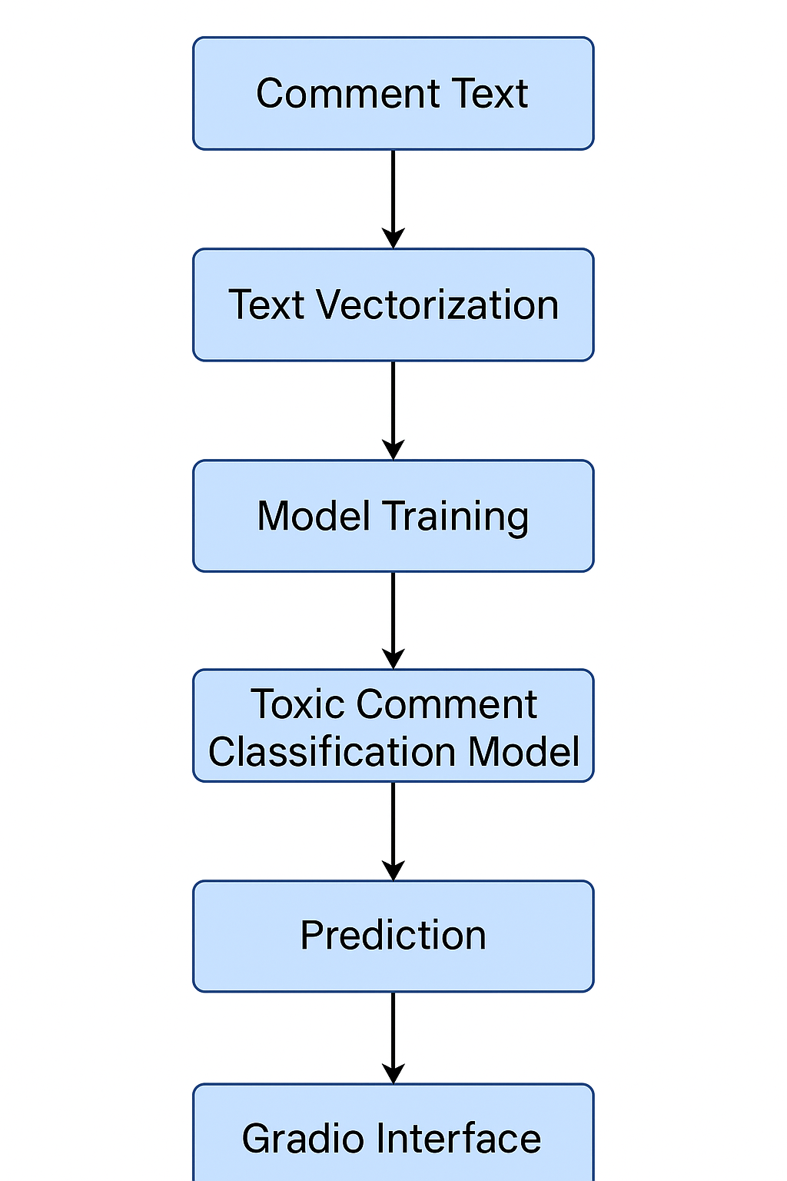

Slide 8
Results & Evaluation
Metrics used:
Precision
Recall
Binary Accuracy
Evaluation performed on a held-out test set
Threshold: 0.2 for classification

Slide 9
Gradio Interface Demo
Live comment scoring interface
Input any comment to get predicted toxicity labels
Easy for moderators and non-technical users

Slide 10
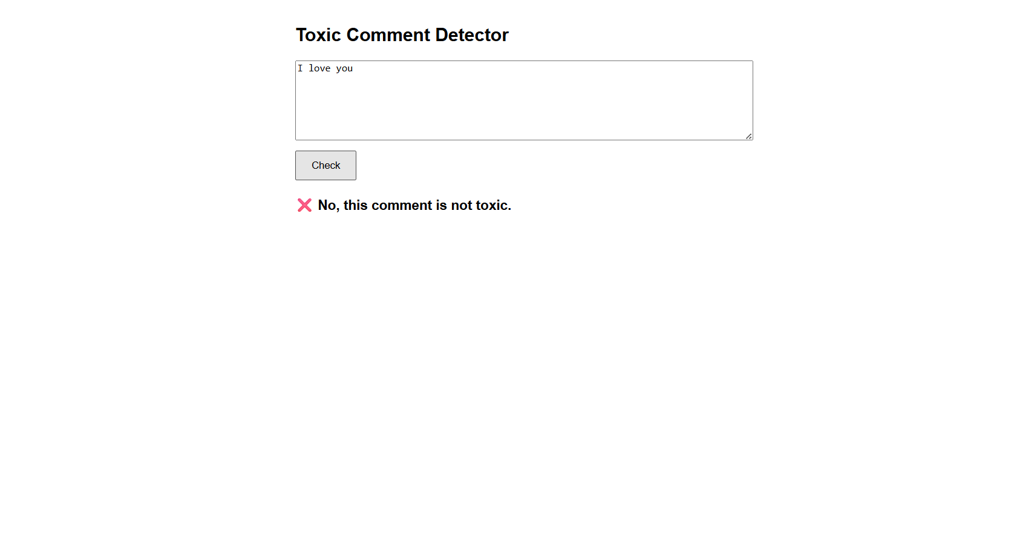

Slide 11
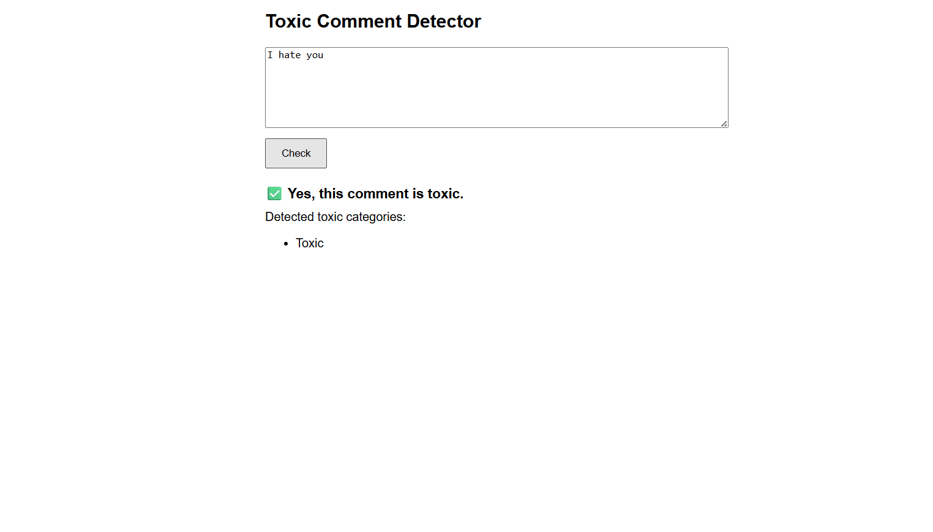

Slide 12
Expected Outcomes
A trained model that detects toxic comments
A functional interface for testing
A deployable solution for moderation systems

