Slide 1
SALES & PROFIT DASHBOARD – SUPERSTONE
Prepared By
Name: A. Abutharik
Internship: Data Analyst
Task: Task 4 – Dashboard Design
Tool Used: Power BI
Date: June 5, 2025

Slide 2
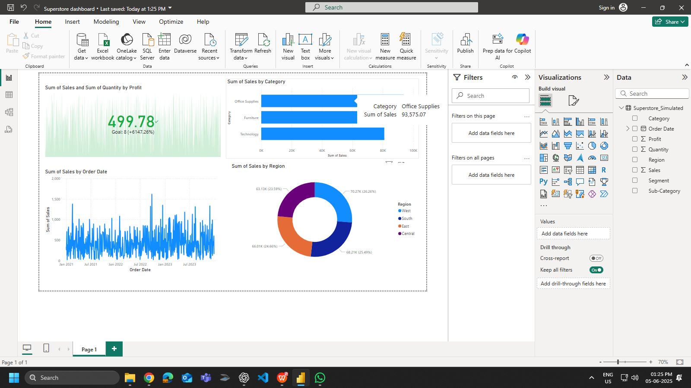
Sales & Profit Dashboard – Superstore

Slide 3
Short summary:
KPIs used
Charts included
Filters/slicers used
Insights (e.g., "Furniture is profitable", "Sales grew in 2023")

