Slide 1
Full Stack Web Development Lecture 2
Dr. Musadaq Mansoor

Slide 2
Web Server
It is a computing server that enables HTTP access to a web site.
A web server runs many additional services behind the scene, e.g., a database, a server application framework, authentication, etc.
Web server refer to either the hardware (the computer) or the software (the computer application) that helps to deliver web content that can be accessed through the Internet. The term web server or webserver can mean one of two things:
A computer program that accepts HTTP requests and return HTTP responses with optional data content.
A computer that runs a computer program as described above.

Slide 4
Web Server Components
A web server typically include the following major components:
networking support : sending responses and receiving requests over the network;
address/domain resolution : analyzing the correct IP address for the requested (virtual) domain, authenticating if necessary;
request processing : serving static or dynamic content as appropriate;
response generation : building the response and passing it to the networking component.

Slide 5
Web Server WorkFlow
A web server has the following workflow steps:
receive a HTTP request;
translate the resource “path” based on the requesting URL;
check access based on the requested information;
validate the user id and authenticate the user if necessary;
determine the MIME (Multi-purpose Internet Mail Extensions) type of the requested resource;
generate the dynamic response if needed, i.e., running local scripts;
send response back
log the request.

Slide 6
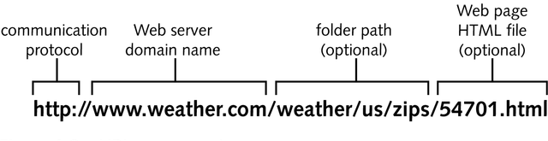
URL
It contains four distinct parts: the protocol type, the machine name, the directory path and the file name.
URI stands for Uniform Resource Identifier. URI is a text which is used to identify any resource or name in Internet.

Slide 7
HTML (Hyper Text Markup Language)
A markup language for describing web pages using tags
The tags describe document content
HTML documents are text documents that contain:
formatting instructions, called tags
the text that is to be displayed on a Web page
Markup Language
It is a set of markup tags or set of characters or symbols
Define a document’s logical structure or how a document should be printed or displayed

Slide 8

DOCTYPE
The <!DOCTYPE> declaration tells browser that this is an HTML page.
There are many different documents on the web, and a browser can only display an HTML page 100% correctly if it knows the HTML type and version used.
HTML5 Example: <!DOCTYPE html>

Slide 9
Tags v Attributes
HTML uses tags to define elements on a web page.
Tags consist of an opening (<tag>) and closing (</tag>) tag.
Example:
<p>This is a paragraph.</p>
Attributes provide additional information about HTML elements.
<img src="image.jpg" alt="Description">

Slide 10
Basic HTML Structure
<!DOCTYPE html>
<html>
<head>
<title>Your Page Title</title>
</head>
<body>
<!-- Content goes here -->
</body>
</html>

Slide 11
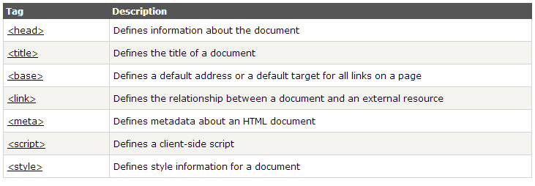
Head Tags

Slide 12
Head Tags
Title
The <title> element is required in all HTMLdocuments.
The <title> element:
Defines a title in the browser toolbar
Provides a title for the page when it is added to favorites
Displays a title for the page in search-engine results
Base
The <base> tag specifies the base URL/target for all relative URLs in a page:

Slide 13
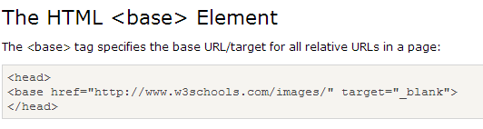
Head Tags
The <base> tag specifies the base URL/target for all relative URLs in a page:
Link
Link include a information e.g stylesheet in a pag
<link href="style.css" rel="stylesheet" type="text/css" media="all">

Slide 14
Head Tags
META
Another tag that can be added in the head is a <META> tag. It is used to help search engines index a page. There are several different meta names.
The author meta:
<META NAME="author“ CONTENT="Nongjian Zhou">
Style
Contains style information for a document, or a part of document. The specific style information is contained inside of this element, usually in the CSS. E.g
<style type="text/css"> body { color:red; } </style>
Script
<script language="javascript" type="text/javascript"> function myFunction()
{ alert('Hello world'); }
</script>

Slide 15
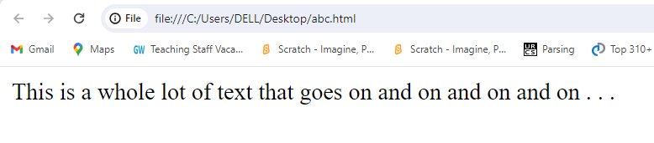
Text Layout
<body>
This is a whole lot of text that
goes on and on and
on
and
on
.
.
.
</body>

Slide 16
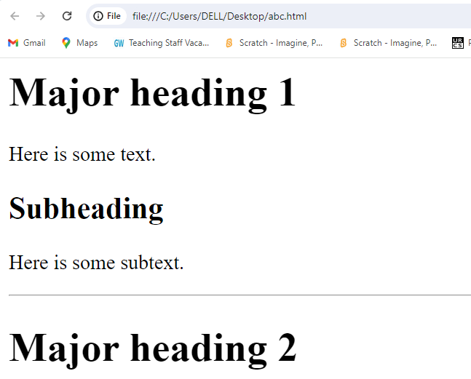
Heading and Horizontal Lines
<body>
<h1>Major heading 1</h1>
<p>
Here is some text.
</p>
<h2>Subheading</h2>
<p>
Here is some subtext.
</p>
<hr/>
<h1>Major heading 2</h1>
</body>

Slide 17
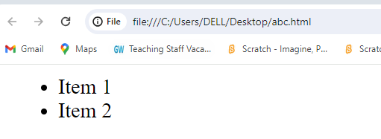
Lists - Ordered and Unordered
<ul> for unordered lists.
<ol> for ordered lists.
<li> for list items.
Example:
<ul>
<li>Item 1</li>
<li>Item 2</li>
</ul>

Slide 18
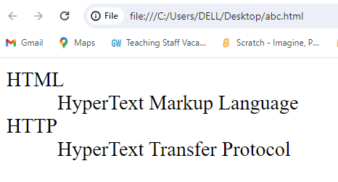
Definition Lists
<dl>
<dt>HTML</dt>
<dd>HyperText Markup Language</dd>
<dt>HTTP</dt>
<dd>HyperText Transfer Protocol</dd>
</dl>

Slide 19
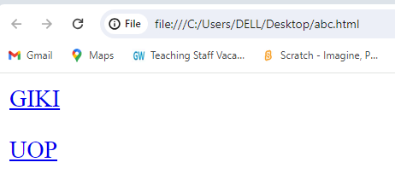
Links
<p>
<a href="http://www.giki.edu.pk">
GIKI</a>
</p>
</p><a href=“http://uop.edu.pk" target="_blank">
UOP</a>
</p>

Slide 20
Forms
What are forms?
An HTML form is an area of the document that allows users to enter information into fields.
A form may be used to collect personal information, opinions in polls, user preferences and other kinds of information.

Slide 21
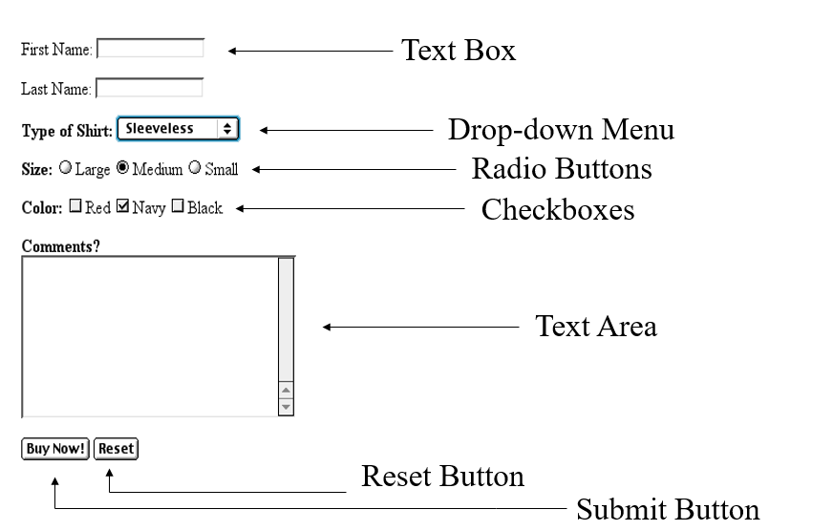
Sample Form

Slide 22
Creating Form
To create a form shell, type <form method=post action=“script_url”> where “script_url” is the address of the script
Create the form elements
End with a closing </form> tag

Slide 23
Key Elements
Textbox
Textarea
Radiobutton
Checkbox
Dropdown
Submit
Reset
File

Slide 24
Form
A form has three important parts:
the <form> tag, which includes the address of the script which will process the form
the form elements, like text boxes and radio buttons
the submit button which triggers the script to send the entered information to the server

Slide 25
Thank You

