Slide 1
Introduction to HTML5

Slide 2

Tag Structure
DOCTYPE
The doctype for HTML 4.01
<!DOCTYPE HTML PUBLIC
"-//W3C//DTD HTML 4.01//EN"
"http://www.w3.org/TR/html4/strict.dtd">
The doctype for HTML5
<!DOCTYPE html>

Slide 3


Tag Structure
<link> Tag
<link rel="stylesheet" type="text/css" href="file.css">
In HTML5
<link rel="stylesheet" href="file.css">
Obsolete Elements In HTML5
Frame , frameset , noframes , font , big , center and few more.
Attributes like bgcolor, cellspacing, cellpadding, and valign.
Use of <a> Tag in HTML5
<a href="/about">
<h2>About me</h2>
<p>Find out what makes me tick.</p>
</a>

Slide 4

Tag Structure
Organizing Code Using Blocking Elements
SECTION
ARTICLE
HEADER
FOOTER
ASIDE
FIGURE
NAV

Slide 5
Forms in HTML5
Form elements can be anywhere and can be associated to form by giving form's ID to form attribute of that element.
<form id=foo>
<input type=”text”>
...
</form>
<textarea form=foo></textarea>

Slide 6
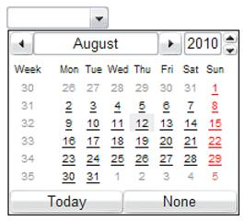
Forms in HTML5
New INPUT types
Email input type
URL input type
<input type=email>
<input type=url>
Date input type
Time input type
<input type=date>
<input type=time>
datetime input type
<input type=datetime>
Month input type
<input type=month>

Slide 7
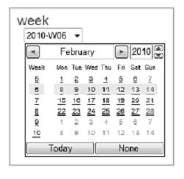


Forms in HTML5
More INPUT types
Week input type
range input type
<input type=week>
<input type=range >
In Chrome
Search input type
<input type=search>
Number input type
tel input type
<input type=number min=0 max=20 step=2 >
<input type=tel>
In Opera

Slide 8
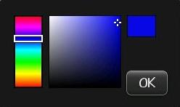
Forms in HTML5
Last INPUT type
color input type
<input type=color >
In Blackberry web browser

Slide 9
Forms in HTML5
New attributes
Autofocus attribute
<input id="status" name="status" type="text" autofocus>
Placeholder attribute
<label for="search">My Search</label>
<input id="search" name="search" type="text"
placeholder="Search Here">
My Search
Search Here

Slide 10
Forms in HTML5
More new attributes
Required attribute
<input id="pass" name="pass" type="password" required>
Autocomplete attribute
<input type="text" name="onetimetoken" autocomplete="off">

Slide 11
Offline Web Applications
Allow you to keep using web apps and sites without a network connection
Browsers cache data in Application cache
Once resources are cached you can access them very quickly (without network request)
HTML5 also allows online and offline detection
We can use offline mechanism that allows us to easily prefetch site resources

Slide 12
Offline Web Applications
The cache manifest
Contents of cache.manifest
CACHE MANIFEST
# Files to cache
index.html
cache.html
html5.css
image1.jpg
html5.js
# Use from Network if available
NETWORK:
network.html
# Fallback content
FALLBACK:
fallback.js fallbackserver.js
/fallback.html
<!DOCTYPE HTML>
<html manifest="/cache.manifest">
<body>
...
</body>
</html>

Slide 13
Canvas
The canvas element provides scripts with a resolution-dependent bitmap canvas, which can be used for rendering graphs, game graphics, or other visual images on the fly.
Canvas gives an easy and powerful way to draw graphics using Javascript.
For each canvas element you can use a "context" (think about a page in a drawing pad), into which you can issue JavaScript commands to draw anything you want.

Slide 14
Canvas
Basics of Canvas
<canvas id="myCanvas" width="300" height="150">
Fallback content, in case the browser does not support Canvas.
</canvas>
<script>
// Get a reference to the element.
var elem = document.getElementById('myCanvas');
// Always check for properties and methods, to make
// sure your code doesn't break
// in other browsers.
if (elem && elem.getContext) {
// Get the 2d context.
// Remember: you can only initialize one context per element.
var context = elem.getContext('2d');
if (context) {
// You are done! Now you can draw your first rectangle.
// You only need to provide the (x,y) coordinates, followed by
// the width and
// height dimensions.
context.fillRect(0, 0, 150, 100);
}
}
</script>

Slide 15
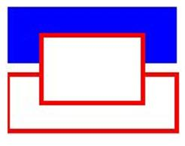
Canvas
Basic lines and strokes
context.fillStyle = '#00f'; // blue
context.strokeStyle = '#f00'; // red
context.lineWidth = 4;
// Draw some rectangles.
context.fillRect (0, 0, 150, 50);
context.strokeRect(0, 60, 150, 50);
context.clearRect (30, 25, 90, 60);
context.strokeRect(30, 25, 90, 60);

Slide 16

Canvas
Text in Canvas
context.fillStyle = '#00f';
context.font = 'italic 30px sans-serif';
context.textBaseline = 'top';
context.fillText('Hello world!', 0, 0);
context.font = 'bold 30px sans-serif';
context.strokeText('Hello world!', 0, 50);

Slide 17
Videos
HTML5 provides a standardised way to play
video directly in the browser, with no plugins
required.
No <object> , <embed> elements required.
<video> elements can be styled with CSS
HTML5 can be tweaked and redisplayed onto
<canvas> with Javascript.

Slide 18
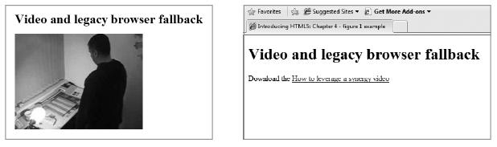
Videos
Usage of video element
<video src=turkish.ogv></video>
Fallback markup between the tags, for
older Web browsers that do not support
native video
<h1>Video and legacy browser fallback</h1>
<video src=leverage-a-synergy.ogv>
Download the <a href=leverage-a-synergy.ogv>How to
leverage a synergy video</a>
</video>

Slide 19

Videos
Attributes supported
autoplay
<video src=leverage-a-synergy.ogv autoplay>
</video>
It tells the browser to play the video or
audio automatically.
controls
<video src=leverage-a-synergy.ogv controls>
</video>
Provides
play/ pause toggle,
a seek bar, and
volume control.

Slide 20
Videos
Attributes supported
poster
<video src=leverage-a-synergy.ogv poster >
</video>
The poster attribute points to an image that the
browser will use while the video is downloading,
or until the user tells the video to play.
height , width
These attributes tell the browser the size
in pixels of the video.

Slide 21
Videos
Attributes supported
loop
<video src=leverage-a-synergy.ogv loop >
</video>
It loops the media playback.
preload (preload=auto)
Indicates browser that it should begin downloading
the entire file.

Slide 22
Videos
Attributes supported
preload = none
<video src=leverage-a-synergy.ogv preload=none >
</video>
This state suggests to the browser that it
shouldn’t preload the resource until the user
activates the controls.

