Slide 1
Bootstrap V4

Slide 2
Summary
What is Bootstrap?
Bootstrap Files
Advantages of Bootstrap
Where to Get Bootstrap 4?
Bootstrap 4 Grid System

Slide 3
What is Bootstrap?
Bootstrap is an open-source Javascript framework developed by the team at Twitter. It is a combination of HTML, CSS, and Javascript code designed to help build user interface components. Bootstrap was also programmed to support both HTML5 and CSS3.
Also it is called Front-end-framework.
Bootstrap is a free collection of tools for creating a websites and web applications.
It contains HTML and CSS-based design templates for typography, forms, buttons, navigation and other interface components, as well as optional JavaScript extensions.

Slide 4
Bootstrap Files
Bootstrap can be boiled down to three main files:
bootstrap.css - a CSS framework
bootstrap.js - a JavaScript/jQuery framework
glyphicons - a font (an icon font set)
Additionally, Bootstrap requires jQuery to function. jQuery is an extremely popular and widely used JavaScript library, that both simplifies and adds cross browser compatibility to JavaScript.

Slide 5
Advantages of Bootstrap
Easy to use: Anybody with just basic knowledge of HTML and CSS can start using Bootstrap
Responsive features: Bootstrap's responsive CSS adjusts to phones, tablets, and desktops
Mobile-first approach: In Bootstrap, mobile-first styles are part of the core framework
Browser compatibility: Bootstrap 4 is compatible with all modern browsers (Chrome, Firefox, Internet Explorer 10+, Edge, Safari, and Opera)

Slide 6
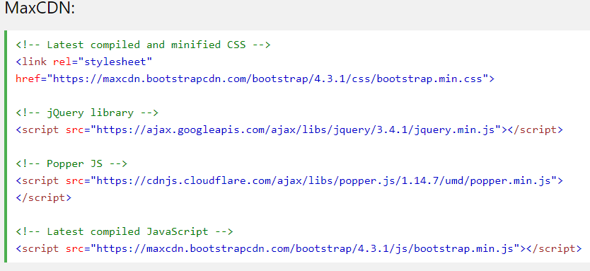
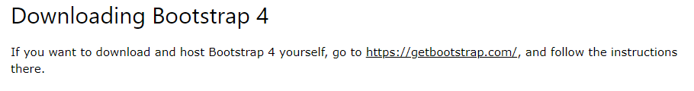
Where to Get Bootstrap 4?
There are two ways to start using Bootstrap 4 on your web site.
You can: Include Bootstrap 4 from a CDN, Download Bootstrap 4 from getbootstrap.com
Bootstrap 4 CDN

Slide 7

Containers
Bootstrap 4 requires a containing element to wrap site contents.
There are two container classes to choose from:
The .container class provides a responsive fixed width container
The .container-fluid class provides a full width container, spanning the entire width of the viewport

Slide 8
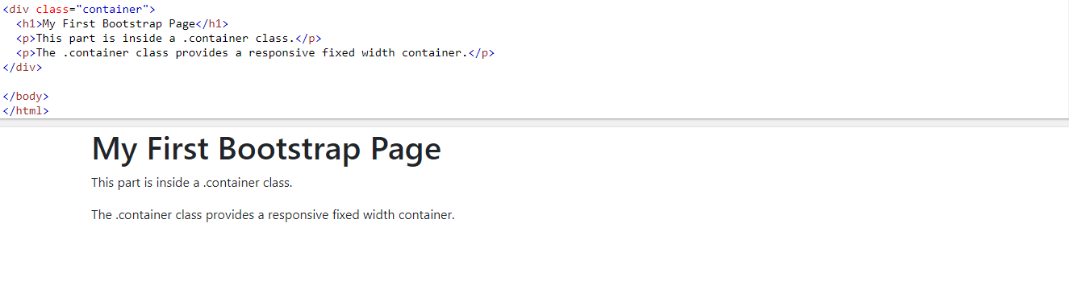
Example of Containers

Slide 9
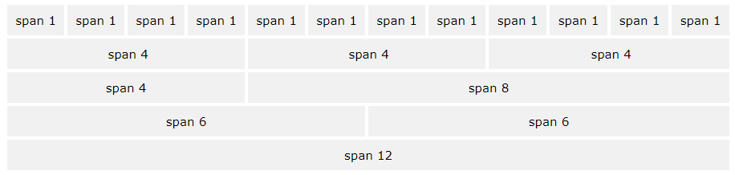
Bootstrap 4 Grid System
Bootstrap's grid system allows up to 12 columns across the page.

Slide 10
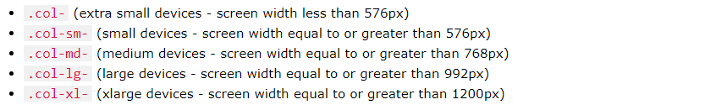
Grid Classes
The Bootstrap 4 grid system has five classes:

Slide 11
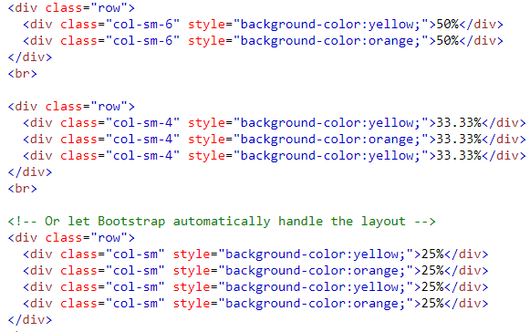
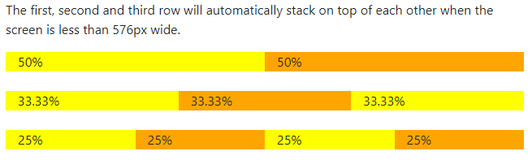
Grid System

Slide 12
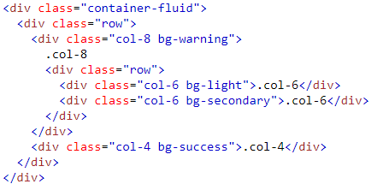
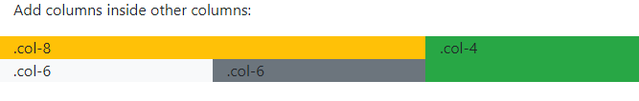
Nested Columns
The following example shows how to create a two column layout, with another two columns inside one of the columns

Slide 13
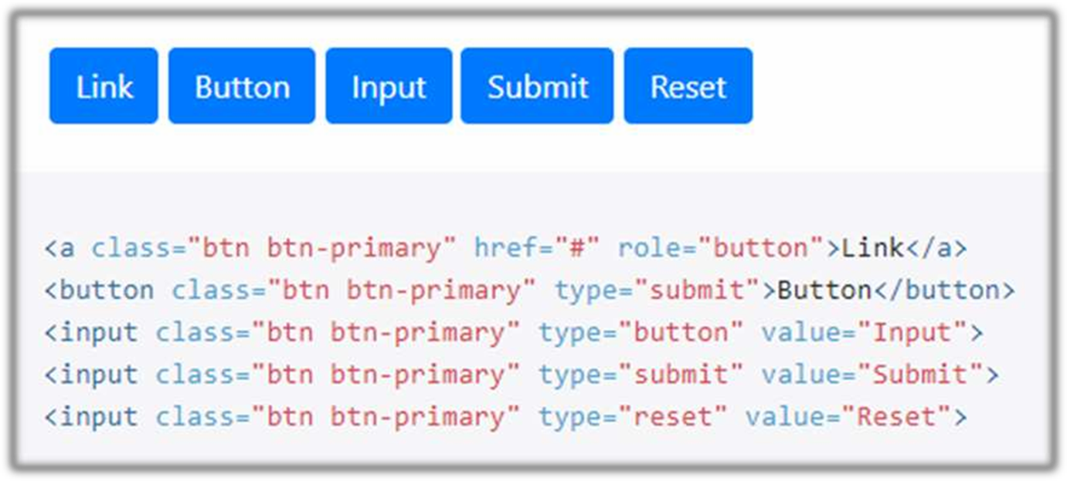
Button tags

Slide 14
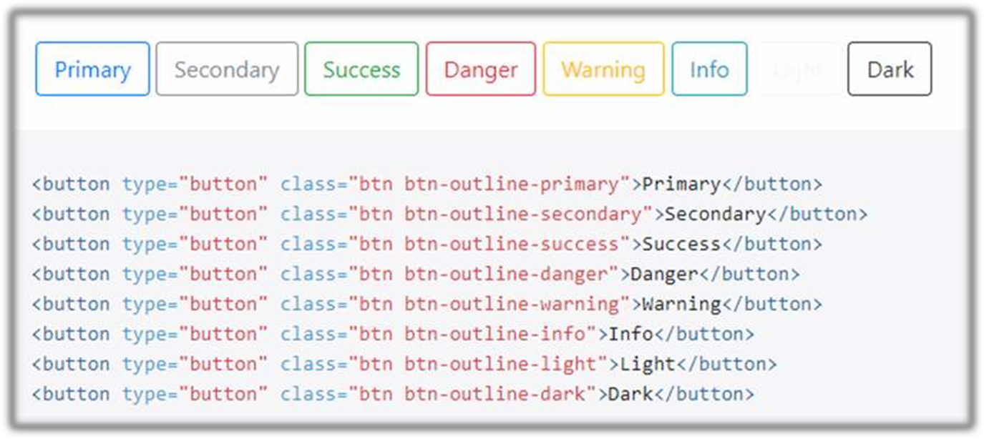
Outline buttons

Slide 15
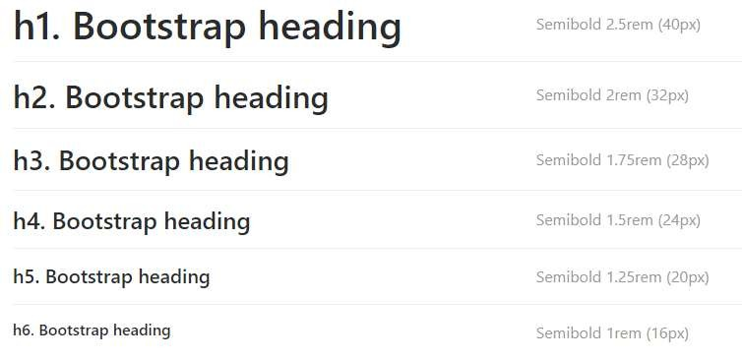
Headings

Slide 16
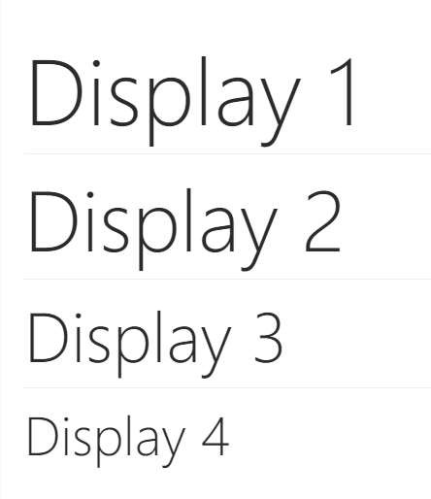
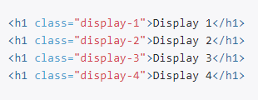
Display

Slide 17
Cards
A card is a flexible and extensible content container.
It includes options for headers and footers, a wide variety of content,
contextual background colors, and powerful display options.
◆ Card titles are used by adding .card-title
◆ Card subtitles used by adding .card-subtitle
.card-img-top places an image to the top of the card
Mix and match multiple content types to create the card you need, or throw everything in there.
◆ an optional header and/or footer within a card an be added

Slide 18
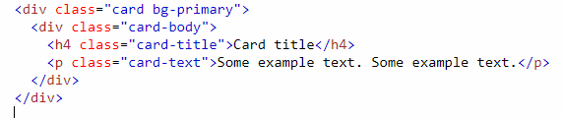
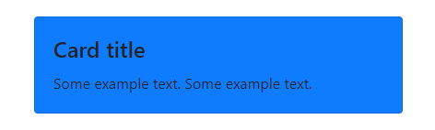
Example

Slide 19
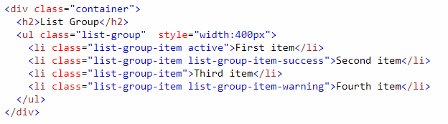
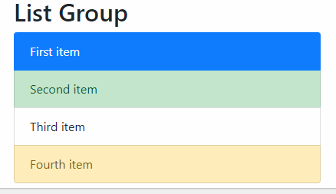
Bootstrap 4 List Groups
To create a basic list group, use an <ul> element with class .list-group, and <li> elements with class .list-group-item:

Slide 20
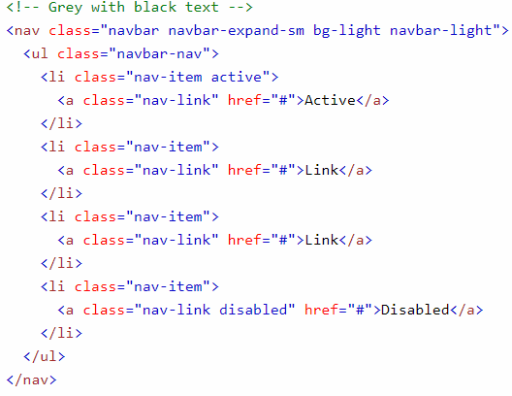
Navigation Bars
A navigation bar is a navigation header that is placed at the top of the page:

Slide 21
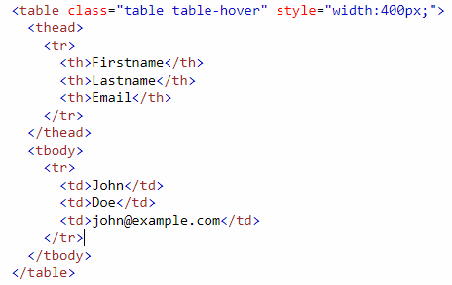
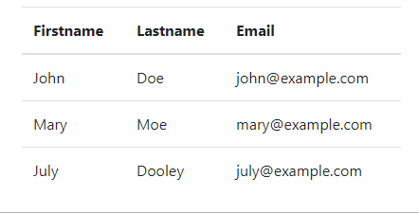
Table
The .table class adds basic styling to a table. .table-striped class adds zebra-stripes. .table-bordered class adds borders. .table-hover class adds a hover effect

Slide 22
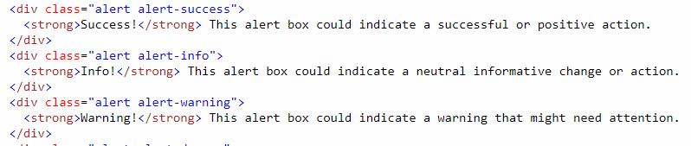
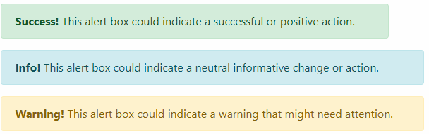
Bootstrap 4 Alerts
Alerts are created with the .alert class, followed by one of the contextual classes .alert-success, .alert-info, .alert-warning, .alert-danger, .alert-primary, .alert-secondary, .alert-light or .alert-dark:

Slide 23
Bootstrap 4 Images
.img-thumbnail class shapes the image to a thumbnail (bordered)
.rounded-circle class shapes the image to a circle
.rounded class adds rounded corners to an image
Aligning Images
Float an image to the right with the .float-right class or to the left with .float-left
Centered Image
Center an image by adding the utility classes.mx-auto and.d-block

Slide 24
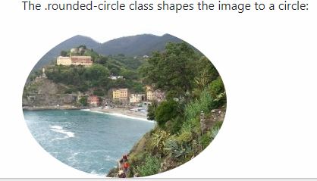
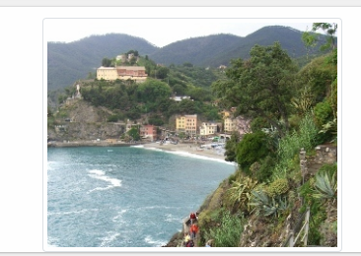
Cont..

Slide 25
Bootstrap 4 Forms
Form controls automatically receive some global styling with Bootstrap
All textual <input>, <textarea>, and <select> elements with class .form-control have a width of 100%
Bootstrap provides two types of form layouts
Stacked (full-width) form
Add a wrapper element with .form-group, around each form control, to ensure proper margins and create Stacked (full-width) form
Inline form
Add class .form-inline to the <form> element to all of the elements are inline and left-aligned

Slide 26
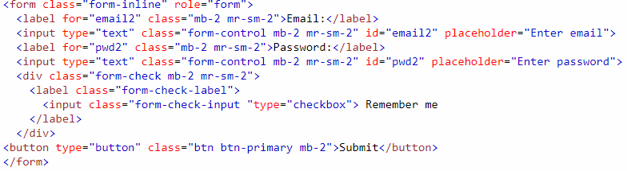
Example of Bootstrap form

Slide 27
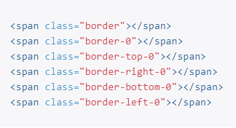

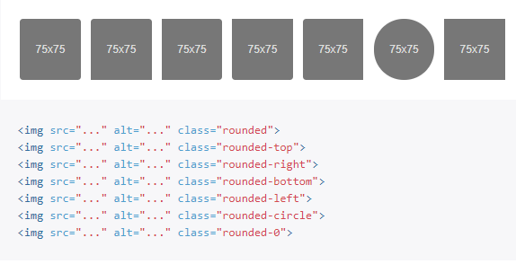
Borders

Slide 28
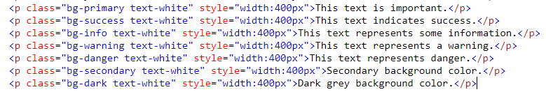
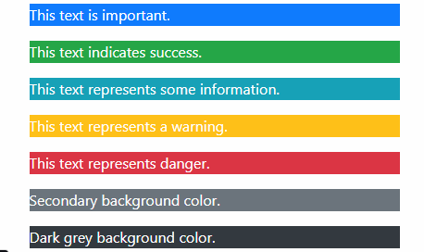
Color
Background Color Classes

Slide 29
Bootstrap 4 Text
Text transform
<p class="text-lowercase">Lowercased text.</p>
<p class="text-uppercase">Uppercased text.</p>
<p class="text-capitalize">Capitalized text.</p>
Font weight and italics
<p class="font-weight-bold">Bold text.</p>
<p class="font-weight-normal">Normal weight text.</p>
<p class="font-italic">Italic text.</p>

Slide 30
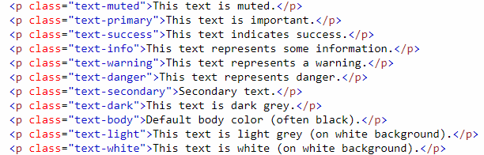
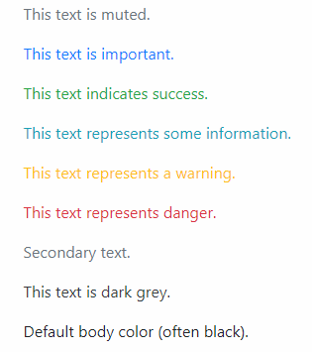
Text Color

Slide 31
Thank You

