Slide 1
IBM University Engagement Project Submission
“Exploring the Power of Agentic AI with IBM Granite and IBM Bob”

Slide 2

Project Title – AI-Based 5G Network Optimization Advisor
Domain of Project – Telecommunications / 5G Networks
Student Name | Recent Passport Photo | Email ID | Mobile number [WhatsApp]
Mohammed Abuzer K |  | abuzercooloop786@gmail.com | 8660911643

Slide 3
Problem Statement -
Problem Statement : AI-Based 5G Network Optimization Advisor
The Challenge
5G networks support high-speed communication, low latency, and large-scale device connectivity. However, maintaining optimal performance is challenging due to fluctuating traffic loads, spectrum congestion, and energy consumption issues. Telecom engineers must continuously analyze network data to identify inefficiencies and optimize resource allocation. Traditional monitoring tools provide raw data but lack intelligent insights. The challenge is to create a system that can analyze network performance data and recommend optimization strategies automatically.
The Objective
Build an AI-powered 5G Network Optimization Advisor that analyzes network traffic patterns and provides recommendations for improving network efficiency.
The solution should:
1. Analyze Network Traffic :- Process performance metrics such as bandwidth usage, latency, and network congestion.
2. Detect Performance Issues :- Identify inefficient resource utilization and potential bottlenecks in the network.
3. Provide Optimization Recommendations :- Suggest strategies to improve bandwidth allocation, reduce congestion, and enhance energy efficiency.
4. Visualize Network Insights :- Display network analytics and optimization suggestions through an interactive dashboard.

Slide 4
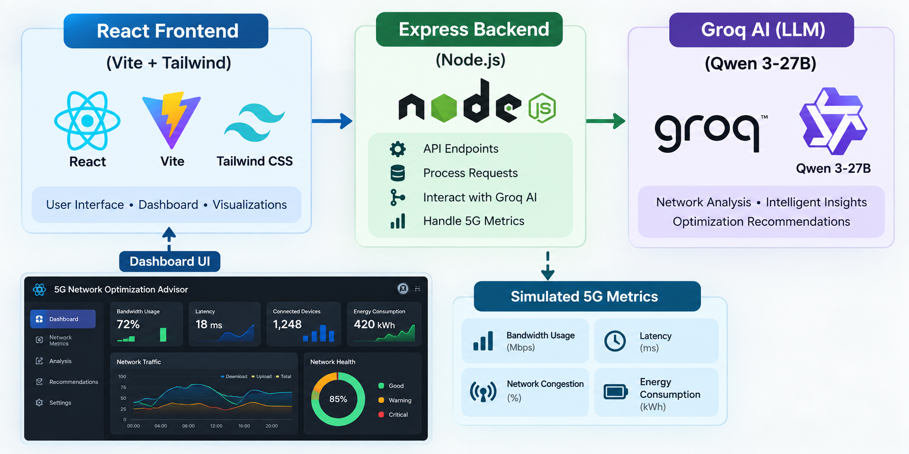
Proposed Solution -
An AI-powered real-time dashboard for 5G network monitoring and optimization.

Slide 5
How It Works
1. Data Layer (Simulated 5G Metrics)
The backend (networkData.js) simulates real-world 5G base station metrics in realistic ranges:
2. Backend (Express REST API)
Three endpoints on /api/network:
GET /status — current snapshot + health score + detected problems
GET /history — last 12 snapshots (60 min at 5-min intervals)
POST /recommend — sends metrics to Groq AI, returns optimization advice
Metric | Range
Bandwidth | 50–1200 Mbps
Latency | 1–60 ms
Packet Loss | 0–5%
Congestion | 0–100%
Signal Strength | -120 to -50 dBm
Energy Usage | 100–900 W
Connected Devices | 50–500

Slide 6
3. Problem Detection & Health Score
Rule-based engine flags issues (e.g. latency > 30ms = HIGH, congestion > 75% = HIGH)
A weighted scoring formula produces a 0–100 Health Score
4. AI Advisor (Groq + Qwen 3-27B)
On demand, the current snapshot is sent to Groq AI with a structured prompt requesting:
A 1-sentence network health assessment
3 actionable optimization recommendations
1 energy-efficiency tip
5. Frontend (React Dashboard)
KPI cards — 8 live metrics with color-coded thresholds
Health Score gauge — circular visual indicator
Problems panel — severity-tagged issue list
Historical charts — trend lines for the last 60 minutes (Recharts)
AI Advisor panel — on-demand AI recommendations
Auto-refresh every 30 seconds

Slide 7
Technology Used
Frontend
React 18
Vite
Tailwind CSS
Recharts
Axios
Backend
Node.js
Express.js
dotenv
CORS
Nodemon
AI Layer
Groq SDK
Qwen 3-27B LLM
Dev Tools
concurrently
PostCSS
Autoprefixer

Slide 8
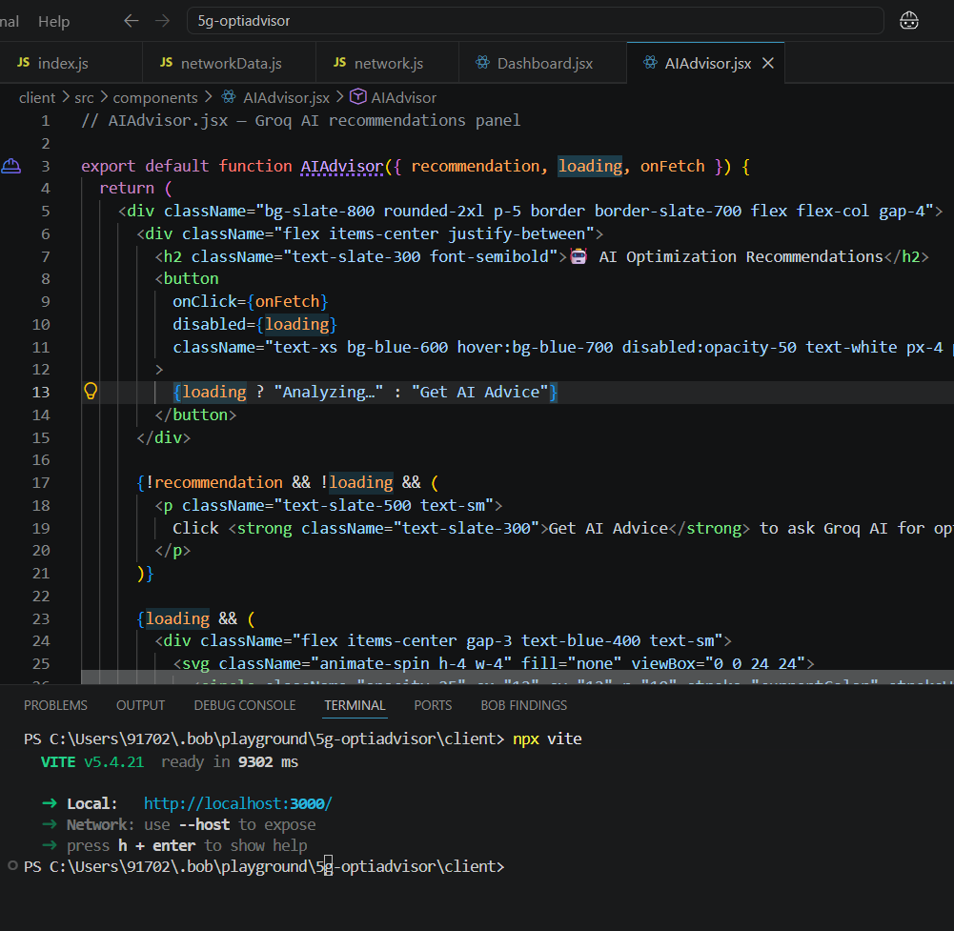
Required Files created using IBM bob -
server/src/index.js — Express server entry point
server/src/networkData.js — 5G metric simulation, health scoring, problem detection
server/src/routes/network.js — REST API routes + Groq AI integration
client/src/pages/Dashboard.jsx — Main UI, fetches data, renders all panels
client/src/components/AIAdvisor.jsx — AI recommendations panel

Slide 9
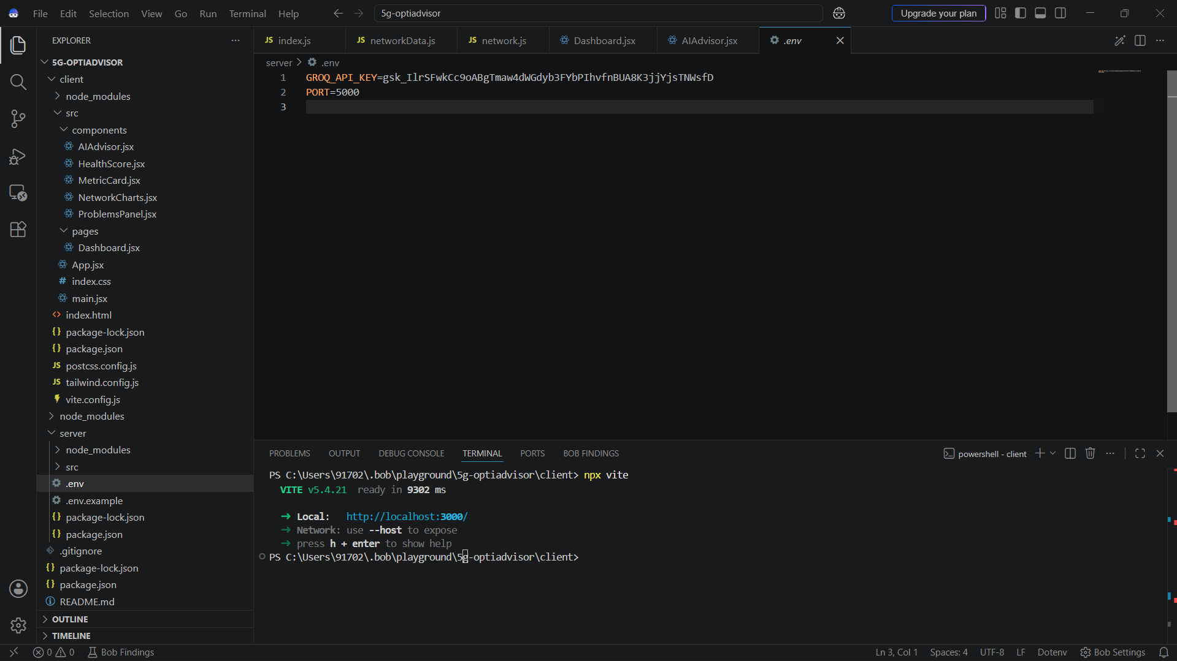
IBM Bob Screenshots:

Slide 10
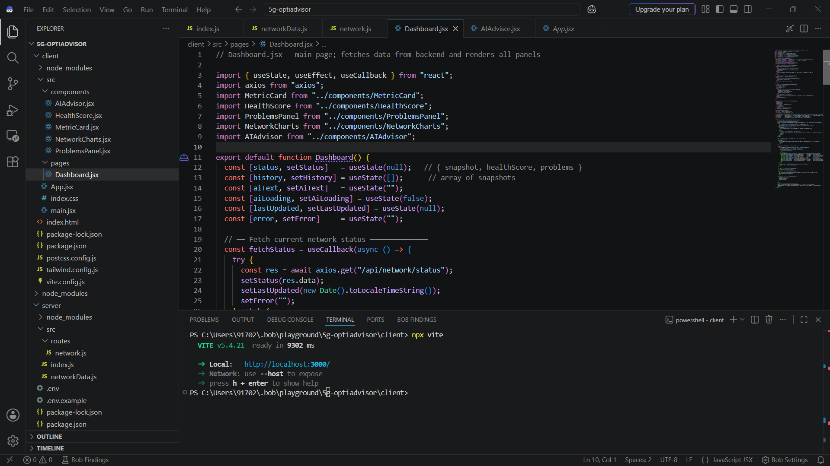

Slide 11
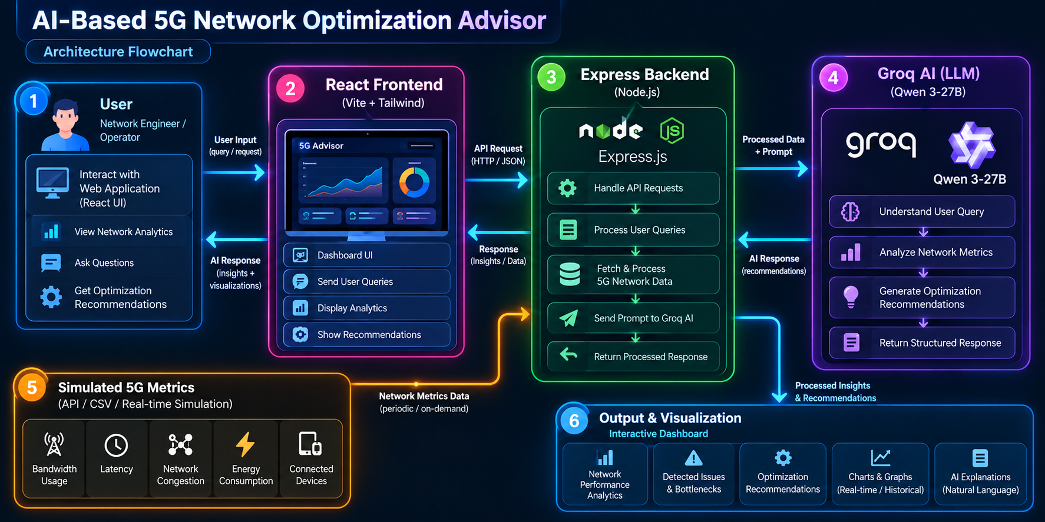
Architecture blueprint for IBM bob:

Slide 12

Role of Agentic AI in the solution
In this project, the AI plays a reactive advisory role — not fully agentic yet, but with clear agentic characteristics:
What It Does (Current)
Perceives — receives real-time 5G network metrics (bandwidth, latency, congestion, packet loss, signal, energy)
Reasons — the Groq/Qwen 3-27B LLM analyses the data and detected problems in context
Responds — generates a structured response: health assessment + 3 optimization recommendations + 1 energy tip
Acts on demand — triggered by the user clicking "Get AI Advice" in AIAdvisor.jsx
Where It Fits in the Agentic Spectrum
Trait | Present?
Contextual awareness (live metrics + problems fed to LLM) | ✅
Natural language reasoning & recommendations | ✅
Goal-directed output (fix problems, save energy) | ✅
Autonomous triggering (self-initiated) | ❌ (user-triggered)
Tool use / taking real actions on the network | ❌ (advisory only)
Memory across sessions | ❌

Slide 13
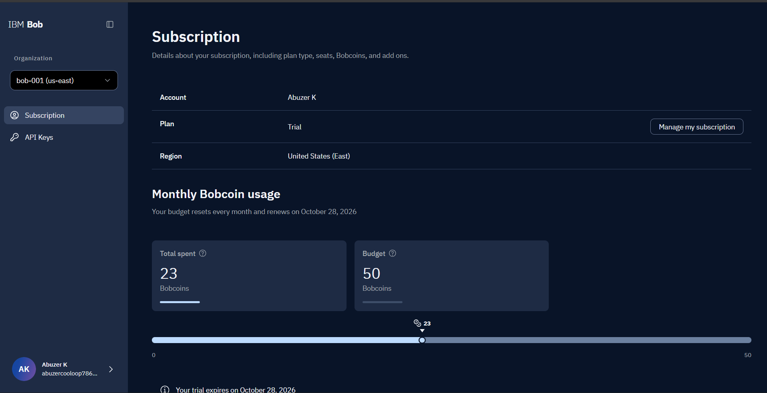
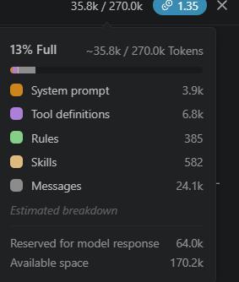
Token Usage
35.8k token are used
·
·
·

Slide 14
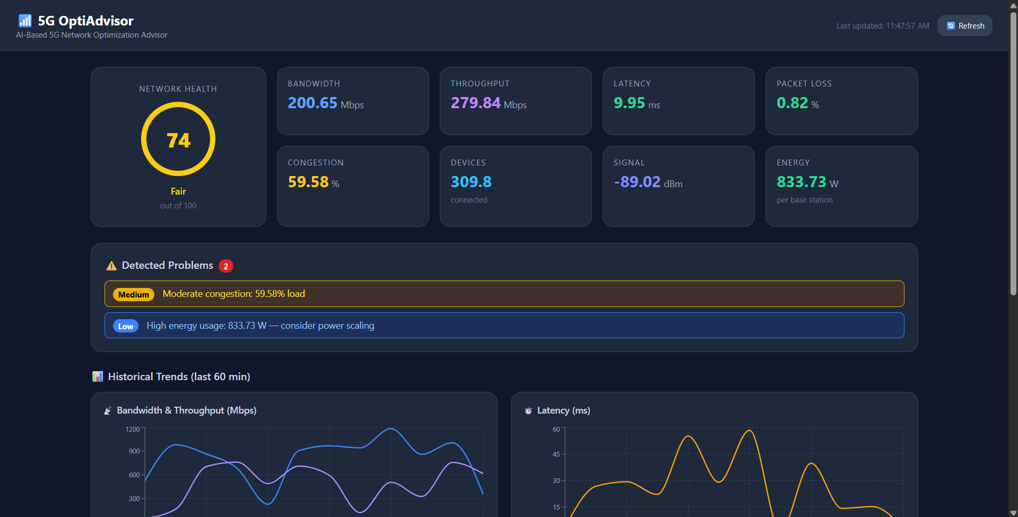
Project Output Screenshot
Please put IBM Bob output screenshots with 2-3 prompts.
You can take 2-3 more slides for each screenshot
·
·
·

Slide 15
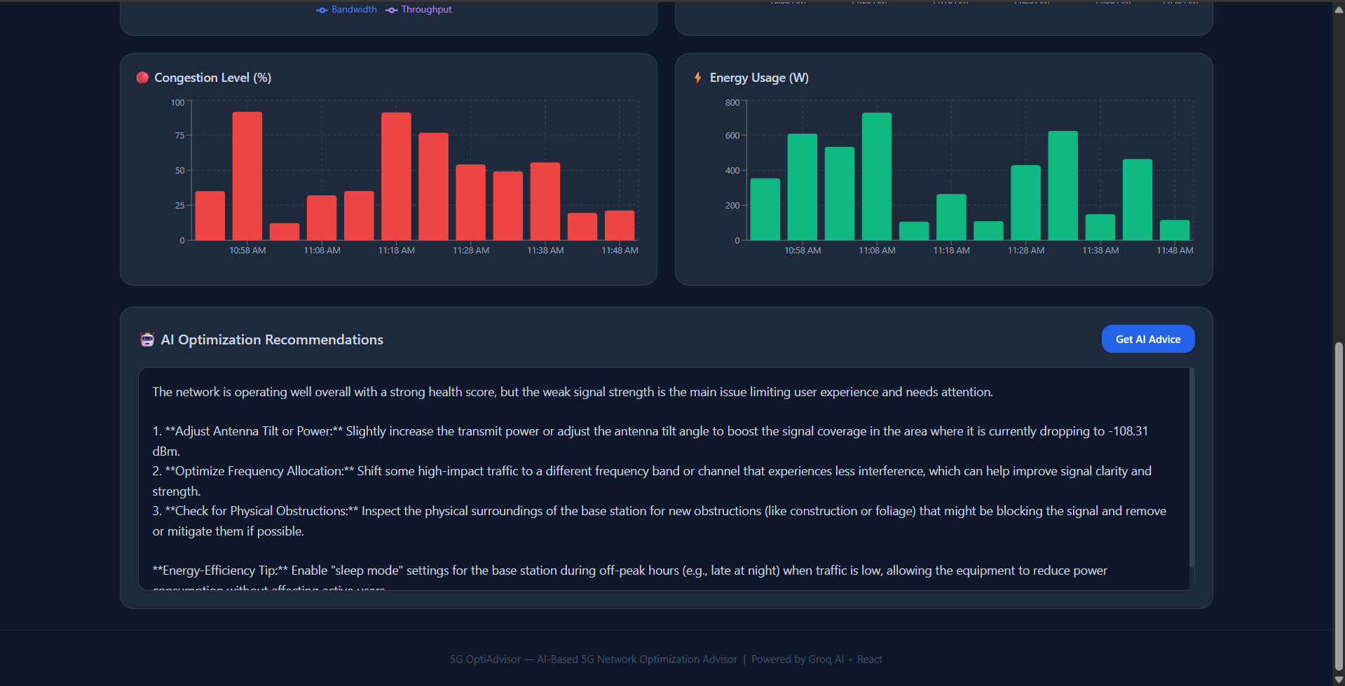
Project Output Screenshot
·
·
·

Slide 16
Novelty and Uniqueness
1. Real-Time AI Advisory for 5G
Most network monitoring tools only show data — this one interprets it using an LLM and tells you exactly what to fix
Combines rule-based problem detection + AI-generated natural language recommendations in a single pipeline
2. Intelligent Health Scoring
Custom weighted scoring formula (0–100) that factors in latency penalty, packet loss penalty, congestion penalty, bandwidth bonus, and signal penalty — not just a simple average
Gives operators a single glance metric instead of reading 8 separate values
3. Context-Aware AI Prompt Engineering
The AI isn't just asked a generic question — it receives a fully structured context: live metrics + severity-tagged problem list + health score
Output is always actionable (3 fixes + 1 energy tip), not vague
4. Energy Efficiency as a First-Class Concern
Explicitly tracks energy usage per base station (Watts) and flags overuse
AI always provides an energy-efficiency tip — aligning with green networking goals in 5G
5. Realistic Metric Simulation
Metrics are simulated in real-world 5G ranges (based on Opensignal, GSMA, Ookla benchmarks) — not dummy random numbers
Makes the project demo-ready without needing actual telecom hardware
6. Full-Stack, Self-Contained
End-to-end working system: data layer → detection → scoring → AI → visual dashboard — all in one project
No external database or cloud dependency beyond the Groq API key

Slide 17
Git Hub Link
Github URL - https://github.com/Abuzer-prog/5g-optiadvisor

Slide 18
Future Scope
Full Agentic AI — AI auto-triggers on threshold breaches and executes corrective actions directly, without human intervention
Predictive Analytics — ML models (LSTM/Prophet) predict congestion before it happens, shifting from reactive to proactive optimization
Real Network Integration — Connect to live 5G base station APIs and O-RAN interfaces, replacing simulated data with actual telemetry streams
·
·
·

Slide 19
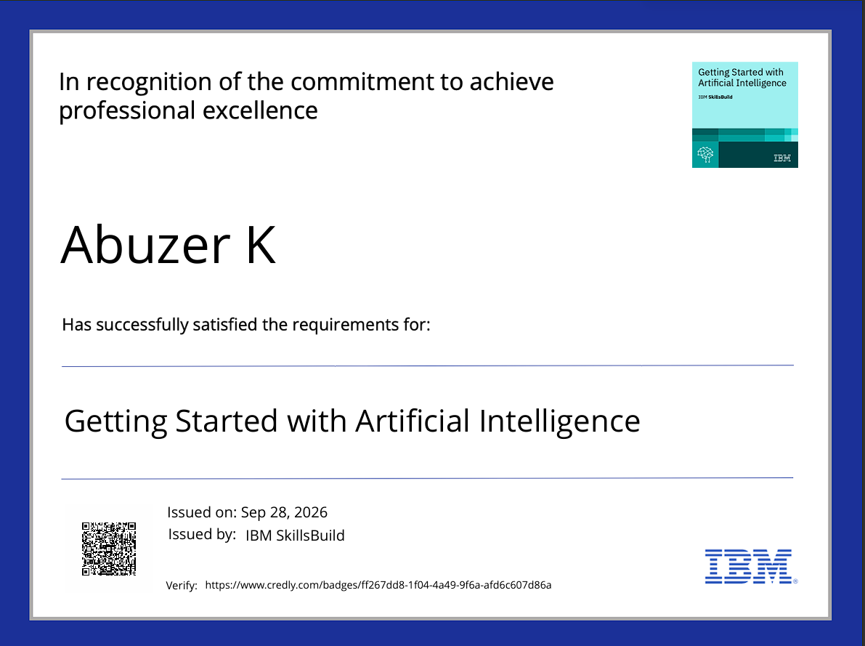
Certificates Earned:

Slide 20
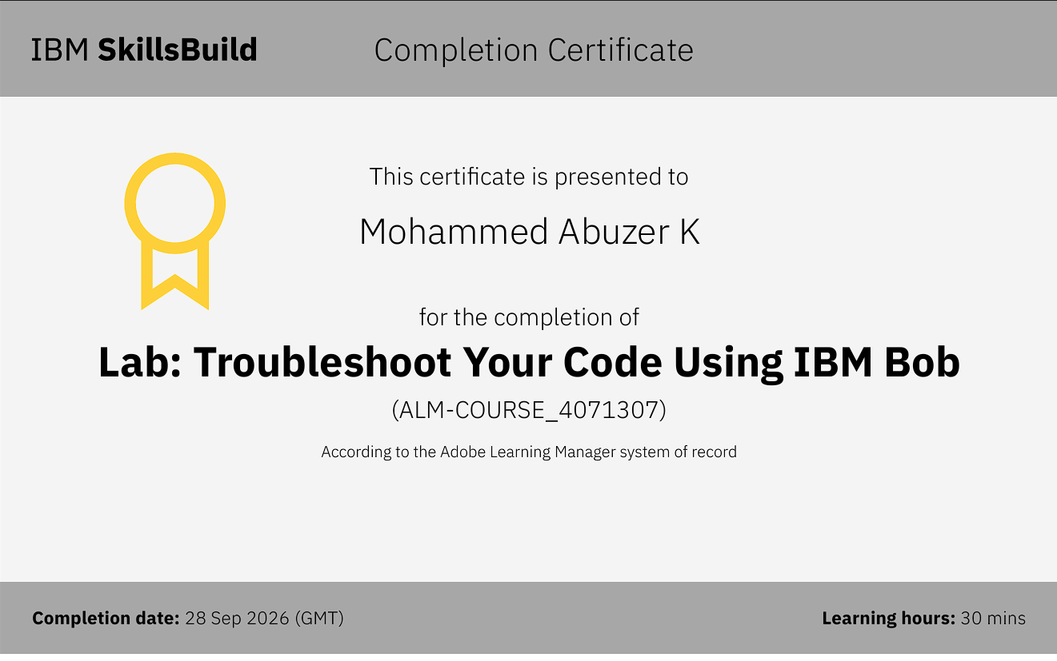
Certificates Earned:​

Slide 21


