Slide 1
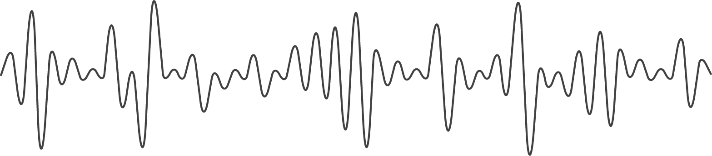
Chords recognition
created by Alexey Bobko

Slide 2


Why is it important?

Slide 3
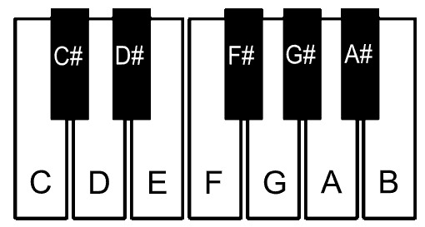


Theory
Note
dièse
bémol

Slide 4
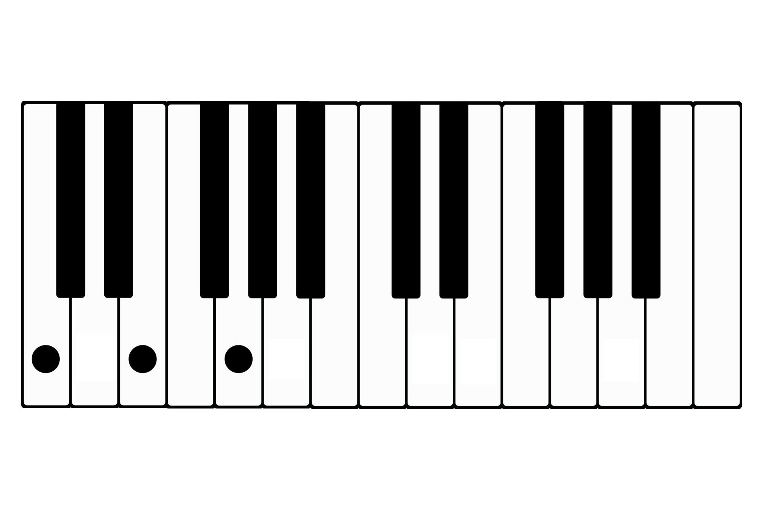
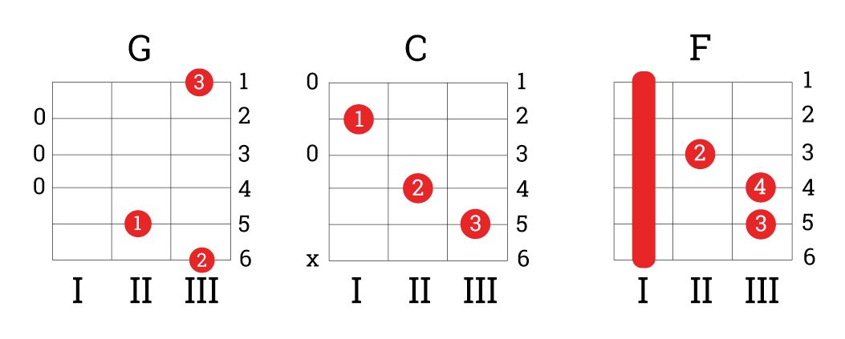
Theory
Chord

Slide 5
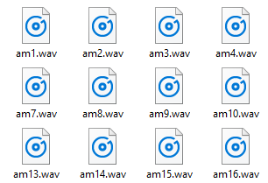
Data

Slide 6
Idea
1. Cut song
on chords
2. Recognize
chords
3. Output the
result

Slide 7
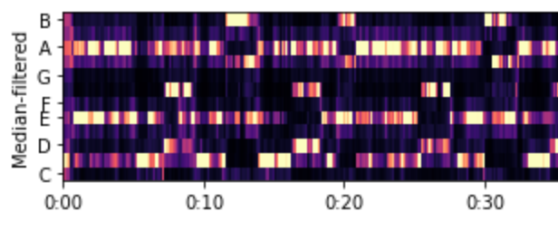
Chroma feature (chromagram)
{C, C♯, D, D♯, E , F, F♯, G, G♯, A, A♯, B}

Slide 8
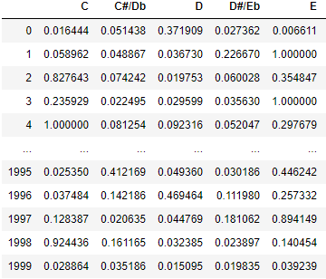
Features

Slide 9
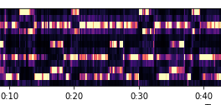
Cutting into chords

Slide 10

Strong - 1 | Weak - 0
NOTE_LOWER
NOISE_LIMIT
(<, =, >) ?
0
1

Slide 11
Strong - 1 | Weak - 0
[0,0,1,0,1,0,0,1,0,0,0,0]
[0,0,1,0,1,0,0,1,0,0,0,0]
[0,0,1,0,0,0,1,1,0,0,0,0]
[0,0,1,0,1,0,1,1,0,0, 1,0]

Slide 12

Strong - 1 | Weak - 0

Slide 13
Model for bounds

Slide 14
Plan
1. Recognize
chords
2. Some magic
3. Output the
result

Slide 15

CatBoost Classifier

Slide 16
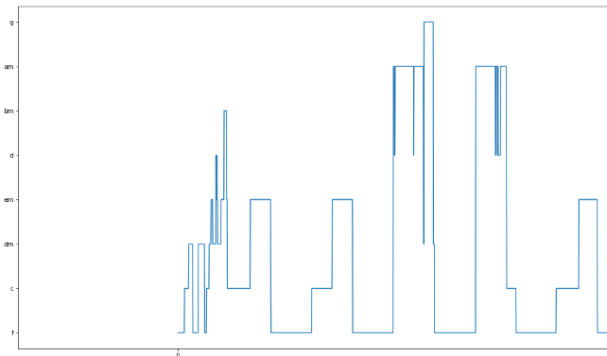
Output & Clearing

Slide 17
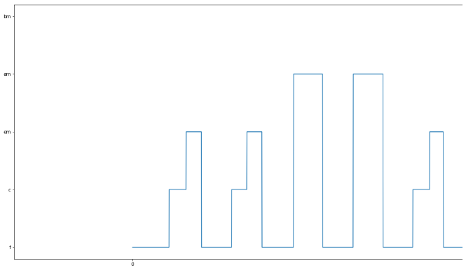
Output & Clearing

Slide 18

Results

Slide 19
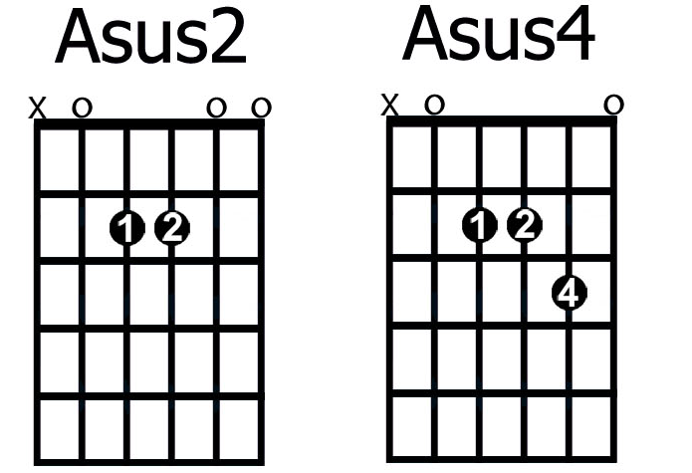
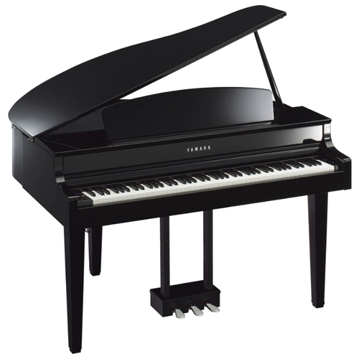
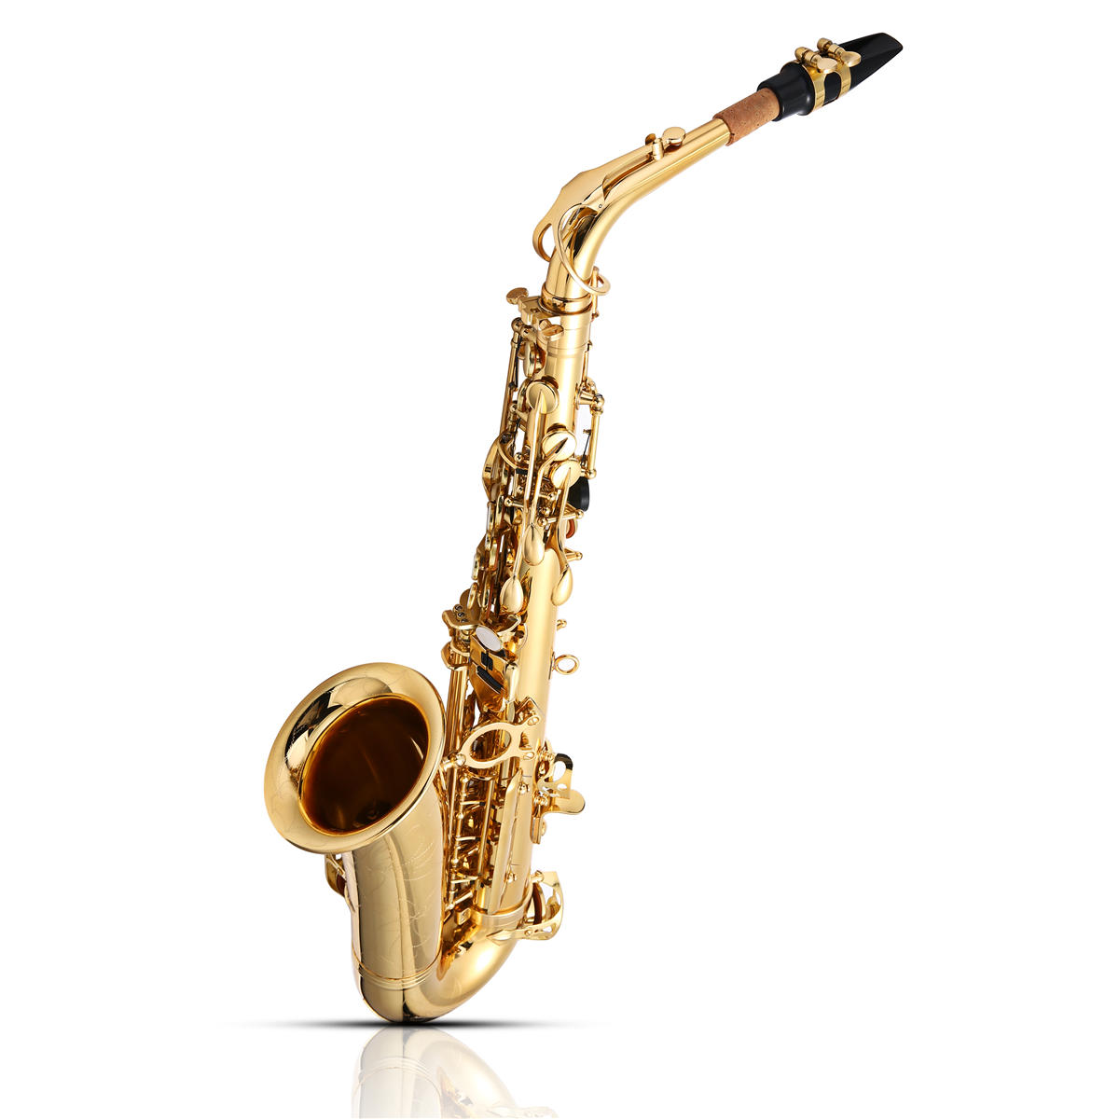
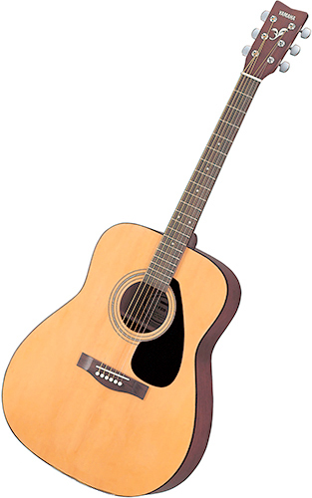
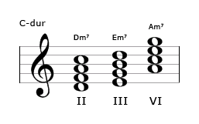
Improving the idea
Song
1.
2.

Slide 20
Thanks for your attention
Contacts: abvbobko@gmail.com

