Slide 1
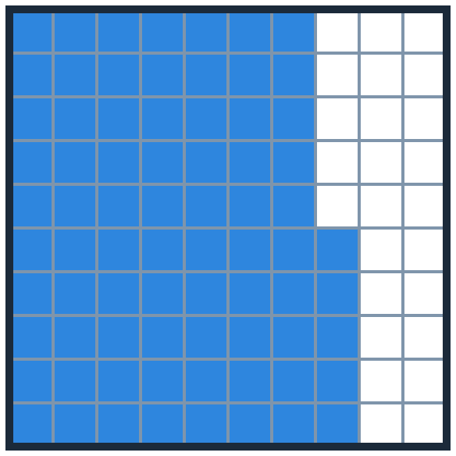

Fractions, Decimals and Percents
=
MATHS · ONE AMOUNT, THREE NAMES
Equivalent forms · Compare and order
Fraction
Decimal
Percent
3/4
0.75
75%
Notes:
Welcome. Today’s big idea: a fraction, a decimal and a percent can name the same amount.
Point at the grid: 75 of 100 squares. That is 3/4, 0.75 and 75%.

Slide 2


Today I can…
WARM-UP
Hi, I’m Dot! One amount can wear three outfits: a fraction, a decimal and a percent.
I can find equivalent fractions, decimals and percents.
I can connect the value of a fraction or a decimal to a percent.
I can compare and order numbers written in different forms.
Notes:
Read the three goals together. Click to show each goal.

Slide 3


Which one doesn’t belong?
WARM-UP
12 : 80
80/100
80/100 = 80%
4 out of 5 = 80 out of 100 = 80%
80%
4 out of 5
12 : 80 = 3 : 20 = 15 : 100. Only 15%!
12 : 80 doesn’t belong: it is not the same amount.
Mindset: share your choice with a partner, then listen to theirs. Other answers can make sense too, if you can explain them!
Notes:
Give students 1 minute to choose silently, then pair and share. Accept any choice that is well explained.
Clicks 1-4: three cards name 80 out of 100; 12 : 80 is only 15 out of 100.
Mindset: how can we connect with our classmates during maths class?

Slide 4


4 out of 5
WARM-UP
40
A
80
B
4 out of 5 = ? out of 100
45
Hint: 5 × 20 = 100.
C
Click an answer to check it.
Notes:
Interactive question: in Slide Show, click (or let a student tap) an answer card. A correct answer opens a “Correct!” slide; a wrong answer opens a hint and then returns to the question.
Answer: B, 80. 4 out of 5 = 80 out of 100.

Slide 5

4 out of 5 · answer
Correct!
4/5 = (4 × 20)/(5 × 20) = 80/100 = 80%.
Next ▶
◀ Back to the question
Notes:
Hidden slide: it opens only when a student picks the correct answer on the question slide.
Read the explanation aloud, then click Next.

Slide 6

4 out of 5 · hint
Not quite. Try again!
Make the 5 into 100: multiply by 20. Then multiply the 4 by 20 too.
◀ Try again
Notes:
Hidden slide: it opens when a student picks a wrong answer.
Use the hint, then click Try again to go back to the question.

Slide 7
Learn
PART 2
3/4 = 0.75 = 75%
One amount, three names
Notes:
Part 2: how fractions, decimals and percents are connected.

Slide 8

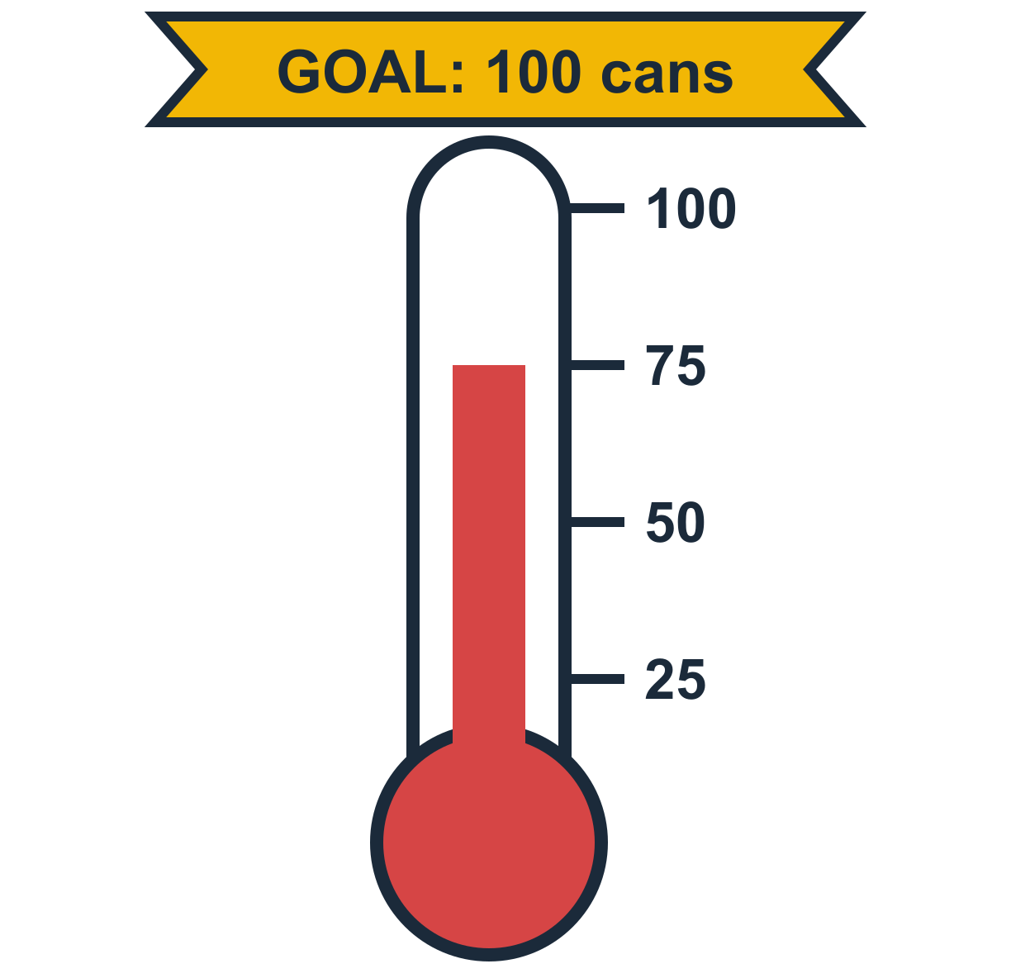
Food Drive
LEARN
Some middle school students run a canned food drive for the local food pantry. Their goal is 100 cans each week. So far this week, they have brought in 75 cans.
How can the students show the part of the goal they have reached so far?
One way: a fraction. 75 out of 100 = 75/100
Another way: a percent. 75 out of 100 = 75%
Notes:
Read the problem. Ask: “How can we show how much of the goal they reached?”
Click 1: as a fraction. Click 2: as a percent, because the whole is 100.

Slide 9
Food Drive: 75 out of 100
LEARN
A percent shows part of a whole, where the whole is 100.
75/100 = 75%
Can we write 75/100 in simplest form?
75 out of 100 cans
Notes:
Each square is one can. 75 of the 100 squares are red: 75/100 = 75%.
Click 2, then advance: Morph regroups the 100 squares into 4 equal parts.

Slide 10
Food Drive: 3 out of 4
LEARN
100 cans in 4 equal parts: 25 cans in each part.
75/100 = 3/4
75 out of 100 cans is 3/4, or 75%, of the goal.
3 out of 4 equal parts
Notes:
The same 100 cans in 4 groups of 25. 3 groups are full: 3/4.
75/100 = (75 ÷ 25)/(100 ÷ 25) = 3/4.
Ask (Making conjectures): “How would the answer change if the goal changed?”

Slide 11

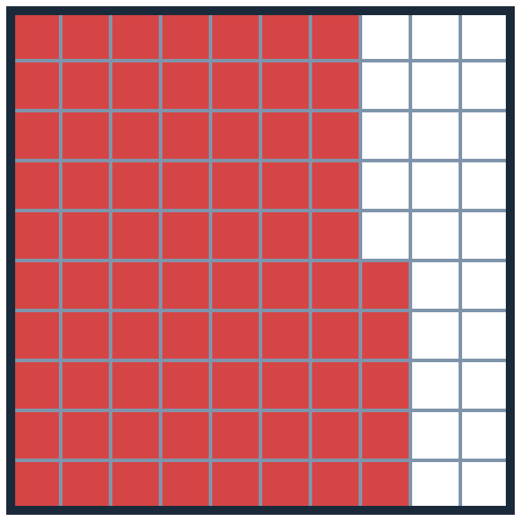
Explore more: decimal notation
LEARN
7.5
A
0.75
B
0.075
C
How could you write 75% in decimal notation?
Click an answer to check it.
Notes:
Interactive question: in Slide Show, click (or let a student tap) an answer card. A correct answer opens a “Correct!” slide; a wrong answer opens a hint and then returns to the question.
Answer: B, 0.75.

Slide 12
75% as a decimal · answer
Correct!
75% = 75/100 = 0.75: seventy-five hundredths.
Next ▶
◀ Back to the question
Notes:
Hidden slide: it opens only when a student picks the correct answer on the question slide.
Read the explanation aloud, then click Next.

Slide 13
75% as a decimal · hint
Not quite. Try again!
75% means 75 hundredths. How do you write 75 hundredths as a decimal?
◀ Try again
Notes:
Hidden slide: it opens when a student picks a wrong answer.
Use the hint, then click Try again to go back to the question.

Slide 14

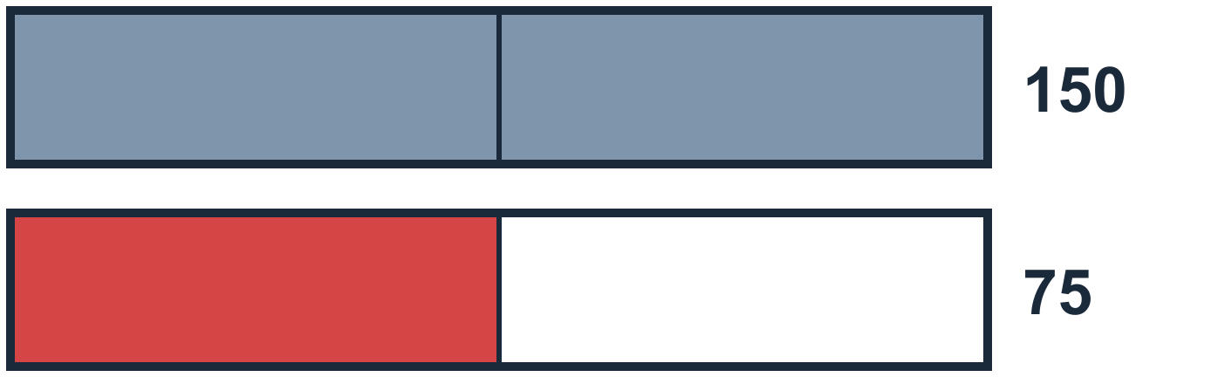
Explore more: think and talk
LEARN
Talk
Make a conjecture
Which form means more to you: 3/4, 0.75 or 75%? Why?
What if the goal changed to 150 cans, and the students still had 75 cans?
Many people like the percent: it always compares with 100, so it is easy to compare.
75/150 = 1/2 = 50%
Notes:
Discuss which form students find most meaningful. There is no single right answer.
Conjecture: the same 75 cans are a smaller part of a bigger goal: 75/150 = 50%.

Slide 15

Number Reorganization
LEARN
How can you put these numbers in order from least to greatest?
2/5
30%
0.25
3/20
0.45
A part of a whole can be a fraction, a decimal or a percent. To compare them, write them all in the same form.
Planning: what is a sensible way to solve this?
Write them all as fractions, all as decimals, or all as percents.
Notes:
Ask students to plan before they solve. Then click to show three possible plans: fractions with the same denominator, decimals, or percents.

Slide 16
Three ways to write them
LEARN
Number
One way: fraction /20
Another way: decimal
Yet another way: percent
2/5
2/5 = 8/20
2/5 = 40/100 = 0.40
2/5 = 40/100 = 40%
30%
30% = 30/100 = 6/20
30% = 30/100 = 0.30
30%
0.25
0.25 = 1/4 = 5/20
0.25
0.25 = 25/100 = 25%
3/20
3/20
3/20 = 15/100 = 0.15
3/20 = 15/100 = 15%
0.45
0.45 = 45/100 = 9/20
0.45
0.45 = 45/100 = 45%
Least to greatest: 3/20, 0.25, 30%, 2/5, 0.45
Notes:
Click 1: all as twentieths (3/20, 5/20, 6/20, 8/20, 9/20). Click 2: all as decimals (0.15, 0.25, 0.30, 0.40, 0.45). Click 3: all as percents (15%, 25%, 30%, 40%, 45%).
Click 4: the order. All three ways give the same order.

Slide 17





Put them in order
LEARN
2/5
Each bar has 20 equal parts.
30%
Which bar is the shortest? Which is the longest?
0.25
3/20
0.45
Notes:
The numbers in the book’s order. Advance: Morph moves the bars into order and shows each one as a percent.

Slide 18
Put them in order
LEARN
15%
Least to greatest:
3/20, 0.25, 30%, 2/5, 0.45
25%
30%
40%
45%
Notes:
Sorted: 15%, 25%, 30%, 40%, 45%. So the order is 3/20, 0.25, 30%, 2/5, 0.45.

Slide 19
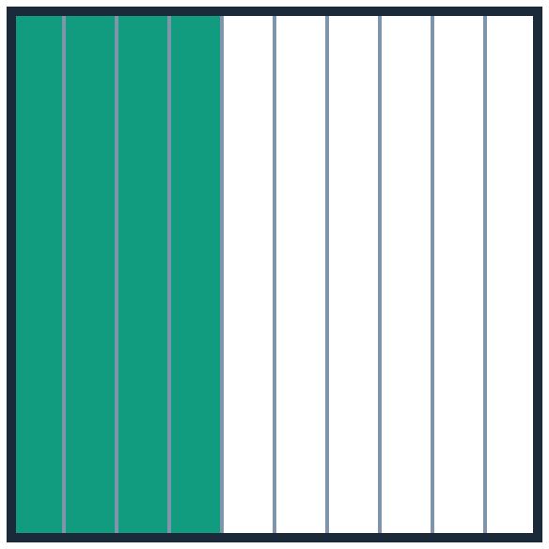
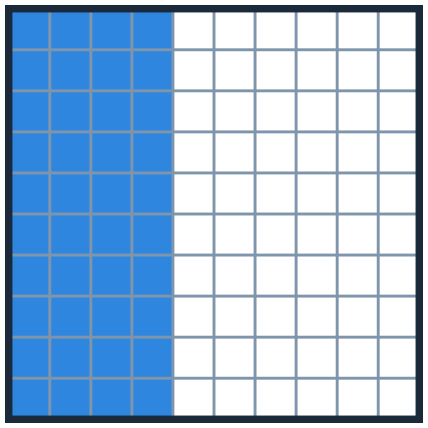
Explore more: 0.4 or 0.40?
LEARN
One student wrote 2/5 as 0.4. Another student wrote it as 0.40. Who is correct? Why?
only 0.4
A
only 0.40
B
both
C
0.4
0.40
Click an answer to check it.
Notes:
Interactive question: in Slide Show, click (or let a student tap) an answer card. A correct answer opens a “Correct!” slide; a wrong answer opens a hint and then returns to the question.
Answer: C, both. 4/10 = 40/100.

Slide 20
0.4 or 0.40 · answer
Correct!
Both are correct. 0.4 = 0.40: four tenths is the same as forty hundredths, because 4/10 and 40/100 are equivalent.
Next ▶
◀ Back to the question
Notes:
Hidden slide: it opens only when a student picks the correct answer on the question slide.
Read the explanation aloud, then click Next.

Slide 21
0.4 or 0.40 · hint
Not quite. Try again!
Look at the two grids. Is the same amount shaded?
◀ Try again
Notes:
Hidden slide: it opens when a student picks a wrong answer.
Use the hint, then click Try again to go back to the question.

Slide 22
Explore more: why 100?
LEARN
When you write a fraction as a percent, why do you look for an equivalent fraction with a denominator of 100?
A percent compares with 100
A
100 is the greatest number
B
2/5 = 40/100 = 40%
It makes the fraction smaller
C
Click an answer to check it.
Notes:
Interactive question: in Slide Show, click (or let a student tap) an answer card. A correct answer opens a “Correct!” slide; a wrong answer opens a hint and then returns to the question.
Answer: A.

Slide 23
Why 100? · answer
Correct!
“Per cent” means “per 100”. A percent compares a number with 100, so the equivalent fraction must compare with 100 too.
Next ▶
◀ Back to the question
Notes:
Hidden slide: it opens only when a student picks the correct answer on the question slide.
Read the explanation aloud, then click Next.

Slide 24
Why 100? · hint
Not quite. Try again!
Think about what the word percent means.
◀ Try again
Notes:
Hidden slide: it opens when a student picks a wrong answer.
Use the hint, then click Try again to go back to the question.

Slide 25

Summarize
LEARN
Fraction → percent
Percent → decimal
Compare and order
Find an equivalent fraction with a denominator of 100.
A percent is a number of hundredths. Divide by 100.
Write every number in the same form first.
3/4 = 75/100 = 75%
75% = 75 ÷ 100 = 0.75
3/4 = 75% < 0.8 = 80%
Notes:
Summarize the three moves. Click to show an example for each.

Slide 26



Apply: High-Top Sneakers
LEARN
There are 15 players on the boys’ basketball team, and 12 of them like to wear high-top sneakers. There are 12 players on the girls’ basketball team, and 9 of them like high-top sneakers.
1
Boys: 12 out of 15
2
Girls: 9 out of 12
12/15 = 4/5
9/12 = 3/4
4/5 = 80/100 = 0.80
3/4 = 75/100 = 0.75
0.80 = 80%
0.75 = 75%
Notes:
Write each team as a fraction in simplest form, a decimal and a percent. Show your work.
Click 1: simplest form (divide by 3). Click 2: decimal. Click 3: percent.
Boys: 12/15 = 4/5 = 0.8 = 80%. Girls: 9/12 = 3/4 = 0.75 = 75%.

Slide 27
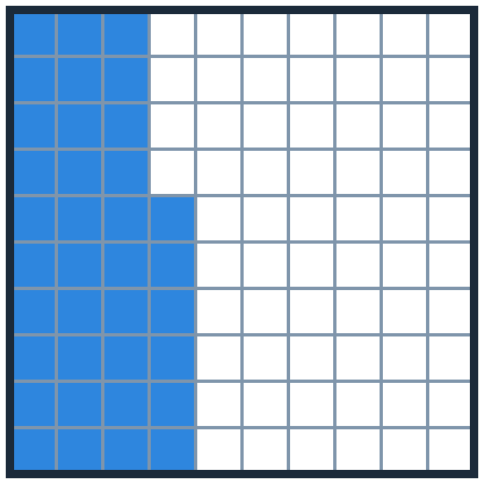
Practice
PART 3
Exercises 1 to 13
Notes:
Part 3: practice. Exercises 1 to 13 use the numbers from the book.

Slide 28

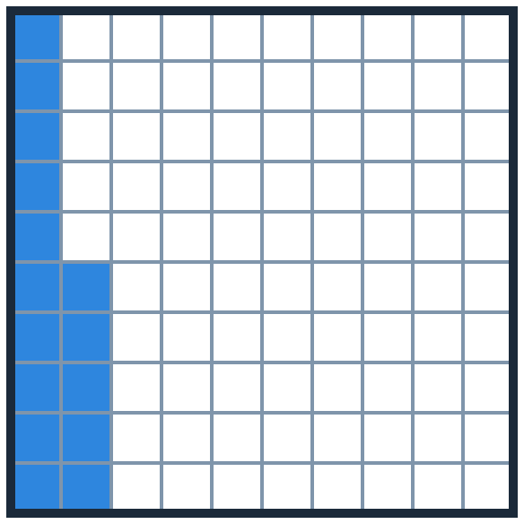
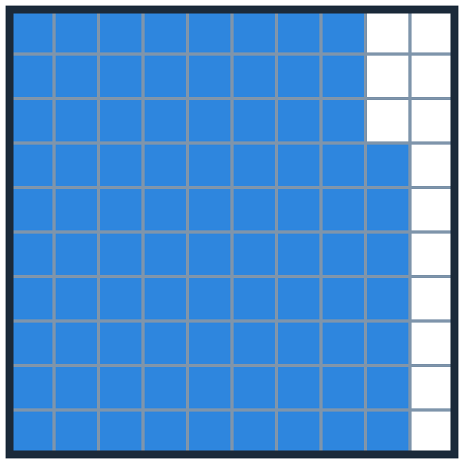
Percents as fractions and decimals
PRACTICE
Exercises 1 and 2: write each percent as a fraction. Exercises 3 and 4: write each percent as a decimal.
1
36%
2
40%
3
15%
4
87%
36/100
40/100
0.15
0.87
Notes:
Exercises 1-4. Percent means out of 100.
1: 36/100. 2: 40/100. 3: 15 hundredths = 0.15. 4: 87 hundredths = 0.87.

Slide 29

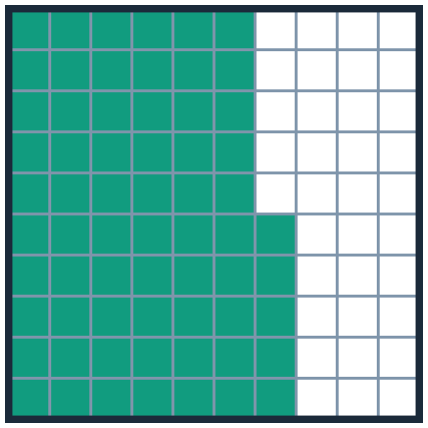
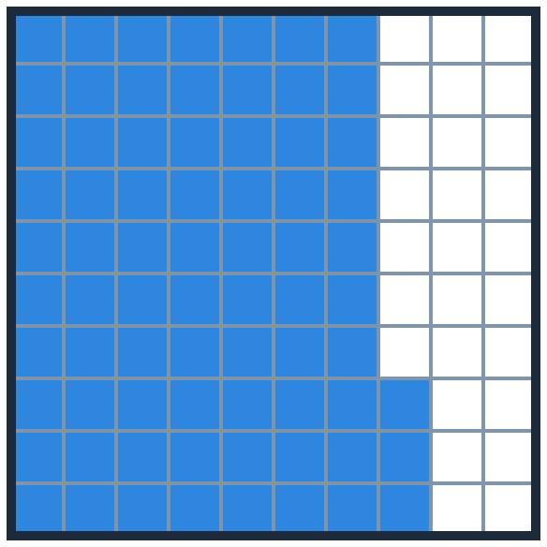
5 · Claire’s soccer team
PRACTICE
Claire’s team won 0.65 of their soccer games last season. They won 73% of their games this season. Which season had the better win record?
this season (73%)
A
last season (0.65)
B
They are the same.
C
Click an answer to check it.
last season
this season
Notes:
Interactive question: in Slide Show, click (or let a student tap) an answer card. A correct answer opens a “Correct!” slide; a wrong answer opens a hint and then returns to the question.
Answer: A, this season. 0.73 > 0.65.

Slide 30
Claire’s team · answer
Correct!
0.65 = 65% and 73% = 0.73. 0.73 > 0.65, so this season was better.
Next ▶
◀ Back to the question
Notes:
Hidden slide: it opens only when a student picks the correct answer on the question slide.
Read the explanation aloud, then click Next.

Slide 31
Claire’s team · hint
Not quite. Try again!
Write both in the same form: 0.65 = ?%
◀ Try again
Notes:
Hidden slide: it opens when a student picks a wrong answer.
Use the hint, then click Try again to go back to the question.

Slide 32
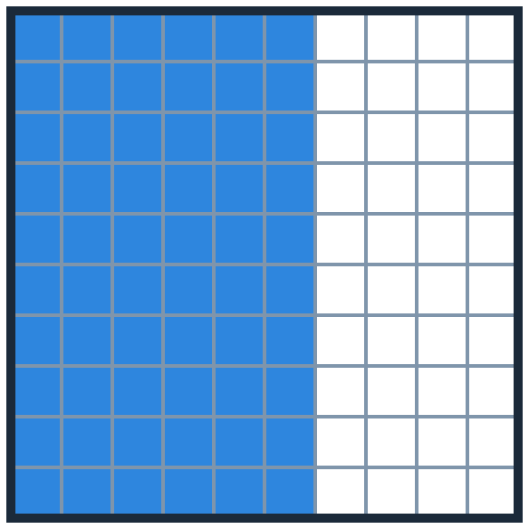
6 · Which is greater?
PRACTICE
Which is greater: 4/10 or 60%? Explain.
4/10
A
60%
B
They are equal.
C
4/10
60%
Click an answer to check it.
Notes:
Interactive question: in Slide Show, click (or let a student tap) an answer card. A correct answer opens a “Correct!” slide; a wrong answer opens a hint and then returns to the question.
Answer: B, 60%.

Slide 33
Greater · answer
Correct!
60% = 60/100 and 4/10 = 40/100. 60/100 > 40/100, so 60% > 4/10.
Next ▶
◀ Back to the question
Notes:
Hidden slide: it opens only when a student picks the correct answer on the question slide.
Read the explanation aloud, then click Next.

Slide 34
Greater · hint
Not quite. Try again!
Write 4/10 with a denominator of 100.
◀ Try again
Notes:
Hidden slide: it opens when a student picks a wrong answer.
Use the hint, then click Try again to go back to the question.

Slide 35
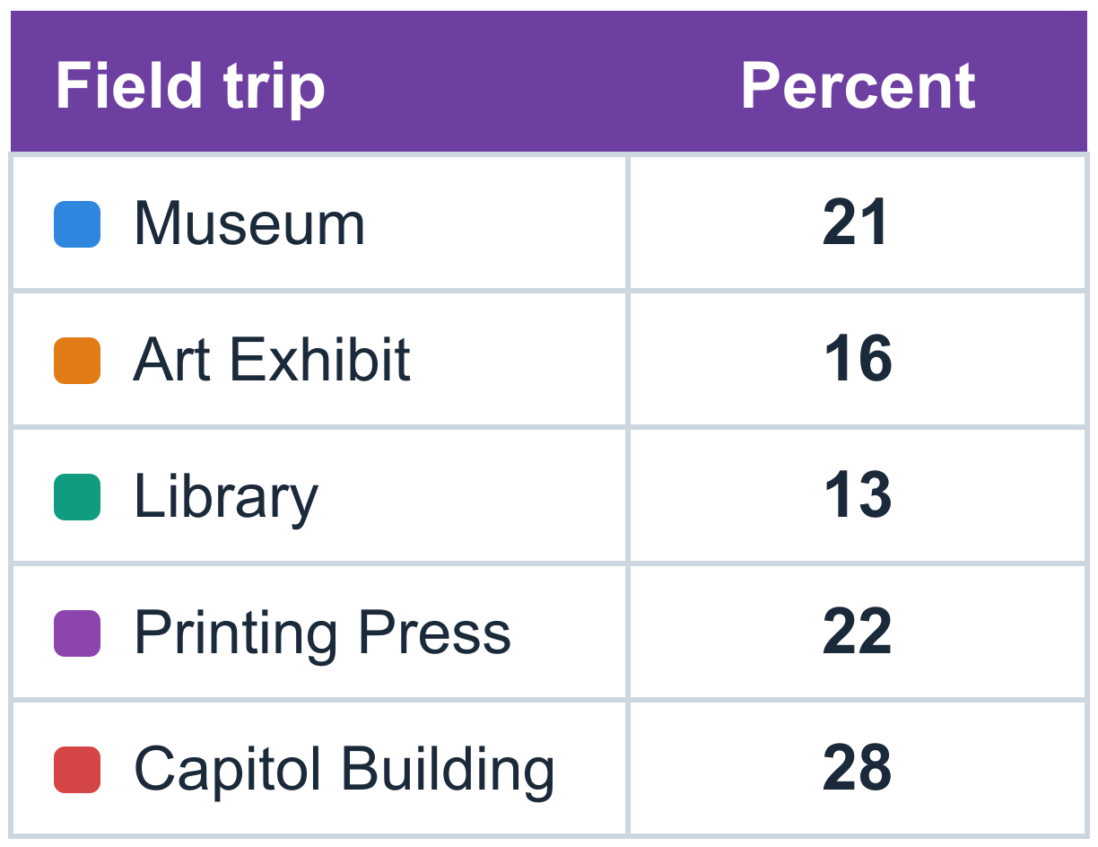
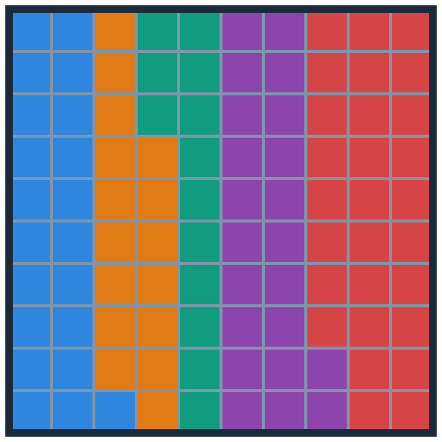
Favourite field trip
PRACTICE
The table shows a survey of this year’s students and their favourite field trip.
7
What fraction of the students chose the museum?
21% = 21/100
8
What part, as a decimal, chose the library or the printing press?
13% + 22% = 35% = 0.35
9
Last year, 0.2 of the students chose the art exhibit. How does this year compare?
0.2 = 20%. This year 16%: 4% fewer
Notes:
Exercises 7-9.
7: 21/100. 8: 13 + 22 = 35, so 0.35. 9: last year 0.2 = 20%; this year 16%; 4% fewer students chose the art exhibit this year.

Slide 36
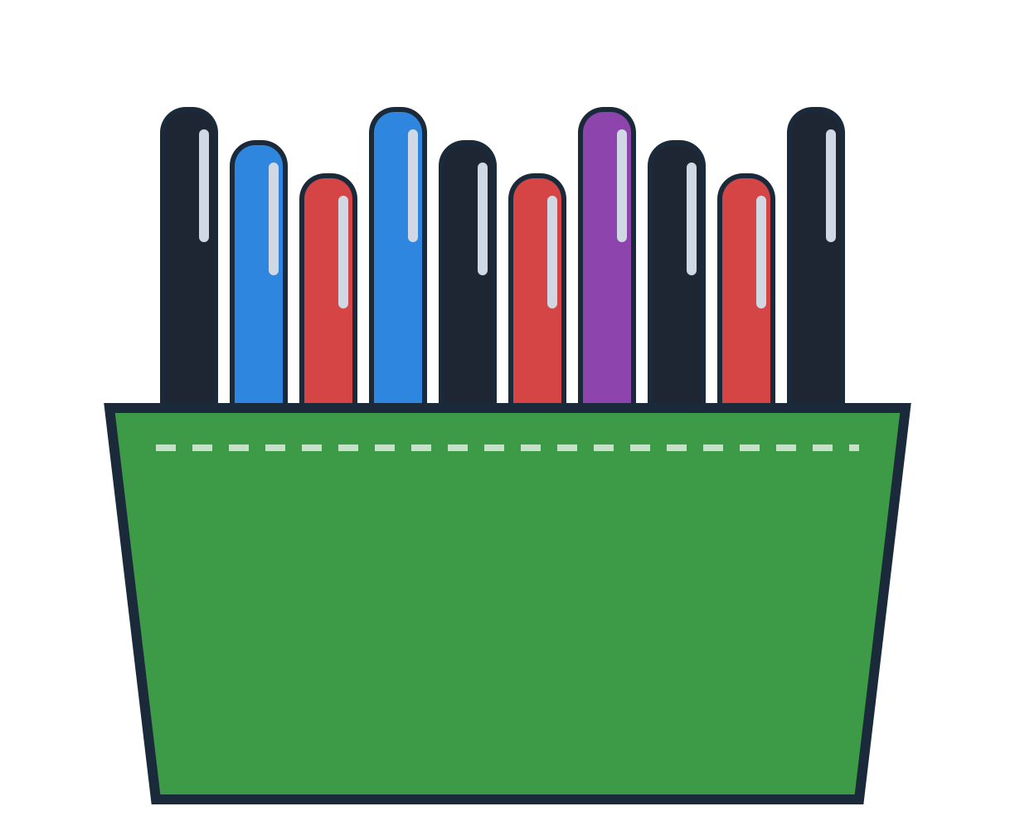
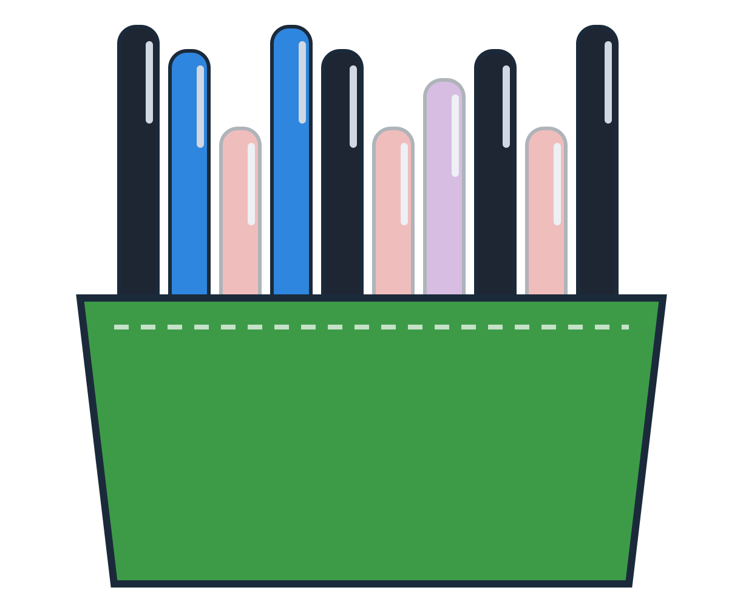
Tahira’s pens
PRACTICE
Tahira’s pen case is filled with black, blue, red and purple pens.
10
What fraction of Tahira’s pens are blue? What is it as a percent?
2/10 or 1/5
= 20%
11
What part of Tahira’s pens, as a decimal, are black or blue?
4 + 2 = 6 of 10
= 0.6
Notes:
Exercises 10-11. Count all the pens first: 10.
10: 2 blue of 10 = 2/10 = 1/5 = 20%. 11: 4 black + 2 blue = 6 of 10 = 0.6.

Slide 37
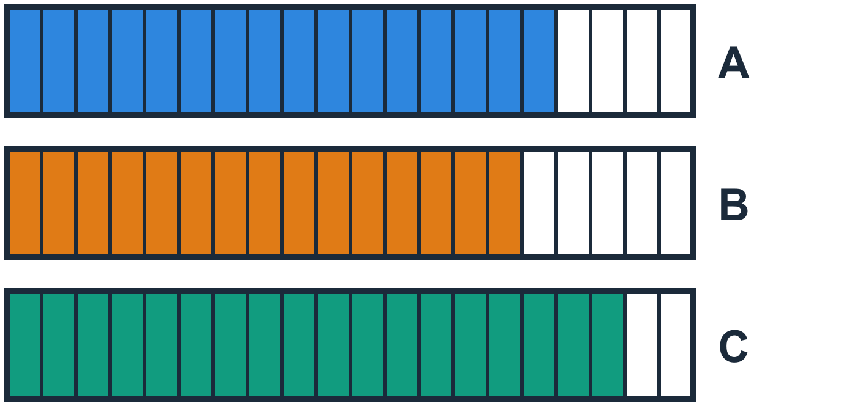
12 · STEM: the fastest program
PRACTICE
A computer scientist writes three programs. Program A takes 4/5 of a second. Program B takes 0.75 second. Program C takes 90% of a second. Which one is fastest?
Program A
A
Program B
B
Program C
C
Click an answer to check it.
Notes:
Interactive question: in Slide Show, click (or let a student tap) an answer card. A correct answer opens a “Correct!” slide; a wrong answer opens a hint and then returns to the question.
Answer: B. 0.75 < 0.8 < 0.9.

Slide 38
The fastest program · answer
Correct!
As decimals: A = 4/5 = 0.8 s, B = 0.75 s, C = 90% = 0.9 s. The least time is 0.75 s, so Program B is fastest.
Next ▶
◀ Back to the question
Notes:
Hidden slide: it opens only when a student picks the correct answer on the question slide.
Read the explanation aloud, then click Next.

Slide 39
The fastest program · hint
Not quite. Try again!
Write all three times as decimals. The fastest program takes the LEAST time.
◀ Try again
Notes:
Hidden slide: it opens when a student picks a wrong answer.
Use the hint, then click Try again to go back to the question.

Slide 40


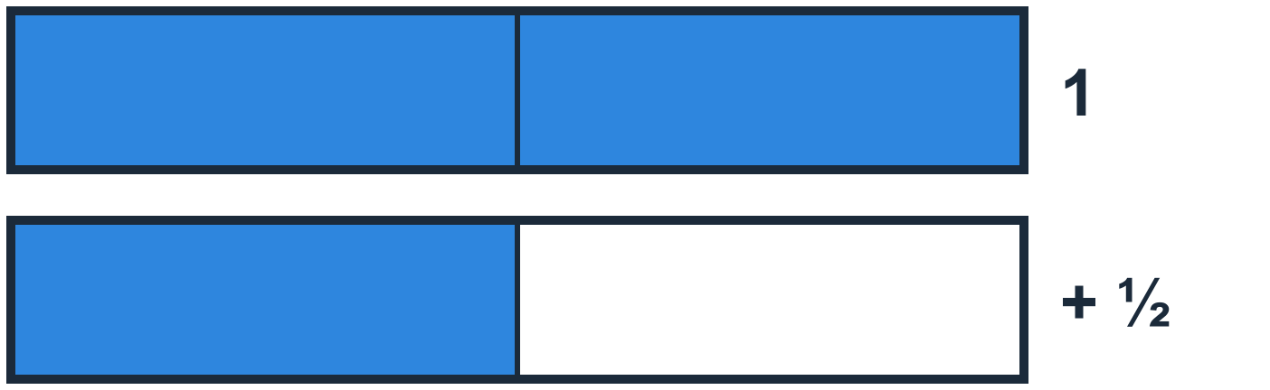
13 · Error Analysis
PRACTICE
“3/2 can’t be written as a percent, because it isn’t a fraction with a denominator of 100.”
Lucy
How would you answer Lucy?
Find an equivalent fraction with a denominator of 100.
3/2 = 150/100 = 150%
Notes:
Exercise 13. Let students argue first.
Lucy needs to write an equivalent fraction with a denominator of 100: 3/2 = 150/100 = 150%. A percent can be more than 100%.

Slide 41
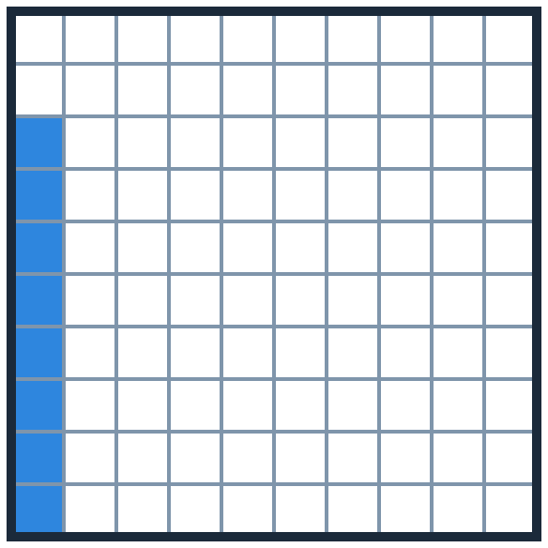
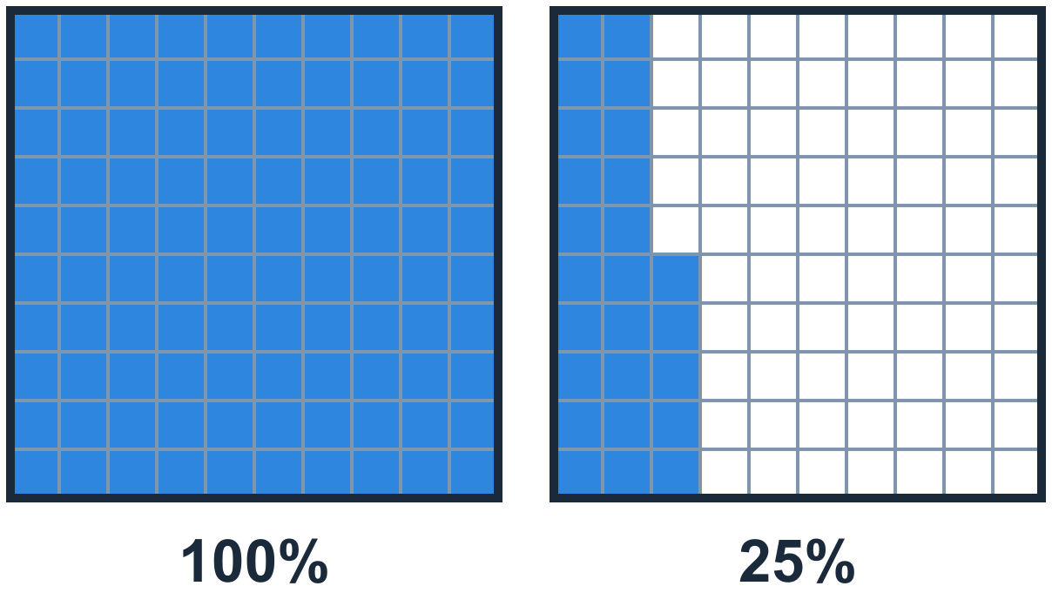
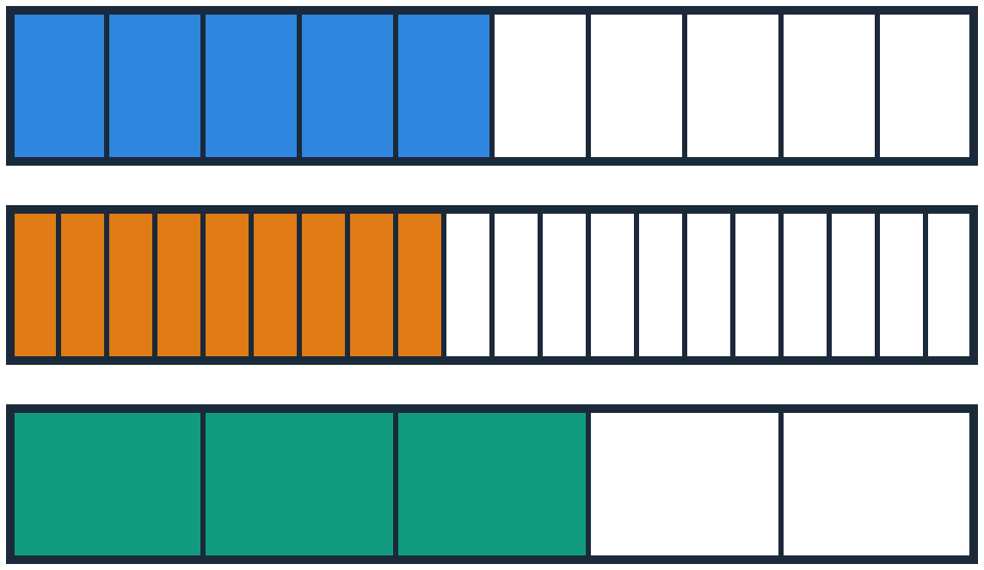

More practice
PRACTICE
A
B
C
D
1/4 = ?%
0.08 = ?%
125% = ? (decimal)
Greatest: 0.5, 45% or 3/5?
1/4 = 25/100 = 25%
0.08 = 8/100 = 8%
125% = 1.25
50%, 45%, 60%: 3/5
Notes:
Extra practice (not from the book). A: 25%. B: 8% (not 80%!). C: 1.25. D: 3/5 = 60% is the greatest.

Slide 42
Check
PART 4
0.3 = 3/10 = 30%
Quiz: show what you know
Notes:
Part 4: the lesson quiz. Students work alone first.

Slide 43

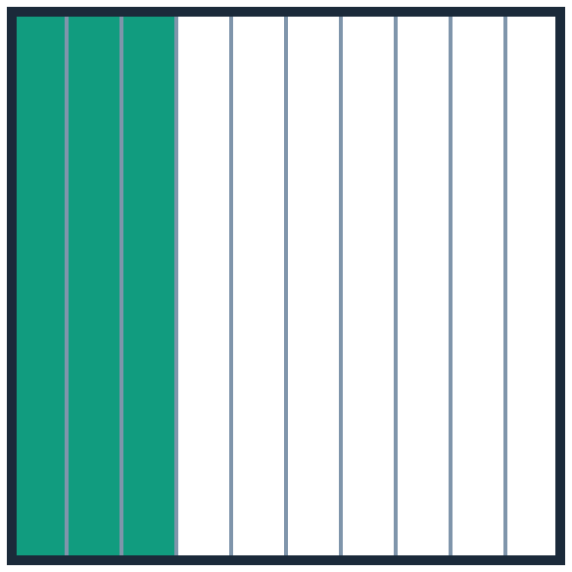
Quiz 1 · Equal to 0.3
CHECK
Which of these are equivalent to 0.3? Choose all that apply.
A
B
C
D
E
3/100
0.3%
30%
3/10
3%
✗ no
✗ no
✓ yes
✓ yes
✗ no
0.3 = 3/10 = 30/100 = 30%
Notes:
Quiz 1. Click 1: the marks (C and D are correct). Click 2: why.
3/100 = 0.03, 0.3% = 0.003, 3% = 0.03.

Slide 44
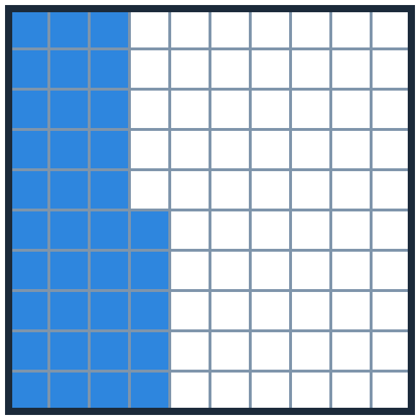

Quiz 2 and 3
CHECK
2
Write an equivalent decimal and percent for 3/5.
3
Write an equivalent fraction in simplest form and a decimal for 35%.
3/5 = 6/10 = 0.6
35/100 = 7/20
3/5 = 60/100 = 60%
35% = 0.35
Notes:
Quiz 2: 3/5 = 0.6 = 60%. Quiz 3: 35% = 35/100 = 7/20 (divide by 5) = 0.35.

Slide 45

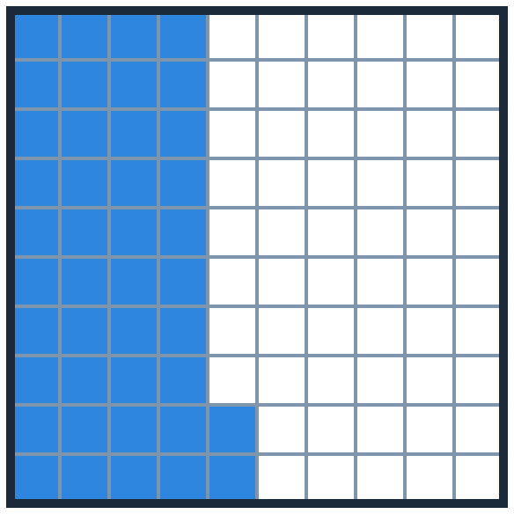

Quiz 4 · Which is greater?
CHECK
Which is greater: 42% or 2/5? Explain your answer.
42%
A
2/5
B
They are equal.
2/5
C
42%
Click an answer to check it.
Notes:
Interactive question: in Slide Show, click (or let a student tap) an answer card. A correct answer opens a “Correct!” slide; a wrong answer opens a hint and then returns to the question.
Answer: A, 42%.

Slide 46
42% or 2/5 · answer
Correct!
42% = 42/100 and 2/5 × 20/20 = 40/100. 42 > 40, so 42% is greater.
Next ▶
◀ Back to the question
Notes:
Hidden slide: it opens only when a student picks the correct answer on the question slide.
Read the explanation aloud, then click Next.

Slide 47
42% or 2/5 · hint
Not quite. Try again!
Write 2/5 with a denominator of 100.
◀ Try again
Notes:
Hidden slide: it opens when a student picks a wrong answer.
Use the hint, then click Try again to go back to the question.

Slide 48
Quiz 5 · Greatest to least
CHECK
Which list orders the numbers from greatest to least?
7/10, 67%, 0.64, 3/5
A
Hint: write each one as a percent.
7/10 = ?% 3/5 = ?% 0.64 = ?%
7/10, 3/5, 67%, 0.64
B
0.64, 67%, 7/10, 3/5
C
67%, 0.64, 7/10, 3/5
D
Click an answer to check it.
Notes:
Interactive question: in Slide Show, click (or let a student tap) an answer card. A correct answer opens a “Correct!” slide; a wrong answer opens a hint and then returns to the question.
Answer: A.

Slide 49
Greatest to least · answer
Correct!
As percents: 7/10 = 70%, 67%, 0.64 = 64%, 3/5 = 60%. So: 7/10, 67%, 0.64, 3/5.
Next ▶
◀ Back to the question
Notes:
Hidden slide: it opens only when a student picks the correct answer on the question slide.
Read the explanation aloud, then click Next.

Slide 50
Greatest to least · hint
Not quite. Try again!
Write each number as a percent first, then order them from the greatest.
◀ Try again
Notes:
Hidden slide: it opens when a student picks a wrong answer.
Use the hint, then click Try again to go back to the question.

Slide 51
Quiz 6 · 42.5%
CHECK
What is 42.5% written as a fraction in simplest form and as a decimal? Explain your answers.
42.5% = 42.5/100 = 425/1,000
425/1,000 ÷ 25/25 = 17/40
Decimal: divide by 100. 42.5 ÷ 100 = 0.425
Notes:
Quiz 6. 42.5% = 425/1,000. Divide by 25: 17/40. As a decimal: 42.5 ÷ 100 = 0.425.
The grid shows 42 full squares; the half square is hard to draw, which is why the fraction helps.

Slide 52

Reflect
WRAP-UP
Do you prefer to show part of a whole as a fraction, a decimal or a percent? Why?
3/4
0.75
75%
Think · 1 min
Pair · 2 min
Share
Example: a percent is a clear way to show a ratio, because it always compares with 100. That makes it easier to compare amounts.
Mindset: what are some ways you connected with your classmates in maths today?
Notes:
Think (1 minute), pair (2 minutes), share. Click to show an example answer.
Mindset: ask two or three students how they connected with classmates today.

Slide 53



Your turn: practise on your device!
1
Scan a code
LESSON · 3D models
VIDEO · Watch again
GAME · Deep Dig
2
Type your name
3
Answer the questions
4
Show your score
Scan a code with a tablet camera
3/4 = 0.75 = 75%
Notes:
Students scan one of the three codes. The left code opens the interactive lesson (every question has a 3D model). The middle code opens the explainer video. The right code opens Deep Dig, a 30-question quiz game.

