Slide 1
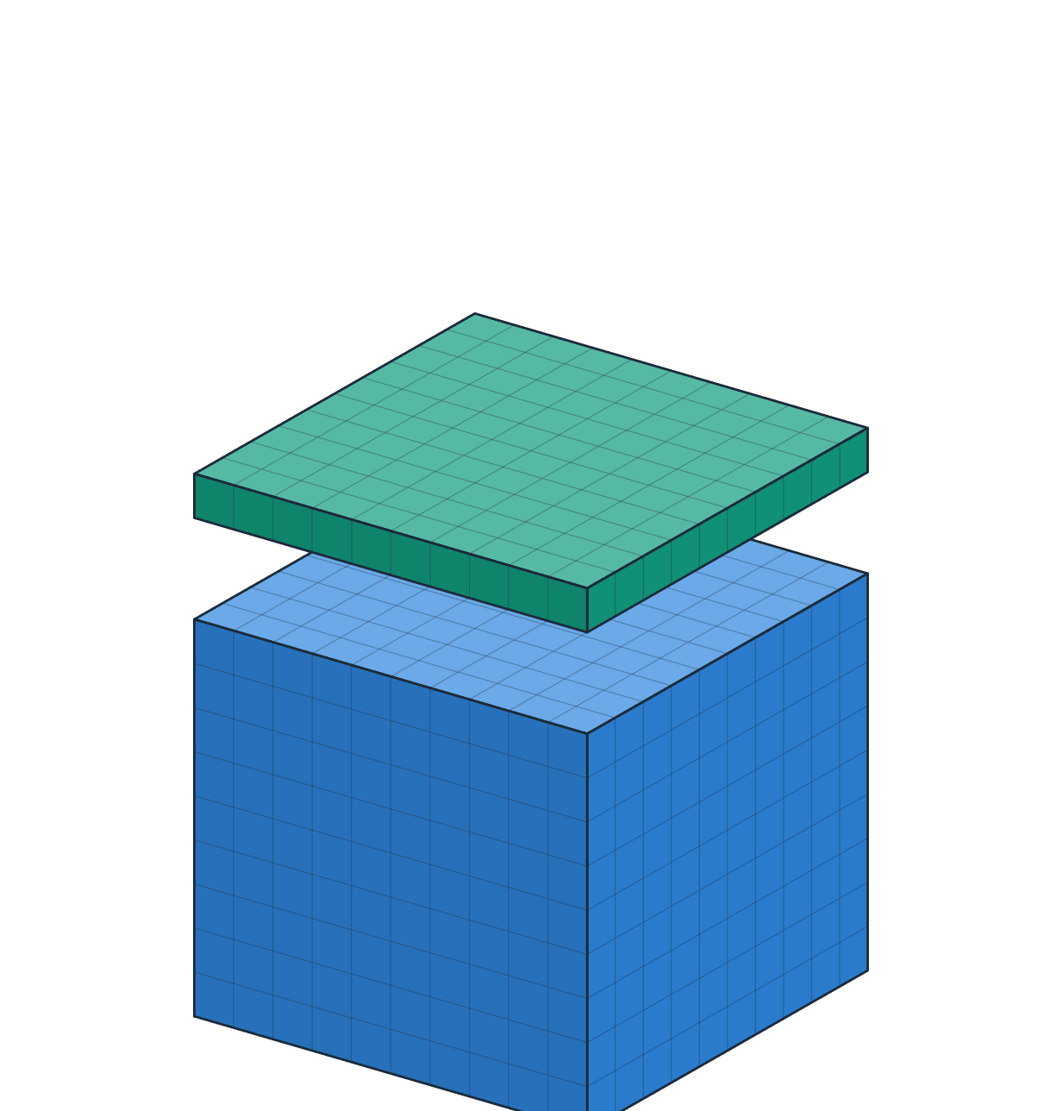

Extend Place Value to Decimals
MATHS · LET’S EXPLORE
Tenths · Hundredths · Thousandths
Ones
Tenths
Hundredths
Thousandths
1
0.1
0.01
0.001
Notes:
Welcome. Today we discover what happens to numbers when we cut 1 whole into 10, 100 and 1,000 equal parts.
Point at the cube: the top slice is lifting off. Ask: “How much of the cube is that slice?” Take a few guesses, do not give the answer yet.

Slide 2


Today I can…
WARM-UP
Hi, I’m Dot, the decimal point! Today you will find out how much each digit is worth.
I can tell the value of a digit in the tenths, hundredths and thousandths places.
I can explain that a digit is worth 10 times as much one place to the left, and 1/10 as much one place to the right.
Notes:
Read the two goals together. Click to show each goal.
Tell the class: by the end, everyone should be able to say “one place left is 10 times as much, one place right is 1/10 as much”.

Slide 3




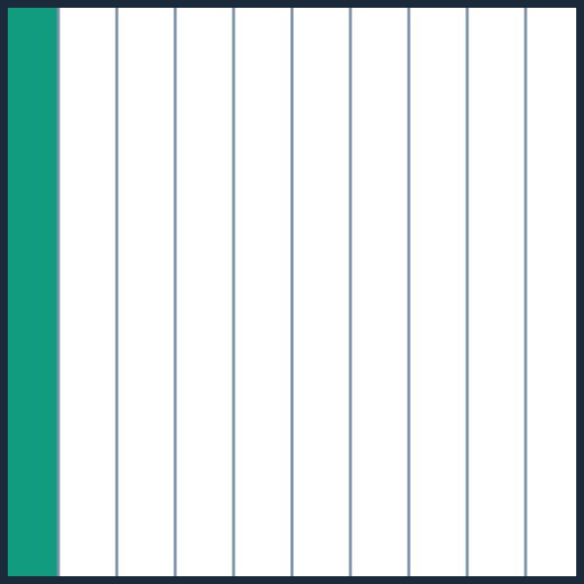
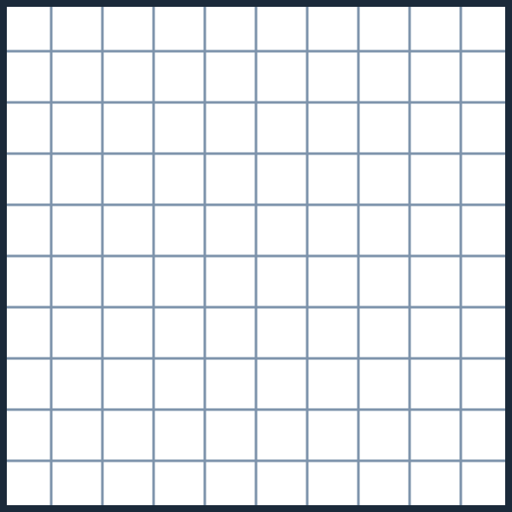
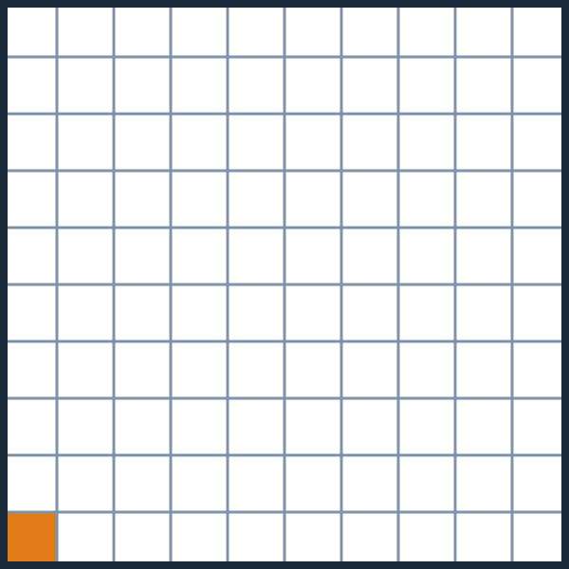
What do you notice?
WARM-UP
The three big squares are the same size.
1 whole
1 tenth: one strip
1 hundredth: one square
?
?
?
I notice…
I wonder…
Notes:
Give 1 minute of silent looking, then partner talk: “What do you notice? What do you wonder?”
Likely ideas: same size squares; one is cut into strips, one into small squares; 10 strips, 100 small squares.
Click to shade 1 whole, 1 tenth (one strip) and 1 hundredth (one small square), and to show their names.

Slide 4

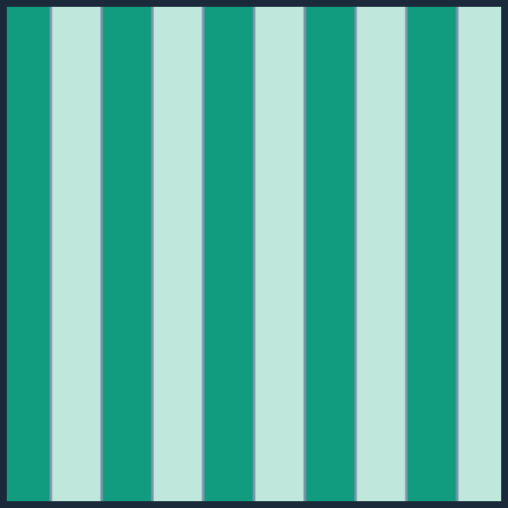

How many tenths make 1 whole?
WARM-UP
10
A
100
B
1,000
C
Each strip is 1 tenth.
Click an answer to check it.
Notes:
Interactive question: in Slide Show, click (or let a student tap) an answer card. Correct goes to a “Correct!” slide; a wrong answer goes to a hint and back.
Answer: A, 10 tenths make 1 whole.

Slide 5

How many tenths make 1 whole? · answer
Correct!
10 tenths = 1 whole. 10 strips fill the square.
Next ▶
◀ Back to the question
Notes:
Hidden slide: it opens only when a student picks the correct answer on the question slide.
Read the explanation aloud, then click Next.

Slide 6

How many tenths make 1 whole? · hint
Not quite. Try again!
Count the strips in the square. Each strip is 1 tenth.
◀ Try again
Notes:
Hidden slide: it opens when a student picks a wrong answer.
Use the hint, then click Try again to go back to the question.

Slide 7
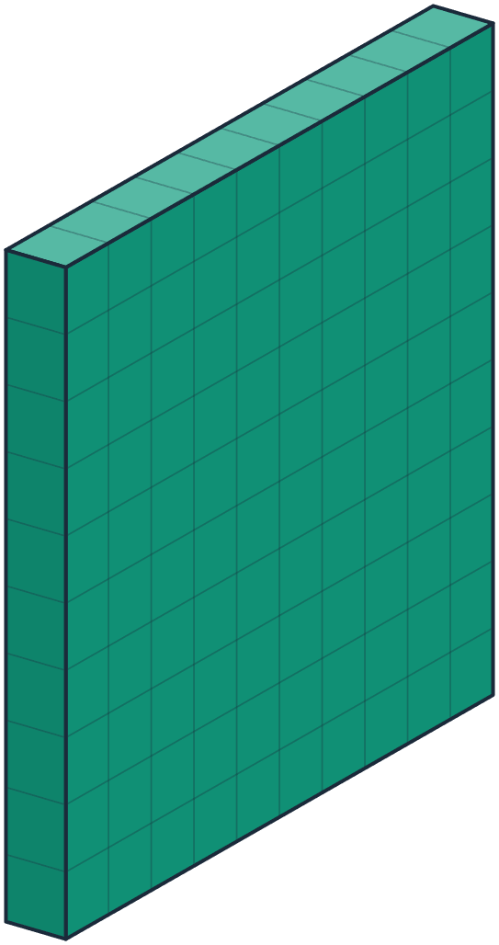
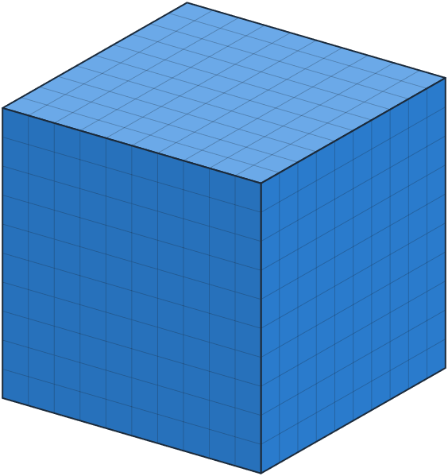

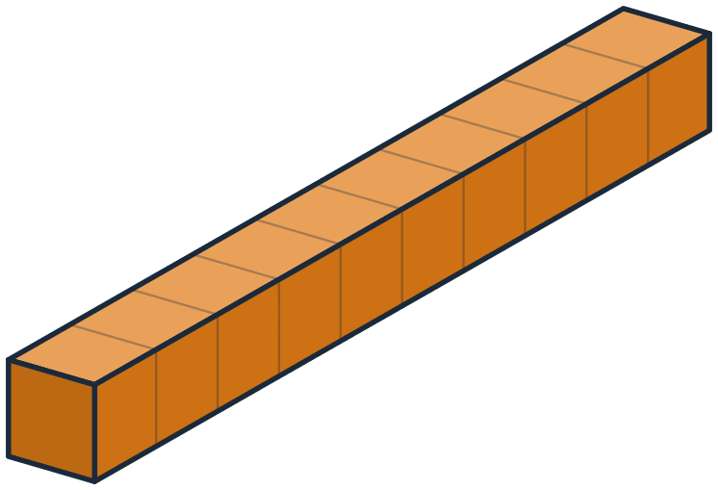
Learn
PART 2
Meet the block family and the ×10 rule
Notes:
Part 2: we are going to cut a cube again and again, and give each piece its name and its number.

Slide 8

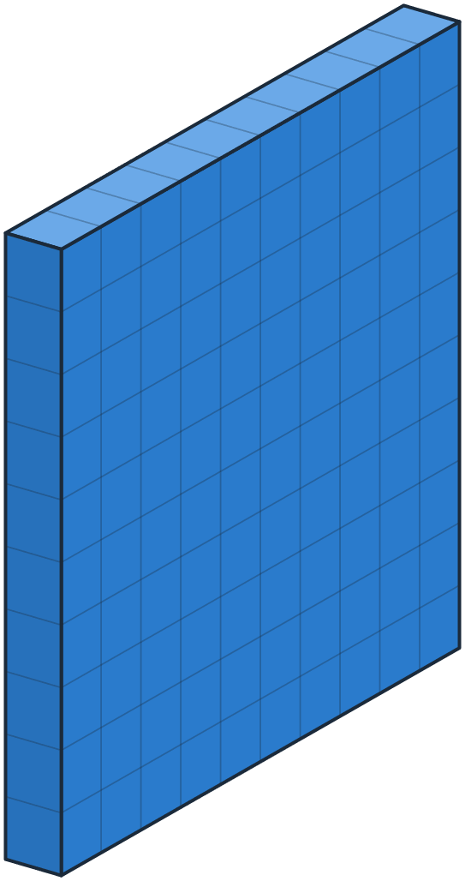

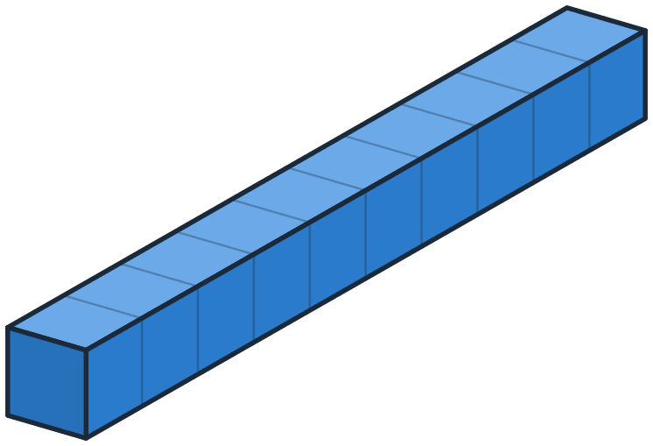
Start with 1 whole
LEARN
1
1 whole
This big cube is 1 whole. Let’s cut it into 10 equal parts…
Ones 1
÷10
Tenths 0.1
÷10
Hundredths 0.01
÷10
Thousandths 0.001
Notes:
This cube is 1 whole: the number 1.
Ask: “If we cut it into 10 equal slices, how big is each slice?” Then click to watch it happen (Morph transition).

Slide 9

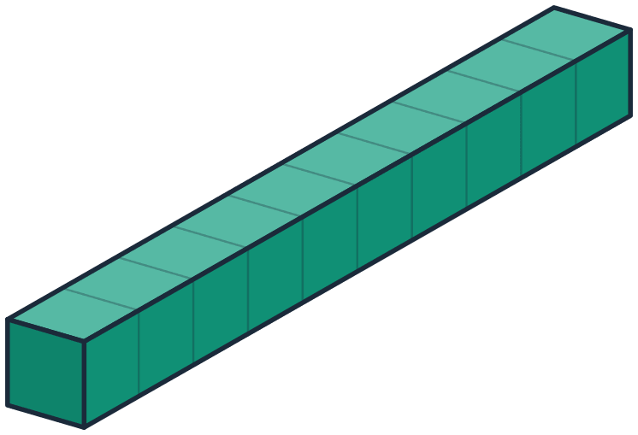
Cut it into 10 equal slices
LEARN
10 × 0.1 = 1
10 tenths make 1 whole
Each slice is 1 tenth of the cube.
Ones 1
÷10
Tenths 0.1
÷10
Hundredths 0.01
÷10
Thousandths 0.001
Notes:
Count the slices with the class: 10. Ten equal slices make the whole cube, so each slice is 1 tenth, written 0.1.
Say it together: “10 tenths make 1 whole.”

Slide 10
Meet 1 tenth
LEARN
0.1
1 tenth
1 tenth = 1/10 of 1 whole.
Look closely: it is made of 10 rods.
Ones 1
÷10
Tenths 0.1
÷10
Hundredths 0.01
÷10
Thousandths 0.001
Notes:
Zoom in on one slice: 1 tenth = 0.1. The digit 1 is in the tenths place, just right of the decimal point.
Ask: “How many rods can you see in this slice?” (10).

Slide 11

Cut 1 tenth into 10 rods
LEARN
10 × 0.01 = 0.1
10 hundredths make 1 tenth
Each rod is 1 hundredth of the whole cube.
Ones 1
÷10
Tenths 0.1
÷10
Hundredths 0.01
÷10
Thousandths 0.001
Notes:
The tenth is cut into 10 rods. Each rod is 1 hundredth (0.01) of the whole cube: 100 rods would fill the cube.
Say together: “10 hundredths make 1 tenth.”

Slide 12
Meet 1 hundredth
LEARN
0.01
1 hundredth
1 hundredth = 1/100 of 1 whole.
It is made of 10 tiny cubes.
Ones 1
÷10
Tenths 0.1
÷10
Hundredths 0.01
÷10
Thousandths 0.001
Notes:
One rod: 1 hundredth = 0.01. The 1 is now two places right of the decimal point.
Ask: “What do you think we get if we cut it into 10 again?”

Slide 13
Cut 1 hundredth into 10 tiny cubes
LEARN
10 × 0.001 = 0.01
10 thousandths make 1 hundredth
Each tiny cube is 1 thousandth. 1,000 of them fill the whole cube!
Ones 1
÷10
Tenths 0.1
÷10
Hundredths 0.01
÷10
Thousandths 0.001
Notes:
Each tiny cube is 1 thousandth (0.001). It would take 1,000 of them to fill the big cube.
Look at the chips at the bottom: every step to the right is ÷ 10.

Slide 14

The block family
LEARN
So tiny!
÷10
÷10
÷10
1 whole
1 tenth
1 hundredth
1 thousandth
1
0.1
0.01
0.001
Pattern spotter: tenths, hundredths, thousandths. The name tells how many equal parts 1 whole is cut into.
Notes:
Here are all four blocks at their real sizes next to each other. Each one is 1/10 the size of the block on its left.
Click for the pattern in the names: tenTHS = 10 parts, hundredTHS = 100 parts, thousandTHS = 1,000 parts.

Slide 15


Is Sam right?
LEARN
Sam says: “Every 1 in 1.111 has the same value.”
Ones
Tenths
Hundredths
Thousandths
Yes. Every digit is a 1, so they are all worth the same.
1
1
1
1
A
No. The value of each 1 depends on its place.
B
Notes:
Read Sam’s claim. Point at each 1 in the chart and the block under it. Are the blocks the same size?
Let students vote, then click an answer. Answer: B. Each 1 is worth 1/10 of the 1 on its left: 1, 0.1, 0.01, 0.001.

Slide 16
Is Sam right? · answer
Correct!
Each 1 is worth 1/10 of the 1 on its left: 1, 0.1, 0.01 and 0.001.
Next ▶
◀ Back to the question
Notes:
Hidden slide: it opens only when a student picks the correct answer on the question slide.
Read the explanation aloud, then click Next.

Slide 17
Is Sam right? · hint
Not quite. Try again!
Look at the blocks under the 1s: 1, 0.1, 0.01 and 0.001. Are they the same size?
◀ Try again
Notes:
Hidden slide: it opens when a student picks a wrong answer.
Use the hint, then click Try again to go back to the question.

Slide 18


The ×10 and ÷10 rule
LEARN
Every digit is a 3. What is each 3 worth?
×10
×10
×10
×10
×10
Hundreds
Tens
Ones
Tenths
Hundredths
Thousandths
3
3
3
3
3
3
300
30
3
0.3
0.03
0.003
One place left = × 10
One place right = ÷ 10
Each place is worth 10 times the place to its right, and 1/10 of the place to its left.
Notes:
Every digit is a 3, but each 3 is worth something different. Click 1: the values 300, 30, 3, 0.3, 0.03, 0.003.
Click 2: the hops. Each hop to the left is × 10. Click 3: left is × 10, right is ÷ 10. Click 4: the rule. Have students say it aloud.

Slide 19
Move the digit to the right
LEARN
Ones
Tenths
Hundredths
Thousandths
VALUE
0
7
0.7
7 tenths
A 7 in the tenths place is worth 0.7: 7 slices.
Notes:
A 7 in the tenths place: 0.7, shown as 7 slices (7 tenths of the cube).
Ask: “What will happen to its value if the 7 moves one place to the right?” Then advance: Morph moves the digit and changes the blocks.

Slide 20
Move the digit to the right
LEARN
÷ 10
Ones
Tenths
Hundredths
Thousandths
VALUE
0
0
7
0.07
7 hundredths
What happens to its value? It becomes 1/10 as much.
One place right: 0.7 ÷ 10 = 0.07
Notes:
The 7 moved one place right. Its value is now 0.07: seven rods instead of seven slices. It is 1/10 as much. A zero keeps the tenths place.
Click to show the answer to “What happens to its value?”

Slide 21
Move the digit to the right
LEARN
÷ 10
Ones
Tenths
Hundredths
Thousandths
VALUE
0
0
0
7
0.007
7 thousandths
One more place right: 0.07 ÷ 10 = 0.007
Notes:
One more place right: 0.007, seven tiny cubes. Every move to the right divides by 10.
Challenge: “What happens if we move the 7 back two places to the left?” (× 10 × 10 = 100 times as much: 0.7).

Slide 22

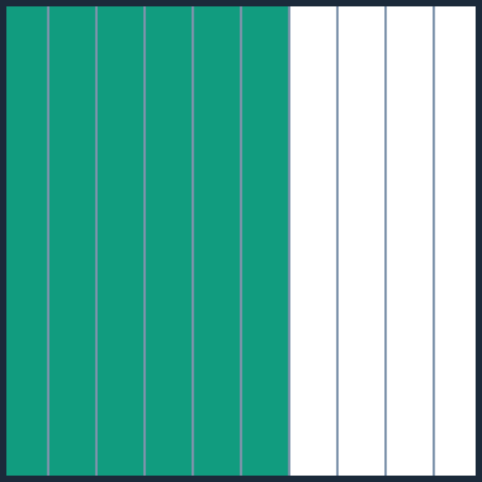
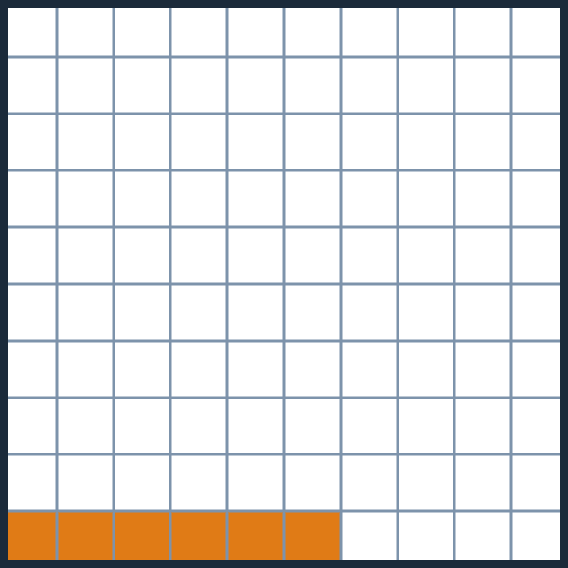
Work together: 0.6 or 0.06?
LEARN
Two ways to say it
0.6 is 10 times 0.06
0.06 is 1/10 of 0.6
0.6 · 6 tenths
0.06 · 6 hundredths
Talk with a partner: which amount is bigger? How many times bigger?
Notes:
Partners compare the grids. 0.6 = 6 whole strips; 0.06 = only 6 small squares.
Click 1: 0.6 is 10 times 0.06. Click 2: 0.06 is 1/10 of 0.6. Both sentences describe the same fact.

Slide 23
Practice
PART 3
5
3
7
7
Same digit, different value
Notes:
Part 3: practice. In every question, look at the PLACE of the digit, not just the digit.

Slide 24

Which statement is true?
PRACTICE
0.004 is 10 times 0.04
0.04 is 1/10 of 0.4
A
B
4 is 10 times 0.04
0.4 is 1/10 of 0.04
C
D
4
÷10 ▶
0.4
÷10 ▶
0.04
÷10 ▶
0.004
Hint: one place to the right is ÷ 10.
Notes:
Interactive: click a statement. Answer: B. 0.4 ÷ 10 = 0.04, so 0.04 is 1/10 of 0.4.
Why not C? From hundredths to ones is two places, so 4 is 100 times 0.04.

Slide 25
Which statement is true? · answer
Correct!
0.4 ÷ 10 = 0.04, so 0.04 is 1/10 of 0.4.
Next ▶
◀ Back to the question
Notes:
Hidden slide: it opens only when a student picks the correct answer on the question slide.
Read the explanation aloud, then click Next.

Slide 26
Which statement is true? · hint
Not quite. Try again!
Use the chips at the bottom: each step to the right is ÷ 10. Check each statement with them.
◀ Try again
Notes:
Hidden slide: it opens when a student picks a wrong answer.
Use the hint, then click Try again to go back to the question.

Slide 27




Pocket money
PRACTICE
Mariam
Omar
Lina
AED 5.00
AED 0.50
AED 0.05
Mariam has
10 times
the money Omar has.
Lina has
1/10 of
the money Omar has.
AED
7.00
is 10 times AED 0.70.
Notes:
Mariam has AED 5.00 (5 ones), Omar AED 0.50 (5 tenths), Lina AED 0.05 (5 hundredths). The blocks are drawn to the same scale.
Click 1: Mariam has 10 times Omar’s money. Click 2: Lina has 1/10 of Omar’s money. Click 3: AED 7.00 is 10 times AED 0.70 (move each digit one place left).

Slide 28

Same digit, different value
PRACTICE
5
3
7
7
blue 7
orange 7
The blue 7 is worth
The orange 7 is worth
0.07
0.007
7 hundredths
7 thousandths
The blue 7 is
10 times
the orange 7.
Notes:
5.377 has two 7s. Ask: “Are they worth the same?”
Click 1: the blue 7 is in the hundredths place: 0.07. Click 2: the orange 7 is in the thousandths place: 0.007. Click 3: the blue 7 is 10 times the orange 7.
Extra: in 4.419, the first 4 is worth 4 and the second 4 is worth 0.4.

Slide 29


Error analysis: is Rami right?
PRACTICE
Rami says: “The 4 in the tens place is worth 10 times the 4 in the tenths place.”
Tens
Ones
Tenths
Yes, Rami is right.
A
4
5
4
No, Rami is not right.
Number: 45.4
B
Find the value of each 4 first.
Notes:
Ask students to find each 4’s value first: the tens 4 is 40, the tenths 4 is 0.4.
Answer: B, Rami is not right. 10 × 0.4 = 4, not 40. Tenths to tens is two places left: × 10 × 10 = 100 times.

Slide 30
Is Rami right? · answer
Correct!
No. 10 × 0.4 is only 4, but the tens 4 is worth 40. Tenths to tens is two places left: 10 × 10 = 100 times as much.
Next ▶
◀ Back to the question
Notes:
Hidden slide: it opens only when a student picks the correct answer on the question slide.
Read the explanation aloud, then click Next.

Slide 31
Is Rami right? · hint
Not quite. Try again!
Find each value: the tens 4 is worth 40 and the tenths 4 is worth 0.4. Is 40 ten times 0.4?
◀ Try again
Notes:
Hidden slide: it opens when a student picks a wrong answer.
Use the hint, then click Try again to go back to the question.

Slide 32
Digit hunt
PRACTICE
In which numbers is the 6 worth 10 times the 6 in 3.462?
2.615
6.243
1.356
9.68
0.564
the 6 = 0.6
the 6 = 6
the 6 = 0.006
the 6 = 0.6
the 6 = 0.06
1
The 6 in 3.462 is in the hundredths place: 0.06.
2
10 times 0.06 is 0.6.
3
So look for a 6 in the tenths place!
Notes:
Every 6 is highlighted in yellow. Let students think and choose (more than one answer!).
Click 1: the three steps. Click 2: the value of each 6. Click 3: the ticks: 2.615 and 9.68, where the 6 is in the tenths place (0.6).

Slide 33


Race time
PRACTICE
Huda ran 100 metres in 22.2 seconds. The digit 2 appears three times!
22.2
The 2 in the ones place is
10 times
the 2 in the tenths place.
The 2 in the tens place is
seconds
100 times
the 2 in the tenths place.
Tens 2 = 20
Ones 2 = 2
Tenths 2 = 0.2
Tens to tenths is two places: 10 × 10 = 100.
Notes:
22.2 has three 2s: 20, 2 and 0.2 (click 1).
Click 2: the ones 2 is 10 times the tenths 2 (2 = 10 × 0.2). Click 3: the tens 2 is 100 times the tenths 2 (20 = 100 × 0.2), because tens to tenths is two places.

Slide 34

Extend your thinking
PRACTICE
Use the digits 3, 6 and 8 once each.
Compare with 3.68
Ones
Tenths
Hundredths
3
6
8
3
6
8
Build a number where the 8 is worth 10 times the 8 in 3.68.
3.86 works for both!
A
The 8 must go in the tenths place (0.8): 3.86 or 6.83
Build a number where the 6 is worth 1/10 of the 6 in 3.68.
B
The 6 must go in the hundredths place (0.06): 3.86 or 8.36
Notes:
Students build numbers on paper or mini whiteboards.
A: the 8 in 3.68 is 0.08, so 10 times is 0.8: the 8 goes in the tenths place (3.86 or 6.83). Click 1.
B: the 6 in 3.68 is 0.6, so 1/10 of it is 0.06: the 6 goes in the hundredths place (3.86 or 8.36). Click 2. Click 3: 3.86 works for both.

Slide 35

Reflect
WRAP-UP
How is the place value pattern in decimals like the pattern in whole numbers?
×10
×10
×10
×10
×10
300
30
3
0.3
0.03
0.003
Think · 1 min
Pair · 2 min
Share
decimal point
It is the same pattern on both sides of the decimal point. Each place is worth 10 times the place to its right, and 1/10 of the place to its left: 300 is 10 times 30, and 0.3 is 10 times 0.03.
Notes:
Think (1 minute), pair (2 minutes), share. Point at the hops: the same ×10 pattern runs on both sides of Dot.
Click to show an example answer.

Slide 36
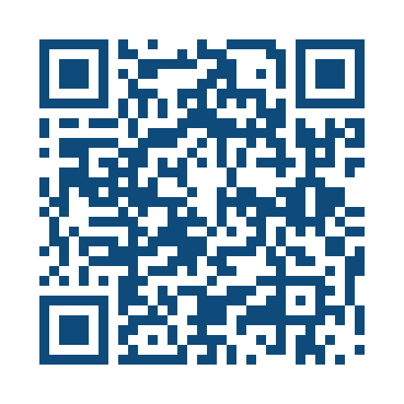
Your turn: practise on your device!
1
Scan the code
2
Type your name
3
Turn the 3D blocks and answer
4
Show your score
◀ One place left = × 10 One place right = ÷ 10 ▶
Scan the code with a tablet camera
Notes:
Students open the interactive lesson on their devices by scanning the code. Every question has a 3D model they can turn with a finger or mouse.
At the end, ask them to show you their results screen.

