Slide 1
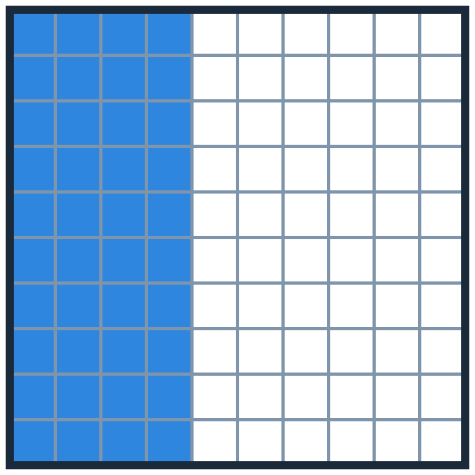

Understand Percent
%
MATHS · A RATE PER 100
Grids · Tape diagrams · More than 100%
Words
Fraction
Percent
40 out of 100
40/100
40%
Notes:
Welcome. Today’s big idea: a percent is a rate per 100.
Point at the grid: 40 of the 100 squares are shaded. We can say it three ways: 40 out of 100, 40/100, or 40%.
Ask: “Where have you seen the % sign?” (shops, phone battery, test scores…).

Slide 2


Today I can…
WARM-UP
Hi, I’m Dot! “Per cent” means “per 100”. Let’s find out what that tells us.
I can explain that a percent is a rate per 100.
I can explain why a percent greater than 100% is more than one whole.
I can use decimal grids and tape diagrams to solve percent problems.
Notes:
Read the three goals together. Click to show each goal.
By the end, everyone should be able to say what 40% means and why 150% is more than one whole.

Slide 3

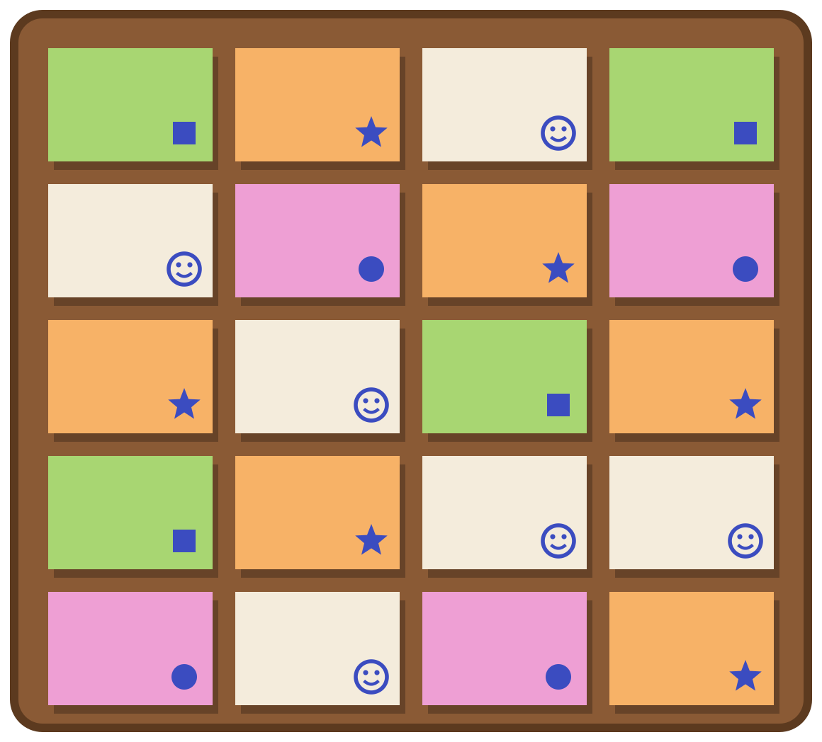
What do you notice? What do you wonder?
WARM-UP
A class put sticky notes on a board.
How many sticky notes are on the board?
5 rows of 4 = 20 notes
How many notes have a star?
6 notes have a star
I notice…
I wonder…
Notes:
Give students 1 minute to look silently, then talk with a partner: “What do you notice? What do you wonder?”
Click 1: 5 rows of 4 = 20 notes. Click 2: 6 notes have a star.
Mindset: we listen to a friend’s idea before we add our own.

Slide 4


Stars compared with all the notes
WARM-UP
6/20
A
6/14
B
20/6
C
6 notes have a star.
20 notes in all.
Which ratio compares the notes with a star to all the notes?
Click an answer to check it.
Notes:
Interactive question: in Slide Show, click (or let a student tap) an answer card. A correct answer opens a “Correct!” slide; a wrong answer opens a hint and then returns to the question.
Answer: A, 6/20. (6/14 compares stars with notes without a star; 20/6 is the wrong way round.)

Slide 5

Stars : all notes · answer
Correct!
6 out of 20 = 6/20. Soon you will see that this is the same as 30 out of 100: 30%.
Next ▶
◀ Back to the question
Notes:
Hidden slide: it opens only when a student picks the correct answer on the question slide.
Read the explanation aloud, then click Next.

Slide 6

Stars : all notes · hint
Not quite. Try again!
Compare the notes with a star (6) with ALL the notes (20). Stars first, then all the notes.
◀ Try again
Notes:
Hidden slide: it opens when a student picks a wrong answer.
Use the hint, then click Try again to go back to the question.

Slide 7
Learn
%
PART 2
A percent is a rate per 100
per cent = per 100
Notes:
Part 2: what a percent is. “Cent” means 100, as in century (100 years). So percent means per 100.

Slide 8

School Mascot
LEARN
Students voted for a new school mascot: a tiger, a shark or an eagle. The results show that 4 out of every 10 voters chose the tiger.
How many students out of every 100 voted for the tiger?
A tape diagram in 10 equal parts. 4 parts are the tiger votes.
4 out of 10 parts: the tiger
Notes:
Read the problem together. The tape diagram has 10 equal parts and 4 are shaded: 4 out of 10.
Ask: “How can we find how many out of 100?” Then advance: Morph turns the tape into a tenths grid.

Slide 9
School Mascot
LEARN
Students voted for a new school mascot: a tiger, a shark or an eagle. The results show that 4 out of every 10 voters chose the tiger.
How many students out of every 100 voted for the tiger?
Stand the parts up: a tenths grid. Each strip is 10 out of 100, or 10%.
4 out of 10 strips
Notes:
The same 4 out of 10, now as a tenths grid. Each strip is one tenth of the whole.
Advance: Morph cuts every strip into 10 squares.

Slide 10
School Mascot
LEARN
Students voted for a new school mascot: a tiger, a shark or an eagle. The results show that 4 out of every 10 voters chose the tiger.
How many students out of every 100 voted for the tiger?
40 out of 100
40/100
40%
40 students out of every 100 voted for the tiger.
40 out of 100 squares
Notes:
Every strip is cut into 10 squares: 100 squares, and 40 are shaded.
Click 1-3: 40 out of 100 = 40/100 = 40%. Click 4: the answer, 40 students out of every 100.
Key idea: 4 out of 10 and 40 out of 100 are the same rate.

Slide 11



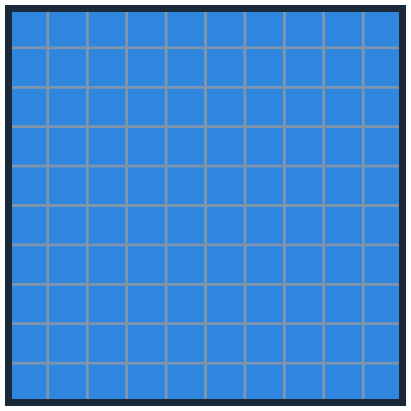
What is a percent?
LEARN
A percent is a ratio, or rate, that compares a number with 100.
1 square = 1%
1 column = 10%
the whole grid = 100%
The % sign means “per 100”: 40% = 40 out of 100 = 40/100
Notes:
A percent compares a number with 100. On a hundredths grid each square is 1%, each column is 10% and the whole grid is 100%.
Click: the % sign means per 100.

Slide 12

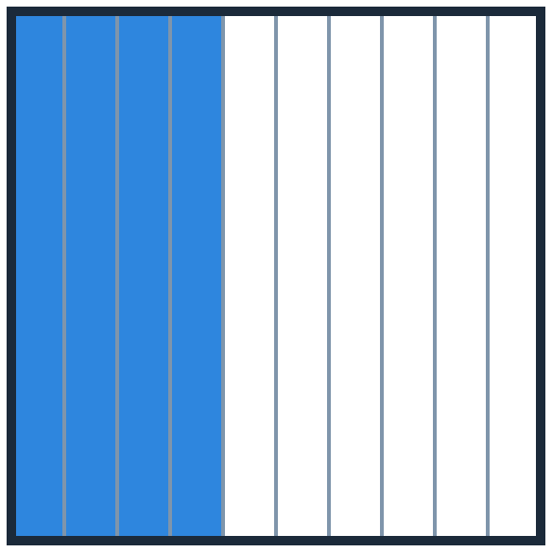
What is NOT shaded?
LEARN
40%
A
60%
B
6%
hundredths grid
tenths grid
C
What percent of each model is NOT shaded?
Click an answer to check it.
Notes:
Interactive question: in Slide Show, click (or let a student tap) an answer card. A correct answer opens a “Correct!” slide; a wrong answer opens a hint and then returns to the question.
Answer: B, 60%. Both models show the same: 6 strips = 60 squares = 60%.

Slide 13
Not shaded · answer
Correct!
60 of the 100 squares (6 of the 10 strips) are not shaded: 60%. And 40% + 60% = 100%.
Next ▶
◀ Back to the question
Notes:
Hidden slide: it opens only when a student picks the correct answer on the question slide.
Read the explanation aloud, then click Next.

Slide 14
Not shaded · hint
Not quite. Try again!
Count the parts that are NOT shaded. The whole grid is 100 squares.
◀ Try again
Notes:
Hidden slide: it opens when a student picks a wrong answer.
Use the hint, then click Try again to go back to the question.

Slide 15


Which model is easier?
LEARN
The results also show that 23 out of every 100 voters chose the eagle.
the hundredths grid
A
the tenths grid
B
Click an answer to check it.
hundredths grid
tenths grid
Which model shows 23 out of 100 more easily?
Notes:
Interactive question: in Slide Show, click (or let a student tap) an answer card. A correct answer opens a “Correct!” slide; a wrong answer opens a hint and then returns to the question.
Answer: A, the hundredths grid: 2 columns (20%) and 3 squares (3%) = 23%.

Slide 16
The eagle: 23% · answer
Correct!
On a hundredths grid you can shade exactly 23 squares: 2 columns and 3 more squares. 23 out of 100 = 23%.
Next ▶
◀ Back to the question
Notes:
Hidden slide: it opens only when a student picks the correct answer on the question slide.
Read the explanation aloud, then click Next.

Slide 17
The eagle: 23% · hint
Not quite. Try again!
Each strip of a tenths grid is 10%. 23% would need 2 strips and part of another strip.
◀ Try again
Notes:
Hidden slide: it opens when a student picks a wrong answer.
Use the hint, then click Try again to go back to the question.

Slide 18


Shanice’s Kittens
LEARN
Shanice’s cat had two kittens, a grey kitten and an orange kitten. The grey kitten weighs 4 ounces. The orange kitten weighs 1.5 times as much as the grey kitten.
4 ounces = 100%
?
What percent of the grey kitten’s weight does the orange kitten weigh?
Notes:
Read the problem. The grey kitten’s weight is the whole: one bar of 10 equal parts = 100% = 4 ounces.
Ask: “1.5 times as much: is that more or less than the whole bar?” Then advance: Morph builds the orange kitten’s bar.

Slide 19
Shanice’s Kittens
LEARN
Shanice’s cat had two kittens, a grey kitten and an orange kitten. The grey kitten weighs 4 ounces. The orange kitten weighs 1.5 times as much as the grey kitten.
4 ounces = 100%
0%
100%
150%
Each part = 10%
15 parts = 150%
1.5 × 4 = 6 ounces
Notes:
The orange bar is the grey bar (100%) and half a bar more (50%): 15 parts of 10% = 150%.
Click 1: each part is 10%. Click 2: 150%. Click 3: another way: 1.5 × 4 = 6 ounces.
Key idea: a percent greater than 100% is more than one whole.

Slide 20
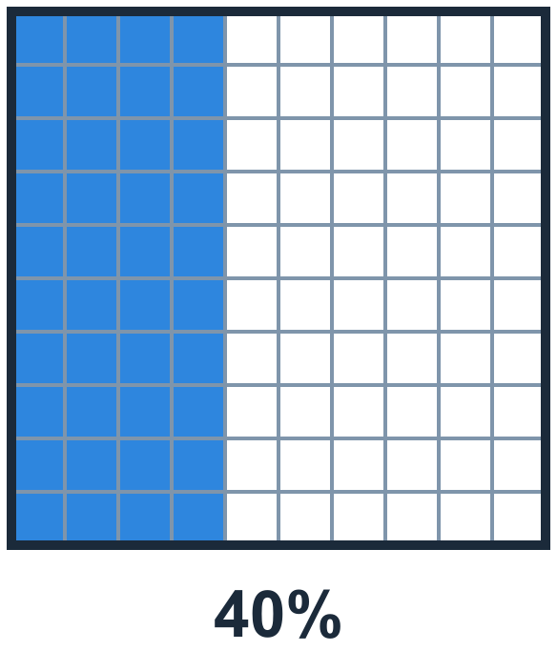
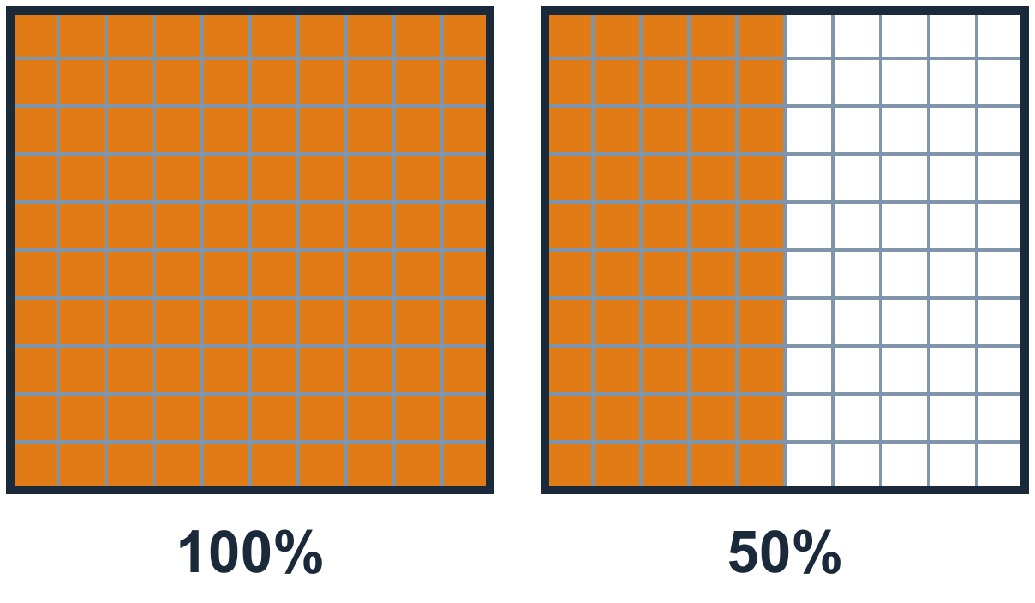
Summarize
LEARN
Less than 100%
More than 100%
A percent is a ratio, or rate, that compares a number with 100. 40% is less than one whole.
A percent can be greater than 100%. Then it is more than one whole. 150% = 100% + 50%.
Notes:
Summarize together. Left: less than 100% fits inside one grid. Right: more than 100% needs more than one grid.
Ask a student to explain in their own words why 150% is more than one whole.

Slide 21

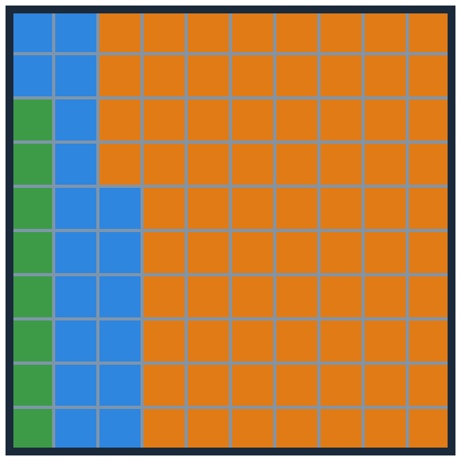
Apply: Car Sales
LEARN
A car dealership sold 100 cars last month: 8 hybrid, 18 all-electric and 74 gas-powered. The owner needs to order 50 more cars from the factory.
Type
Sold
Percent
Hybrid
8
8%
All-electric
18
18%
Gas-powered
74
74%
What percent of the cars sold were gas-powered?
Notes:
100 cars, so every car is 1 out of 100: 1%. The grid shows each car as one square.
Click 1-3: 8%, 18%, 74%. Ask: “What percent were gas-powered?” (74%). Check: 8 + 18 + 74 = 100.

Slide 22
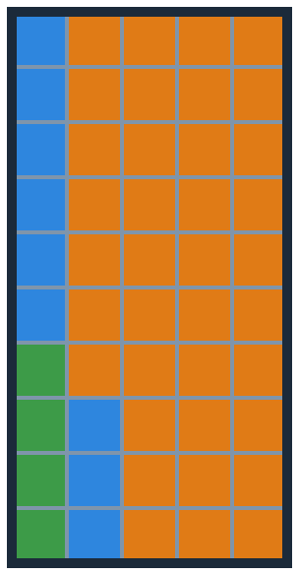
Apply: Car Sales
LEARN
The owner orders 50 more cars, with the same percents as last month. How many of each type should the owner order?
Type
Percent
Order of 50
Hybrid
8%
8% of 50 = 4
All-electric
18%
18% of 50 = 9
Gas-powered
74%
74% of 50 = 37
50 is half of 100, so order half as many of each type: 4 + 9 + 37 = 50 cars
Notes:
Same percents, but out of 50 instead of 100. 50 is half of 100, so each number halves.
Click 1-3: 4 hybrid, 9 all-electric, 37 gas-powered. Click 4: check, 4 + 9 + 37 = 50.

Slide 23
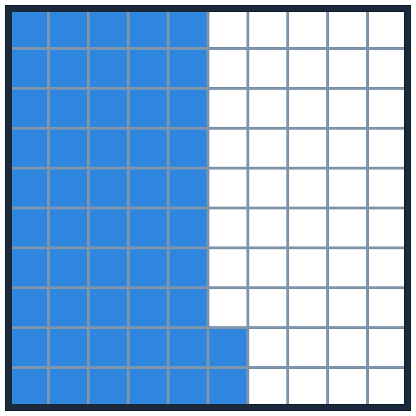
Practice
PART 3
Models and real-life percents
Notes:
Part 3: practice. First, read the percent from a model. Then, real-life problems.

Slide 24



What percent does the model show?
PRACTICE
1
Tape diagram
2
Hundredths grid
3
7/10 = ?/100 = ?%
3 × 10% = 30%
52 out of 100 = 52%
7/10 = 70/100 = 70%
Notes:
Exercises 1-3. Students write the percent first, then click to check each one.
1: each part of 10 is 10%, so 3 parts = 30%. 2: 5 columns and 2 squares = 52%. 3: 7/10 = 70/100 = 70%.

Slide 25
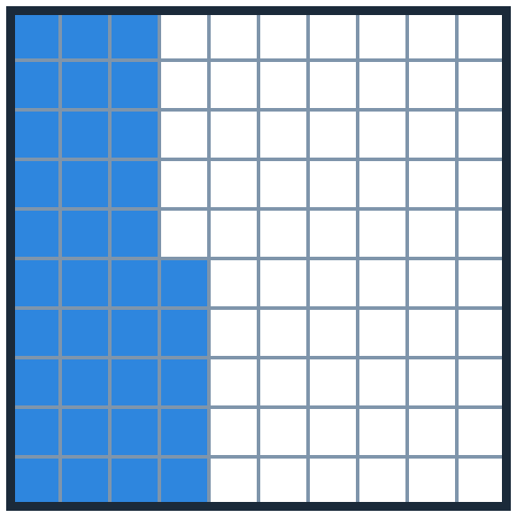
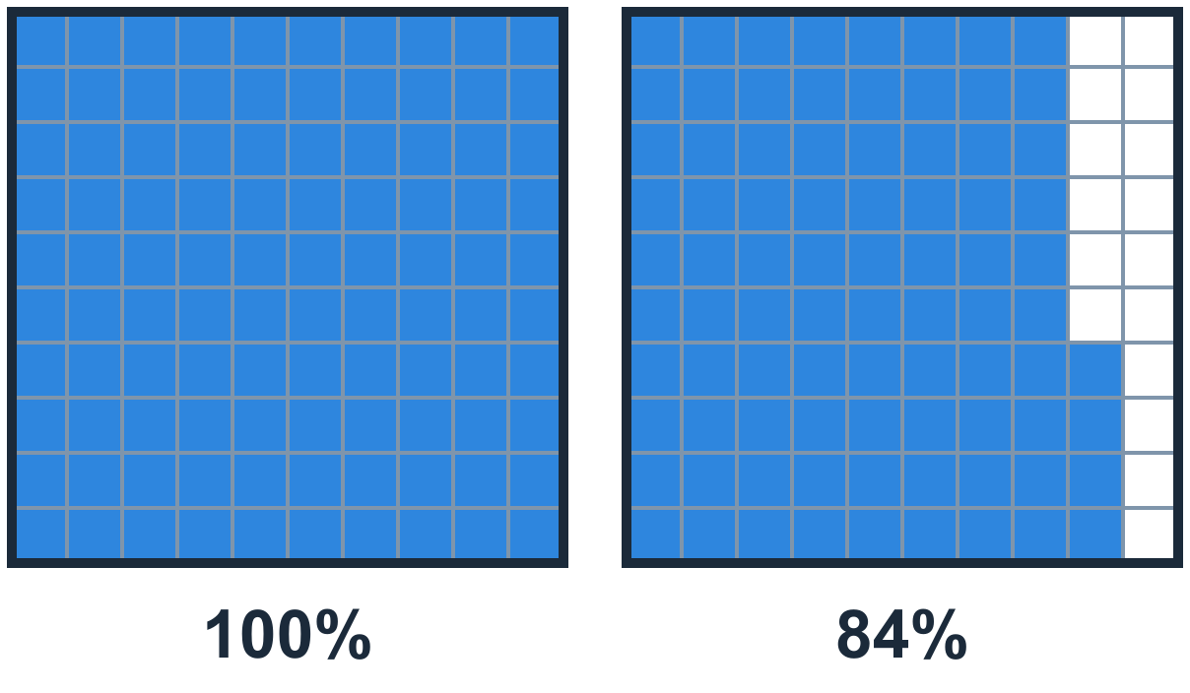
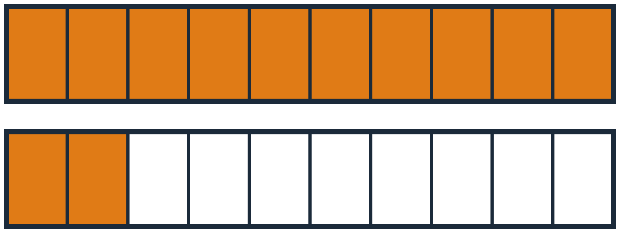
What percent does the model show?
PRACTICE
4
12/10 = ?/100 = ?%
5
?/100 = ?%
6
?/100 = ?%
12/10 = 120/100 = 120%
35/100 = 35%
184/100 = 184%
Notes:
Exercises 4-6. Two of them are more than one whole.
4: 12 tenths = 120 hundredths = 120%. 5: 35%. 6: one whole grid and 84 squares = 184%.

Slide 26

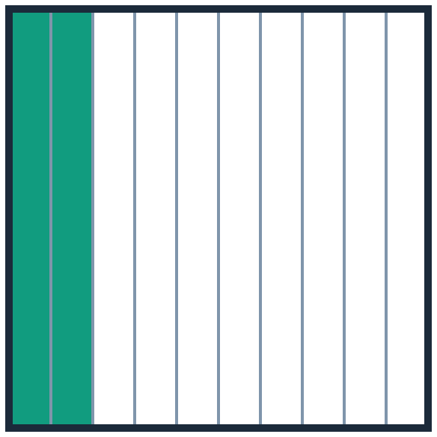
The new restaurant
PRACTICE
In a school survey, 2 out of every 10 students said they had tried the new restaurant in town.
2%
A
20%
B
80%
C
What percent of the students had tried the new restaurant?
Click an answer to check it.
Notes:
Interactive question: in Slide Show, click (or let a student tap) an answer card. A correct answer opens a “Correct!” slide; a wrong answer opens a hint and then returns to the question.
Answer: B, 20%. (2% would mean 2 out of 100.)

Slide 27
The new restaurant · answer
Correct!
2 out of 10 = 20 out of 100 = 20%. Each strip is 10%.
Next ▶
◀ Back to the question
Notes:
Hidden slide: it opens only when a student picks the correct answer on the question slide.
Read the explanation aloud, then click Next.

Slide 28
The new restaurant · hint
Not quite. Try again!
Each strip is 1 student out of 10, which is 10 out of 100. How much are 2 strips?
◀ Try again
Notes:
Hidden slide: it opens when a student picks a wrong answer.
Use the hint, then click Try again to go back to the question.

Slide 29
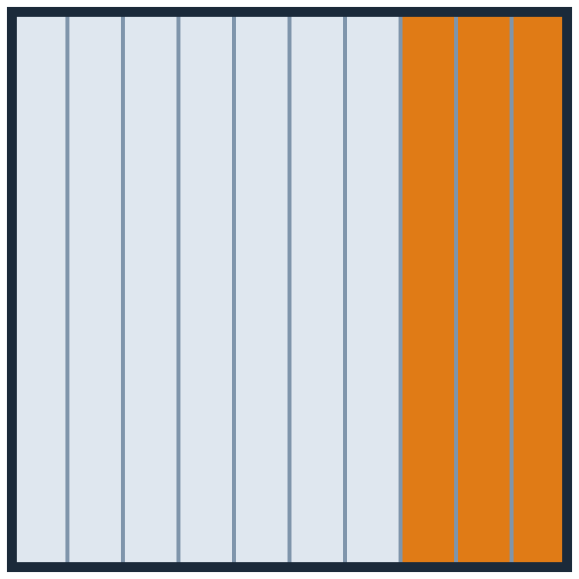
Cars in a car park
PRACTICE
7 out of every 10 cars in a car park are white.
70%
A
30%
B
3%
C
What percent of the cars are NOT white?
Click an answer to check it.
Notes:
Interactive question: in Slide Show, click (or let a student tap) an answer card. A correct answer opens a “Correct!” slide; a wrong answer opens a hint and then returns to the question.
Answer: B, 30%. 70% are white, and 100% − 70% = 30% are not.

Slide 30
Not white · answer
Correct!
3 out of 10 cars are not white. 3 out of 10 = 30 out of 100 = 30%.
Next ▶
◀ Back to the question
Notes:
Hidden slide: it opens only when a student picks the correct answer on the question slide.
Read the explanation aloud, then click Next.

Slide 31
Not white · hint
Not quite. Try again!
70% of the cars ARE white. Count the strips that are not white.
◀ Try again
Notes:
Hidden slide: it opens when a student picks a wrong answer.
Use the hint, then click Try again to go back to the question.

Slide 32
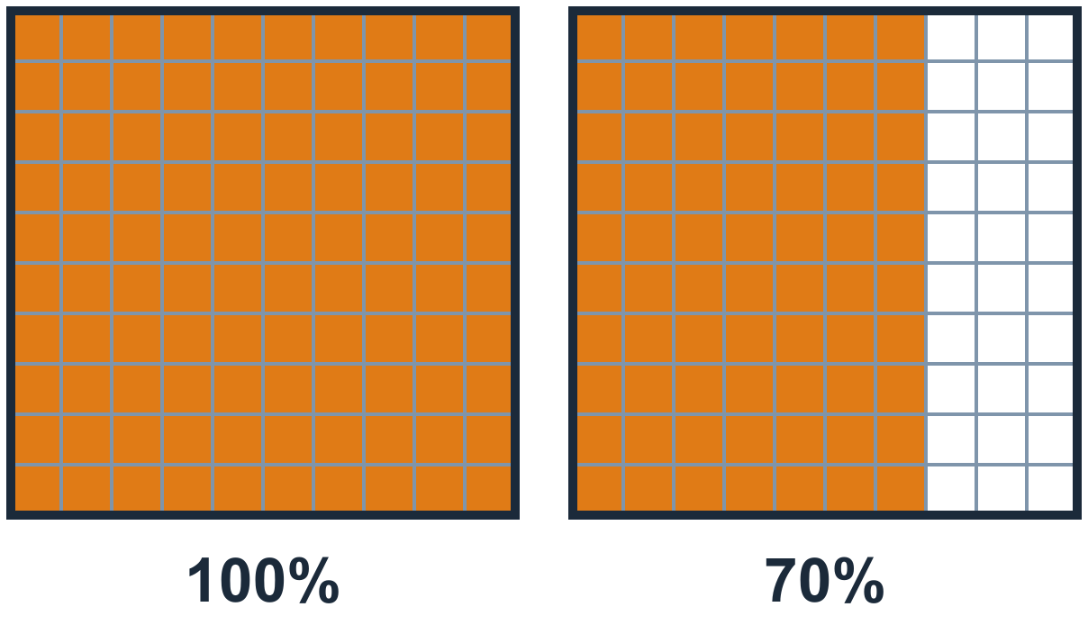
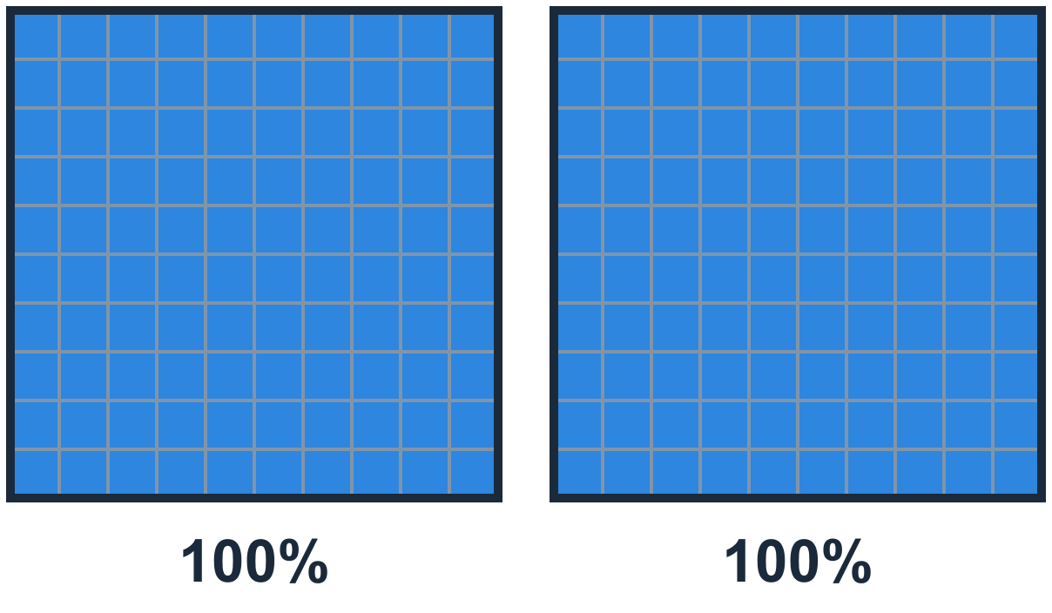
More than one whole
PRACTICE
Popcorn
Sharks
The size of a medium popcorn is 1.7 times the size of a small popcorn. What percent of the small popcorn’s size is the medium popcorn?
An Atlantic blacktip shark can grow to be 6½ feet long. A mako shark is 2 times as long as a blacktip shark. Write a percent that compares the mako with the blacktip.
1.7 × 100% = 170%
2 × 100% = 200%
Notes:
Both are more than one whole. The small popcorn and the blacktip shark are each the whole: 100%.
Click 1: 1.7 times = 170%. Click 2: 2 times = 200%.
The 6½ feet is extra information: we compare, so we do not need it.

Slide 33
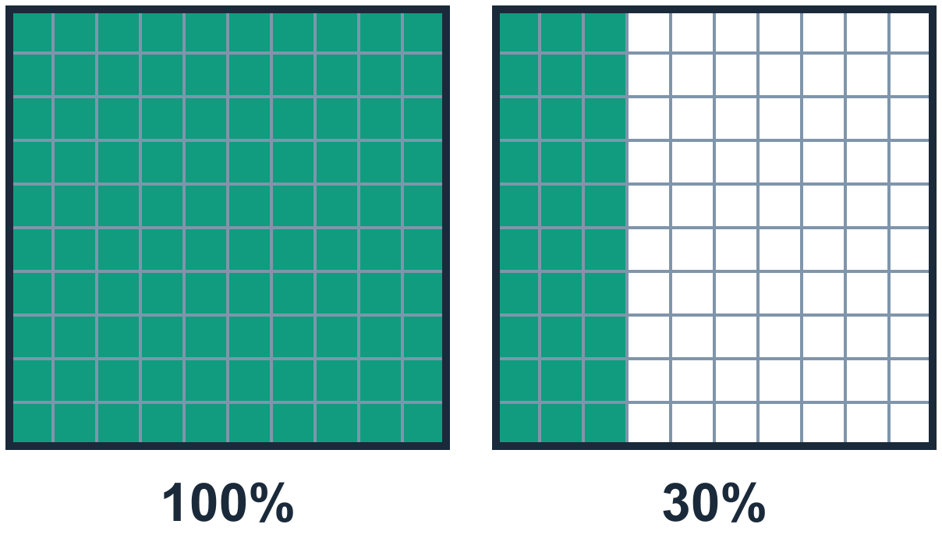
Sofia’s Lemonade
PRACTICE
Sofia sold 1.3 times as many cups of lemonade this week as last week. Each grid is last week’s sales: 100%.
What percent are this week’s sales compared with last week’s sales?
1.3 × 100% = 130%
Did Sofia sell more or less than 30% of last week’s sales this week?
More! 130% = 100% + 30%
Notes:
Exercise 11. Shade one whole grid (last week, 100%) and 30 squares of the second grid.
Click 1: 130%. Click 2: more than 30%: she sold all of last week’s amount and 30% more.

Slide 34



Error Analysis
PRACTICE
“To write a number as a percent, just write the number and then the % sign.”
Andrew
Is Andrew right? Try his rule on 4 out of 10.
No!
4 out of 10 = 40 out of 100 = 40%, not 4%. A percent always compares with 100.
Notes:
Exercise 12. Let students argue first.
His rule only works when the number is already out of 100 (40 out of 100 = 40%).
Click 1: No. Click 2: 4 out of 10 is 40%, not 4%.

Slide 35
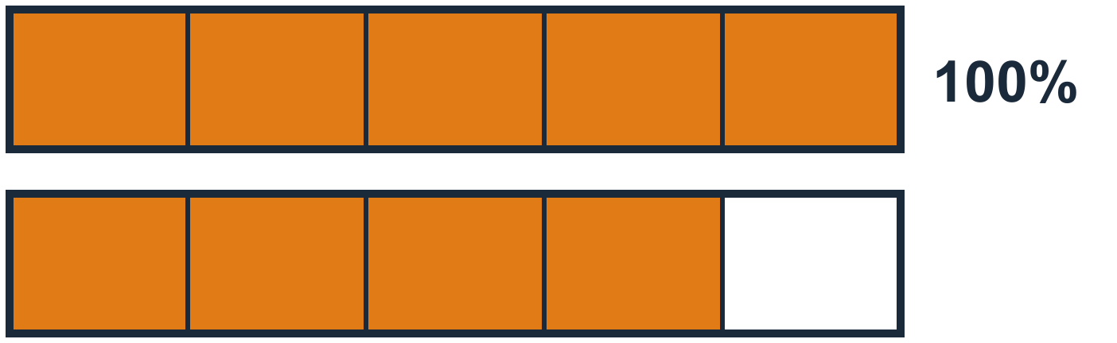
Check
PART 4
Show what you understand
Notes:
Part 4: check your understanding. Students work alone first, then compare with a partner.

Slide 36

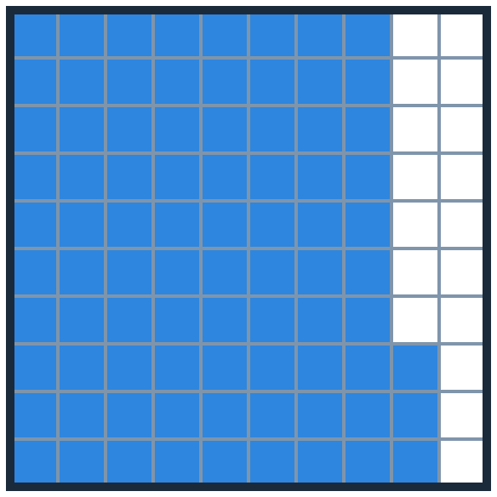
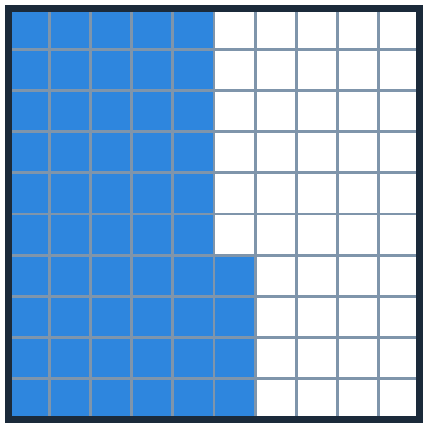

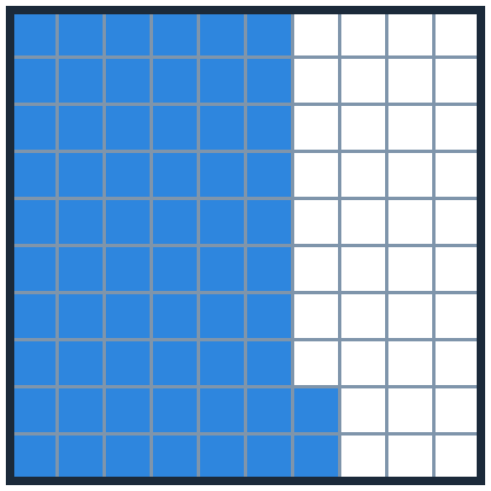
Shade the grid
CHECK
On the last test, 83% of the class earned an A. Shade a grid for each percent.
83%
54%
17%
62%
8 columns + 3 squares
5 columns + 4 squares
1 column + 7 squares
6 columns + 2 squares
Notes:
Exercise 13. Students shade on paper or in the online lesson first.
Each click shows one shaded grid: 83% = 8 columns and 3 squares; 54%; 17%; 62%.

Slide 37

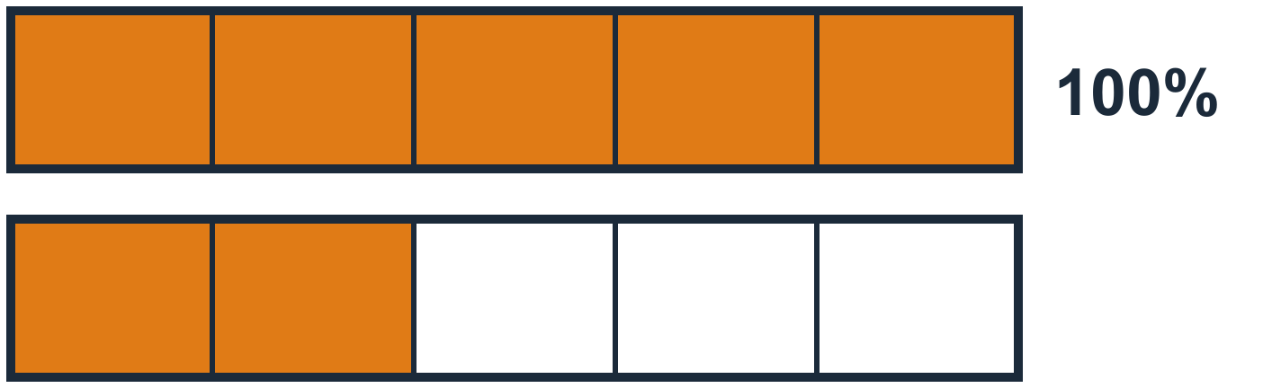
Tape diagram
CHECK
2%
A
20%
B
40%
The top bar is 100%. What percent does the bottom bar show?
C
Click an answer to check it.
Notes:
Interactive question: in Slide Show, click (or let a student tap) an answer card. A correct answer opens a “Correct!” slide; a wrong answer opens a hint and then returns to the question.
Answer: C, 40%. 100% ÷ 5 = 20% per part.

Slide 38
Tape diagram · answer
Correct!
The whole has 5 equal parts, so each part is 20%. 2 parts = 2 × 20% = 40%.
Next ▶
◀ Back to the question
Notes:
Hidden slide: it opens only when a student picks the correct answer on the question slide.
Read the explanation aloud, then click Next.

Slide 39
Tape diagram · hint
Not quite. Try again!
The top bar is 100% and it has 5 equal parts. What is one part worth?
◀ Try again
Notes:
Hidden slide: it opens when a student picks a wrong answer.
Use the hint, then click Try again to go back to the question.

Slide 40
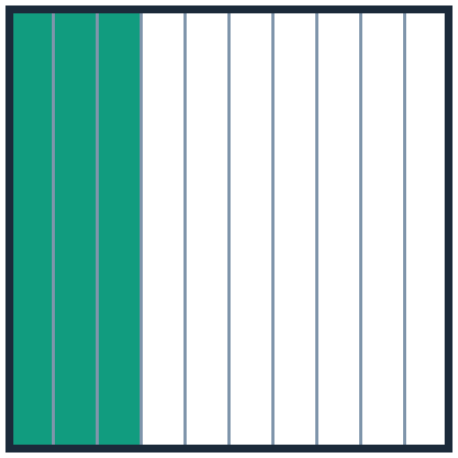
Springfield
CHECK
A survey finds that 3 out of every 10 students in Springfield live more than 2 miles from their school.
What percent of the students live more than 2 miles from school?
3 out of 10 = 30 out of 100 = 30%
Notes:
Exercise 15. Each strip is 1 student out of 10 = 10%.
Click: 3 strips = 30%.

Slide 41
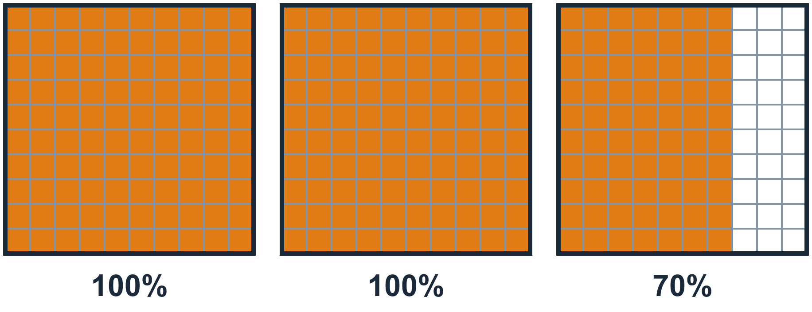
Frozen yogurt
CHECK
A frozen yogurt shop sells 2.7 times as many vanilla frozen yogurts as strawberry frozen yogurts.
0.27%
2.7%
A
B
27%
270%
C
D
Click an answer to check it.
The vanilla sales are what percent of the strawberry sales?
Notes:
Interactive question: in Slide Show, click (or let a student tap) an answer card. A correct answer opens a “Correct!” slide; a wrong answer opens a hint and then returns to the question.
Answer: D, 270%. The strawberry sales are the whole (100%).

Slide 42
Frozen yogurt · answer
Correct!
2.7 times as many = 2.7 × 100% = 270%. Vanilla sells more than strawberry, so the percent is more than 100%.
Next ▶
◀ Back to the question
Notes:
Hidden slide: it opens only when a student picks the correct answer on the question slide.
Read the explanation aloud, then click Next.

Slide 43
Frozen yogurt · hint
Not quite. Try again!
Vanilla sells MORE than strawberry. Should the percent be more or less than 100%?
◀ Try again
Notes:
Hidden slide: it opens when a student picks a wrong answer.
Use the hint, then click Try again to go back to the question.

Slide 44

Is Steve correct?
CHECK
4 out of 5 people in a survey said they would travel by train more often if it cost less. Steve says that 40% of the people said this.
Yes, 40%
A
No
B
Click an answer to check it.
4 out of 5
Notes:
Interactive question: in Slide Show, click (or let a student tap) an answer card. A correct answer opens a “Correct!” slide; a wrong answer opens a hint and then returns to the question.
Answer: B, No. 4 out of 5 = 80%. Steve may have thought of 4 out of 10. But 4 out of 5 = 8 out of 10 = 80 out of 100 = 80%.

Slide 45
Steve · answer
Correct!
No. Each fifth is 20%, so 4 out of 5 = 80 out of 100 = 80% of the people.
Next ▶
◀ Back to the question
Notes:
Hidden slide: it opens only when a student picks the correct answer on the question slide.
Read the explanation aloud, then click Next.

Slide 46
Steve · hint
Not quite. Try again!
40% means 40 out of 100. Is 4 out of 5 the same as 40 out of 100? Look how much of the bar is shaded!
◀ Try again
Notes:
Hidden slide: it opens when a student picks a wrong answer.
Use the hint, then click Try again to go back to the question.

Slide 47

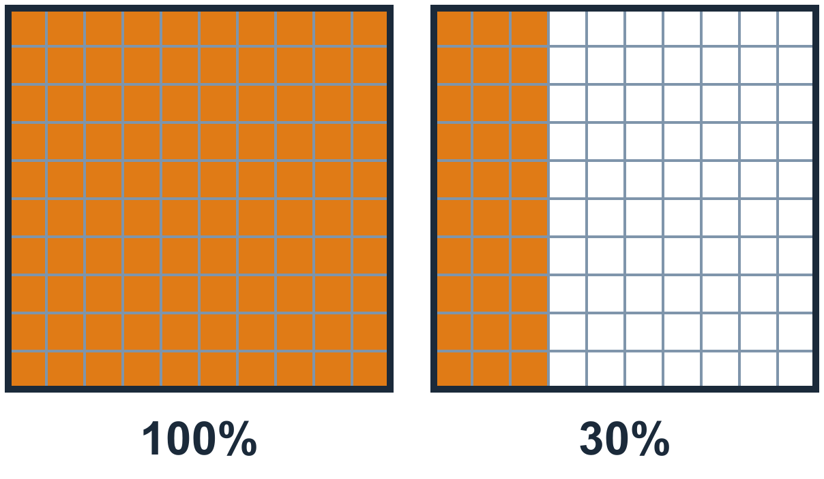
Reflect
WRAP-UP
How are percents less than 100% and percents greater than 100% alike? How are they different?
Think · 1 min
Pair · 2 min
Share
40%
130%
Alike: both compare a number with 100, and both can be shown on grids or tape diagrams. Different: less than 100% is part of one whole; more than 100% is more than one whole, so 130% needs one full grid and 30 more squares.
Notes:
Think (1 minute), pair (2 minutes), share.
Mindset: “Did you change your mind today after hearing a friend’s idea?” Ask two or three students.
Click to show an example answer.

Slide 48


Your turn: practise on your device!
LESSON · 3D models
VIDEO · Watch it again
1
Scan a code
2
Type your name
3
Answer the questions
4
Show your score
Scan a code with a tablet camera
Percent means “per 100”!
Notes:
Students scan one of the two codes. The left code opens the interactive lesson: every question has a 3D model they can turn. The right code opens the explainer video.
At the end, ask them to show you their results screen.

