Slide 1


NTU x Base Web3 Hackathon---Sogni AI SDK Track
NTU Poster Lab
Group Member: Shen YuShu,Song PuChuan,Huang QiYuan,Wang JingHan

Slide 2


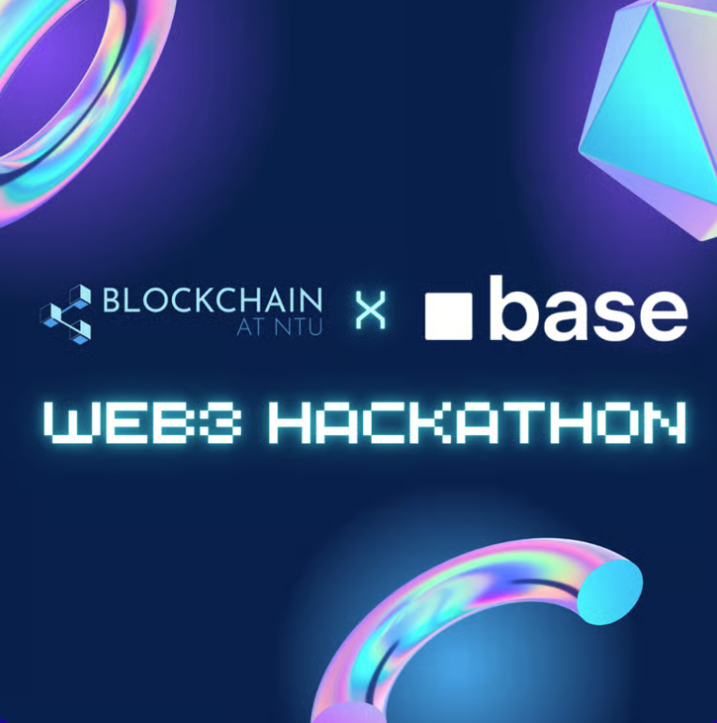
Our Group
Product
Backgroud
Product
Demo
Technical
Highlights
BlockPunk from MSBT

Slide 3

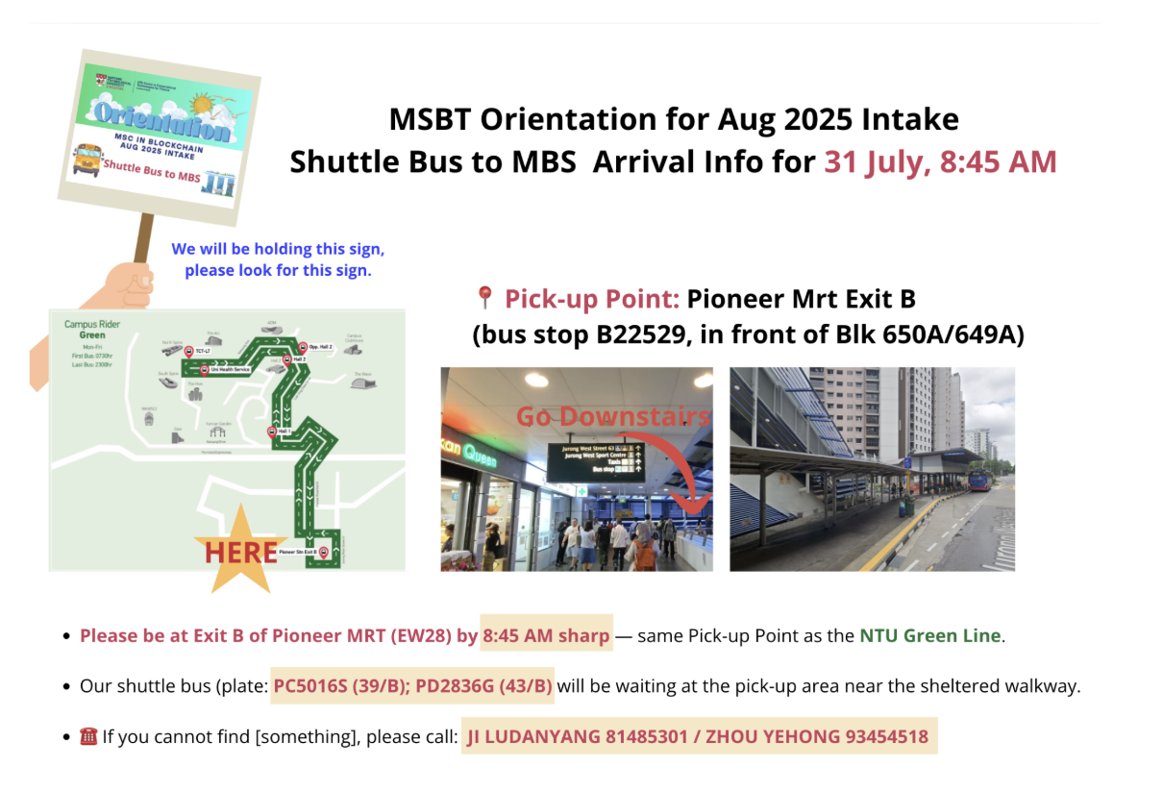
User Pain Points
🎓 NTU&student clubs organize events every day: talks, competitions, gatherings……
🎨 Most organizers lack design skills and make posters look unattractive.
🕒 Manual poster creation is time-consuming and requires tools knowledge.
📉 Poor poster design leads to lower visibility and participation.
Our Value Proposition
⚡ One-click poster generation
→ simply fill in event details.
🎨 Powered by Sogni SDK’s decentralized AI art
→ professional, creative results.
🔄 Multiple variations
→ refresh until you find the perfect design.
📥 Instant download
→ share online or print immediately.
Our Group
Product
Backgroud
Product
Demo
The layout is difficult to conceive, and adjusting information is troublesome
Technical
Highlights
Only text accumulation
without design sense

Slide 4
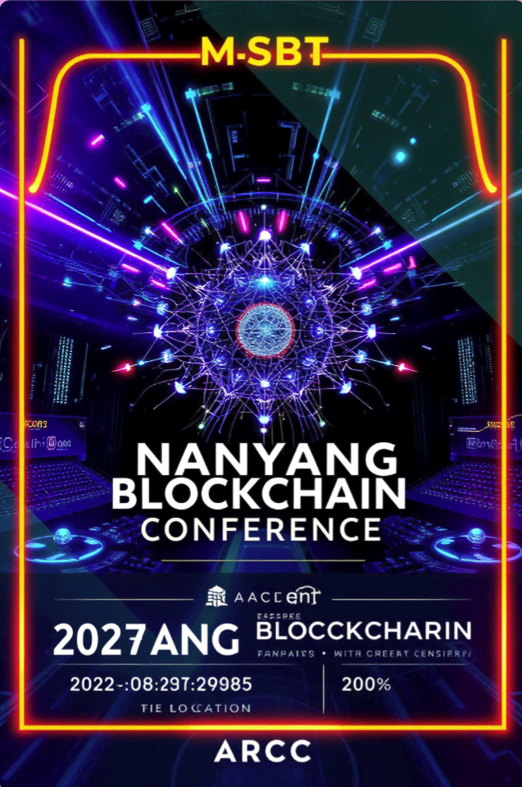

HERE WE ARE
Boost event visibility ：more participants, more engagement.
Save cost ： no need to hire designers.
Save time ： just enter the infomation of activity,and the poster will ready in seconds.
Scalable ： beyond campus——businesses, communities, personal events,and you can choose the unique style as you like!
Our Group
Product
Backgroud
Product
Demo
Technical
Highlights
Generate Example

Slide 5
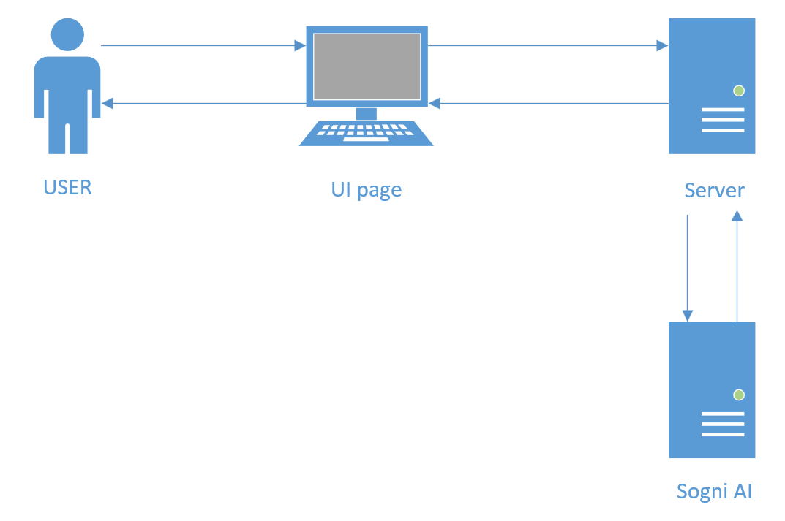
Our Group
Product
Backgroud
Product
Demo
Lets see how it works
Technical
Highlights

Slide 6
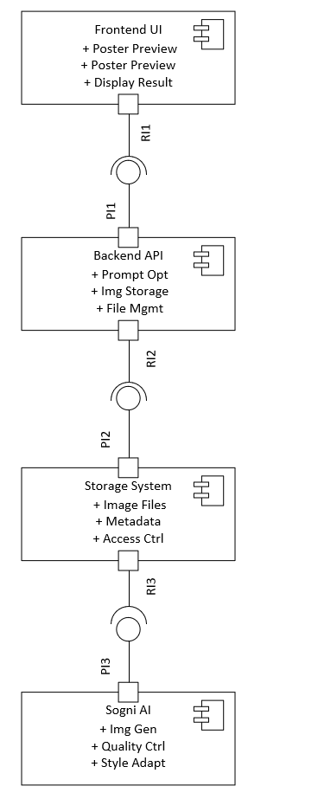
Node.js ： Express to handle backend services.
Sogni AI SDK：Power decentralized art generation.
Prompt Optimization： ensure better results and avoids text-quality issues.
Redis： Helps with caching and session management.
Storage System : Organize posters with metadata and access control.
Our Group
Product
Backgroud
Product
Demo
Technical
Highlights
UML Component Diagram

Slide 7
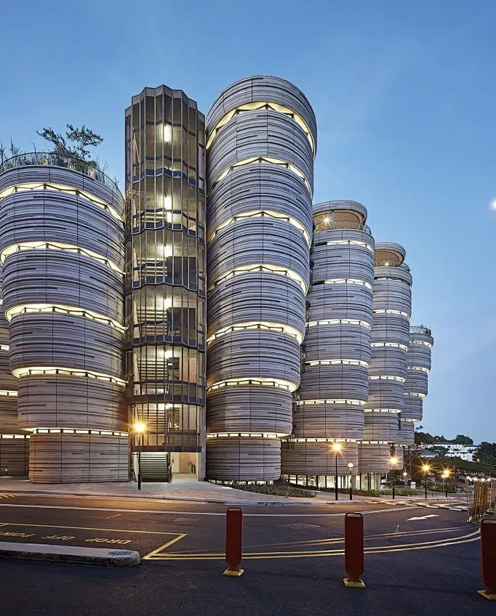
THANKS FOR WATCHING
Presenter:Song PuChuan Ieader:Shen YuShu

