Slide 1
U.S Accidents
Abzal Bacchus
R Shiny Project

Slide 2
Background
according to the Centers for Disease Control and Prevention (CDC), Motor Vehicle crashes are the leading cause of death for teens
some of the common causes are inexperience, speeding, not using seat belts, alcohol use and bad weather
car accidents results to property damage, asset losses, injury and in many cases death (driver, passengers, pedestrians)

Slide 3
About the dataset
it’s a countrywide traffic accident dataset which covers 49 states of the United States
the data is collected from February 2016 to December 2019 (ongoing) which uses two APIs which provide streaming traffic event data
these APIs broadcast traffic events captured by a variety of entities, such as the US and state departments of transportation, law enforcement agencies, traffic cameras, and traffic sensors within the road-networks
about 3.0 million accident records in this dataset

Slide 4
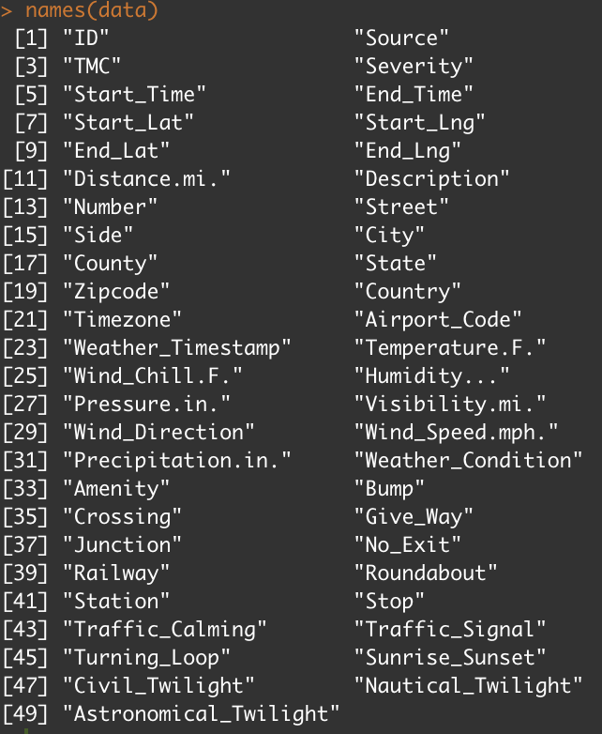

Slide 5
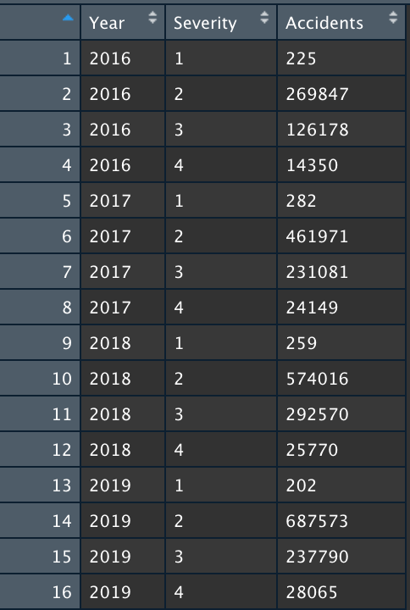

Slide 6
Focus points
I chose to focus on severity which ranges from 1 to 4 (1 being the least impact 4 being the highest)
I also chose to focus on visualizing the accidents among the 49 states and visually see which states had the highest/lowest accidents
I wanted to be able to select among the different years and see how many accidents were reported based on the severity

Slide 7
Why this dataset?
being someone who drives daily, I found this dataset to be appealing
inquiry such as what states have the most/least accidents
how severe were the accidents that were reported?
are there any states that continuously have a high amount of reported accidents?
any sudden increases in accidents in any particular state between two years?

Slide 8
Future work
if given more time, I would like to be able to narrow down which roads/intersections during what time of the day a driver would need to be cautious driving on
provide other insights with other focus points within the dataset such as does incremental weather correlate to accidents
correlation between sunshine and the occurrences of traffic accidents (and likewise for driving at night)
times of the year that accidents are likely to happen

Slide 9
References
Moosavi, Sobhan, Mohammad Hossein Samavatian, Srinivasan Parthasarathy, and Rajiv Ramnath. “A Countrywide Traffic Accident Dataset.”, 2019.
Moosavi, Sobhan, Mohammad Hossein Samavatian, Srinivasan Parthasarathy, Radu Teodorescu, and Rajiv Ramnath. "Accident Risk Prediction based on Heterogeneous Sparse Data: New Dataset and Insights." In proceedings of the 27th ACM SIGSPATIAL International Conference on Advances in Geographic Information Systems, ACM, 2019.
Centers for Disease Control and Prevention (CDC). WISQARS (Web-based Injury Statistics Query and Reporting System). US Department of Health and Human Services; September 2019. Available at https://www.cdc.gov/injury/wisqars/index.html. Accessed 2–3 October 2019.

Slide 10
Link
https://abzalb.shinyapps.io/RShinyApp/

