Slide 1
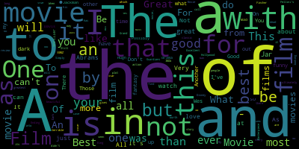
IMDB Analysis
Abzal Bacchus

Slide 2
Background
IMDB is one of the many used websites that people use to decide if a movie is worth watching
users can access movie ratings, and they can read different reviews on the movie to see why/why not it was well rated
having access to movie reviews in addition to ratings allows potential viewers to determine whether a movie would be good/not so good to watch

Slide 3
About the project
IMDB Top 250 Rated Movies (1921- 2017 )
scrapy
I wanted to analyze any correlation between genre and gross
general trend for ratings
least/most favorable genres
first movie to be in color was Cupid Angling (1918)

Slide 4
Information obtained from scraping:
genre
gross
reviews
length of the movies (in minutes)
rating
score
title
year

Slide 5
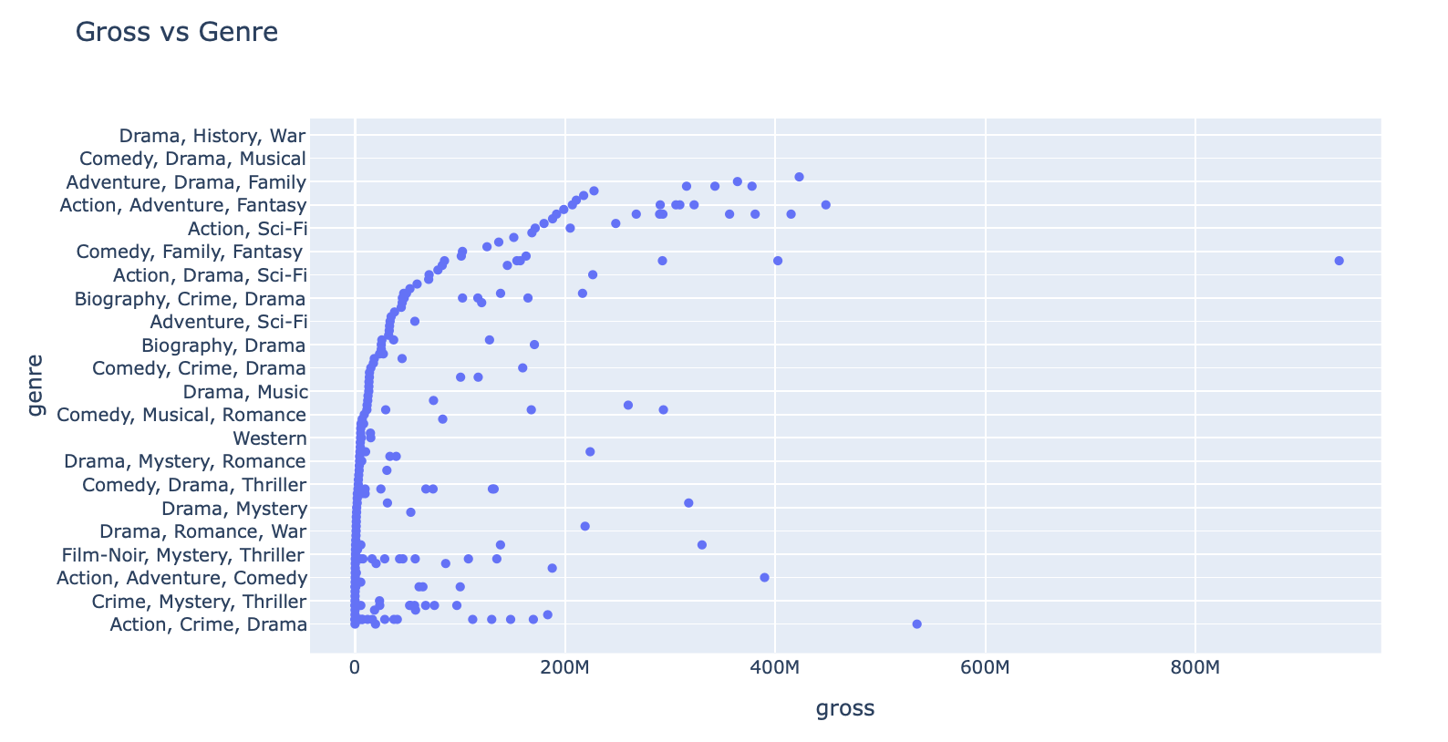

Slide 6
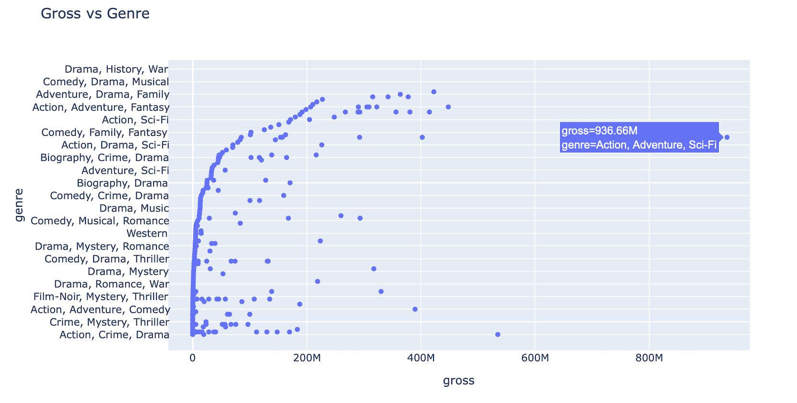

Slide 7
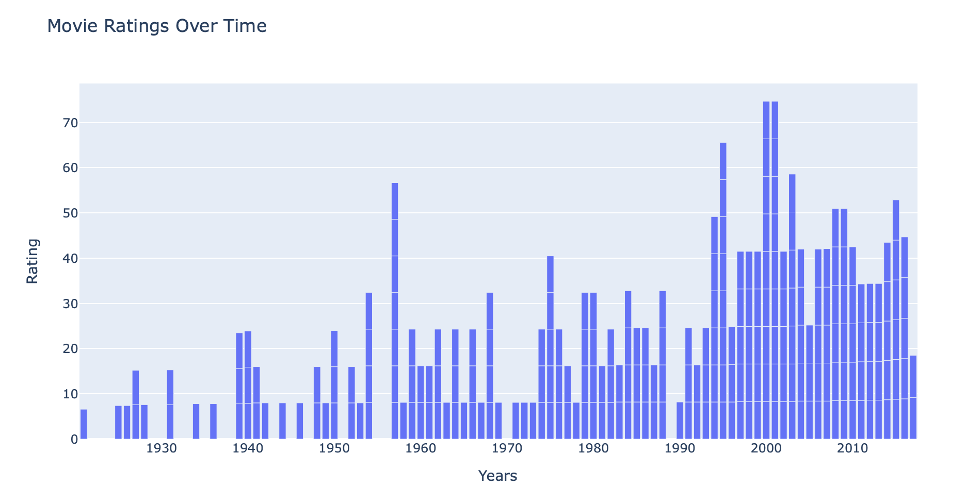

Slide 8
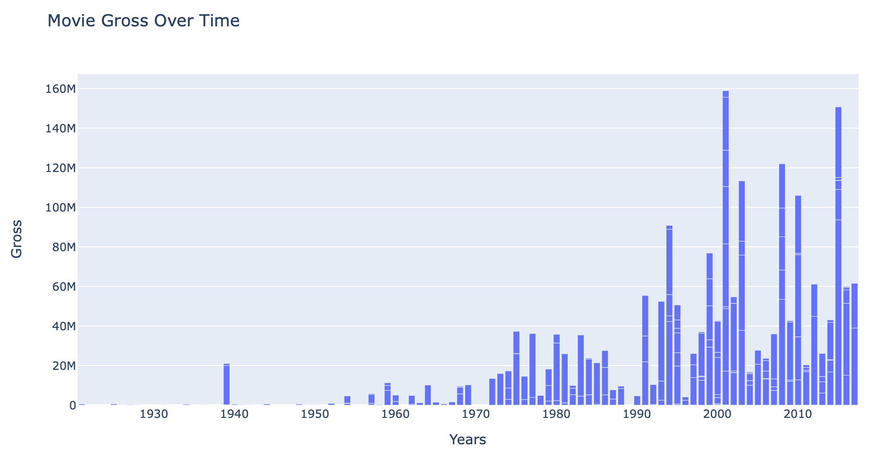

Slide 9
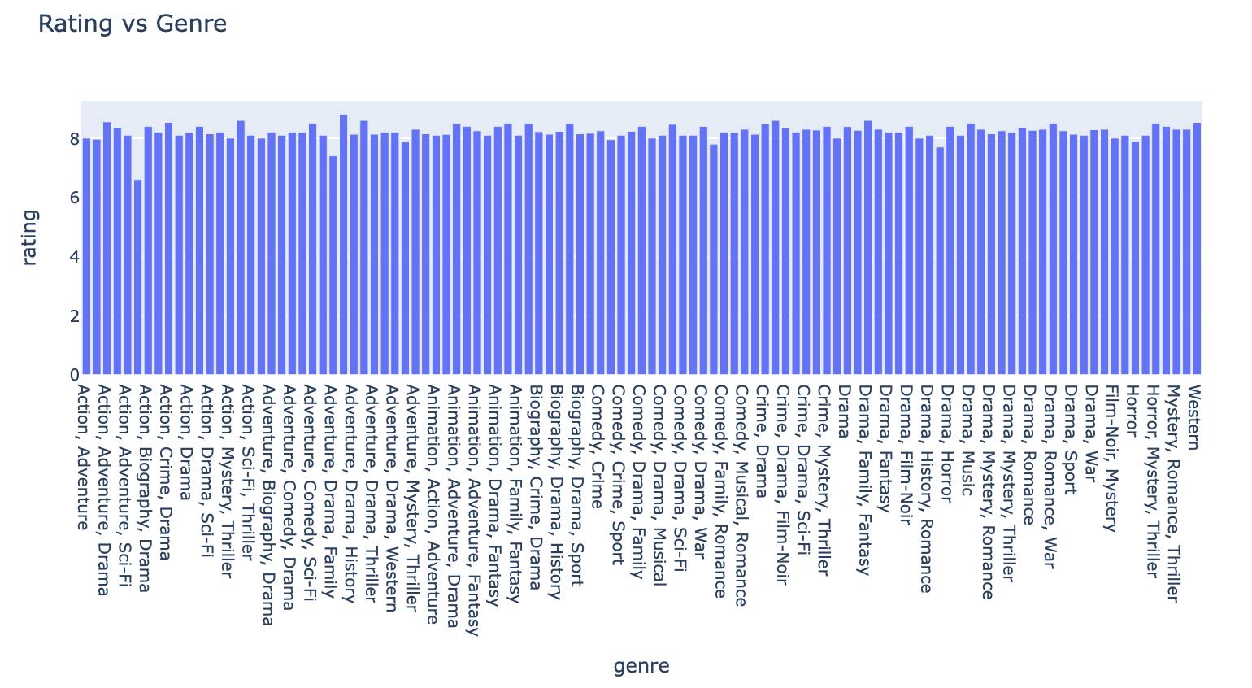

Slide 10
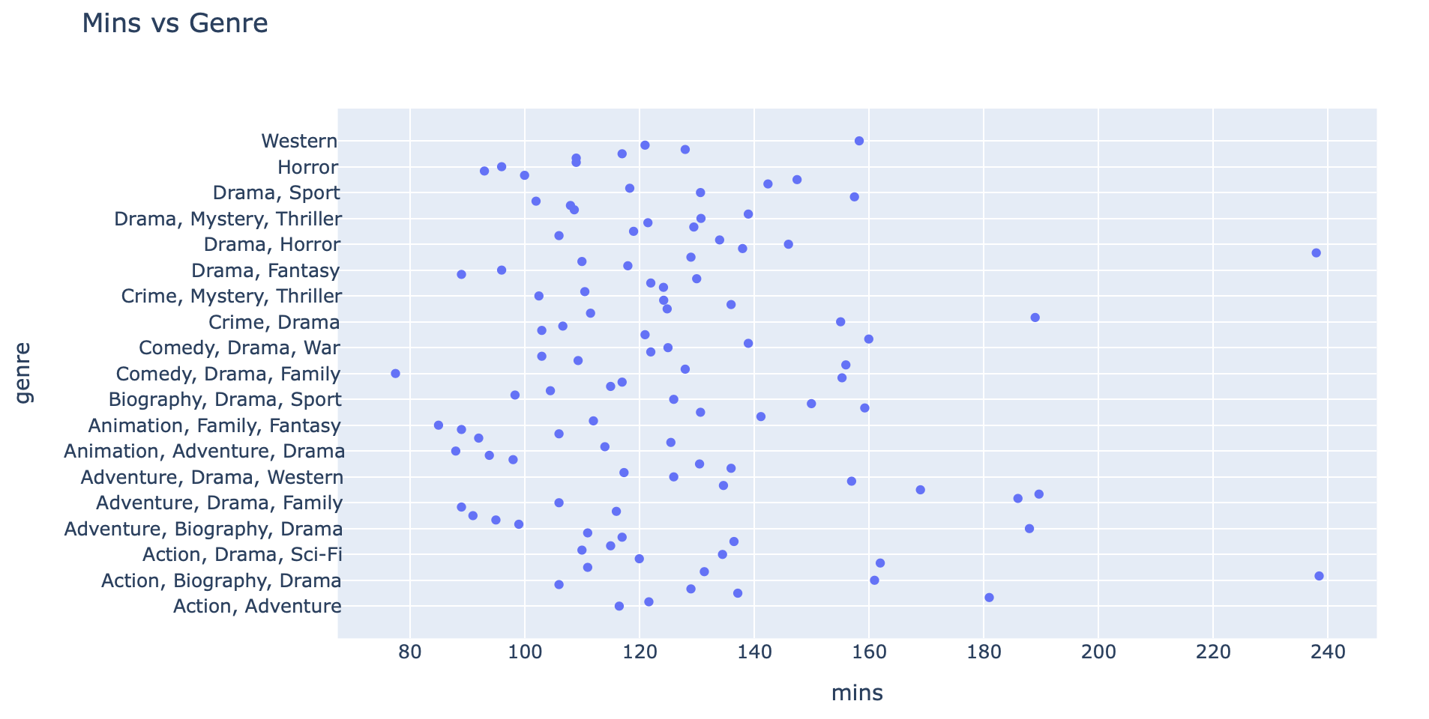

Slide 11
Future Work
I would like to analyze the average profit from directors and the ratings they receive
split between color and black and white films to gain more insights
incorporate how different genders/ages play a role in ratings
determine a way to detect any possible sarcasm in the ratings

Slide 12
References
https://www.imdb.com/chart/top/?ref_=nv_mv_250
https://plot.ly/python/time-series/

