Slide 1
CEDR
Creating a Community Economic Development Roundtable
Technology will feed data to the participants for their discussions and decisions

Slide 2
GUIDING PRINCIPLES
Open conversations leading to recommendations and options
Diversity and Inclusion
Outreach to those that are less digitally savvy
Create interconnected, value-added economy so the money stays in the community
Emphasize Social Purpose Corporations structure
B Corp is to business what Fair Trade certification is to coffee or USDA Organic certification is to milk.
https://www.bcorporation.net/
March 30, 2012 Washington State legalized Social Purpose Corporations
Environmentally conscious & Clean Tech businesses
Capability building
Close education and opportunity gap
Support work life balance
Have childcare/healthcare – dentistry and pet care closer to Kenmore residents

Slide 3
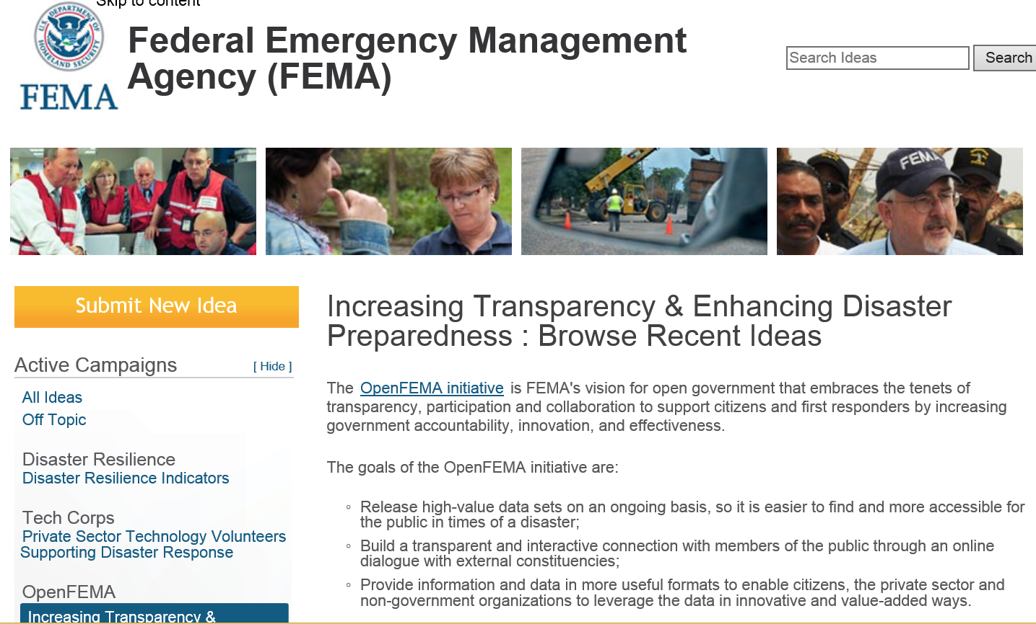
MODELLED AFTER EXISTING THINK TANKS
By Idea Scale
Notes:
FEMA recognizes that the best solutions to the challenges we face are generated by the people and the communities who are closest to these challenges. Therefore, they are reaching out to state, local, and tribal governments, and to all members of the public, including the private sector, the disability community, and volunteer community, to seek their input on how to improve the emergency management system.

Slide 4
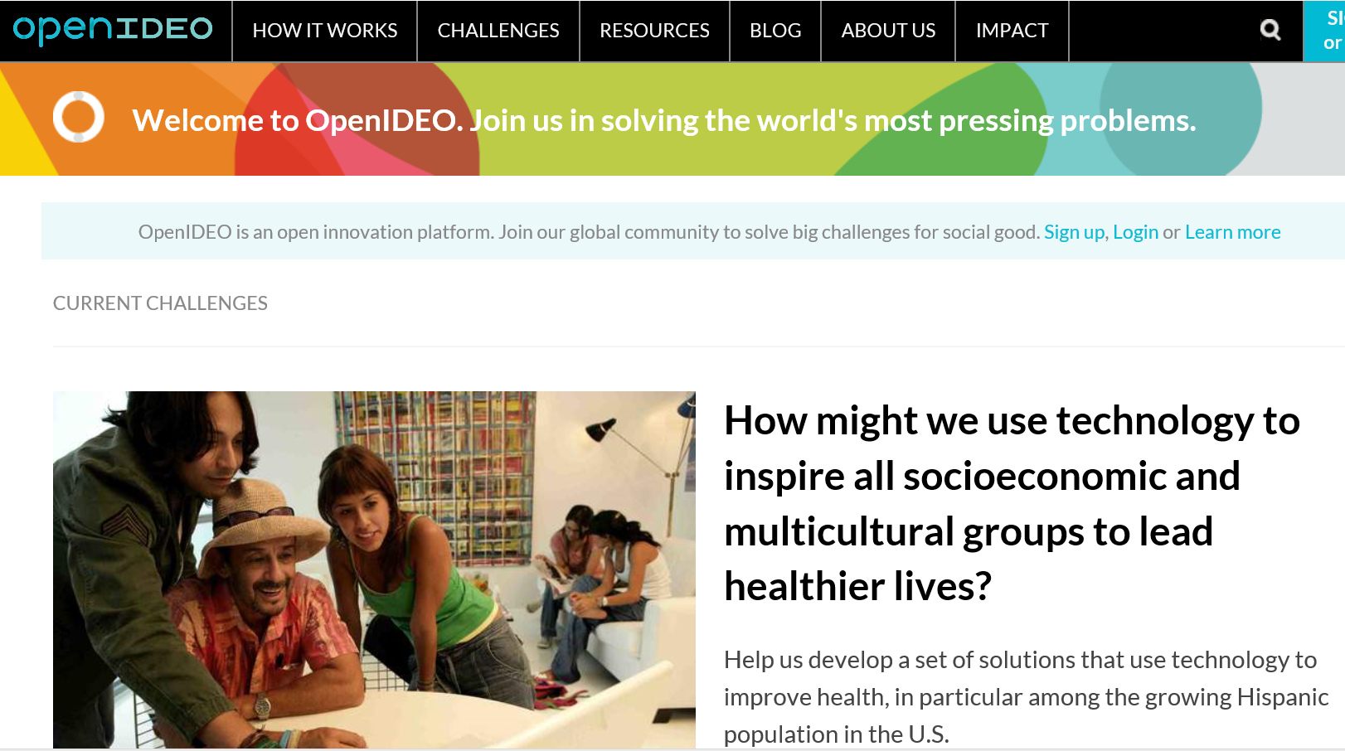


Slide 5
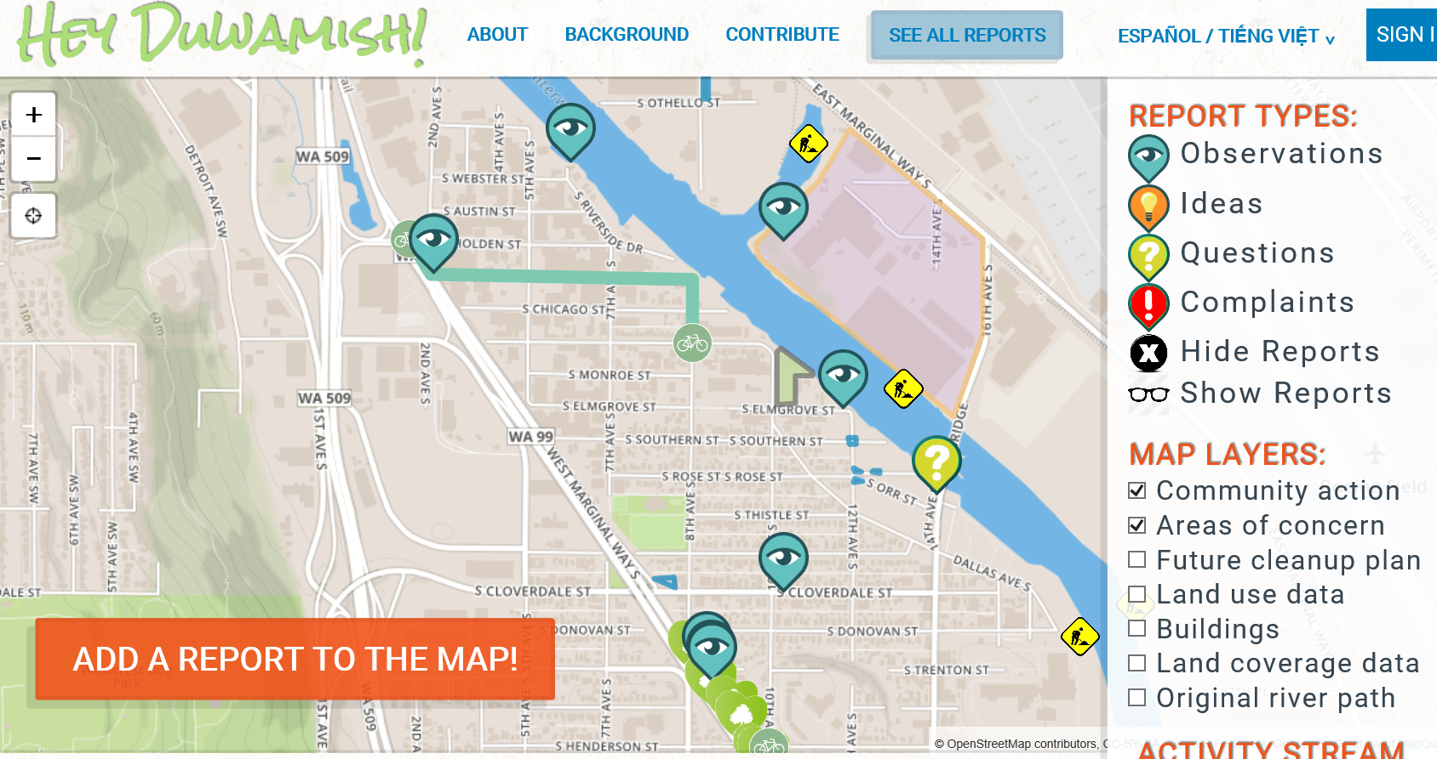

Slide 6
THEMES
What areas in the city will need healthcare services?
Demographics – gaining populations
What kind of healthcare needed
Healthcare deserts
Availability of workplace clinics
Expand Bastry’s presence
Connect current incubator to would be entrepreneurs – especially those who need to be encouraged to be entrepreneurs
What support services in addition to those already provided?
Extend the Incubator
To existing businesses in Kenmore
To invite businesses to relocate to Kenmore
To create a program of “Giving Back”
Clean Technology
Education sector/business

Slide 7
EXAMPLE OF STORIES AND FEATURES
As a ….
I want …
So that …
Target VA ADA housing construction
Target SEIU Training Partnership
Home healthcare professions
WA state incentive money for Health Homes
Home health monitoring – electronic and human services
Transfer of Care needs of large hospitals in surrounding area
Support of Accountable Care Organizations
What is the current education level of Kenmore residents?
What level is needed to develop businesses or entice businesses to relocate?
Identify “cusp” populations
Identify veteran populations
Identify current location and type of healthcare businesses
Dentistry
Pet care
Work place clinics
Urgent care and lab facilities

