Slide 1
IDENTIFICATION OF OPTIMUM DRUG COMBINATION FOR CANCER USING BOOLEAN NETWORKS
PRESENTED BY
ABHISEK KARMAKAR
ARGHA NANDAN
BISHAL SAHA

Slide 2
PROBLEM STATEMENT
Simulation of faults in a Boolean network inferred from a GF signaling pathway
Identification of optimum drug therapy to nullify the effects of faulty conditions

Slide 3
PROBLEM OBJECTIVE
Convert a signaling pathway into a Boolean network using pathway logic
Identify unique input vector
Simulate single and multiple faulty conditions
Apply drug combinations on faulty networks
Prescribe optimum therapy

Slide 4
SIGNALING PATHWAYS

Slide 5
SIGNALING PATHWAYS
Consists of a group of molecules in a cell
Control cell functions, such as cell division and cell death
Each molecule receives a signal, which is transmitted to other molecules down the pathway
GF pathway contains protein-protein interactions which govern cell division

Slide 6
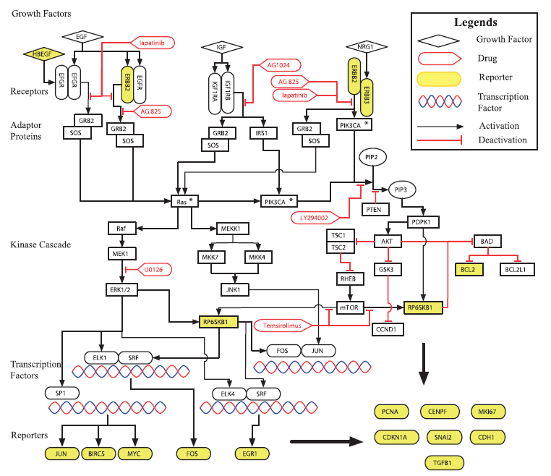
GROWTH FACTOR SIGNALING PATHWAY

Slide 7
BOOLEAN NETWORKS

Slide 8
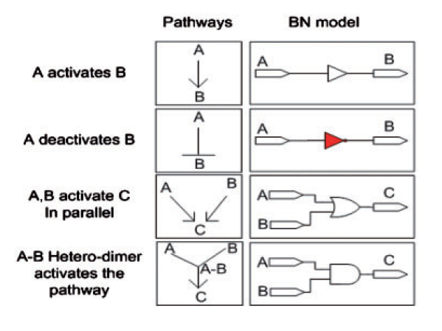
PATHWAY LOGIC
Defines the conversion of interactions in signaling pathways into their Boolean equivalents

Slide 9
BOOLEAN NETWORKS
Converted from a signaling pathway
Consists of nodes and edges
Nodes represent proteins
Edges represent Boolean interactions
Nodes hold values of 0 or 1
0 – inactive protein
1 – active protein

Slide 10
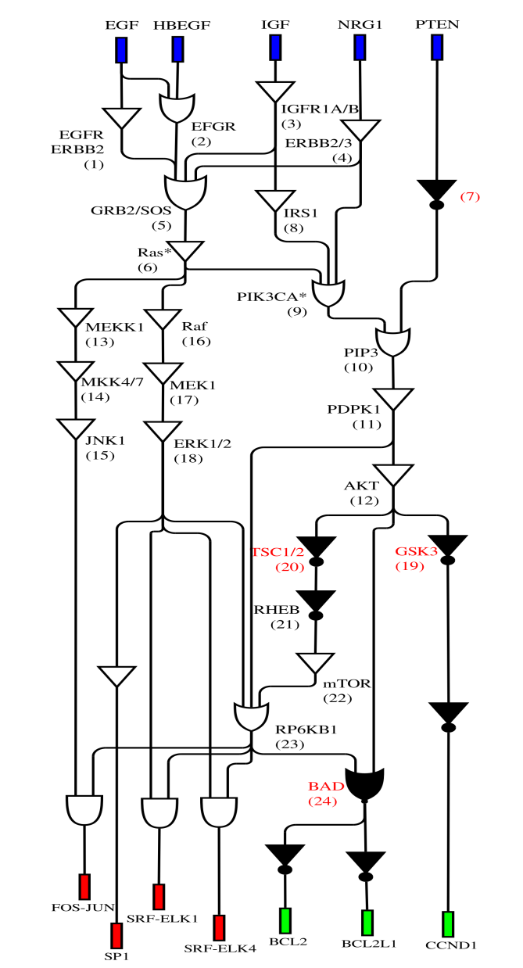
BOOLEAN NETWORK CONVERTED FROM GF SIGNALING PATHWAY

Slide 11
FAULTS AND DRUG THERAPY

Slide 12
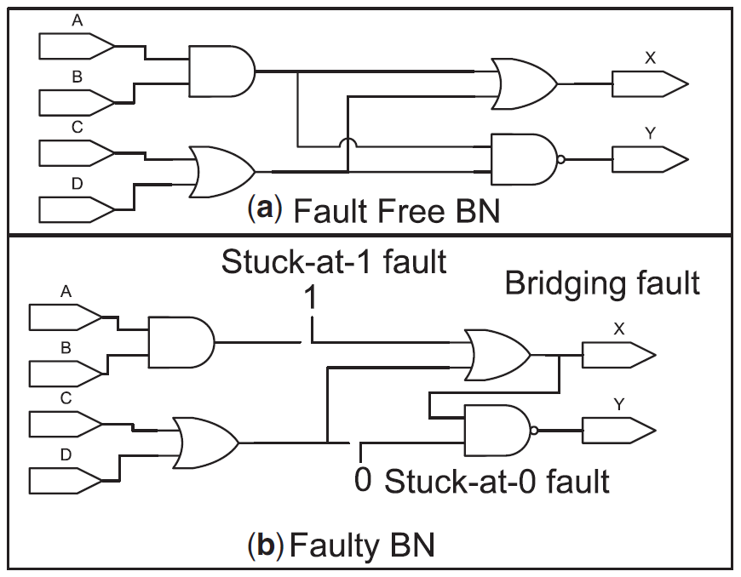
FAULTS
Malfunctions in the BN
Getting stuck to a state, or incorporation of new interactions
Faulty states reflect the states of nodes further down the network

Slide 13
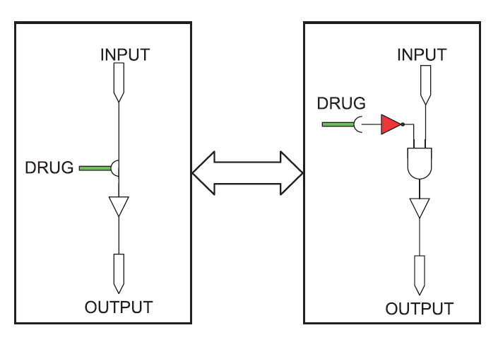
DRUG THERAPY
Drug: substance that inhibits a protein
Stuck-at-1 and stuck-at-0 nodes both are inhibited

Slide 14
GPU ACCELERATION
Multiple fault modeling takes hours
CPU provides a few parallel threads
GPU provides hundreds of threads at once
Greatly reduces execution time
CPU provides 8 threads
GPU provides 1024 threads
Decreases execution time 2¹⁰⁻³ = 2⁷ folds

