Slide 1
Identification of Optimum Drug Combination for Cancer Using Boolean Networks
Presented by
Abhisek Karmakar
Argha Nandan
Bishal Saha

Slide 2
INTRODUCTION
Cancer is causes when cells divide in an uncontrolled way.
This happens due to errors/faults in the protein-protein or gene-gene interactions
Drugs can’t eradicate the faults, but can nullify them to some extent

Slide 3
PROBLEM STATEMENT
Identification and classification of potential faults in a given Boolean Network, inferred from a Growth Factor Signalling Pathway.
Prescription of an optimum drug combination to nullify the faults to maximum extent.

Slide 4
PROJECT OBJECTIVE
Given a Signalling Pathway for cell growth, which will be converted into a Boolean Network.
Identification of an input vector which produces a unique output vector.
Using that input vector to classify the potential faults in the network, which lead to uncontrolled proliferation.
Find a number of drugs and their interference points in the network, i.e. the protiens which they inhibit (deactive).
Find a combination of those drugs which attempts to nullify the faulty network.

Slide 5
RELATED STUDY
Gene Regulatory Network:
Network which consist of genes, proteins, and the interactions between them.
Difficult to analyse computationally, as levels of proteins are continuous, not quantised.
GRN is equivalent to signalling pathway.

Slide 6
RELATED STUDY
Boolean Network:
Converted from a GRN
Consists of a set of nodes n(proteins/genes) where each node denotes the state of the gene/protein
When it is OFF the gene/protein is Inactive and when it is ON the gene/protein is Active

Slide 7
RELATED STUDY
Fault: A fault is defined by any error in the network.
Types of fault:
Stuck-At Fault
Bridging Fault

Slide 8
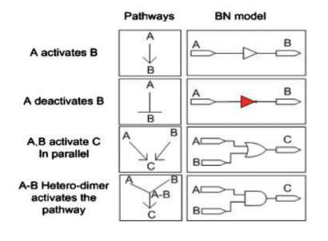
Boolean Network Modeling
Design: Module 1
CSV file containing proteins and their corresponding initial Boolean states
Conversion of given signaling pathway into Boolean logic

Slide 9
Unique Input Vector Identification
Design: Module 2
Executing fault-less Boolean Network
- execution of Boolean Network using all 32 combinations as the input vectors and observe the output vectors.
Identifying Unique Input Vector
-combination which corresponds to an output vector where all the bits are 0’s.

Slide 10
Fault Introduction Into Boolean Network
Design: Module 3
Use the unique input vector for all the operations.
Run the Boolean Network (faulty) with same input vector but changing the fault location each time.
When there is a NOT gate involved, assign a stuck-at-0 fault, assign a stuck-at-1 fault otherwise.
Observe all the output vector generated and classify faults.

Slide 11
Drug Combination Application
Design: Module 4
Drug: inhibits the effect of a particular protein, i.e. deactivation.
Apply drug combination vector on faulty BN.
Stuck-at-1 faults generate Boolean 0, stuck-at-0 faults generate Boolean 1.
Visualize which vector produces output closest to 0000000.

Slide 12
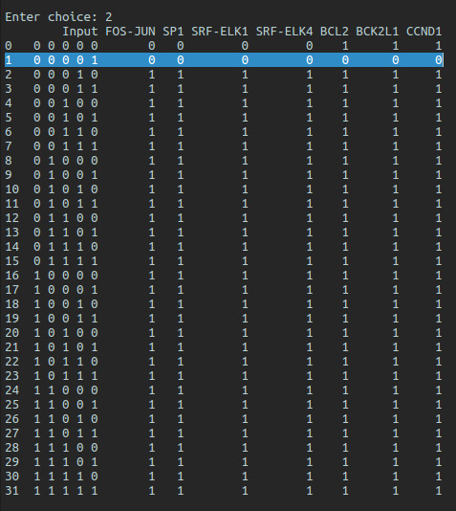
IMPLEMENTATION
DataFrame containing input combinations and their corresponding output vectors
Unique input vector, which produces output vector where all bits are 0’s

Slide 13
CONCLUSION
Laying out a Boolean Network from a Gene Regulatory Network will help us understand the workings of proteins in a simple manner, stemming from the fact that every protein has an ON-OFF feature.
Identification of unique input vector will produce output vectors which signify both proliferative and non-proliferative situations.
Fault location will convey that every gate in the Boolean Network is a potential fault in the system.
Assumption of more than one fault at a given time will produce a more realistic solution to cancerous conditions, while figuring out the drug combination for the faulty network.

Slide 14
FUTURE SCOPE
Introduction of more than two faults if we get increased computation power.
Introduction of bridge faults.

Slide 15
REFERENCES
Ritwik Layek, Aniruddha Datta, Michael Bittner and Edward R. Dougherty,“Cancer therapy design based on pathway logic”, Bioinformatics, Vol. 27,Advance Access 30 December 2010
Osama A. Arshad, Priyadarshini S Venkatasubramani, Aniruddha Datta,Jijayanagaram Venkatraj, “Using Boolean Logic Modeling of Gene Regulatory Networks to Exploit the Links Between Cancer and Metabolism for “Therapeutic Purposes”, IEEE Journal of Biomedical and Health Informatics, Vol. 20, No. 1,January 2016
Frank Emmert-Streib, Matthias Dehmer, Benjamin Haibe-Kains, “Gene regulatory networks and their applications: understanding biological and medical problems in terms of networks”, Frontiers in Cell and Developmental Biology, Mini Review Article, 19 August 2014
Handbook of Computational Molecular Biology, “Chapter 27: Identifying Gene Regulatory Networks from Gene Expression Data”

