Slide 1
Classes
#1 : Dangerous VFL VF
#2 : Special Form VTTdP
#3 : Threatening VT
#4 : Potential Dangerous
#5 : Supraventricular
#6 : Sinus Rhythm

Slide 2
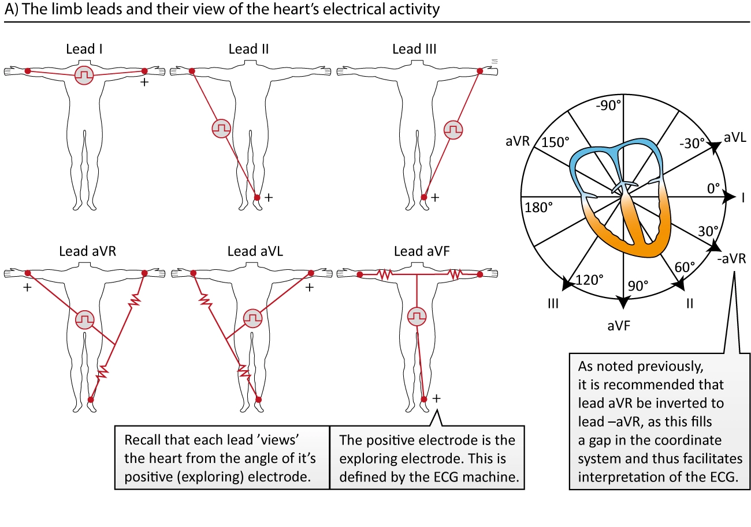
This database contains heart rhythm disturbances necessary for research and is widely used for testing and comparative analysis of various algorithms for detecting arrhythmia threats. The signal is a modified limb leadII (MLII).

Slide 3
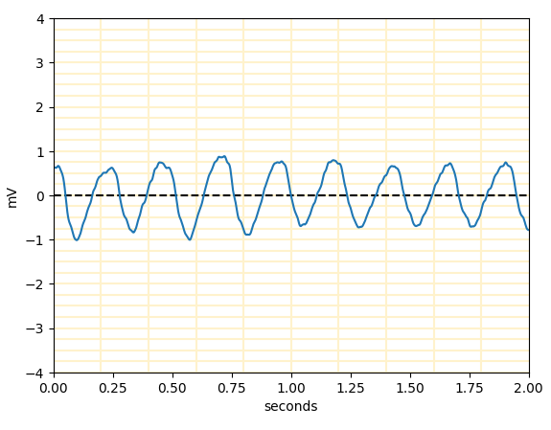
#1 : Dangerous VFL VF
Undetected

Slide 4
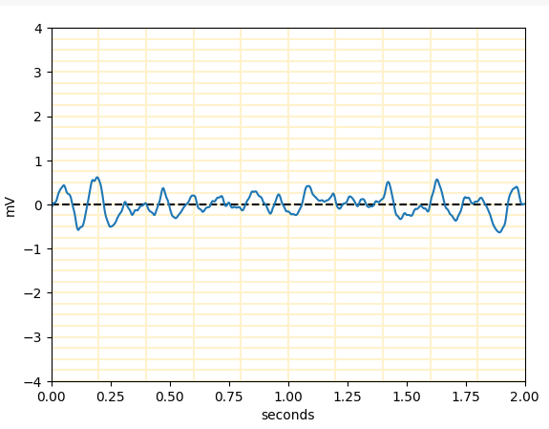
#1 : Dangerous VFL VF
Undetected

Slide 5
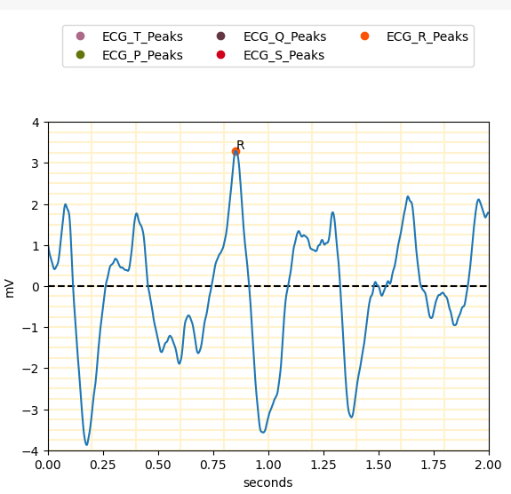
#2 : Special Form VTTdP

Slide 6
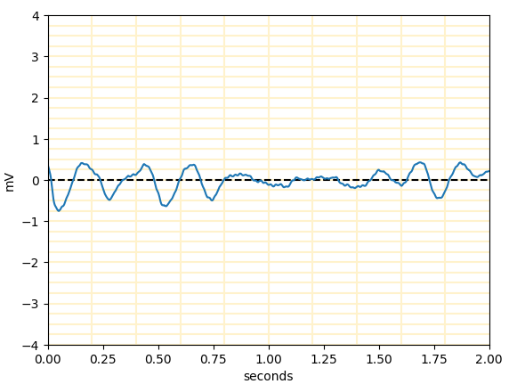
#2 : Special Form VTTdP
Undetected

Slide 7
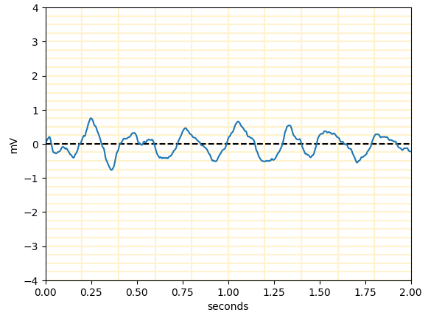
#3 : Threatening VT
Undetected

Slide 8
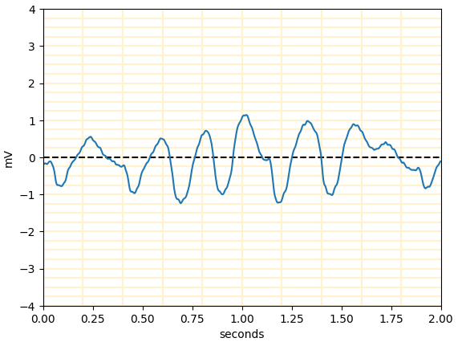
#3 : Threatening VT
Undetected

Slide 9
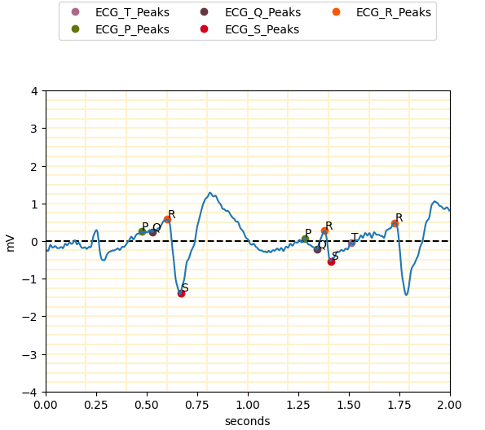
#4 : Potential Dangerous

Slide 10
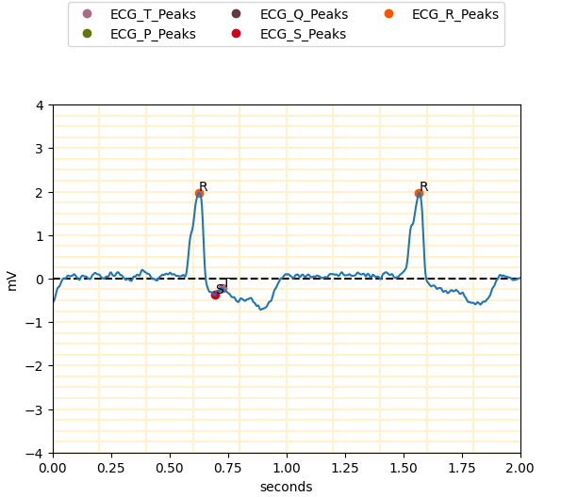
#4 : Potential Dangerous

Slide 11
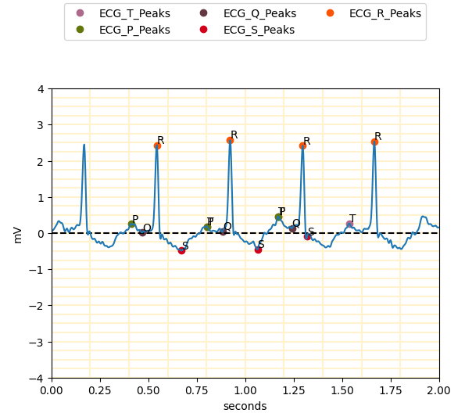
#5 : Supraventricular

Slide 12
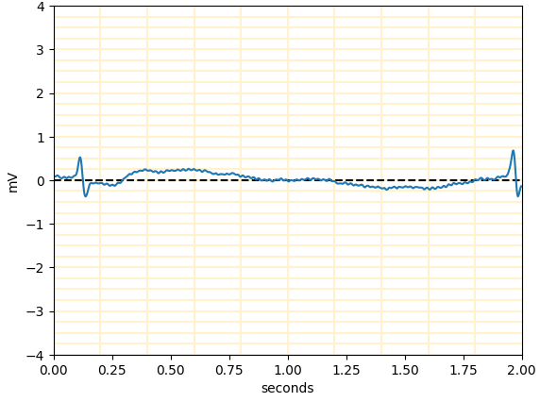
#5 : Supraventricular
Undetected

Slide 13
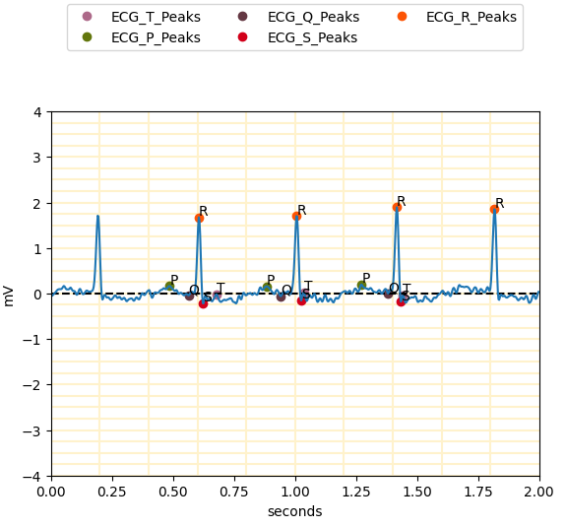
#6 : Sinus Rhythm

Slide 14
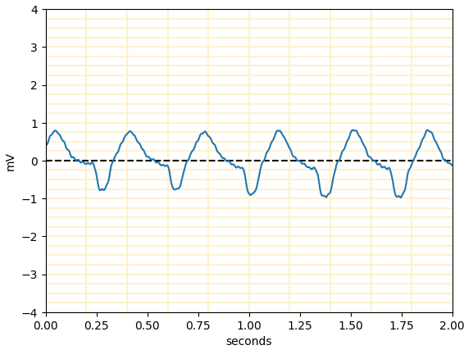
#6 : Sinus Rhythm
Undetected

Slide 15
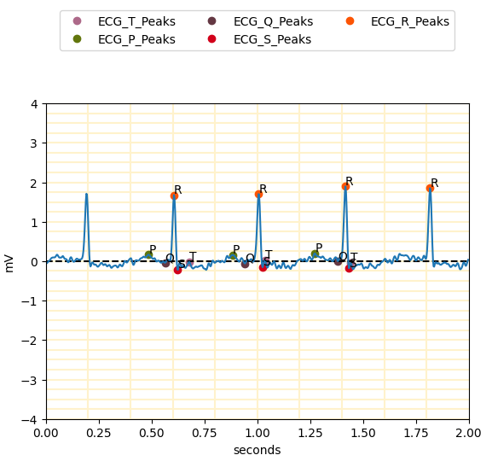
#6 : Sinus Rhythm

