Slide 1
ECG Fragment Database
for
the Exploration
of
Dangerous Arrhythmia

Slide 2
Life-threatening arrhythmias requiring urgent resuscitation:
VFL: ventricular flutter;
VF: ventricular fibrillation.
A special form of life-threatening arrhythmias:
VTTdP: ventricular tachycardia torsade de pointes.
Life-threatening ventricular arrhythmias:
VTHR: high rate ventricular tachycardia (monomorphic and polymorphic).
Potentially dangerous ventricular arrhythmias:
VTLR: low rate ventricular tachycardia (monomorphic and polymorphic);
B: ventricular bigeminy;
HGEA: high degree of ventricular ectopic activity;
VER: ventricular escape rhythm.
Supraventricular arrhythmias:
AFIB: atrial fibrillation;
SVTA: supraventricular tachycardia;
SBR: sinus bradycardia;
BI: first-degree heart block;
NOD: nodal (a-v) rhythm.
Sinus rhythm:
BBB: sinus rhythm with bundle branch block;
N: normal sinus rhythm;
Ne: normal rhythm with single extrasystole.
Classes

Slide 3
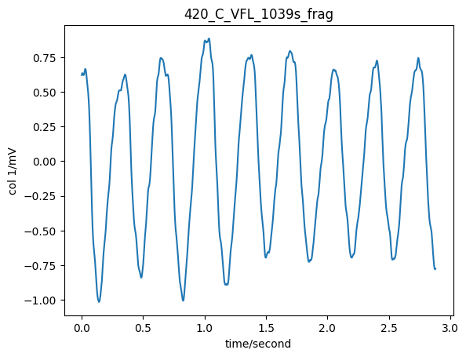
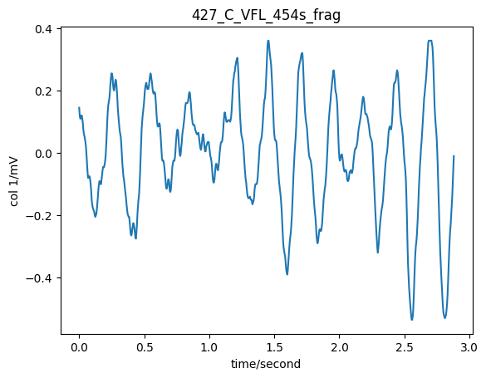
Classes 1
ventricular flutter

Slide 4
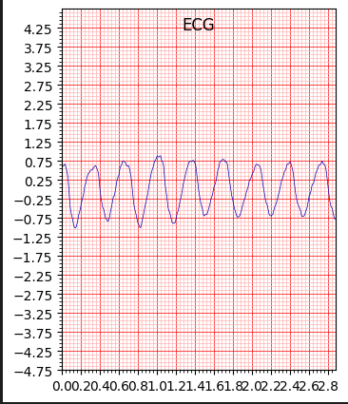

Slide 5
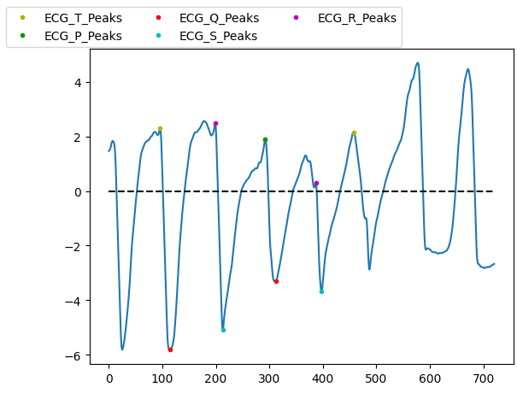
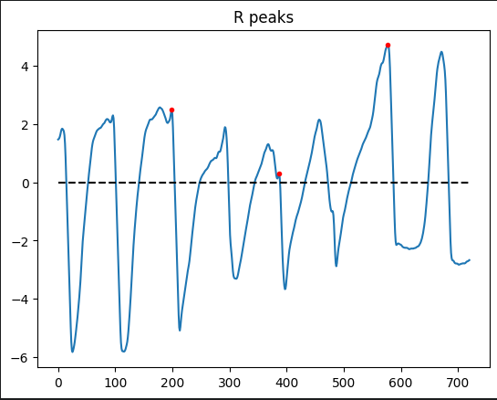

Slide 6
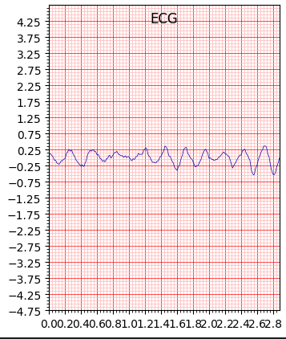
no R peaks were found so no P Q R S T.

Slide 7
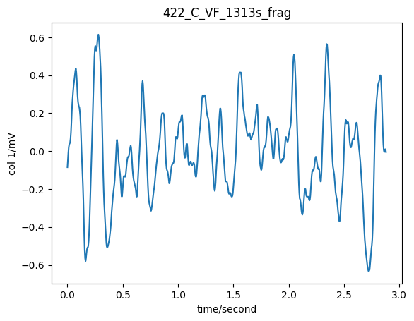
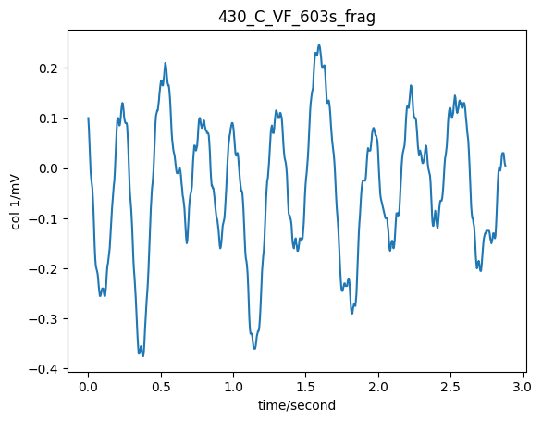
Classes 1
ventricular fibrillation

Slide 8
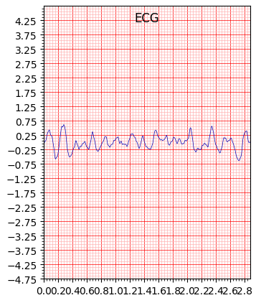

Slide 9
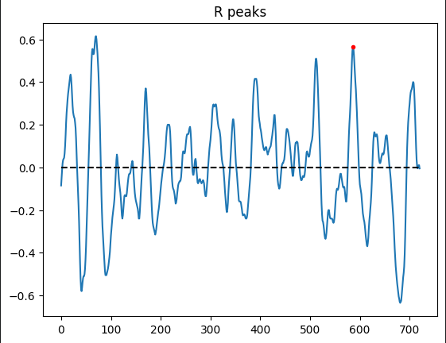
only one R peak was found and this amount is not enough so could not find P Q R S T

Slide 10
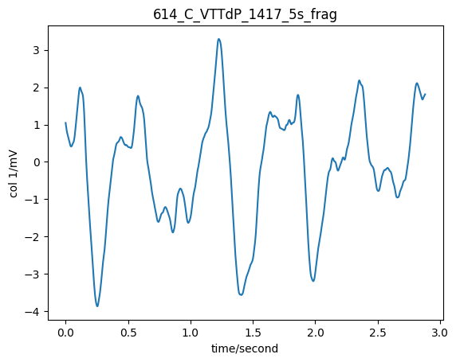
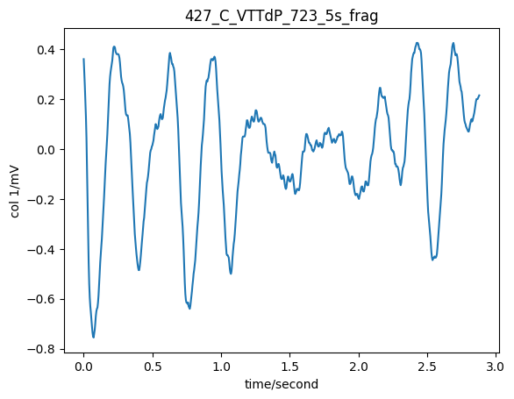
Classes 2
ventricular tachycardia torsade de pointes

Slide 11
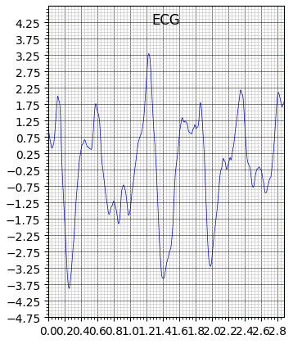

Slide 12
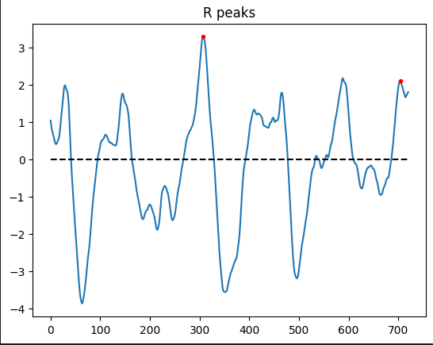
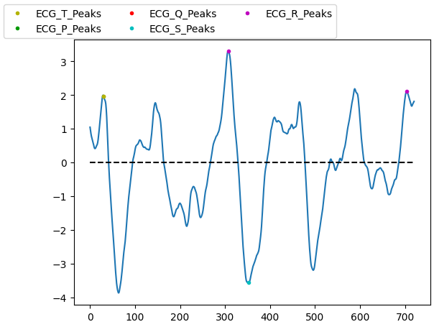

Slide 13
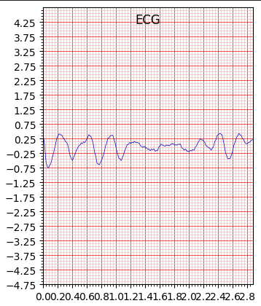

Slide 14
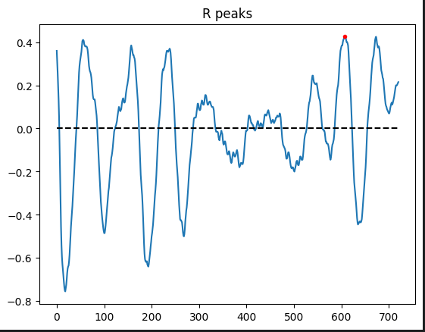
not enough R peaks were found so no P Q R S T waves

Slide 15
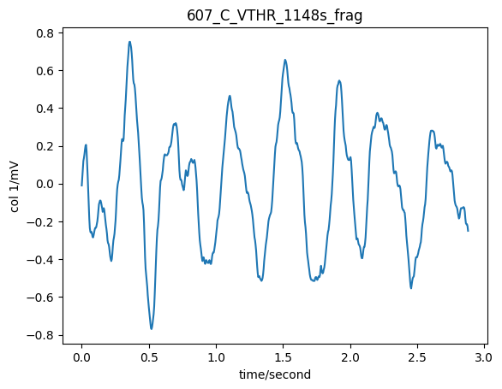
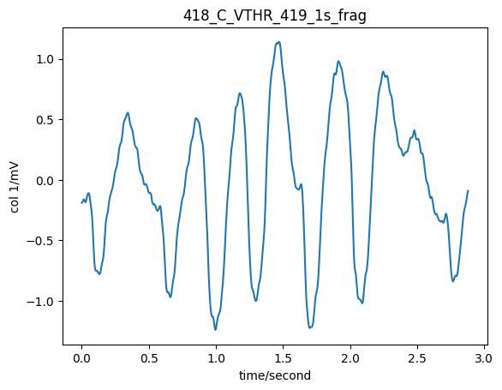
Classes 3
high rate ventricular tachycardia

Slide 16
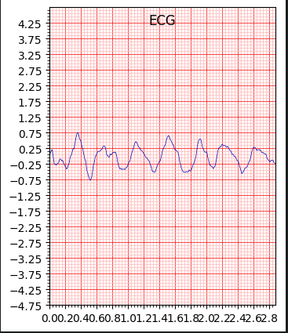
no R peak was found so no P Q R S T

Slide 17
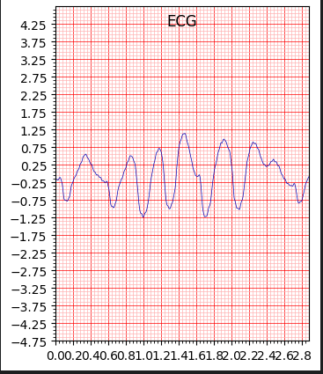

Slide 18
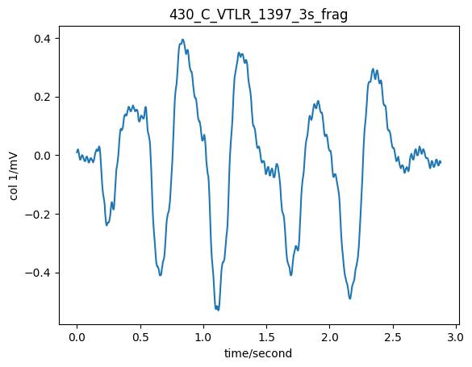
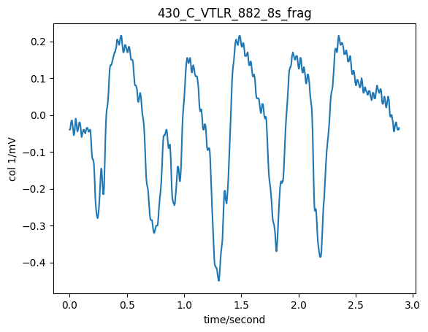
Classes 4
low rate ventricular tachycardia

Slide 19
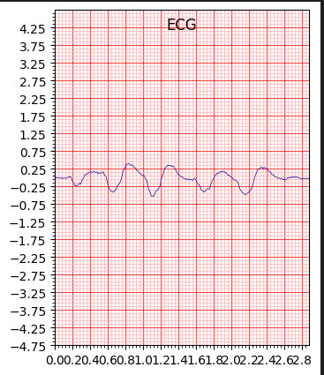
no R peak was found so no P Q R S T

Slide 20
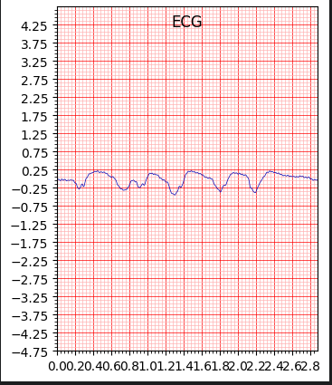

Slide 21
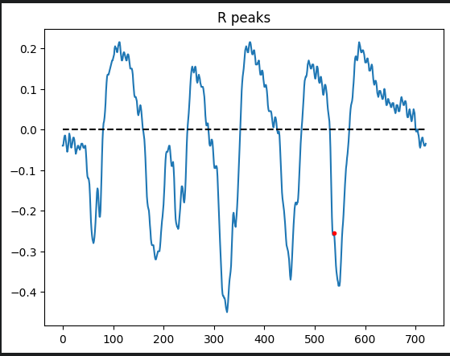
not enough R peaks were found so no P Q R S T waves

Slide 22
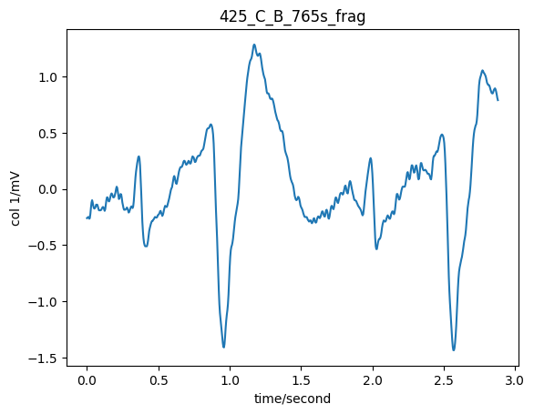
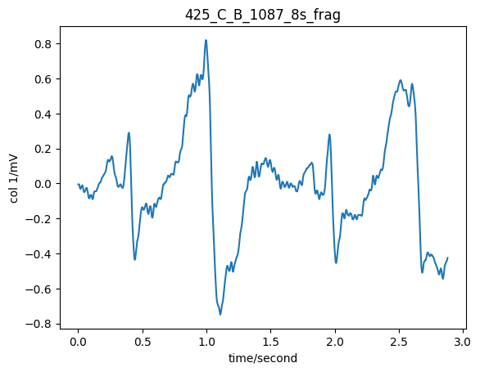
Classes 4
ventricular bigeminy

Slide 23
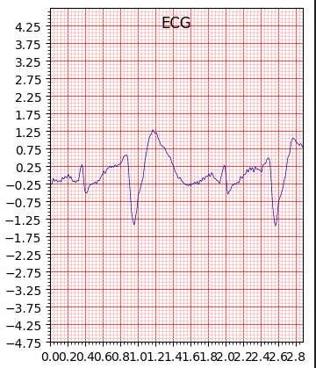

Slide 24
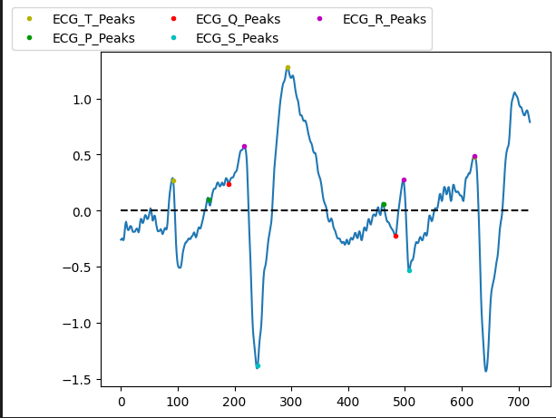
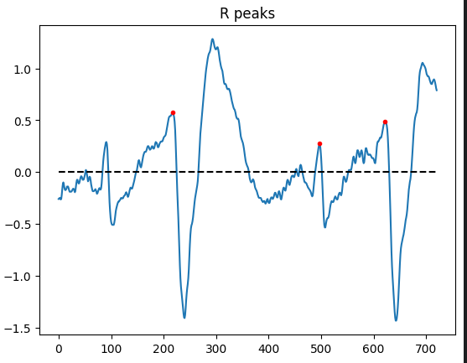

Slide 25
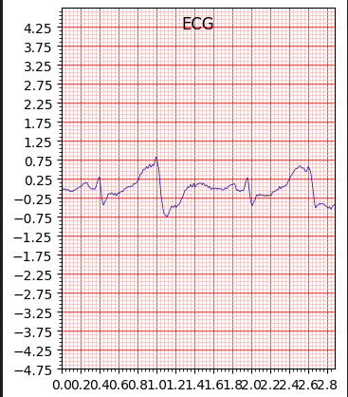

Slide 26
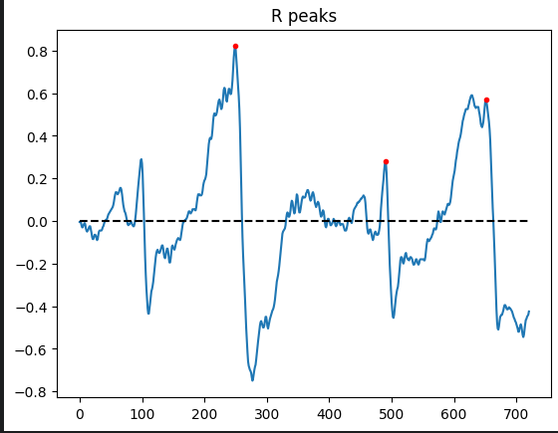
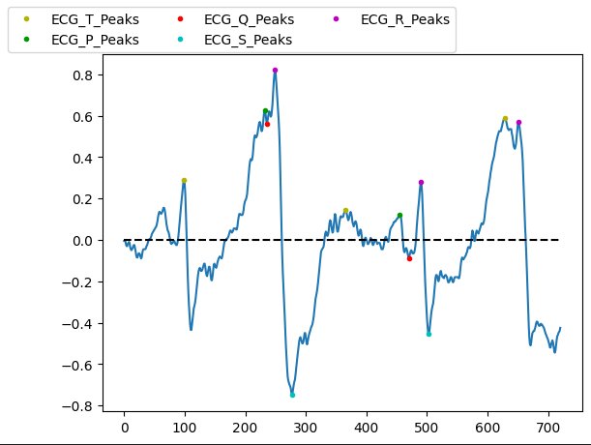

Slide 27
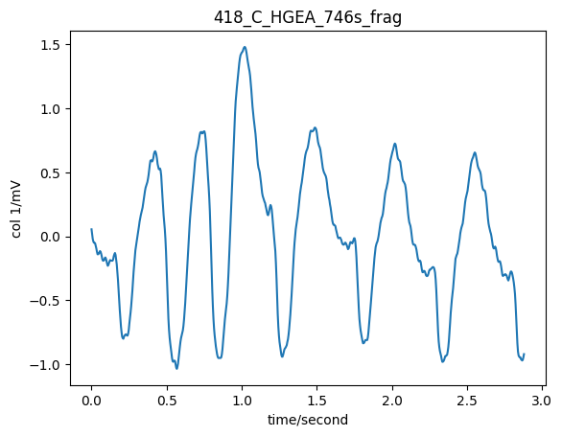
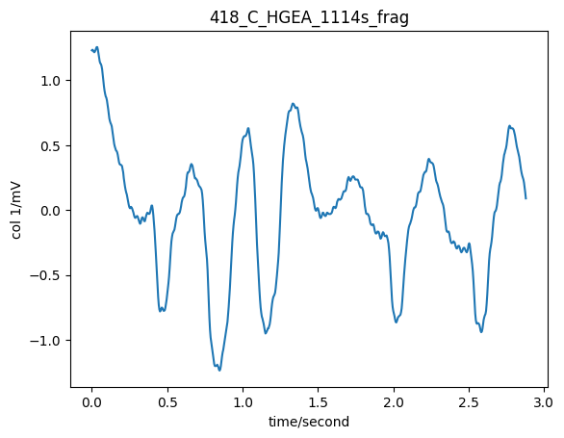
Classes 4
high degree of ventricular ectopic activity

Slide 28
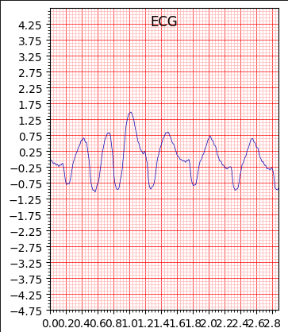
no R peak was found so no P Q R S T

Slide 29
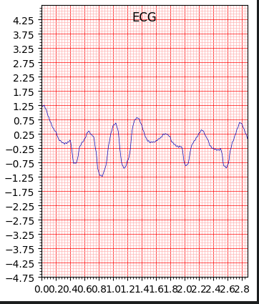

Slide 30
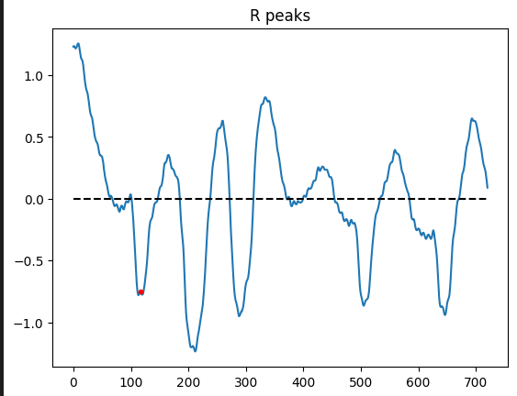
not enough R peaks were found so no P Q R S T waves

Slide 31
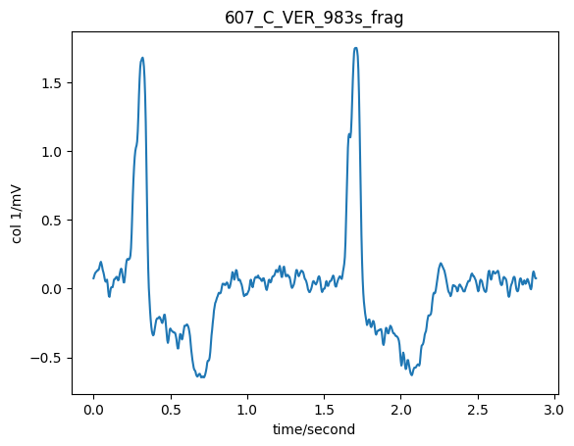
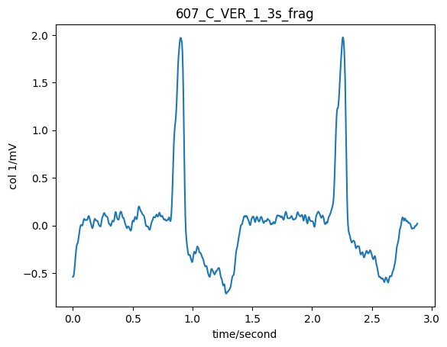
Classes 4
ventricular escape rhythm

Slide 32
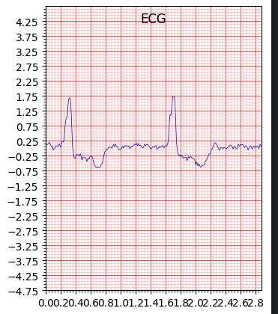

Slide 33
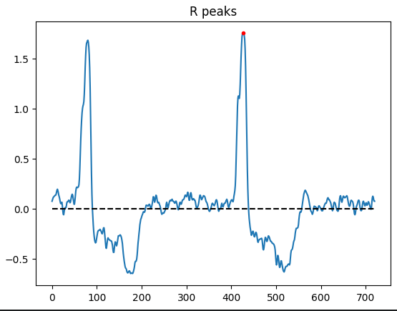
not enough R peaks were found so no P Q R S T waves

Slide 34
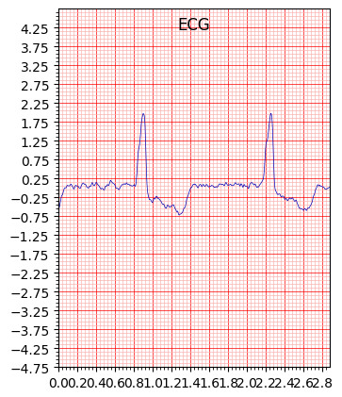

Slide 35
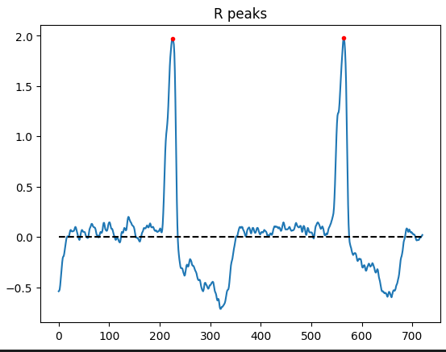
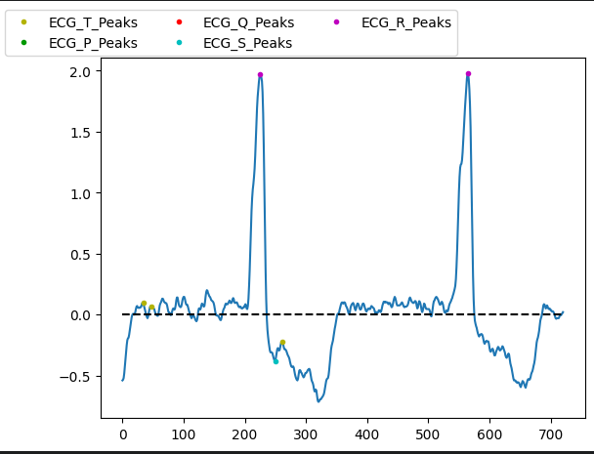

Slide 36
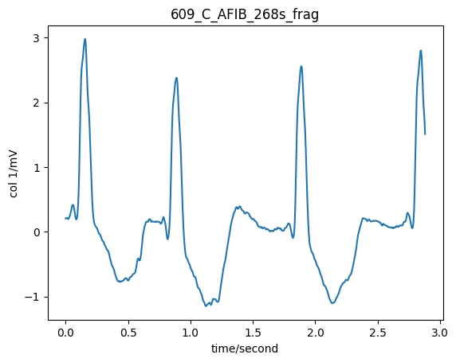
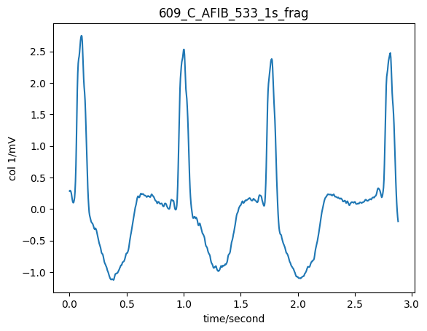
Classes 5
atrial fibrillation

Slide 37
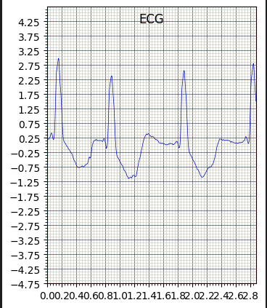

Slide 38
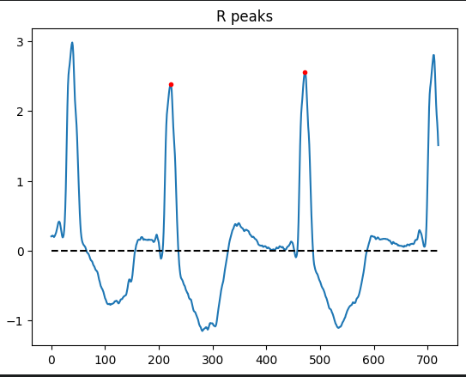


Slide 39


Slide 40



Slide 41


Classes 5
supraventricular tachycardia

Slide 42


Slide 43



Slide 44


Slide 45



Slide 46

Classes 5
sinus bradycardia

Slide 47


Slide 48



Slide 49


Classes 5
first-degree heart block

Slide 50


Slide 51



Slide 52


Slide 53



Slide 54


Classes 5
nodal (a-v) rhythm

Slide 55


Slide 56



Slide 57

no R peak was found so no P Q R S T

Slide 58


Classes 6
sinus rhythm with bundle branch block

Slide 59

no R peak was found so no P Q R S T

Slide 60

no R peak was found so no P Q R S T

Slide 61


Classes 6
normal sinus rhythm

Slide 62


Slide 63



Slide 64


Slide 65



Slide 66


Classes 6
normal rhythm with single extrasystole

Slide 67


Slide 68



Slide 69


Slide 70



