Slide 1

Faculty of computer engineering
Final project fundamentals of digital logic
1398-1399
2020-2021
Made by :
Name and last name : Ayda Zamanian
Student number : 9832067
Professot:farshad khoonjoosh
Assistnants: alireza khaleghi
-aref sayarreh-ardavan laknezhad

Slide 2
This project includes a text file : mytest.txt
This file consist two 20 bits numbers.
I thought that the 3 bits that shows type is not necessary if I make two different arrays.
Each array includes five 4 bits number .
In the first array :
each number is the amount of goods in my vending machine.
In the second array :
each number shows the price of goods in my vending machine.
array
…
Type 000
Type 001
Type 100

Slide 3
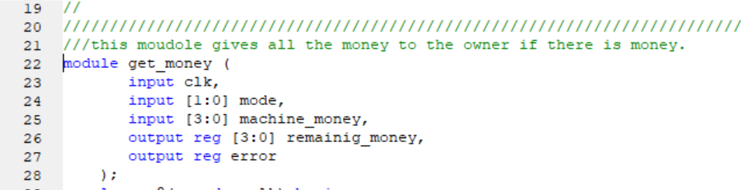
The main idea of my project is giving a decimal number that shows type to each function and then they will find the price or the number of goods if they were needed.
This project has 4 modules:
1.get_money
2.Charge
3.Customer
4.vending_machine
.Get_money:
This module will give the owner all the money that exist in this vending machine. So update saved money will become zero.
If anything goes wrong status will be 1 and that means error. So saved money wont update to zero.

Slide 4
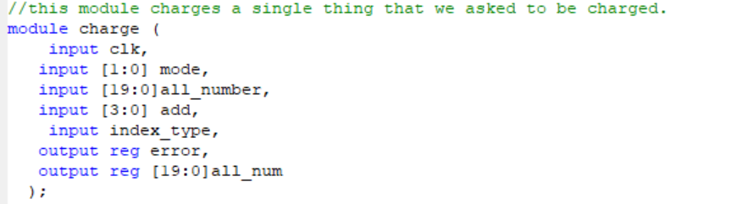
Charge :
This module gives a number from the owner that shows the number of adding products to vending machine. It also gets a decimal number called type that shows type of product so the vending machine can find its price and number of existence.
This module is able to add just one type of product to the machine.

Slide 5
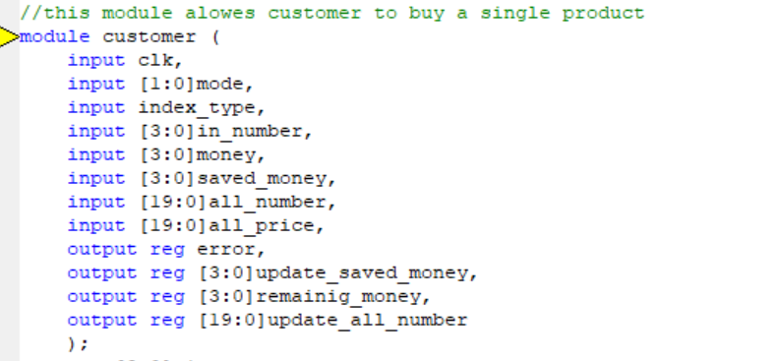
Customer:
this module gets customers and machines money ,type ,a number that shows the amount of the product that customer asked for.
By having the type we have the number of that special product that exist in the machine also we are able to have the price of that product.
All this module does is updating the number and customers money also the machine money if buying be successful otherwise nothing will be updated.

Slide 6
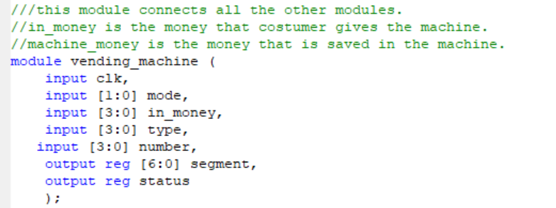
vending_machine :
This module is the main module.
It connect all the modules and here all the updates happens.
Before anything starts it finds the type of the products and gives it to other modules.
The inputs are money and mode and type and the number of exist product.
Outputs of this module is a seven segment and status.

Slide 7
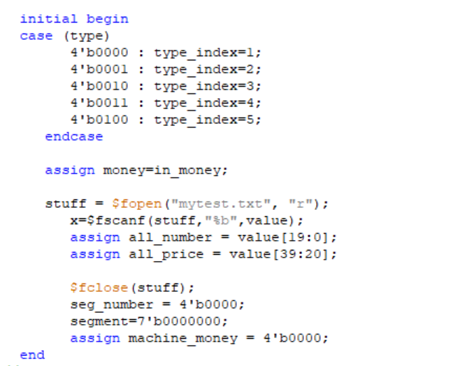
In the initial part first the type of the given product will be declared so other modules can work with that.
in the beginning every thing is zero.

Slide 8
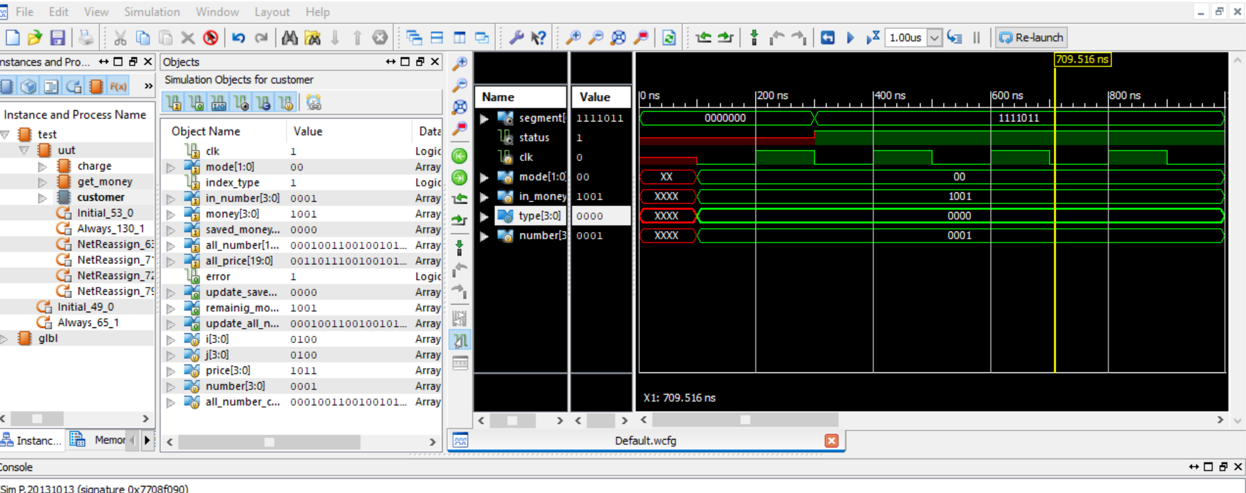

Slide 9
