Slide 1
Data.Visualization.in.R <- ggplot2(FUN)
Berenica Vejvoda, Data Librarian, Academic Data Centre
Carina Luo, Geospatial Data Analyst, Academic Data Centre
March 9, 2020
bvejvoda@uwindsor.ca carina@uwindsor.ca
libdata@uwindsor.ca

Slide 2
Learning objectives
Use current global time series data to visualize disease outbreak trends
Manipulate data as a data frame in R
Understand the logic of ggplot building blocks (layers) and the basic structure of a plot
Practice creating both static and animated visualization prototypes
Create line graphs using ggplot2 (also animated plot using gganimate)
Create bar graphs using ggplot2

Slide 3
Why Visualize Data and What to Consider?
Large and small data can become easier to understand visually, especially if the data are complicated
Detect patterns, trends, outliers
COVID-19 – infectious disease control
John Snow – 1854 cholera outbreak

Slide 4
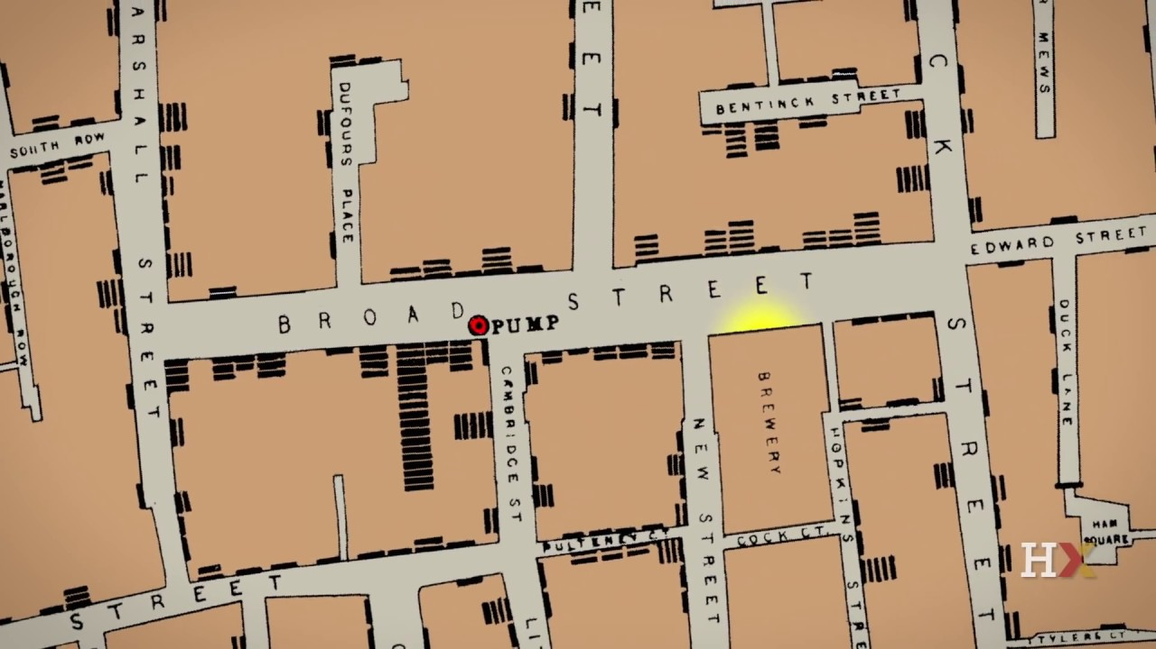
Why Visualize Data and What to Consider?

Slide 5
Why Visualize Data and What to Consider?
Data visualization is ONLY as good as how clean and complete your dataset
80% data cleaning and 20% visualization
A lot of steps – so you want to save your code! Trust us ☺

Slide 6
What is ggplot2
ggplot2 is a data visualization package for the statistical programming language R
ggplot2 is based on the grammar of graphics, the idea that you can build every graph from the same few components:
a dataset
a set of geoms—visual marks that represent data points
and a coordinate system

Slide 7
ggplot(data = <DATA>, mapping = aes(<MAPPINGS>)) + <GEOM_FUNCTION>()

Slide 8
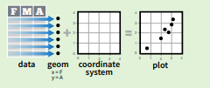

Slide 9
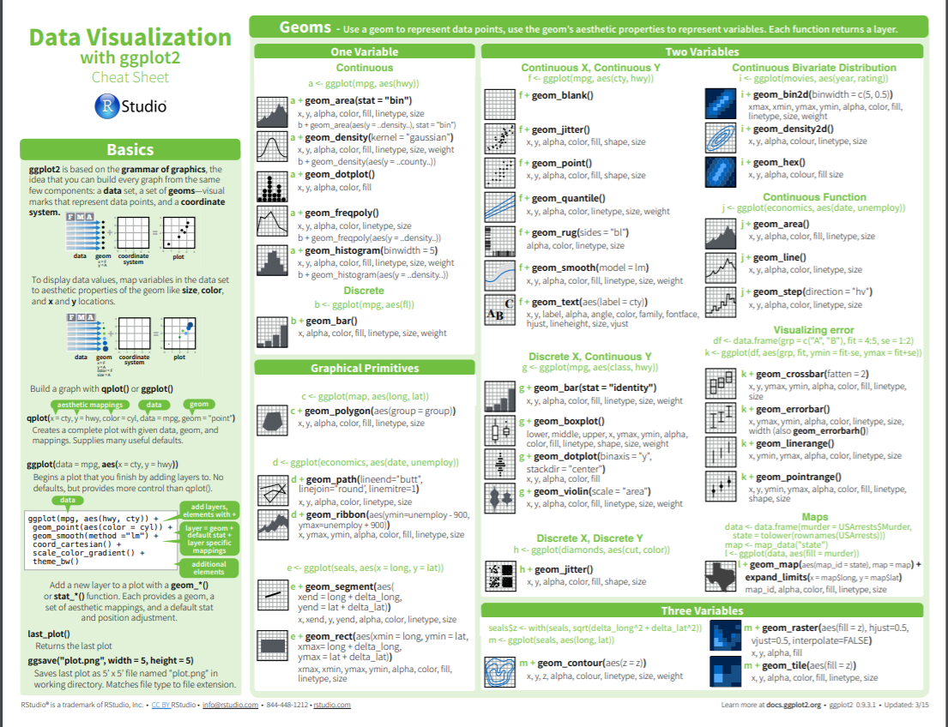

Slide 10
To Cover
Data cleaning:
install.packages()
library()
read.csv
View()
Melt()
Aggregate()
Colnames()
Removing variables
Converting factors to date format

Slide 11
To Cover
ggplot2
data =
mapping =
aes()
geom()
fill()
stat()
theme()
axis.text
labs()
print(), ggsave(), plot()
gganimate()
facet_wrap()

Slide 12

To Cover

Slide 13
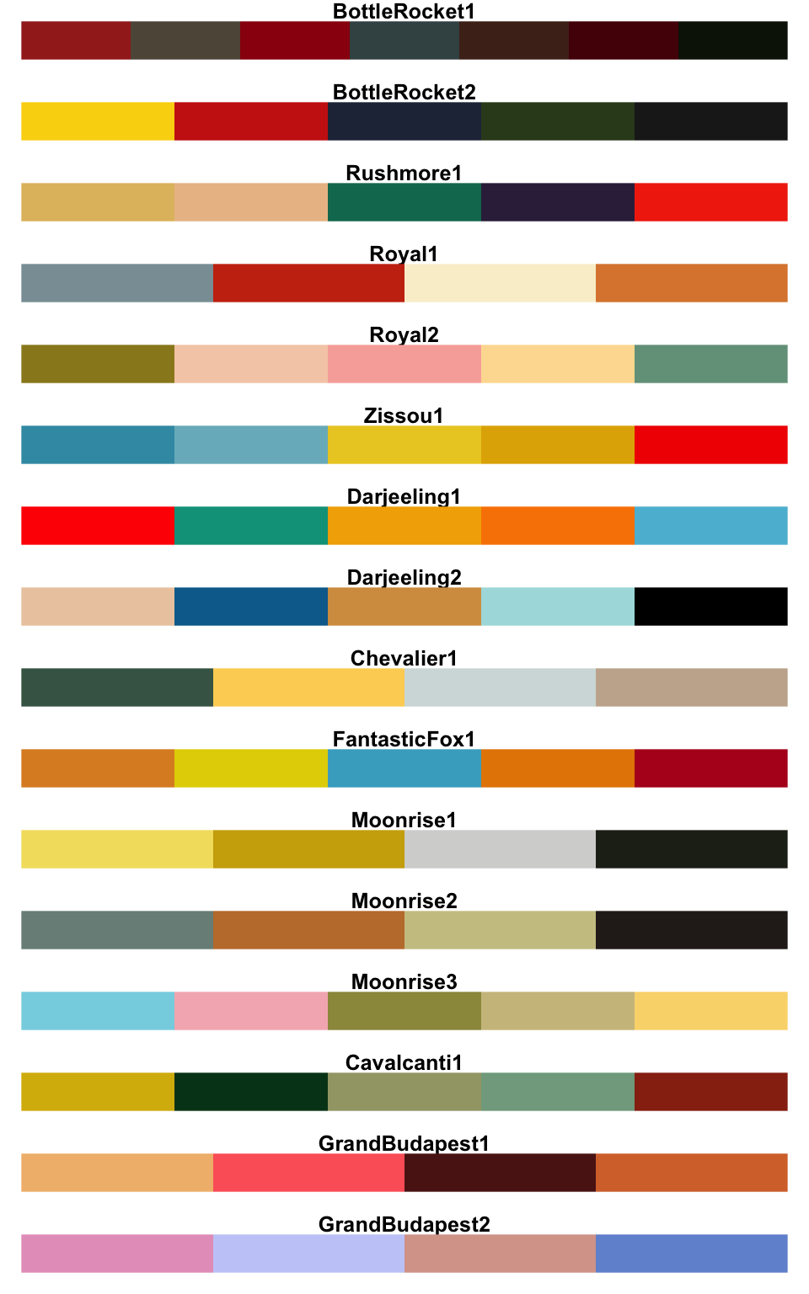
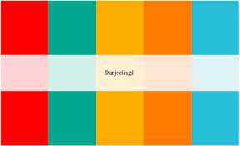
Aesthetics Make a Difference
See also: Edward Tufte – The Visual Display of Information

Slide 14
About the Data
Lancet Inf Dis Article: Here. Mobile Version: Here. Visualization: JHU CSSE. Automation Support: Esri Living Atlas team and JHU APL.
Data sources: WHO, CDC, ECDC, NHC and DXY. Read more in this blog. Contact US.
Downloadable database: GitHub: Here. Feature layer: Here.
Visit the Johns Hopkins Coronavirus Resource Center where our experts help to advance understanding of the virus, inform the public, and brief policymakers in order to guide a response, improve care, and save lives.
Point level: City level - US, Canada and Australia; Province level - China; Country level - other countries. All points shown on the map are based on geographic centroids, and are not representative of a specific address, building or any location at a spatial scale finer than a city.
Active cases = total confirmed - total recovered - total deaths.
Time Zones: lower-left corner indicator - your local time; lower-right corner plot - UTC.

Slide 15
More About the Data
From January 22-31 the entire data collection and processing was managed manually. During this period the number of updates were typically conducted twice a day, both morning and night (Eastern Time).
As the outbreak evolved, the manual reporting process became unsustainable, and on February 1, we adopted a semi-automated living data stream strategy.
Our primary data source is DXY, an online platform run by members of the Chinese medical community, which aggregates local media and government reports to provide COVID-19 cumulative case totals in near real-time at the province level in China and country-level otherwise.
Every 15 minutes, the cumulative case counts are updated from DXY for all provinces in China and affected countries and regions.
For countries and regions outside mainland China (including Hong Kong, Macau and Taiwan), we found DXY cumulative case counts to frequently through the lag other sources; we therefore manually update these case numbers throughout the day when new cases are identified. To identify new cases, we monitor various Twitter feeds, online news services, and direct communication sent dashboard.

Slide 16
More about the Data
Before manually updating the dashboard, we confirm the case numbers using regional and local health departments, namely the China CDC (CCDC), Hong Kong Department of Health, Macau Government, Taiwan CDC, European CDC (ECDC), the World Health Organization (WHO), as well as city and state level health authorities.
For city level case reports in the U.S., Australia, and Canada, which we began reporting on February 1, we rely on the US CDC, Government of Canada, Australia Government Department of Health and various state or territory health authorities.
All manual updates (outside mainland China) are coordinated by a team at JHU.

Slide 17
Links to Files
R scripts and datasets: https://github.com/vejvodab/data_visualization
Alternatively for data: https://github.com/CSSEGISandData/COVID-19

