Slide 1
Handling and Displaying Arrays of Data
Potentially huge amount of data

Slide 2
A random diversion
The Random class is part of the Java API
  It has different methods for random number generation
  Generated numbers are not really random

Slide 3
Handling large amount of data with arrays
Declare and initialize many separate variables is not convenient
It is better to have a single name with many cells accessed by index

Slide 4
Arrays are objects
Arrays are reference variables
Address to a group of variables of a given type
Have methods and properties
Know its own length
Can be multidimensional

Slide 5
Getting dynamic with arrays
Each element should be declared and initialized individually
The size of the array itself is fixed

Slide 6
Entering the nth dimension with arrays
Array can hold other arrays
Theoretically there is limit for array dimensions

Slide 7
Array out of bounds exceptions
Access an element of an array that does not exist
Index starts from 0
Last index is n-1 for the array wit size n
Exception is thrown in case of invalid index

Slide 8
ArrayLists
Data container
It is based on array
It size can be changed
Can be used only with objects

Slide 9
ListView and BaseAdapter
Model-view-controller approach
Single visual controls (views) are used to display many different objects (models)

Slide 10
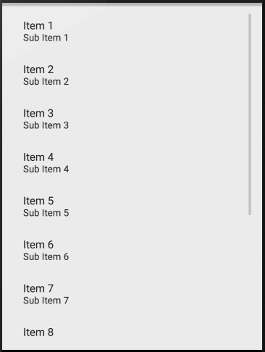
How to use ListView and BaseAdapter
s
XML item description
ArrayList data
BaseAdapter handling

Slide 11


