Slide 1
Navigation Drawer and Where It's Snap
Cool UI pattern

Slide 2
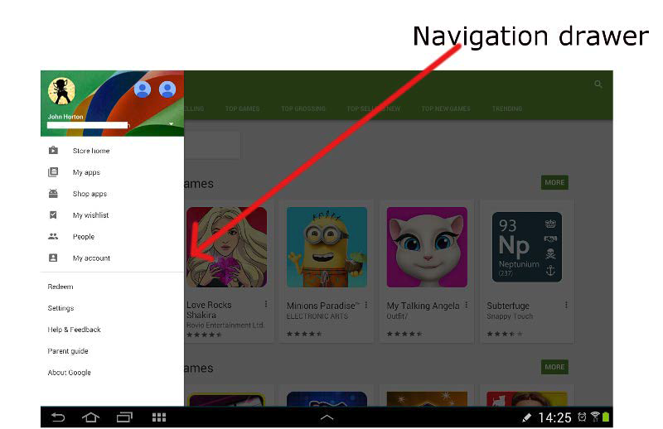
Navigation drawer

Slide 3
Introducing the navigation drawer
While the navigation drawer is open, the rest of the screen is slightly dimmed
  Helping the users to focus on the navigation options offered
  Tap anywhere off of the navigation drawer while it is open and it will slide itself away
  The drawer is also opened by tapping on the menu icon in the top-left corner

Slide 4
Preparing the resources
In strings.xml file
  Put string-array element
  Items are used in navigation drawer

Slide 5
Placeholder code for Fragments
Extend Fragment classes
  As many as needed
  Instances would be switched

Slide 6
Main Activity layout
Use DrawerLayout for the main activity
Use RelativeLayout for the fragments
Use ListView for side navigation

Slide 7
Main Activity class
Add ListView member variable
  Hold the navigation options
Add DrawerLayout member variable
  Reference to navigation drawer
Add ArrayAdapter member variable
  Bind string array to the ListVew
Add ActionBarDrawerToggle member variable
  Bring the menu icon in the action bar

Slide 8
Switching between Fragments
FragmentManager is used
Chain of calls is used
  beginTransaction()
  replace()
  commit()

Slide 9

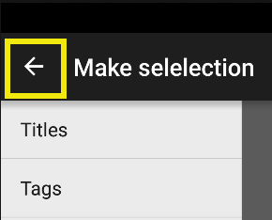
Setting up the drawer
ActionBarDrawerToggle instance
  Handle the event when the drawer is opened
  Handle the event when the drawer is closed

Slide 10
Handling the back button
The onBackPressed method is an overridden

Slide 11
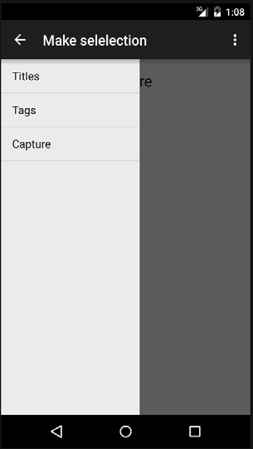

Slide 12


